Slide 1
FriendNET
Myanna Harris and Kristina Spring

Slide 2
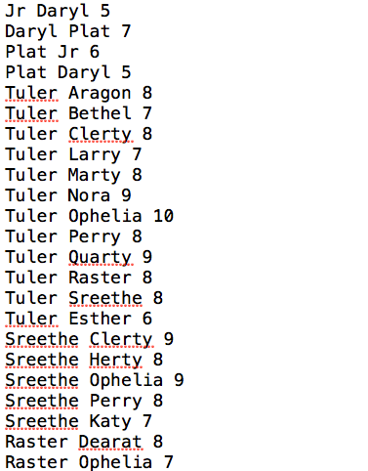
Example input file

Slide 3
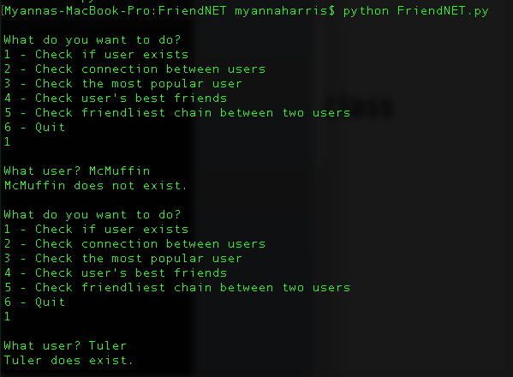
Check if user exists
Dictionary check

Slide 4
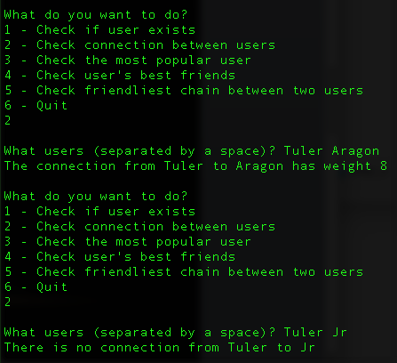
Check Connection between users
Linear Search

Slide 5
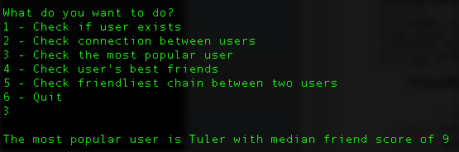
Check the most popular user
Traverse entire graph and use Transform-and-Conquer

Slide 6
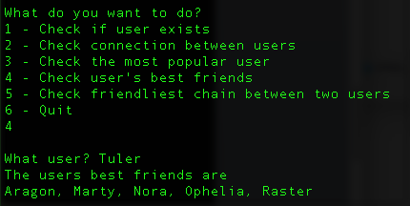
Check User’s best friends
Depth-first-like traversal

Slide 7
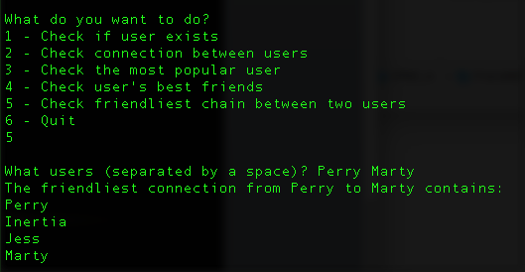
Check friendliest chain
Dijkstra’s

