Slide 1
CULMINATING PROJECT:
ANDROID APPLICATION
Myanna Harris

Slide 2
BACKGROUND
4 years in Computer Science
Worked at PNNL last summer
  Programmed a GUI for glycan cancer research using C++ and XAML

Slide 3
PROJECT: TERRAIN OF LIES
(A SNOWBOARDING GAME)
Taught me more about listeners and how phone applications work
I chose this project because I like snowboarding and making a game application sounded interesting
I ended up creating a more realistic project that counted touches when I started learning how complicated the programming was

Slide 4
GOALS AND OBJECTIVES
Make a game
Use bitmaps
I did not accomplish to make a complete game and the bitmaps only worked as backgrounds
working app
touch-screen features
I accomplished these basic goals by writing a test program with the help of some Linda videos and an android app code book

Slide 5
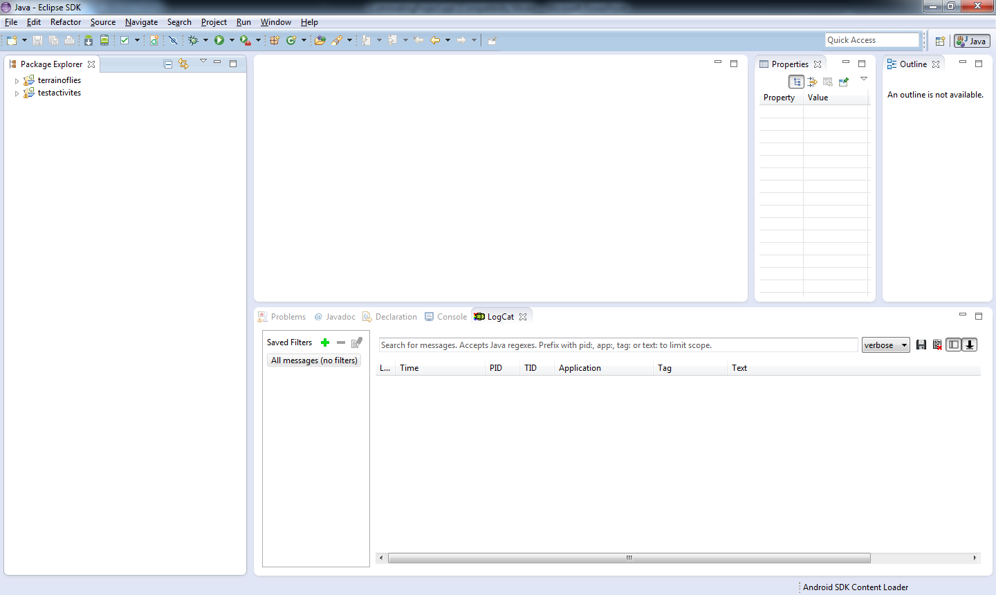
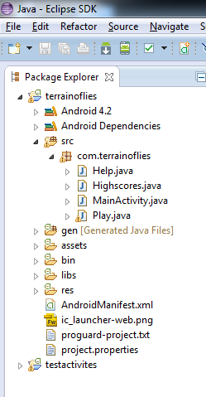

Slide 6
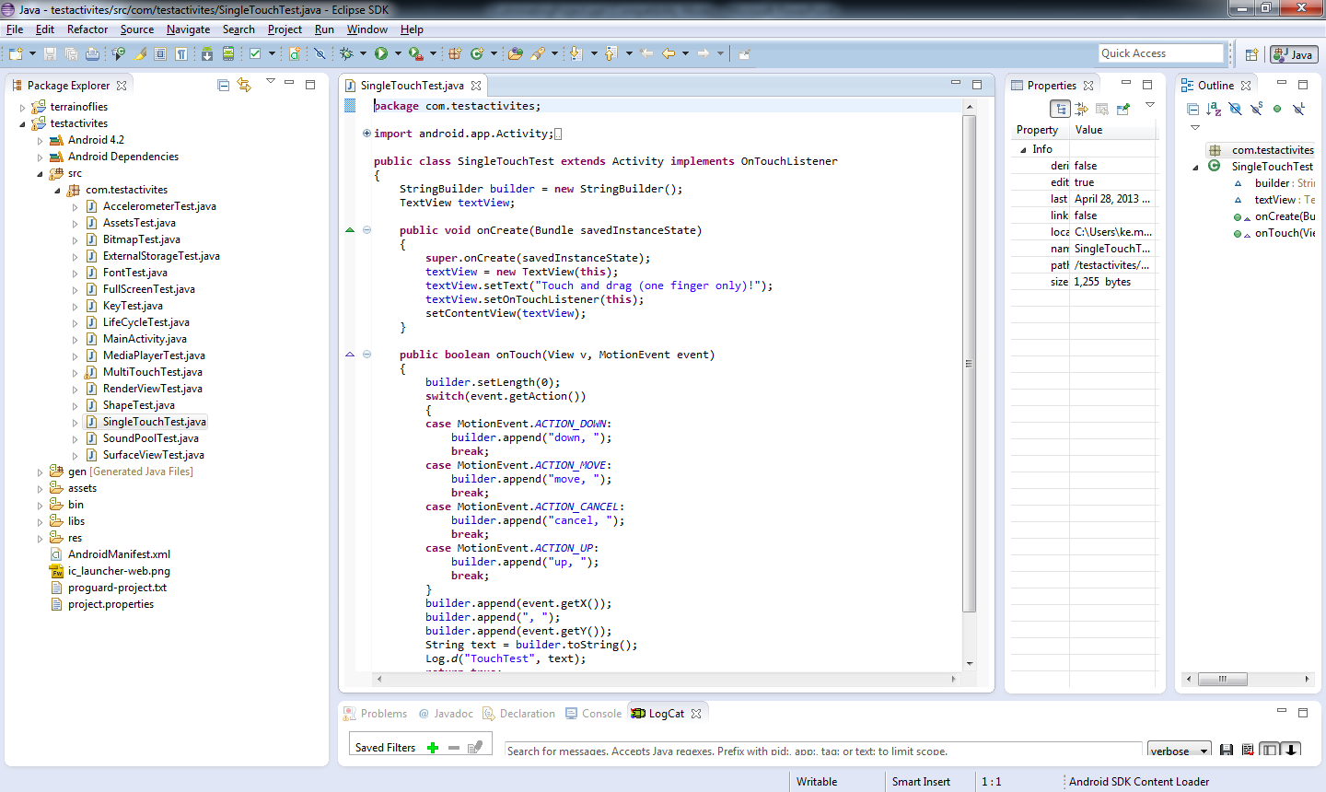

Slide 7
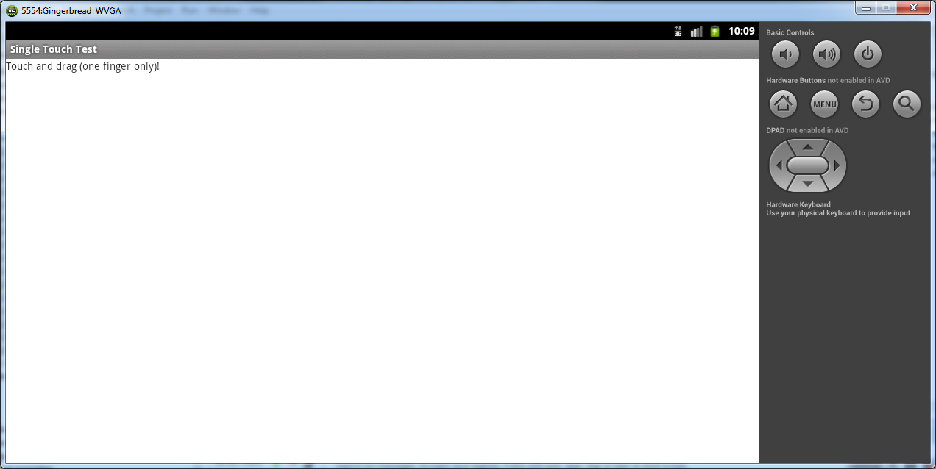
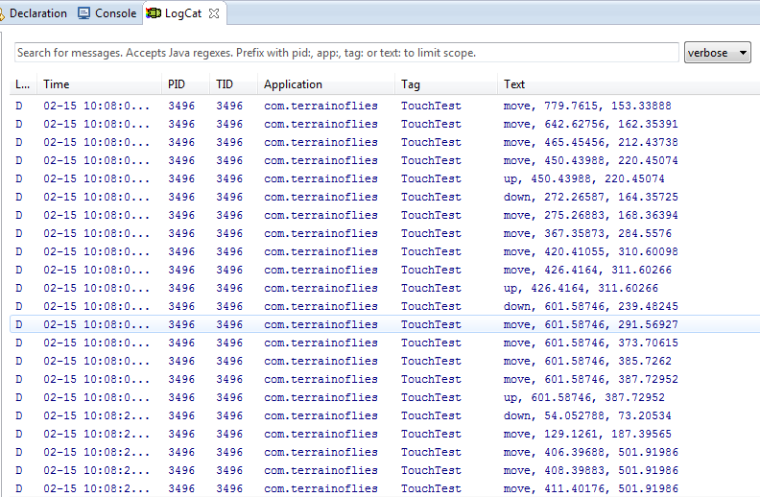

Slide 8
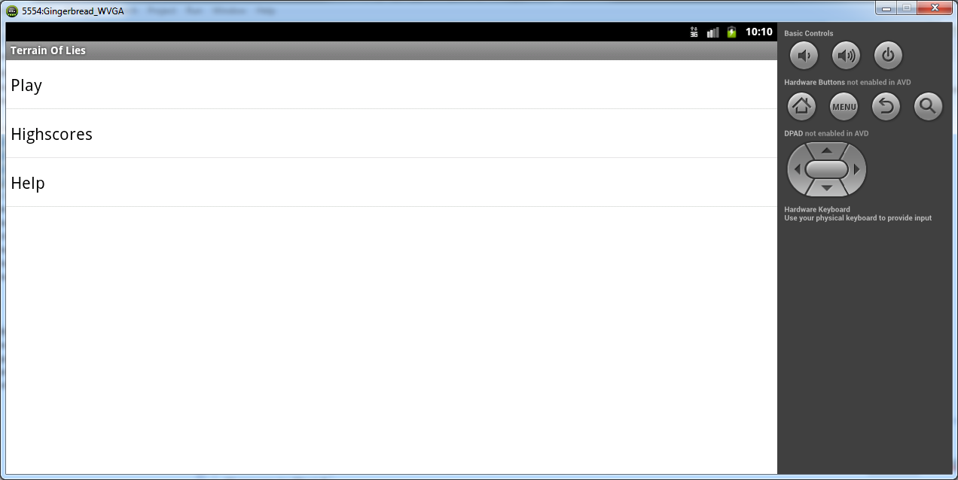
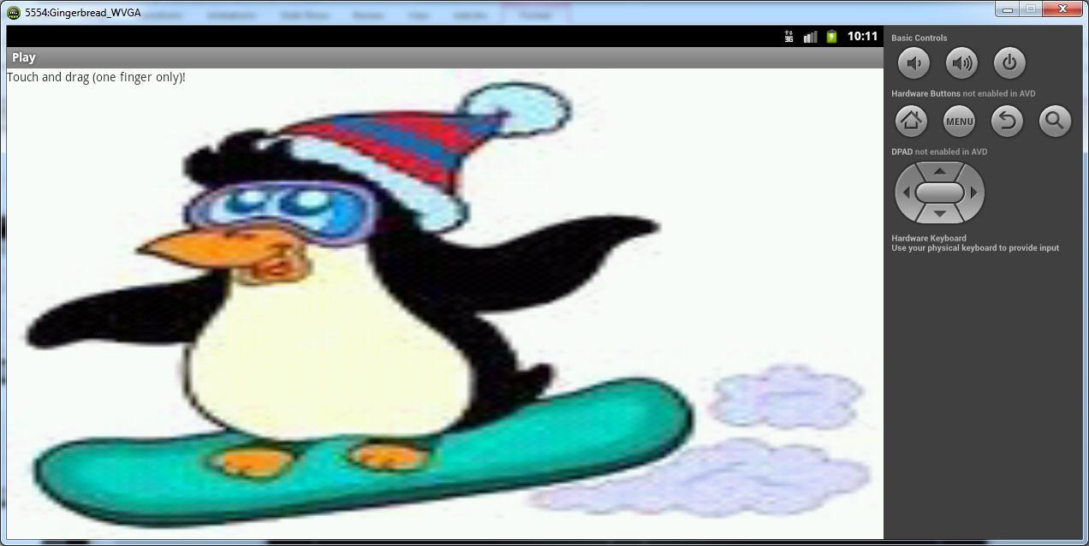

Slide 9
CHALLENGES
I overcame:
  Adding files to the assets
  The activities not opening
  The manifest.xml not working
I did not overcome:
  The audio not loading
  Merging two activities
  Layering a TextView on a Canvas
  Making an Android Virtual Device(ADV)

Slide 10
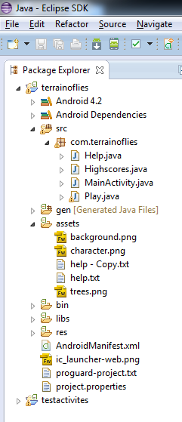
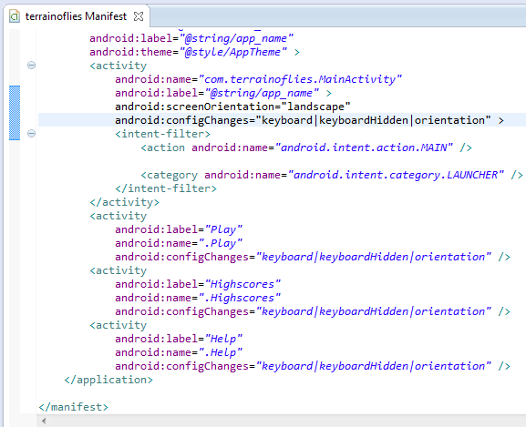

Slide 11
LEARNED HOW TO:
start creating an android application
add assets
write a file to the external memory
draw shapes
sense touches and keyboard presses
I have a base to build android applications on

Slide 12
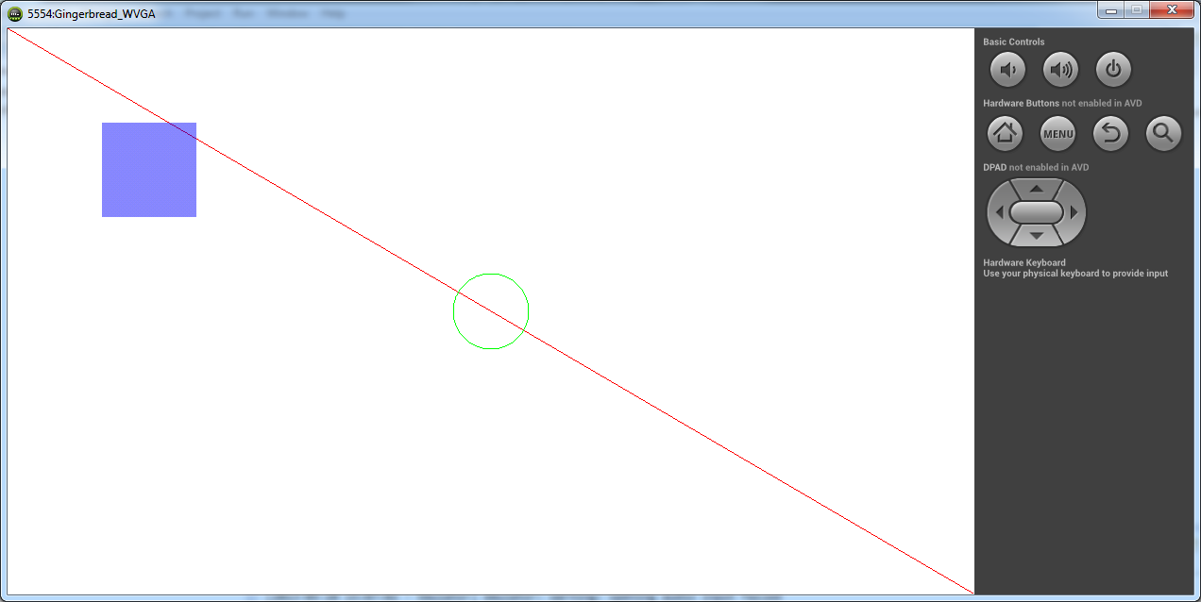
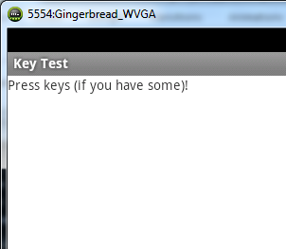


Slide 13
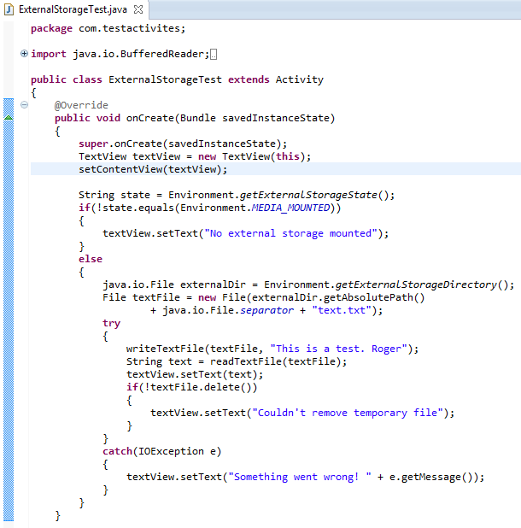
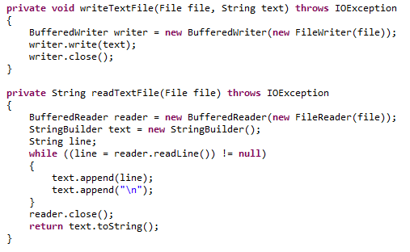

Slide 14
CONCLUSION
I found that I could write a functioning application which I found very exciting.
More knowledge
Gonzaga University
Double majoring in Computer Science and Electrical Engineering.

