Slide 1
MIL-Test-NAS
Alexey Gorbatovski
14.09.2023

Slide 2
Tasks
Introduction to SuperNet
SuperNet implementation
SubNet sampler
Training SuperNet
Model evaluation
Comparison with Independently Trained Models

Slide 3
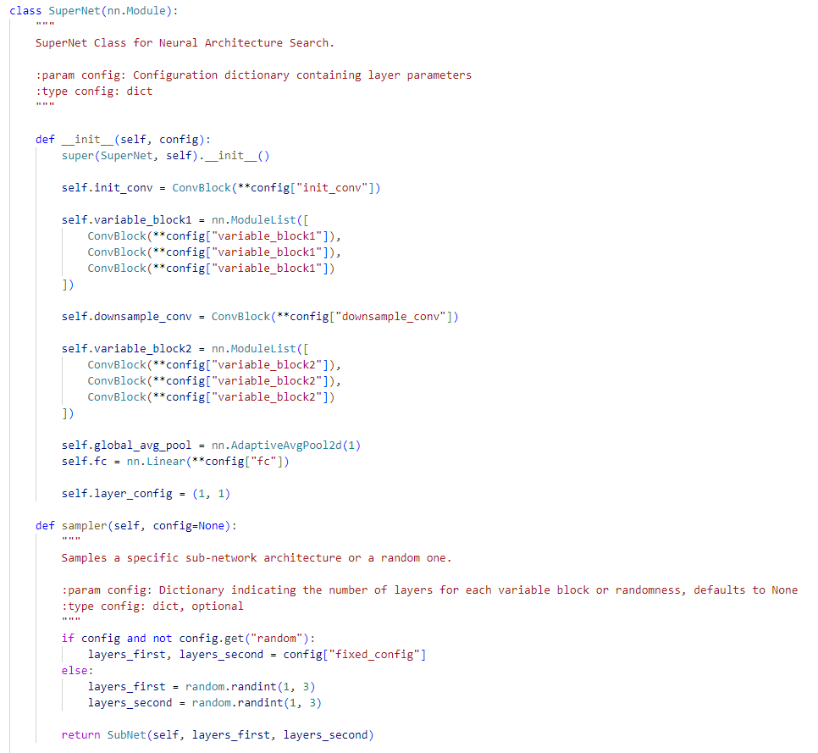
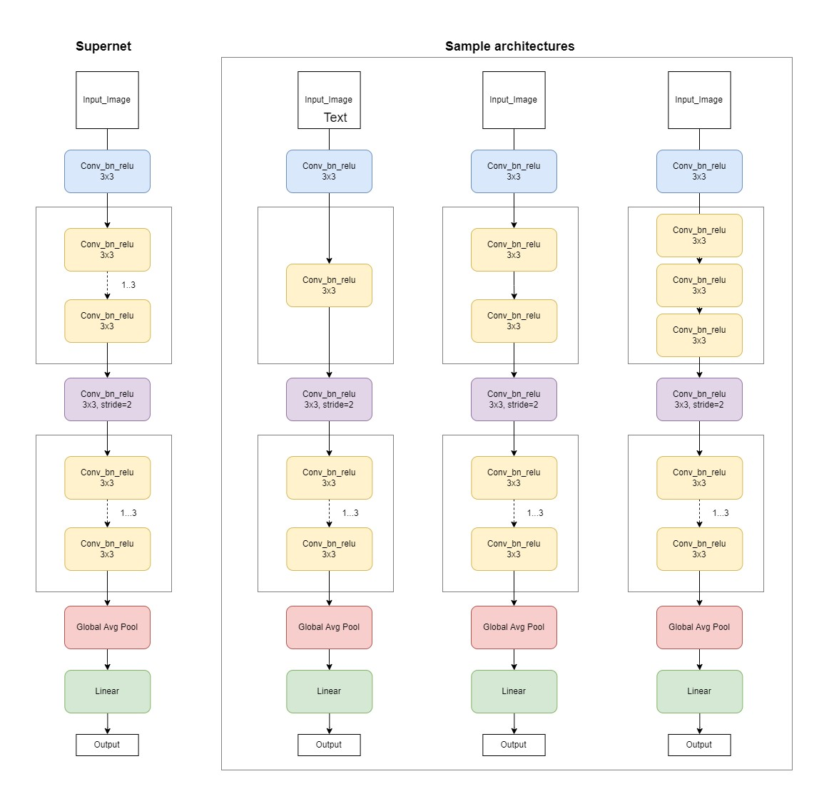
SuperNet implementation
Were implemented:
ConvBlocks (Conv-BN-ReLU)
Sampler method to create a SubNet
SuperNet module

Slide 4
SuperNet training
2 model configuration:
SuperNet 16_32
Init_conv – ConvBlock [1; 16]
Variable_block – 3x ConvBlock [16; 16]
Downsample_block – ConvBlock [16; 32]
Variable_block – 3x ConvBlock [32; 32]
Global_avg_pool
Linear – [32; 10]
SuperNet 32_64
Init_conv – ConvBlock [1; 32]
Variable_block – 3x ConvBlock [32; 32]
Downsample_block – ConvBlock [32; 64]
Variable_block – 3x ConvBlock [64; 64]
Global_avg_pool
Linear – [64; 10]
Training details:
Epochs = 200
AdamW optimizer
Learning rate = 3e-0.3
Wight decay = 0.01
Dataset MNIST*
Validation data = 0.15% of train MNIST dataset
Train batch size = 8192
Validation batch size = 64**
Wandb logging
*ref: https://pytorch.org/vision/main/generated/torchvision.datasets.MNIST.html
**SubNet sampling each batch -> more accurate average assessment of SuperNet

Slide 5
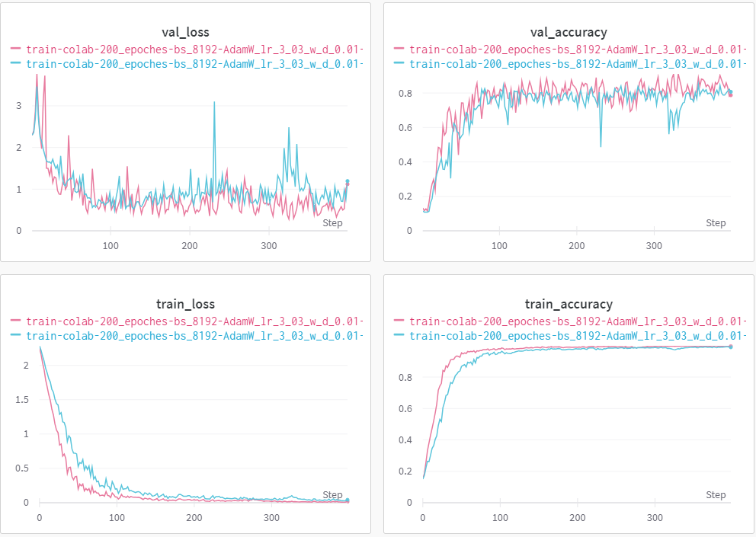
SuperNet training
SuperNet 16_32
SuperNet 32_64
Training features:
Unstable training
AdamW > SGD + momentum

Slide 6
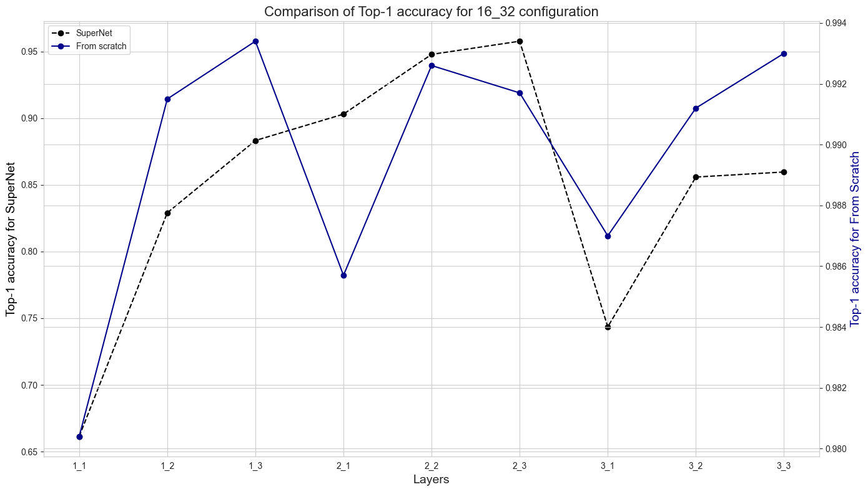
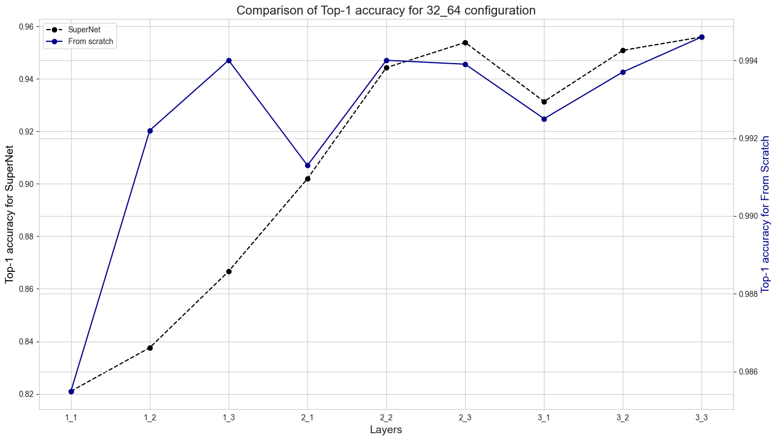
Results comparison
Top-1 accuracy comparison table
Active layers | SuperNet 16_32 | From scratch 16_32 | SuperNet 32_64 | From scratch 32_64
[1; 1] | 0,6613 | 0,9804 | 0,821 | 0,9855
[1; 2] | 0,8291 | 0,9915 | 0,8376 | 0,9922
[1; 3] | 0,8833 | 0,9934 | 0,8667 | 0,994
[2; 1] | 0,9031 | 0,9857 | 0,902 | 0,9913
[2; 2] | 0,9479 | 0,9926 | 0,9443 | 0,994
[2; 3] | 0,9578 | 0,9917 | 0,9539 | 0,9939
[3; 1] | 0,7435 | 0,987 | 0,9314 | 0,9925
[3; 2] | 0,8559 | 0,9912 | 0,9509 | 0,9937
[3; 3] | 0,8597 | 0,993 | 0,956 | 0,9946

Slide 7
Outcome & Reflections
Outcome:
Upon evaluating models trained from scratch, there's a noticeable inconsistency between the results of SuperNet subnets and those trained independently. Despite the Pearson correlation coefficients indicating some relation between accuracy results (16_32: 0.738; 32_64: 0.714), the selection method requires further refinement and research.
There's an evident variation in test results based on model depth. As per prior visualizations, the search space for deeper models seems better evaluated with a smaller accuracy gap between SuperNet subnets and models trained from scratch. It's intriguing to speculate the outcomes if a less complex network was utilized.
Reflections:
Implementing Dropout in VariableConvBlock might stabilize the training process and lead to more consistent outcomes.
The frequency of weight updates, whether per batch or epoch, could be an intriguing aspect to delve into.
Reassessing how SuperNet results are evaluated during training is essential. My approach was to sample a subnet for each batch, aiming to average the results; however, individually assessing each subnet might be beneficial.
Experimenting with different optimization techniques or learning rates could shed light on potential improvements.

Slide 8
Links
Github:
https://github.com/Myashka/miltesttasks-task-nas_int-mid
WandB:
https://wandb.ai/myashka/mil-test/workspace

