Slide 1
TITANIC
Myint Myat Aung Zaw

Slide 2
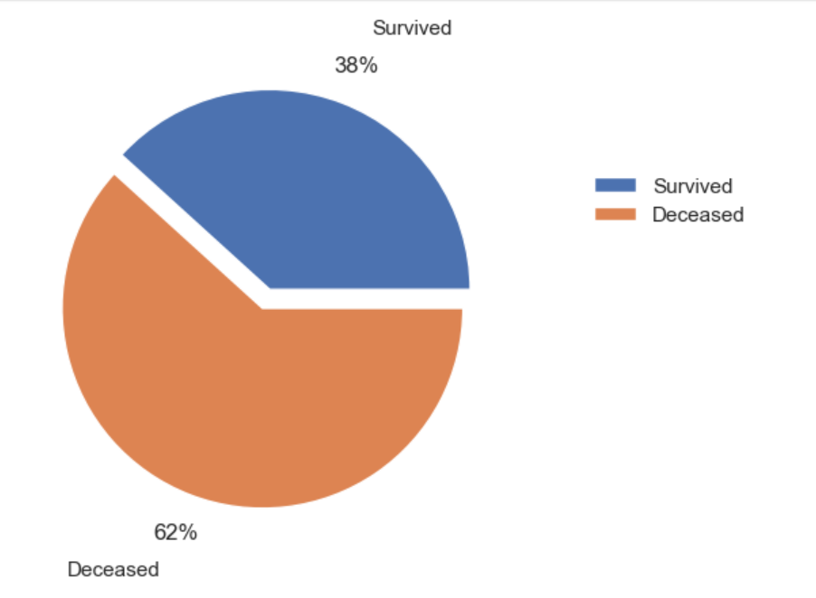

Slide 3
