Slide 1
iPlate
CSC648-01 Team02
Presented by Tun-Ni Chiang
Teammates: Prathiba, Jinxing, Myat, Aung, Christopher

Slide 2
Outline
iPlate Introduction, Tech Stack
Intro to Major Functional Feature
Live Demo
GitHub Management
Test Coverage
Conclusion

Slide 3
iPlate Intro
What is iPlate?
Who use iPlate?
Why choose iPlate?

Slide 4
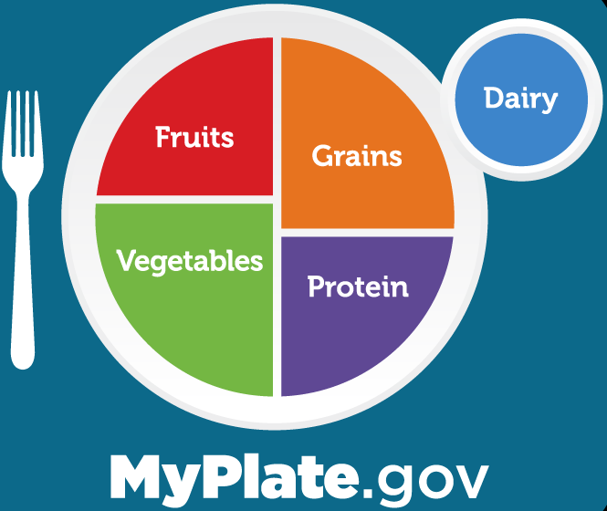
What is iPlate
Food recording app
Uses MyPlate method
Help users to develop healthy eating habits
Notes:
Food recording app: iPlate is a web application that help users to record what they eat. They won’t involve in any calorie counting, it’s simply record the food with the amount. iPlate has a built-in food nutrition database, which after the user input some food data, we’ll utilize the database to get more food nutrition information. Our database split the foods into four general food groups, vegetables, fruits, carb, and protein, so user will have to record their meals with these food groups.
Uses MyPlate method: iPlate promote the MyPlate eating method that is published by the U.S. Department of Agriculture. Instead of focusing on the calorie intake, MyPlate method focuses on the ratio of each food groups that user consume. The main idea is to put the food based on their food group on the plate. By following this, we will be able to have a healthier eating style.
Help users to develop healthy eating habits: Our goal is to help our users to develop a healthy eating habits without putting too much effort on counting the calorie or worry about the macronutrients. We hope that by using iPlate, we help them to follow the MyPlate methods, then gradually forming their habits.

Slide 5
Who uses iPlate
Ages of 12 - 25 years old
Women & Girls
Diabetes patients
Notes:
Our target user would be the people who is being trap by the idea of counting calorie, who wish to develop a better relationship with food, or who just want to eat healthier.
Ages of 12-25 years old: From research, people from 12 to 25 years old are the most common cases who might or is facing eating disorder issue. One of the common causes of eating disorder is having a restricted diet such as calorie counting. It’s important to be aware of what we ate, but it’s also important to take care our mental health. iPlate could provide these user a easier way of developing healthy eating habits without trigger their eating disorder.
Women & Girls: Extending from the previous stakeholder, females are more common in experiencing such issue because of their conscious of their body image. There’s also some women and girls who is not experiencing eating disorder but still want to be thinner. Since the popular eating tip for people who want to lose weight, maintain weight, or even gain weight, is to count their calorie intake, they usually start with downloading some calorie counting app and start to focus on the number. As I mentioned earlier, this is one of the common causes of creating eating disorder, so instead of putting themself in the risk of triggering it, iPlate help them to focus on the value of the food but not the number, and also help them to have a healthier life.
Diabetes patients: From studies, diabetes patients can also benefit from this eating method if they increase the vegetable and reduce the fruit intake. Some patients are struggling in using medical to stabilize their blood sugar, while some changed their eating style and recovered without using medical. They way we eat and the food we put into our body is crucial and is reflecting to our health. If we have some health issue, instead of using medical to cover it up, we should focus more on spotting if there’s any life style that is causing it, if there is, then we should improve it first, so we won’t have to worry about it in the future.

Slide 6
Why choose iPlate?
No numbers
Lifelong habit
Easy SignUp
Avoid eating disorder
Easy access
No long list of questions!
Notes:
No numbers: Since we are using the MyPlate method, users won’t need to worry about the calorie or how many grams of protein they had etc. As I said, because we are not following a restricted diet, we avoid the risk of triggering eating disorder while still developing a healthy lifestyle.
Lifelong habit: We don’t have to worry about macronutrients, which trust me, it’s A LOT of work if you’re not interesting in calculation and nutrients stuff. Because users would only need to focus on the ratio of each food groups that they they are consuming, it’s so much more easier to follow this eating style and so is more likely for them to stick with it.
Easy SignUP: After gaining some user experience of other food recording app, we found that most of the app require user to spend more than five minutes or even longer on their registration page which they ask tons of question. It’s good that they tried to use those data to develop a more customized plan for their user, but sometimes data are not exactly accurate and so their customized plan might still need to change in future. Instead of wasting time on collecting data, we just ask for user’s username and password.

Slide 7
Tech Stack Intro
MERN Stack
Team Info

Slide 8



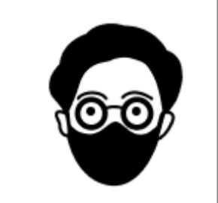

Team Info
Prathiba
Tunni
Jingxing
Myat
Aung
Christopher
Team Lead
React, JavaScript, MongoDB
Frontend Lead
React, JavaScript
Backend Lead
MongoDB, Node, React
Github Master
JUnit, MongoDB, JavaScript
Scrum Master
React, JavaScript
Frontend Support
Javascript
Notes:
Need to get myat, aung, and christopher’s tech skill

Slide 9
Feature Intro
Register / Login / Signout
Food Recording
Search Meal History

Slide 10
Register / Login / Signout
Sign up page
Username, password, confirm password
Basic validation
Login page
Username, password
Account validation
Sign out button
Redirect to login page
Notes:
http://34.127.94.100/

Slide 11
Food Recording
Food recording page
Date selection
Dropdown lists
Food option card
Recorded food card
Date selection
Past , current, future
Dropdown lists
Meal type selection
Food group selection
Food option card
Food amount
Recorded food card
Notes:
http://34.127.94.100/

Slide 12
Search Meal History
Food history page
Date selection
Pie chart
Recorded food card
Date selection
Past , current, future
Invalid date - alert message
Pie chart
Food group ratio reflection
Calorie calculation logic
Recorded food card
Fetch data from backend
Notes:
http://34.127.94.100/

Slide 13
DEMO
Notes:
http://34.127.94.100/

Slide 14
GitHub Management
https://github.com/CSC-648-SFSU/csc648-spring22-01-Team02
Branch Organization
Master/Release Branch
Development Branch
Feature Branches
Record
FoodHistory
Homepage
BugFixing
Review Policy
Any push to Feature Branch is assigned for code review
Merge to Dev request is approved by Reviewer.

Slide 15
Test Coverage
Integration Testing- Done by peer
https://docs.google.com/spreadsheets/d/1S6Tn649DEFCCpTngU3xek6lh403E_q9Z4y-DYrdiXDs/edit#gid=1637708246
Unit Testing- Done by developer
Next Slide

Slide 16
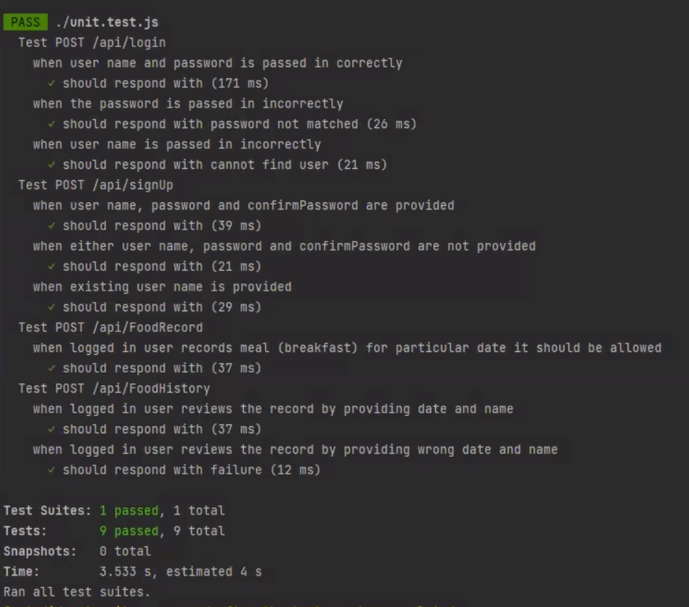
Unit Test Coverage -
Functions Covered (Register, Login, Meal Record, Meal History) - using Jest
Valid Scenario
InValid Scenario
Notes:
Total of 9 cases
Total of 9 passed

Slide 17
Challenges or improvements?
Deployment
Data Design
Food API
Change from AWS to Google Cloud.
Needed to change our data design during implementation.
Using third party API for food database.
Notes:
Data Design: In the middle of implementation, we decided to update the data design to improve the readability of our code and avoid spaghetti code.
Deployment: AWS was crashing because it ran out of the memory space so we ended up changing to Google Cloud.
Food API: Next step would be utilizing a third party API as our food database, so this would let us have a more accurate data and more food options.

Slide 18
