Slide 1
UNIVERSITY OF SOUTH FLORIDA
A companion application for a
sensor-embedded athletic mouthguard
Master's thesis defense
Myat Phone Tha
Department of Computer Science and Engineering
Notes:
Thank the committee. One sentence: GuardSync is the phone application that receives a Bluetooth text line from a holder board, shows it, and stores it. Say you will be clear about what the prototype does not do.

Slide 2
THE CLAIM
A phone path for one Bluetooth text line
GuardSync receives a text line from an nRF52840 on a Particle Argon board.
It shows the line, saves it on the phone, and uploads it when the athlete is signed in.
The athlete, not the software, confirms the activity label.
This is not a concussion test, and the Argon is not the mouthguard.
GuardSync · Master's thesis defense
2 / 19
Notes:
Read the four lines slowly. Pause on the last one. If they remember one slide, it should be this.

Slide 3
PROBLEM
A sensor reading still has to reach a person
A short head impact can be missed by someone watching from the sideline.
A mouthguard can hold sensors because the upper teeth are fixed to the skull.
The reading is useful only after a phone can receive it, show it, and keep it.
Deciding that a concussion occurred stays with a clinician.
GuardSync · Master's thesis defense
3 / 19
Notes:
Cite the idea, not a number. Camarillo and Liu motivate the mouthguard. McCrory is why you do not diagnose. Do not claim your board has been compared with a headform.

Slide 4
HARDWARE
The chip is real. The board is a holder.
On the bench today
Not this project
Chip: Nordic nRF52840
Not the mouthguard board
Board: Particle Argon
Not an nRF52840 DK
Bluetooth text line in
Message format can change
ESP32 Wi-Fi is unused
No firmware in the repository
GuardSync · Master's thesis defense
4 / 19
Notes:
If they ask 'is this the mouthguard?': the chip is the one planned for the mouthguard. The Argon is a holder so the phone could be built first. The Nordic development kit is a different board.

Slide 5
MESSAGE FORMAT
One comma-separated line, about every 2 seconds
Fields: uptime, minutes, head acceleration, heart rate, oxygen, temperature, bite force.
The phone accepts a 7-field line and an older 3-field line.
A short line fills oxygen, temperature, and bite force with defaults.
Those defaults are not measurements.
GuardSync · Master's thesis defense
5 / 19
Notes:
Example if they want one: 123456,15,95,72,98,98.4,160. Say the defaults on a short line are not measurements. File: ble/nordicUart.ts.

Slide 6
PATH
From the notify to a stored row
1. Bluetooth notify → base64 decode → parse
2. Dashboard updates on every accepted line
3. Every 2 seconds: save on the phone, then insert if signed in
4. History merges the phone and the cloud, and does not wait forever
GuardSync · Master's thesis defense
6 / 19
Notes:
Point at the code if they ask. uartStream.ts receives the notify. useArgonLiveTelemetry.ts has the 2-second gate. upload.ts does the insert. History gives the cloud 8 seconds, then keeps the local rows.

Slide 7
STORAGE
What actually gets saved
Its own column
Only inside the line
Head acceleration → metric_v1
Oxygen
Heart rate → metric_v2
Temperature
The whole line → csv_raw
Bite force
Mode, session, and time
Active minutes
GuardSync · Master's thesis defense
7 / 19
Notes:
History recovers oxygen, temperature, and bite force by parsing csv_raw again. If that parse fails, the old defaults come back. Table name: argon_telemetry_samples. Signed-in user id is sent with the row.

Slide 8
LABELS
The athlete confirms Training, Game, or Sleep
A fixed set of rules can suggest a different label.
The stored label does not change until the athlete says yes.
Yes starts a new session and relabels recent rows on the phone.
Rows already in the database are not rewritten.
GuardSync · Master's thesis defense
8 / 19
Notes:
Rules live in modes/detect.ts. Confirm is modes/confirmChange.ts. Confidence numbers on the rules are constants, not learned probabilities. Night uses the phone clock.

Slide 9
THE TWO UNFINISHED READINGS
These numbers are not the final product
Head acceleration
Bite force
One integer. The card adds g.
One integer, with an N label
A hit needs distance, velocity, and time.
Could be a hard bite
Measure those only during the hit.
Could be a collision
The app does not compute them.
The app cannot tell them apart
GuardSync · Master's thesis defense
9 / 19
Notes:
This is the slide to slow down on. The color bands use the raw integers. A larger number is treated as a larger event. That is not a measurement of how the head moved, and it is not a way to know why the jaw loaded.

Slide 10
WHAT YOU CAN SEE
The athlete path is the one that uses Bluetooth
Sign in, choose Athlete, pair, or use the demo line.
Calibration is five labels. It stores no baseline.
The dashboard is the live view. History is 1, 3, or 5 minutes.
Parent and trainer screens use made-up people, not this Bluetooth line.
GuardSync · Master's thesis defense
10 / 19
Notes:
If the Argon is not in the room, use the demo path and say so. The demo writes a fixed line and the device id 'demo'. Do not call that a collected impact. The cards can also show 95 before any real reading, and the band treats that as moderate. The next four slides are photographs of the Android build.

Slide 11
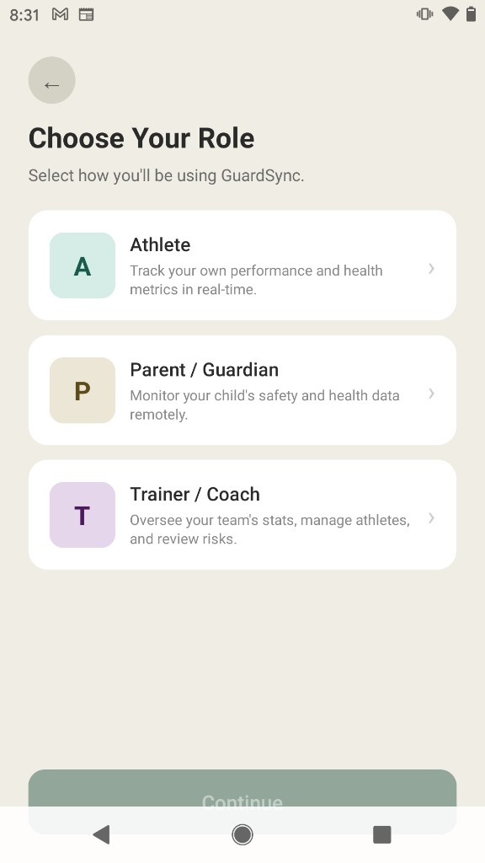
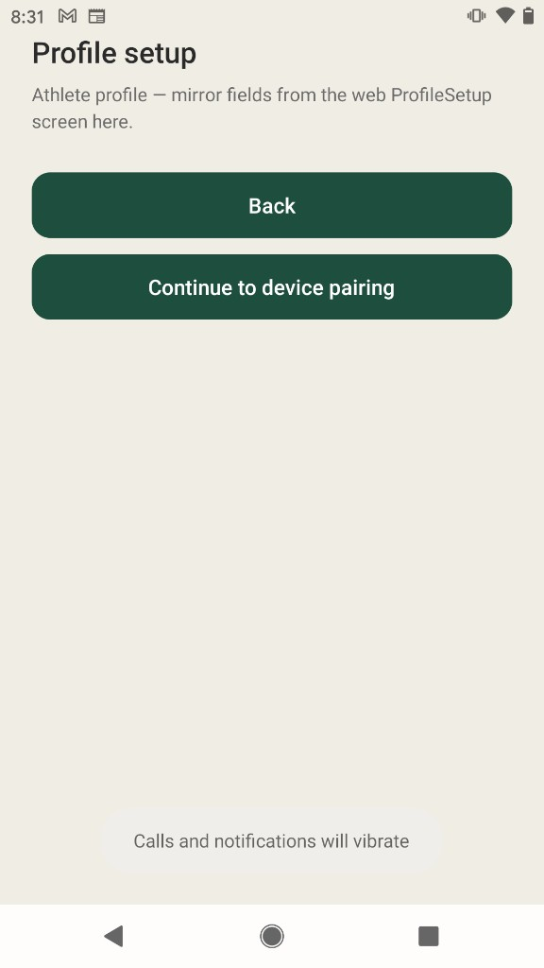
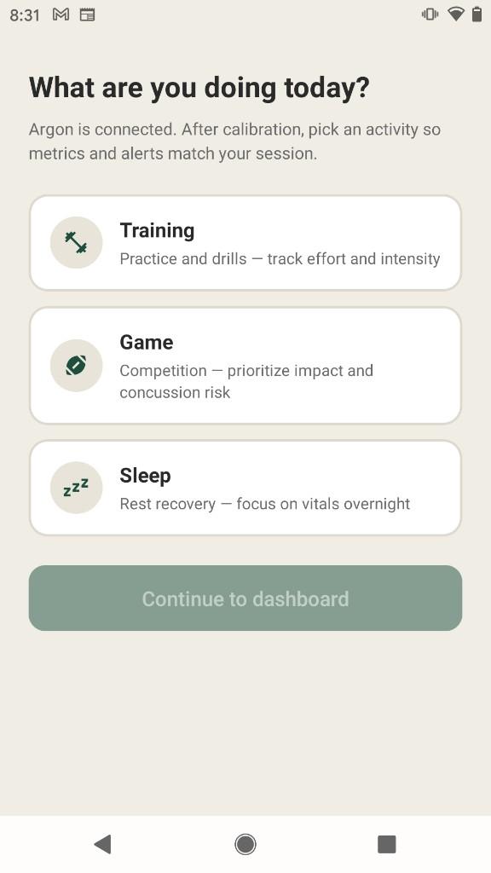
INTERFACE
Role, profile, then the activity for this session
Choose Athlete, Parent, or Trainer
Profile is a placeholder. Continue opens pairing.
Training, Game, or Sleep, chosen by the athlete
GuardSync · Master's thesis defense
11 / 19
Notes:
Walk left to right. Continue on the role screen stays off until a card is selected. The profile screen stores nothing. Pairing and the five calibration labels sit between the second and third photos and were not photographed. Calibration stores no baseline. The activity choice is the label later rows carry.

Slide 12
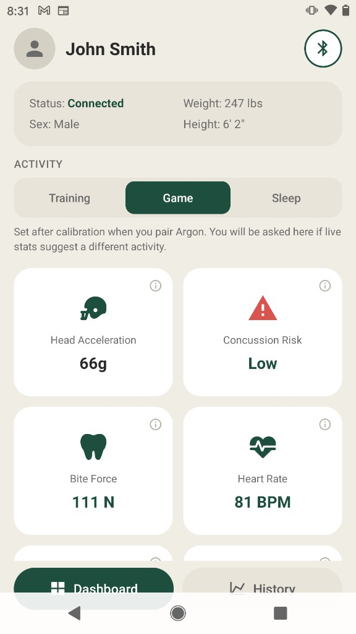
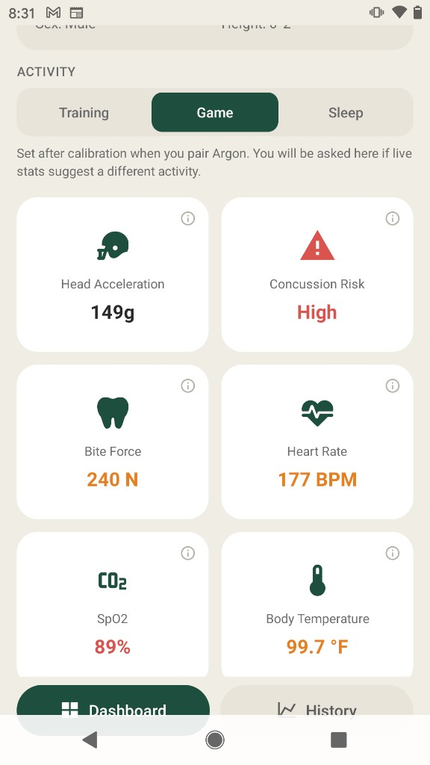
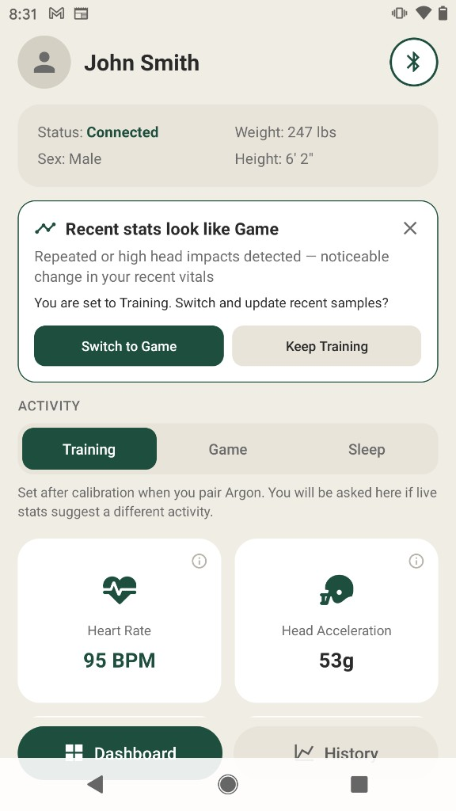
INTERFACE
The live dashboard, then a question before the label changes
Game session. 66g, band reads Low.
Same screen. 149g, band reads High.
Training stays until the athlete chooses.
GuardSync · Master's thesis defense
12 / 19
Notes:
The name and body size are literals, not a loaded profile. Game puts head acceleration first. Colors are interface cuts: warning at 90, high at 120. Say the band is a reading aid, not a diagnosis. On the third photo the detector suggests Game while Training is still selected. Switch relabels recent phone rows. Keep leaves the label. Database rows already inserted are not rewritten.

Slide 13
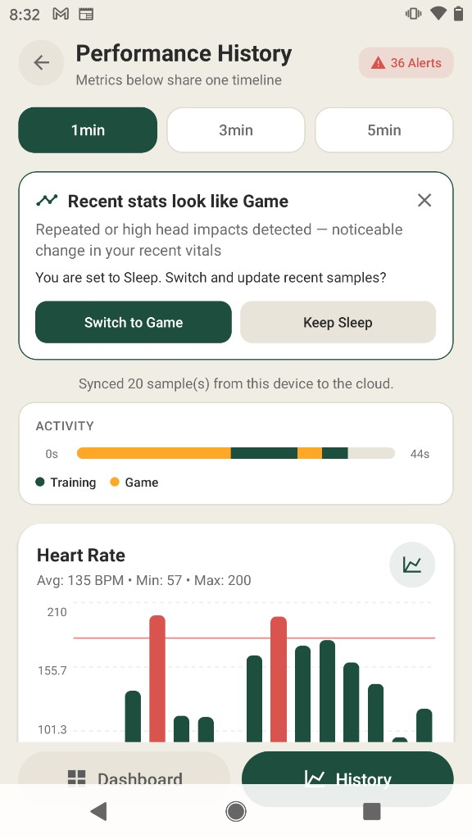
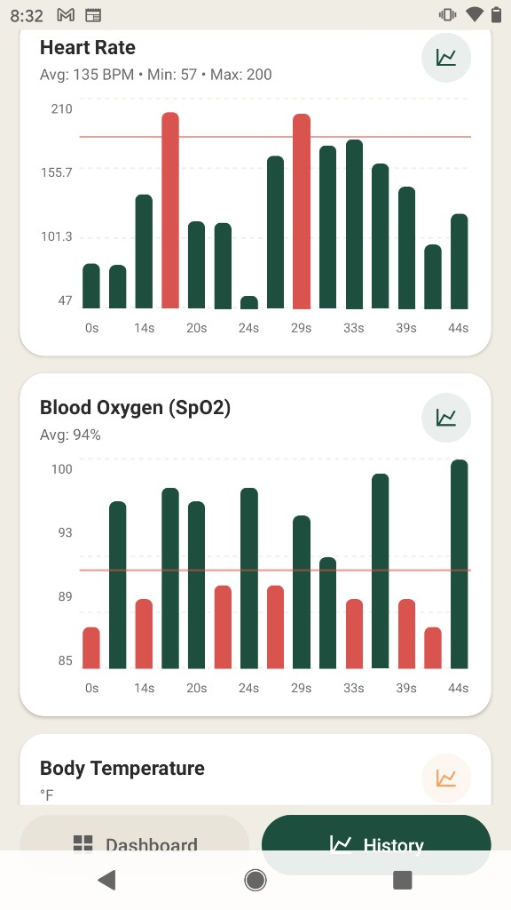
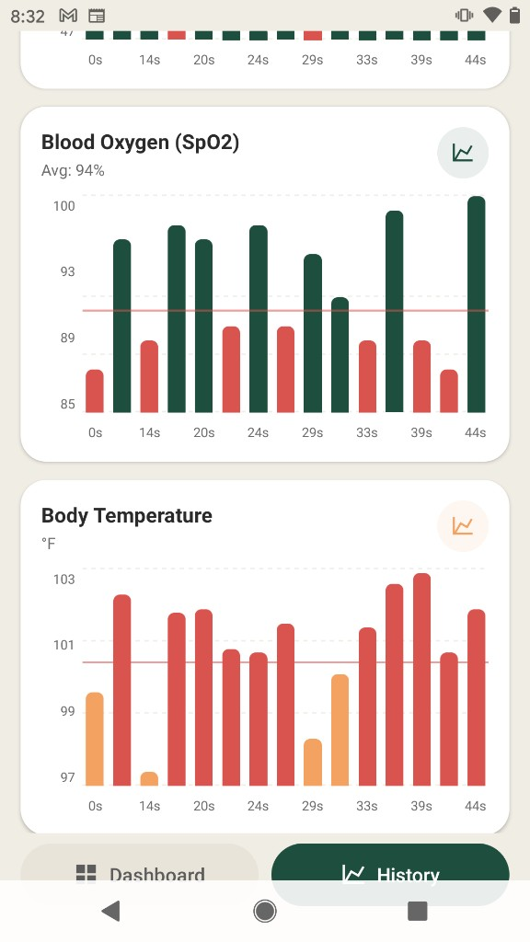
INTERFACE
History is one timeline, with chart marks counted as alerts
1 minute, 36 alerts, Training and Game on one strip
Heart rate and SpO2. Red bars are critical marks.
Temperature is orange. Red is still the critical mark.
GuardSync · Master's thesis defense
13 / 19
Notes:
The badge counts chart marks, not medical events. This window was set to Sleep and the banner suggests Game. The strip is the confirmed activity over the same seconds as the bars. Heart rate is marked above 180 or below 50. SpO2 below 92. Temperature above 100.4. Those cuts are not the same cuts as the dashboard colors.

Slide 14
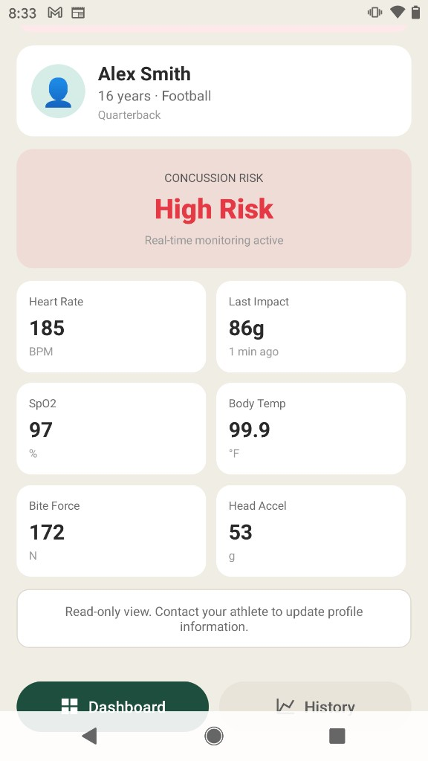
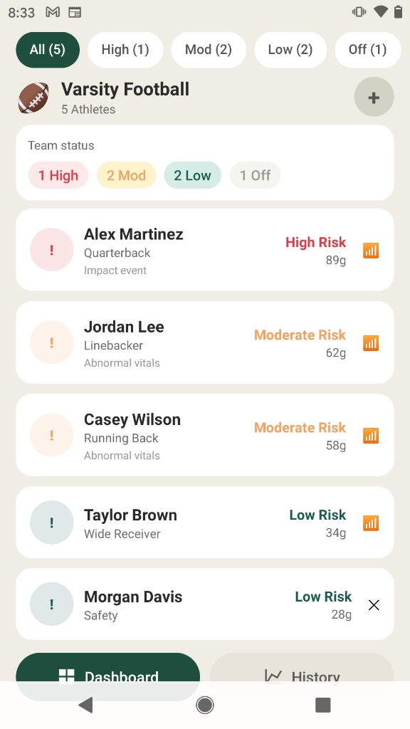
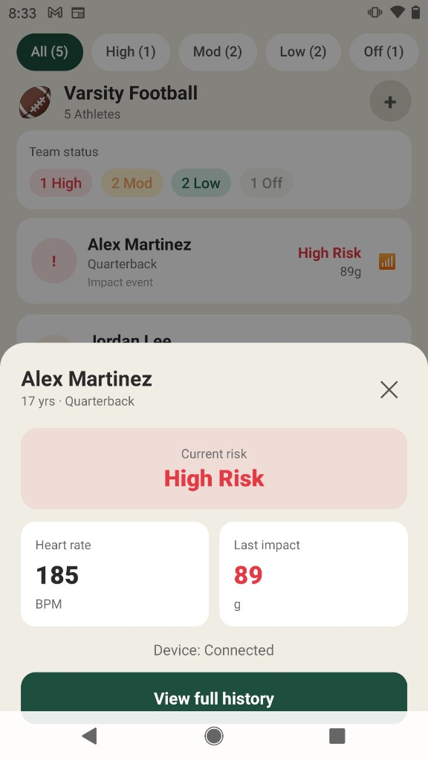
INTERFACE
Parent and trainer screens use simulated people
Parent view. Values are drawn on a timer.
A fixed roster of five athletes
The sheet reads that same fixed record
GuardSync · Master's thesis defense
14 / 19
Notes:
Slow down here so nobody thinks these are live mouthguards. The parent screen replaces the tiles about every three seconds inside the component. The trainer list is a fixed array. The disconnected mark is separate from the risk label. View full history only opens the history route. Neither screen subscribes to Bluetooth.

Slide 15
RESULTS BY INSPECTION
No packet test was logged
Implemented
Not implemented
Scan, connect, parse, show
Counted delivery or latency
Phone outbox and cloud insert
A trained model
History survives a slow network
A real calibration baseline
Athlete-confirmed activity label
Encrypted Bluetooth
GuardSync · Master's thesis defense
15 / 19
Notes:
Say this before they ask. Chapter Eight is an inspection of version 1.0.0, not a bench campaign. If they ask for a percentage, say you do not have one.

Slide 16
A DEFECT TO KNOW
One reading can be inserted twice
A successful live upload leaves the phone copy in the outbox.
History later uploads the newest outbox rows again.
The chart hides the pair. The database can keep both.
There is no uniqueness rule in the checked-in SQL.
GuardSync · Master's thesis defense
16 / 19
Notes:
Key is device id plus the phone's receipt time. Live success does not remove the outbox row. Only a successful history sync removes it, after it may have inserted again. This is a real bug. Do not defend it as a feature.

Slide 17
CONTRIBUTION
A documented path, with the limits written down
A phone client for the holder board's Bluetooth text line.
Local storage, a signed-in insert, and one history timeline.
An activity label that the athlete has to confirm.
A clear statement of what head acceleration and bite force are not.
GuardSync · Master's thesis defense
17 / 19
Notes:
The contribution is the software path and the honest boundary. It is not a biomechanics result and not a clinical result.

Slide 18
NEXT
What changes when the mouthguard board arrives
New message format: field types, rate, and Bluetooth service.
For a hit: distance, velocity, and contact time on that short window.
For bite force: this athlete's rest and hardest bite, then bite versus collision.
One logged lab session, then bonding and encryption.
GuardSync · Master's thesis defense
18 / 19
Notes:
Resting jaw and a deliberate hard bite were the point of calibration. That screen does not record them yet. A collision is a short spike of bite force together with head acceleration. A bite holds while the head stays quiet.

Slide 19
Questions
I can walk the parser, the insert, or either unfinished reading.
Notes:
Stop. Do not fill silence with a new claim. If you do not know, say which chapter states the limit. Files to offer: ble/nordicUart.ts and telemetry/upload.ts.

