Slide 1
Overflow Flag

Slide 2
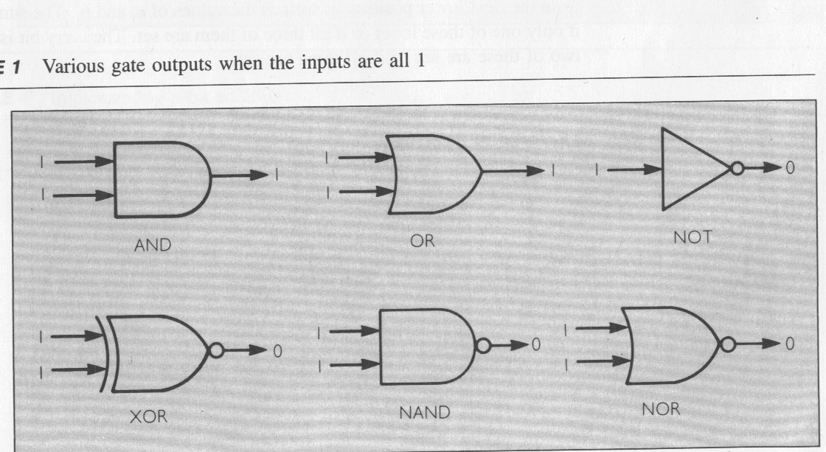
Overflow
Logic Gates

Slide 3
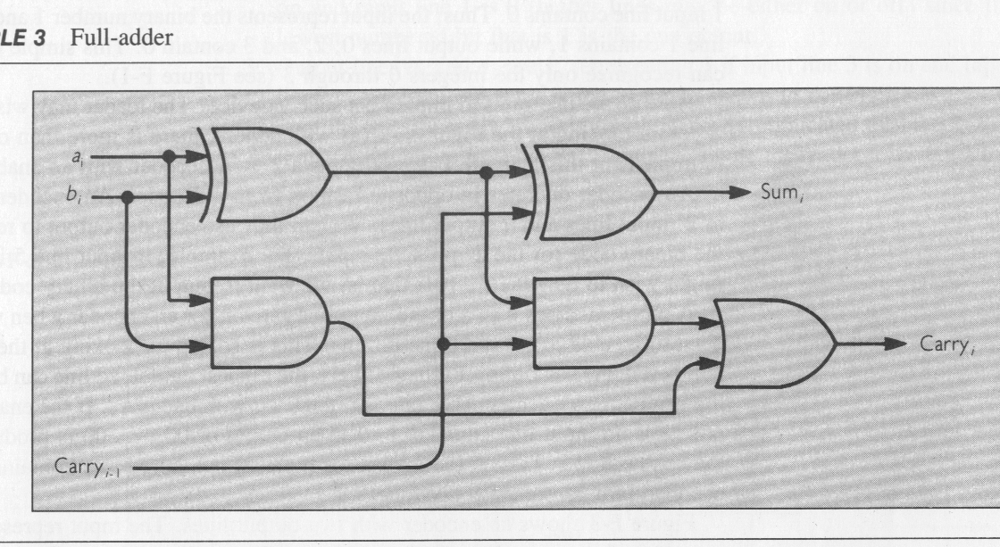
Overflow
Full Adder

Slide 4
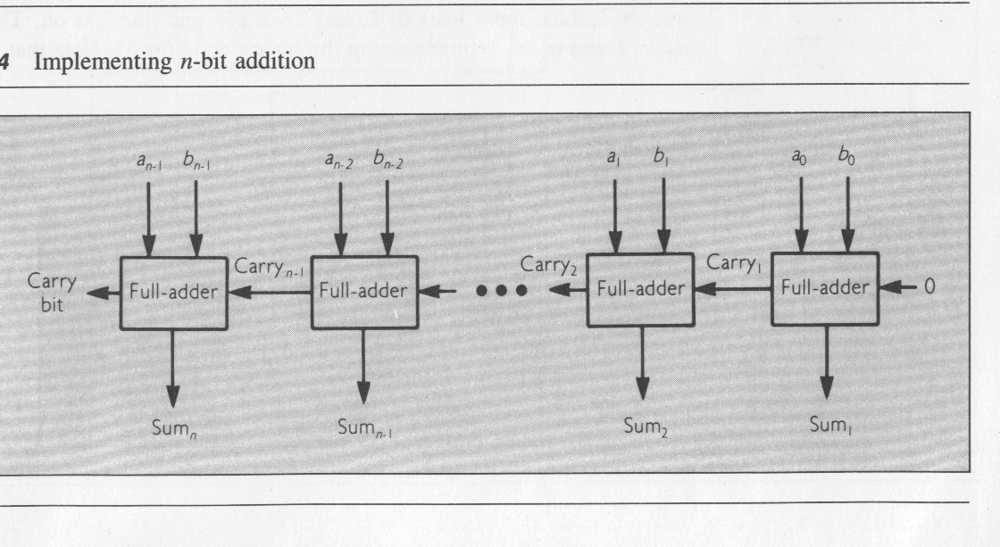
Overflow
Addition

Slide 5
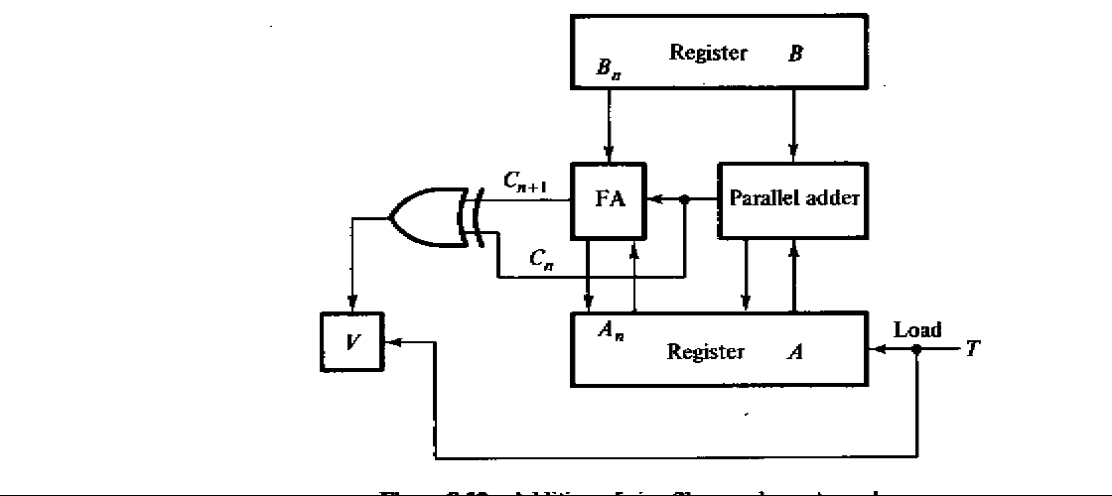
Overflow
Full Adder
OF
XOR the carry in and carry out
(or borrow in and borrow out)
to set the overflow flag

