Slide 1

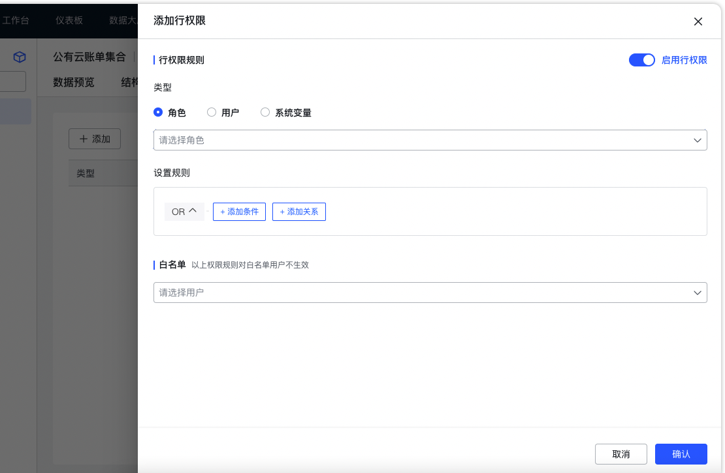
Total Productive MaintenanceSelf-Service Reporting Tool: Feature Examples-Permission Configuration
Functionality and Features
By configuring permissions, different users are granted varying levels of access and operational capabilities within the system.
1
Menu Permissions (Role-based Permissions)
√Publish Resources: Release the report page as a resource.
✓Resource to Menu: Establishing a Menu Mapping Resource
Check markCharacter Binding Menu: After accessing the Character Binding Menu, you can view
2
Data Permissions (Row and Column Permissions)
√ Access Rights: Reallocate across different dimensions, such as allowing employees in the "Operations and Maintenance Department" to view only data related to operations and maintenance;
√Column Permissions: After setting to "Disabled," the entire column, including the field name and data, will be hidden. For example, the "Price" column can be configured so that only purchasers can view it.
√Whitelist: Individuals on the whitelist are exempt from this rule, and multiple people can be added to the whitelist.

