Slide 1
Geography 211A
Specific Population Travel Behavior Analysis Based on 2017 NHTS
Stone Shi

Slide 2
Contents
Female assume housework
Parents responsibility
Holiday trip demand
Age
Linear regression model
Dummy variable
Relevance
Summary
1
2
3
4
Background
Methodology
Factors affect travel behavior
Population characteristic
Population group vs travel behavior
Result
Accuracy
Future development

Slide 3
Research Background
Despite playing more overlapping roles at work and home than ever before, men and women in the U.S. still display different travel behavior.
Gender differences in travel respond to multiple aspects of household structure in complex and interactive ways (Fan 2017, pp.284).
According to previous studies and general observation, travel behavior probably have significantly different patterns between:
Men & Women
People as parents & People living single
Age groups
Working vs Homemaker
The purpose of this research is to find how significant these factors affect the travel behavior. Gender equity issue / family structure would be shown in the survey.

Slide 4
National Household Travel Survey (NHTS)
Conducted by the Federal Highway Administration (FHWA)
Authoritative source on the travel behavior of the American public
Allows one to analyze trends in personal and household travel
Includes daily non-commercial travel by all modes
Survey contains every day in one year
2017 NHTS
55,819 respondents
199 characteristics, surveyed people’s employment, sex, age and family relationship.
Published on October 20, 2017

Slide 5
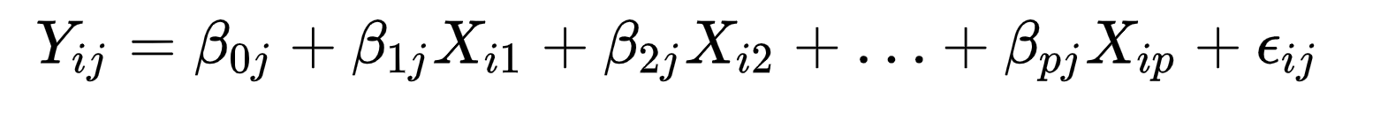
Multiple Linear Regression Model
where, for i=n, j=n observations:
yij = dependent variable
xi​ = explanatory variables
β0j ​=y-intercept
βpj​ = slope coefficients for each explanatory variable
ϵij = Residuals

Slide 6
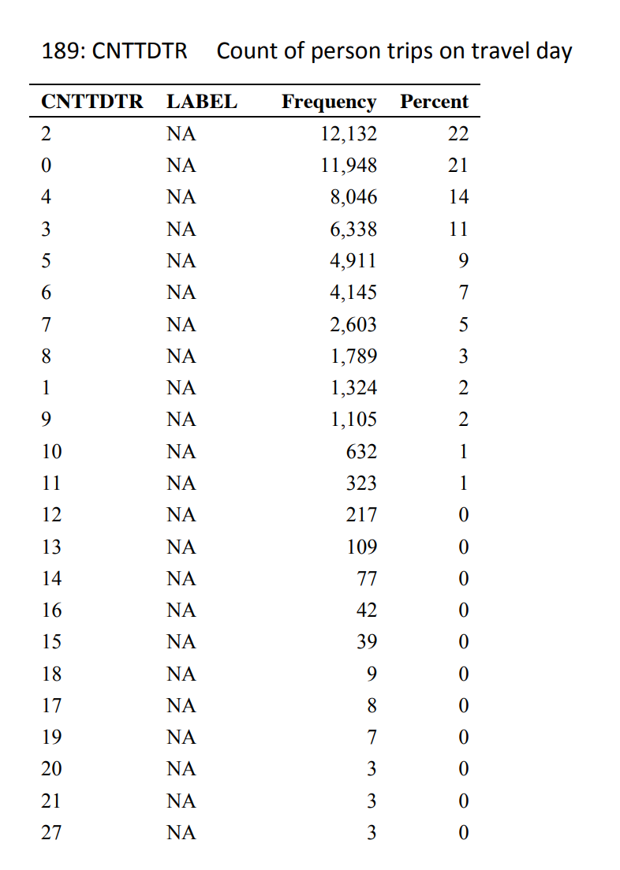
Methodology: In R Coding
Independent variable yij
cnttdtr - Count of person trips on travel day
Explanatory variable xi
asparent - People’s household relationship as parent
yesmale - People identify as male
yesfemale - People identify as female
tripholidays - People take the survey in holidays
older18 - People’s age equal and older than 18
older21 - People’s age equal and older than 21
work_women - People identify as female and the primary activity in previous week(PRMACT) is working
work_men - People identify as male and the primary activity in previous week(PRMACT) is working
homemaker_women - People identify as female and the primary activity in previous week(PRMACT) is a homemaker
homemaker_men - People identify as male and the primary activity in previous week(PRMACT) is a homemaker
Note: The table is from NHTS 2017 Person File Frequencies, Table 189, by Federal Highway Administration, 2017, U.S. Department of Transportation. Copyright 2021 by U.S. Department of Transportation.

Slide 7
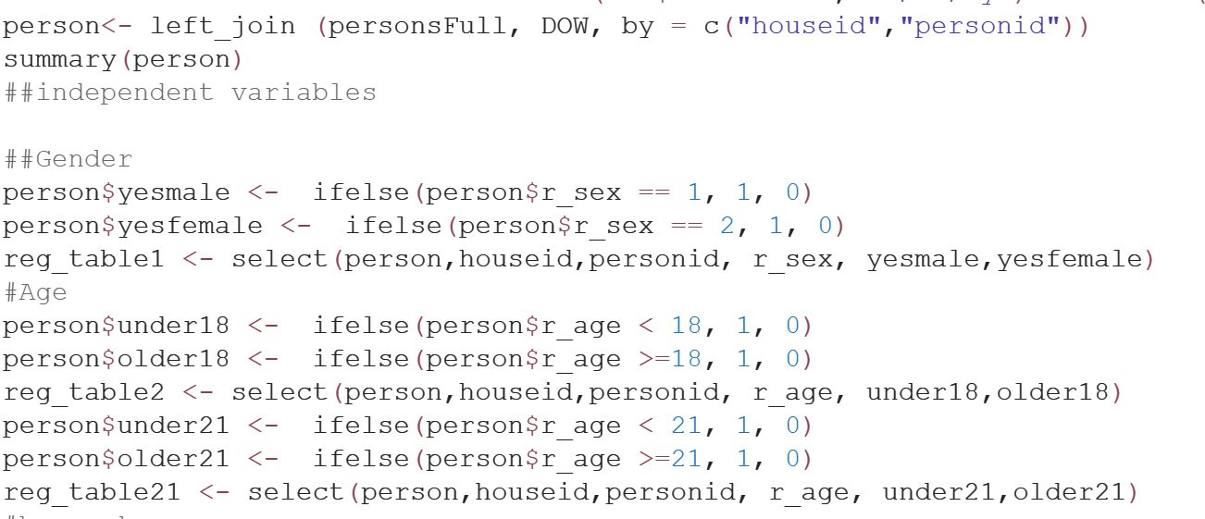
Methodology：In R Coding
Dummy Variables
All the explanatory variables are transformed to dummy variables, by 0 and 1.

Slide 8
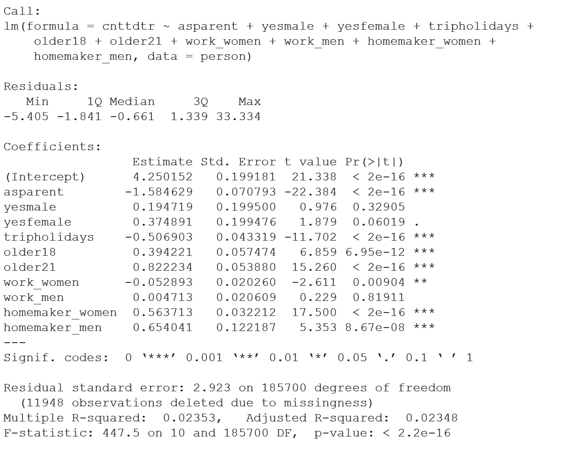
Regression Result Table

Slide 9
Parents are likely to have less trips
They might need to look after their children at home
People travel less on holidays than non-holidays
They may stay at home with family and friends, take a rest
Adults have more trips, especially older than 21
In the US, juvenile can’t drive alone. People older 21 can go to several places (Casino, booking hotel, club)

Slide 10
Male vs Female
Male vs Female: working
Male vs Female: homemaker
Female have slightly higher positive correlation of trip
A number of female still take the responsibility for buying groceries and household goods
Working women have higher negative correlation of trip times than working men.
Probably because women are at greater risk than men when traveling at night after get off work.
As homemaker, both women and men have strong negative correlation of trip times. But the significance of women is higher than men. This may because only 627 males are as homemaker in this survey, but females have 10980.

Slide 11
Future works
Linear regression result is affected by explanatory variable chosen
NHTS only collects if people identify them as male
Try other dependent variables in NHTS to deeply analyze the how significant the effect of different factors
Use different models to take further validation and develop the accuracy

Slide 12
Reference
Fan, Y. (2017). Household structure and gender differences in travel time: spouse/partner presence, parenthood, and breadwinner status. Transportation, 44(2), 271-291.
Federal Highway Administration. (2017). 2017 National Household Travel Survey, U.S. Department of Transportation, Washington, DC. Available online: https://nhts.ornl.gov

