Slide 1
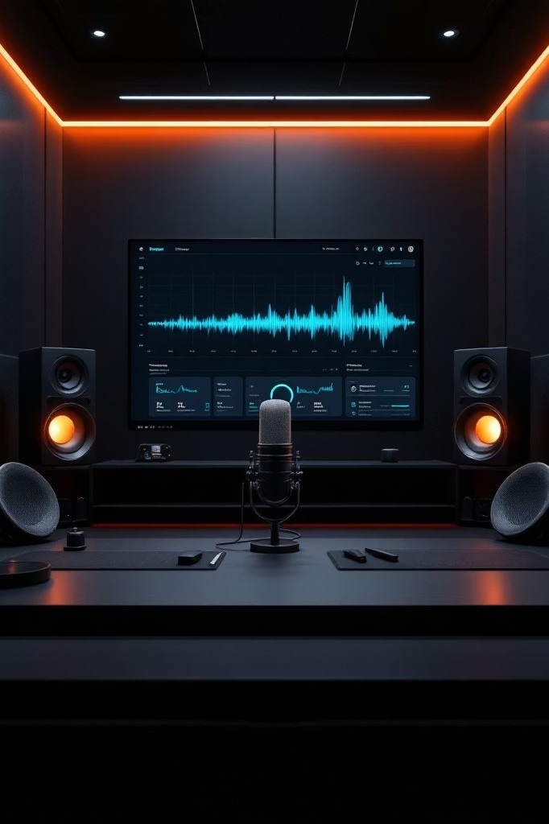
EchoAI - Automated Podcast Transcription s Intelligent Topic Segmentation System
Presented by: Mydhili Alladi | Infosys Springboard 6.0(Batch 11)

Slide 2

Problem Statement
Manual transcription is time-consuming and error-prone.
Long-form podcasts and discussions are difficult to search and analyze.
Inefficient retrieval of specific topics or sentiments within large audio files.
Lack of structured insights from unsegmented audio data.

Slide 3
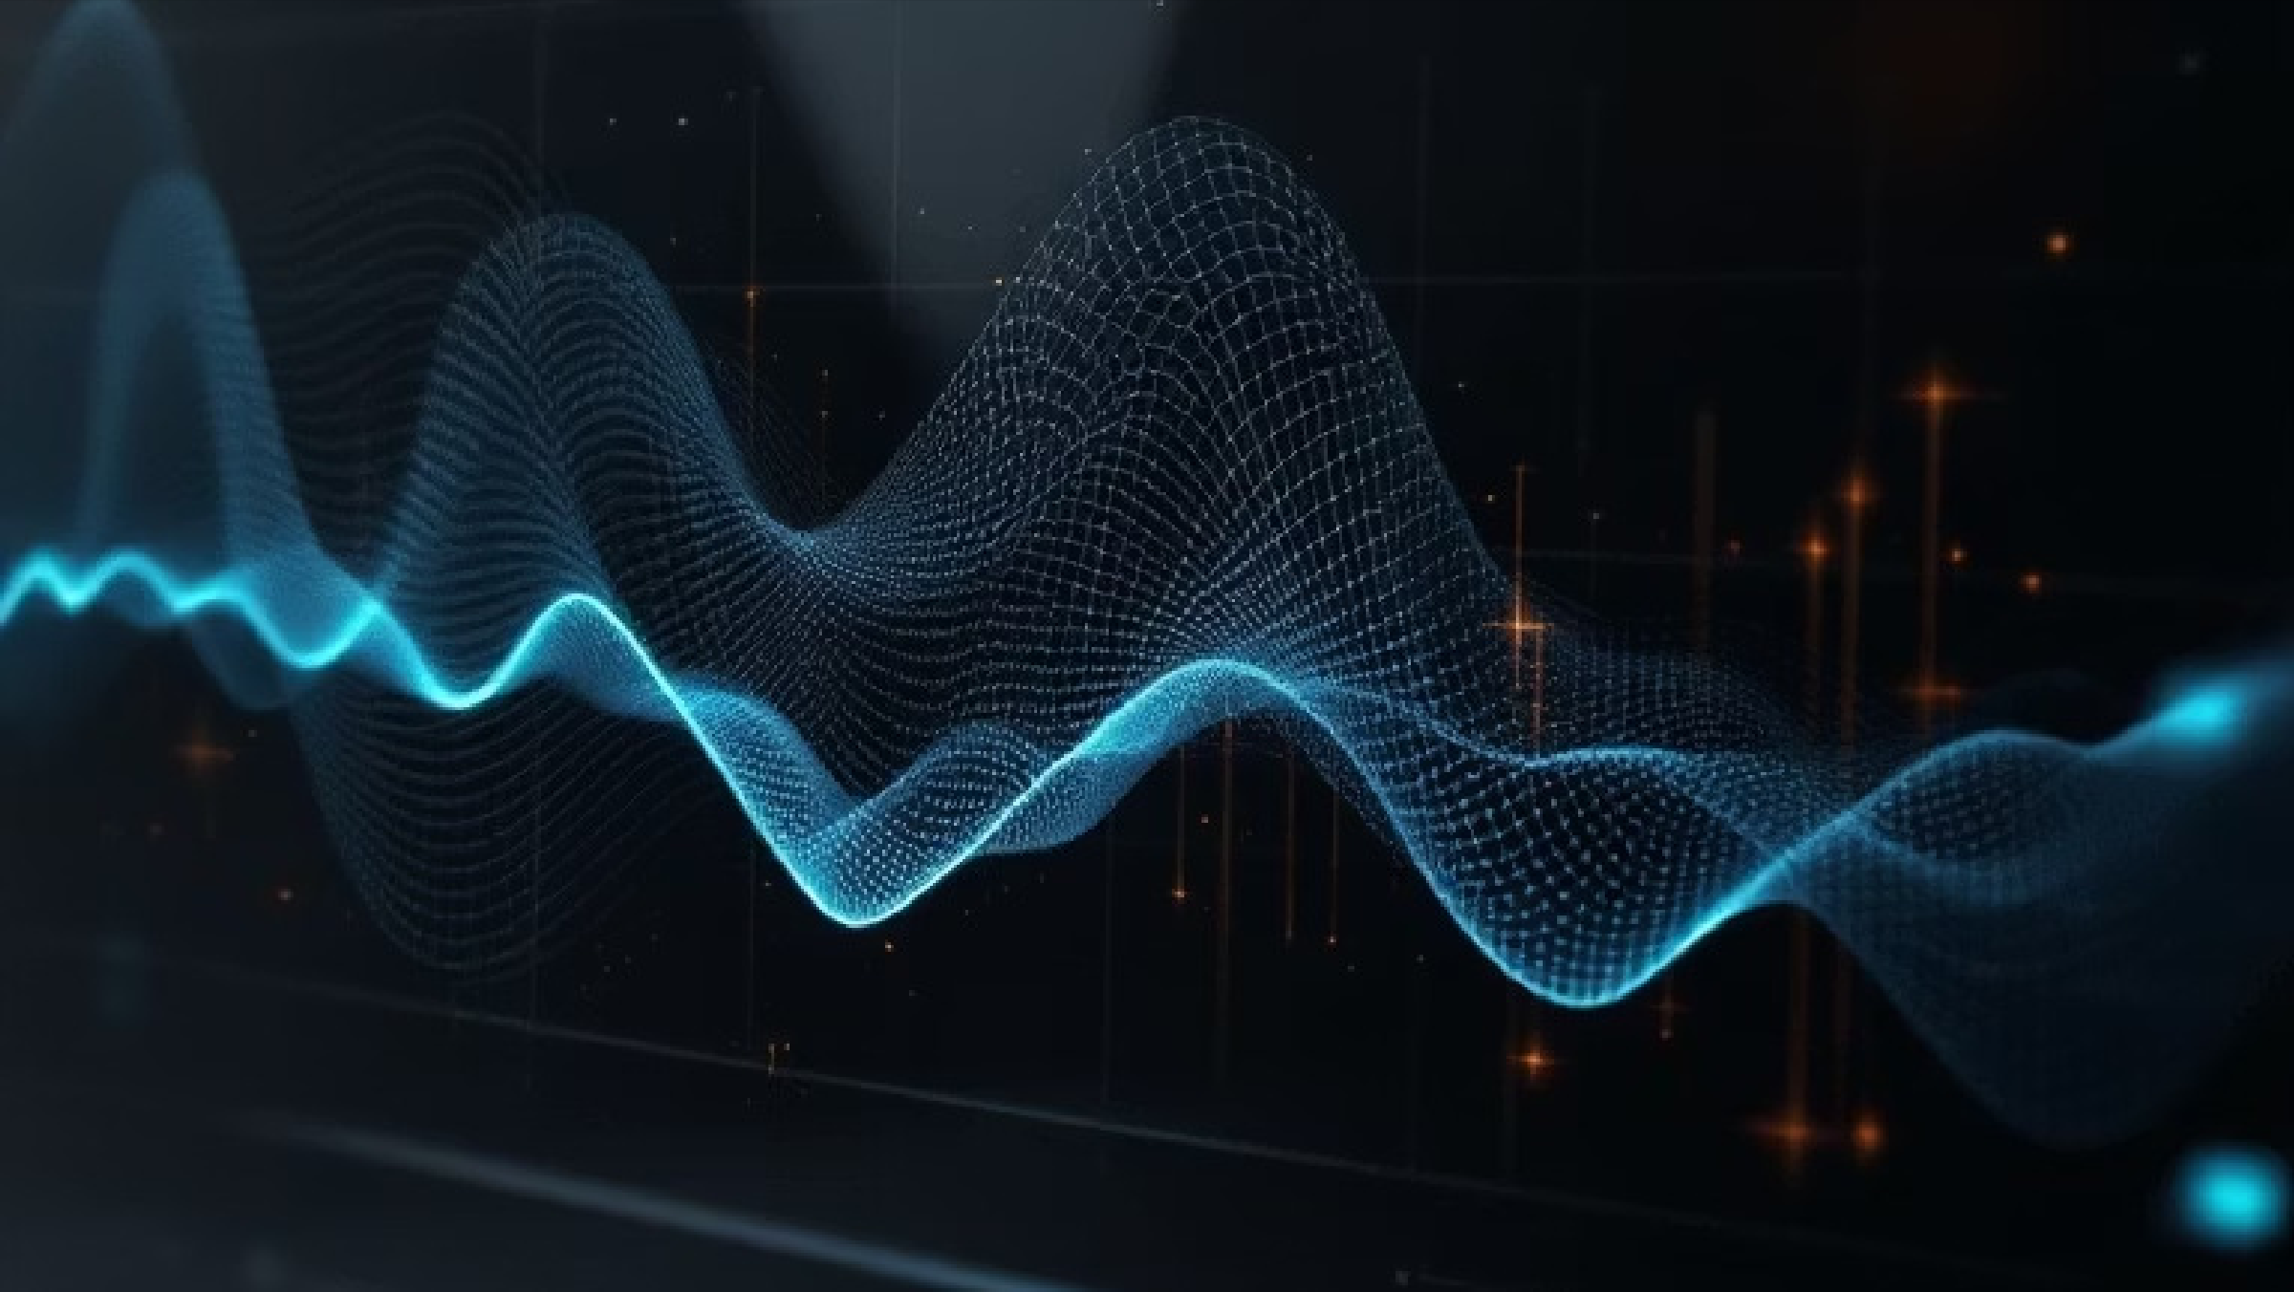


Proposed Solution
AI-driven system for automated transcription and intelligent topic
segmentation.
Integrates speech-to-text, topic modeling, and sentiment analysis.
Converts unstructured audio into searchable, structured insights.
Provides an interactive dashboard for exploration and visualization.

Slide 4



System Architecture
Pipeline: Audio ³ Whisper (Transcription) ³ Segmentation (TextTiling / TF-IDF) ³ Sentiment (TextBlob) ³ UI (Streamlit)
Audio input uploaded by user.
Text segmentation algorithms identify topic boundaries.
Results visualized in an interactive dashboard.
Whisper model generates accurate transcription.
Sentiment analysis adds emotional context.

Slide 5
Core Algorithms
Whisper: Multilingual speech-to-text model for
transcription.
TF-IDF: Keyword extraction and topic
relevance scoring.
TextTiling: Topic boundary detection in long-form
text.
SBERT: Semantic similarity for clustering related segments.
TextBlob: Sentiment polarity and subjectivity analysis.

Slide 6
Technology Stack
Programming Language:
Python
Framework:
Streamlit (for UI)
Audio Processing:
Librosa
NLP Libraries:
NLTK, scikit-learn, Sentence-Transformers
Visualization:
Matplotlib, WordCloud

Slide 7
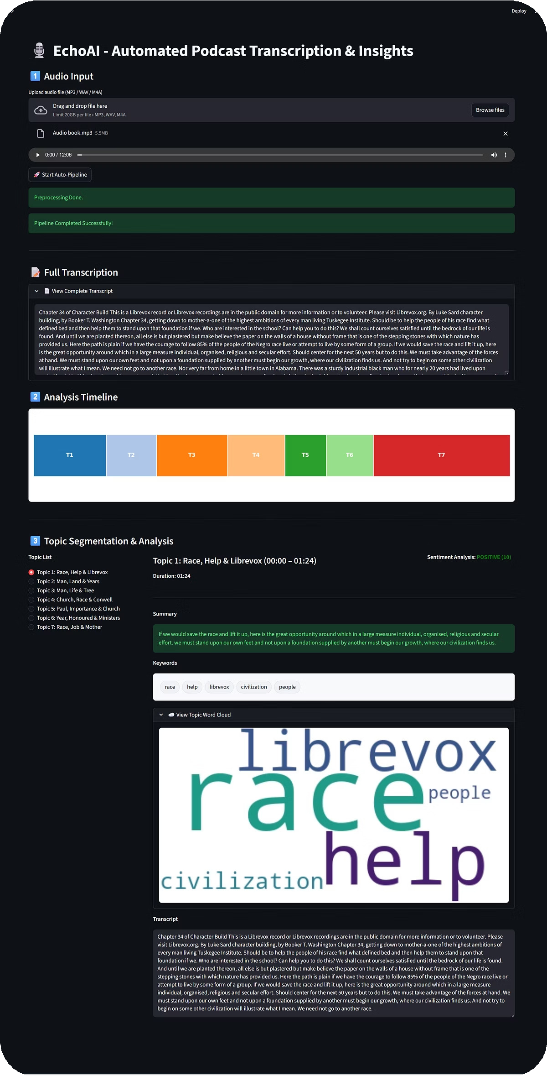
Prototype Demonstration
UI Features:
1
2
Audio upload and transcription panel.
Real-time progress and analysis timeline.
3
4
Topic segmentation with color-coded sections.
Word cloud visualization for topic keywords.
5
Sentiment summary and transcript viewer.

Slide 8
System Capabilities s Constraints
Constraints:
Dependent on Whisper model accuracy. Processing time increases with audio length.
Requires stable internet and GPU for optimal performance.
Capabilities:
Handles long-form audio efficiently.
Provides structured topic and sentiment insights. Interactive and visually minimal dashboard.

Slide 9
Performance Considerations
Optimized for medium-length podcasts (303 90 mins).
Caching and parallelization for faster inference.
Batch processing for large datasets.
Evaluation metrics: WER (Word Error Rate), segmentation precision, sentiment accuracy.

Slide 10

Conclusion s Future Scope
EchoAI transforms unstructured audio into structured, searchable insights.
Enhances accessibility and analysis of long-form content.
Future Enhancements:
Multi-speaker diarization.
Real-time transcription and topic tracking.
Integration with podcast platforms and APIs.

