Slide 1
Ethical Risk Assessment of
Predictive AI Models in
Healthcare Logistics
Mydhili Jeevakumar
Dublin Business School
May 2026

Slide 2
1
Research Aim & Questions
AIM
FOUR SUB-QUESTIONS
Evaluate predictive AI models in hospital capacity planning for bias, transparency, and unequal performance using real hospital data.
1
Which ML models best identify hospital resource shortages?
2
Do predictive models perform differently across hospital groups (states, capacity)?
3
How can XAI reveal the decision logic behind predictions?
4
What ethical risks emerge from deploying such models in healthcare logistics?

Slide 3
2
Problem & Research Gap
01
02
03
Validation
Opacity
Governance
Healthcare ML pipelines report aggregate metrics only; subgroup performance not disaggregated.
Most accurate models (boosted trees, deep nets) hide which features drive disparate outcomes.
WHO and EU AI Act set principles; no operational tests for individual models.
THE GAP
No single reproducible workflow combining statistical feature testing, multi-model comparison, ensembles, and explainability on real hospital data.

Slide 4
3
Data & Target Variable
100,000
19,202
49
77 / 23
rows sampled
after preprocessing
US states
% class split
DATA SOURCE
TARGET
HHS COVID-19 Reported Patient Impact and Hospital Capacity by Facility
Public, facility-level weekly reports (HealthData.gov, 2025)
ICU_capacity_risk
= 1 if icu_occupancy_rate ≥ 0.90 (operational stress threshold)
KEY FEATURES
total_beds, inpatient_beds_used, total_icu_beds, icu_beds_used, bed_occupancy_rate, state, collection_week_ordinal

Slide 5
4
Methodology Pipeline
1. Preprocess
2. Chi-square
3. Train 7 Models
4. Stack
5. CV + Test
6. SHAP
Clean, resolve columns, engineer rates
>
Test feature-target independence
>
LR, DT, RF, XGB, GBM, ET, LGBM
>
5 base + LR meta-learner
>
Stratified 5-fold + held-out 30%
>
Explain XGBoost predictions
INCORPORATED FROM SUPERVISOR FEEDBACK (APRIL 2026)
Chi-square test of independence
Expanded base models from 4 to 7, plus stacking ensemble
Stratified 5-fold cross-validation

Slide 6
5
Chi-Square Test Results
All tested features reject H₀ at α = 0.05. Every feature is statistically associated with the target.
KEY FINDINGS
state
Strongest association: geographic context matters most.
bed_occupancy_rate
Hospital-wide pressure predicts ICU stress.
→ Addresses Sub-Q 2

Slide 7
6
Held-Out Test Performance
3-WAY TIE AT TOP
F1 = 0.9992
LightGBM
Stacking Ensemble
Gradient Boosting
HEADLINE METRICS
Accuracy
0.9997
ROC-AUC
1.0000
→ Addresses Sub-Q 1

Slide 8
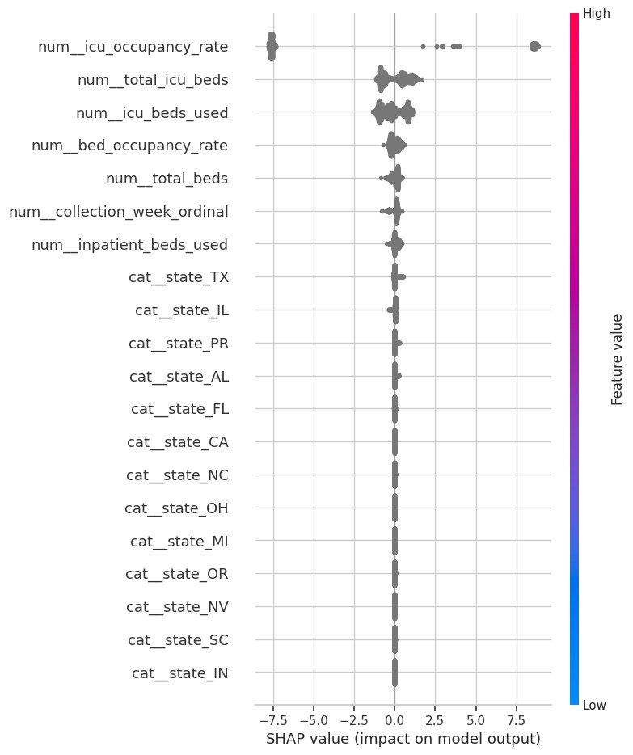
7
SHAP Explainability (XGBoost)
FEATURE IMPORTANCE
1
icu_occupancy_rate
dominant predictor
2
total_icu_beds
facility size
3
icu_beds_used
absolute load
4
bed_occupancy_rate
hospital-wide stress
5
total_beds
facility scale
6
state indicators
geographic context
→ Addresses Sub-Q 3

Slide 9
8
Ethical Risks Surfaced
01
02
Geographic disparity
Precision-recall trade-off
State has the strongest association with the target. Region-aware evaluation is essential before deployment.
Models differ in error type: 0 vs 94 false positives. Choice is operational, not purely technical.
03
04
Opacity of top models
Data quality bias
Gradient-boosted trees lead on F1 but are hard to audit without post-hoc tools like SHAP.
Smaller or under-resourced hospitals may report less consistently, risking under-representation.
→ Addresses Sub-Q 4

Slide 10
9
Conclusions & Future Work
WHAT WAS DELIVERED
FUTURE WORK
End-to-end reproducible workflow on real HHS data
Three top models tied at F1 = 0.9992
Statistical evidence of regional variation in target
SHAP-based audit of opaque model logic
Template for governance and EU AI Act readiness
Extend to multi-region datasets
Add explicit subgroup performance metrics
Develop leak-aware forecasting target
Apply post-processing fairness mitigation
Integrate with deployment monitoring + governance
Thank you

