Slide 1

Credit Card Fraud Detection Model
Group-6
Scam Guards
Using Logistic Regression
Ayon Kumar Das
Myesha Mahazabeen
Najia Jahan
Professor Yunhua Zhao
CSC 448 (Artificial Intelligence)

Slide 2
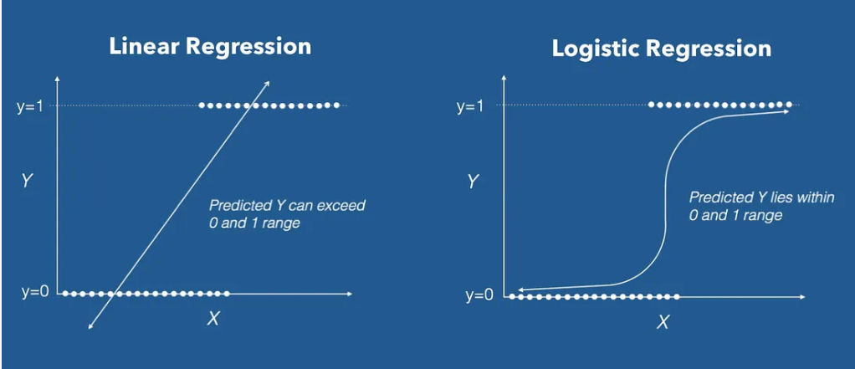
Logistic Regression
What is it?
Purpose: Binary classification for predicting outcomes.
Probability Estimation: Uses sigmoid function for probability transformation.
Interpretability: Coefficients illustrate feature impact.
Efficiency: Computationally efficient and suitable for real-time tasks.
Notes:
https://towardsdatascience.com/introduction-to-logistic-regression-66248243c148

Slide 3
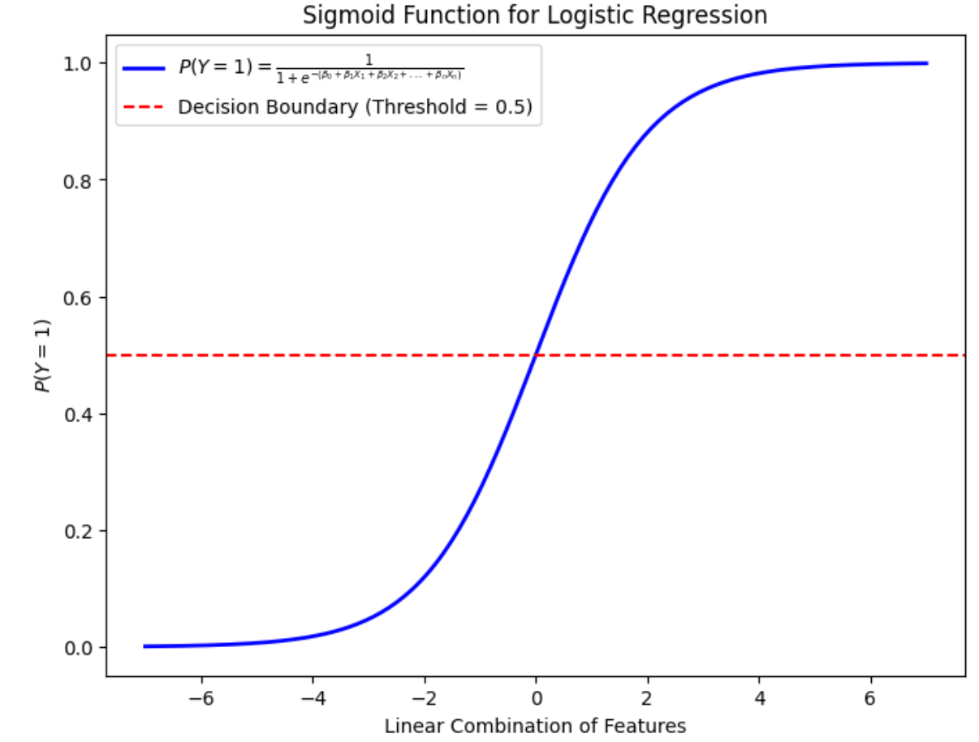
Logistic Regression Equation
Sigmoid Function
P(Y=1)=1 / 1+e^−(β0​+β1​X1​+β2​X2​+...+βn​Xn​)
P(Y=1) is the probability of the positive class (event happening)
e is the base of the natural logarithm
Β0, β1,...,βn ​ are coefficients associated with features X1,X2,...,Xn
Notes:
https://towardsdatascience.com/introduction-to-logistic-regression-66248243c148

Slide 4
How will this work?
Hypothetical Example
P(Y=1)=1 / 1+e^−(β0​+β1​X1​+β2​X2​+...+βn​Xn​)
Features(e.g amount, time)
X1 = 50
X2 = 12
Log-odds = −3+(0.1×50)+(0.05×12) = −3+5+0.6 = 2.6
P(Y=1) = 1 / 1+e^−(2.6)
= 0.93086
= 93%
Indicates a high probability of the transaction being fraudulent.
Coefficients
β0​= -3
β1​= 0.1
β2=​ 0.05

Slide 5
Credit Card Fraud Detection
Data Exploration:
Load a dataset with 284,807 transactions.
Investigate statistical summaries and class distribution.
Data Preprocessing:
Visualize correlations among features using a heatmap.
Split the dataset into features (X) and the target variable (Y).
Model Building:
Use Logistic Regression.
Handle potential convergence issues with an increased iteration limit.
Evaluation Metrics:
Assess model performance using key metrics:
Accuracy, Precision, Recall, F1-Score, Matthews Correlation Coefficient.

Slide 6
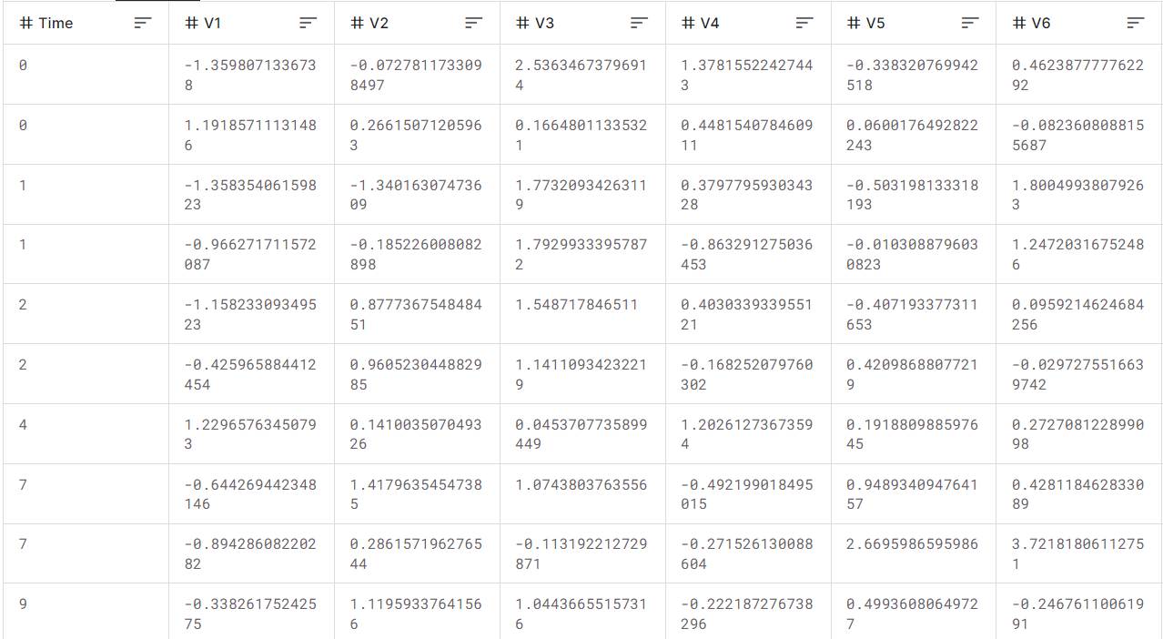
Data (creditcard.csv)
LINK: https://www.kaggle.com/datasets/mlg-ulb/creditcardfraud
31 Columns
1 column ‘Class’ is Target Variable.
Other 30 Columns are 30 features.
(V1,V2..,V28) are PCA transformations.
Other two are Amount, Time.
Notes:
https://www.kaggle.com/datasets/mlg-ulb/creditcardfraud

Slide 7
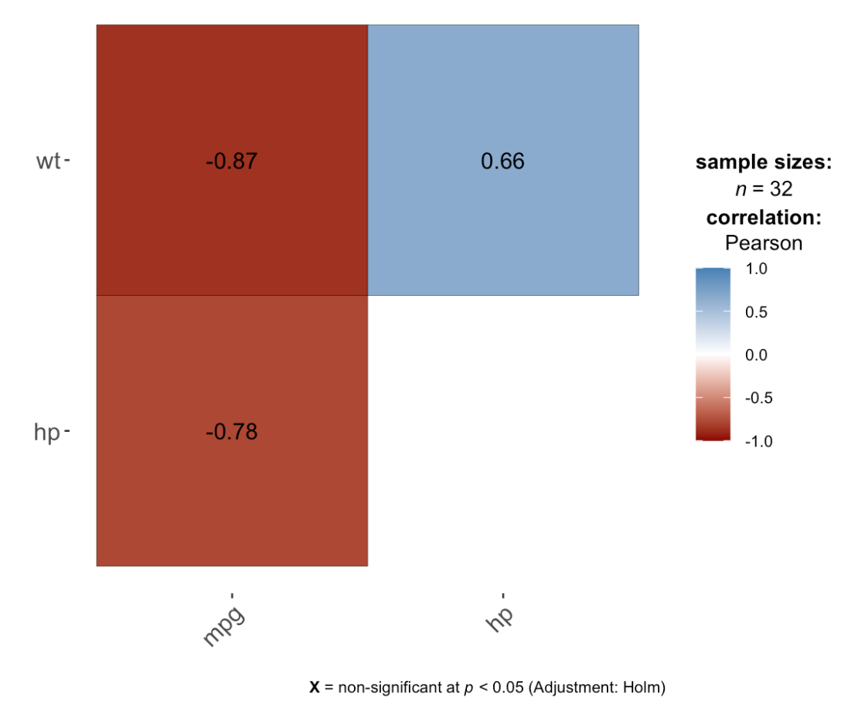
Correlation Matrix
Hypothetical Example
Notes:
https://statsandr.com/blog/correlation-coefficient-and-correlation-test-in-r/

Slide 8
Confusion Matrix
NN True Negative | NF False Positive
FN False Negative | FF True Positive

Slide 9
Challenges
Enormous Data Processing
01
Rapid model response required for daily data influx
Imbalanced Data
02
99.8% transactions non-fraudulent
Data Availability and Privacy
03
Handling private data securely
Misclassified Data
04
Not catching all fraud cases

Slide 10
Possible Solutions
Enormous Data Processing
01
Optimize for speed, explore parallel processing
Imbalanced Data
02
Resampling, use metrics for imbalanced data
Data Availability and Privacy
03
Anonymize data, comply with privacy laws
Misclassified Data
04
Continuous model updates, feedback loops

Slide 11

THANK YOU!
Ayon Kumar Das
Myesha Mahazabeen
Najia Jahan
adas010@citymail.cuny.edu
mmahaza000@citymail.cuny.edu
njahan010@citymail.cuny.edu

