Slide 1
Predictive Analytics and Machine Learning in R -a day in the life of a Data Scientist
Myfanwy Hopkins
Data Scientist
Intel

Slide 2

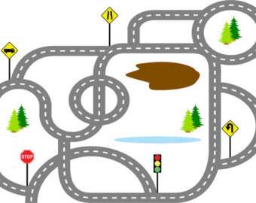
Data science and predictive models: Not a one way street
We want it to be this:
But in reality looks more like this:
Notes:
With Dead ends, wrong turns, and so many circular loops it may just drive you insane.
In short: nobody said this was easy, but no one ever says why it is so hard

Slide 3
What makes Data Science so hard? - hint: its not the programing
Preparing for this talk- What data to use?
Can’t use Intel data- that’s confidential
Can’t download data I want on company bankruptcy, Zip file is incomplete…
Get some data, looks good, but….
I want to show seamless model-building with a perfectly generated model on the first try…. I was stumped.
THIS IS DATA SCIENCE…
nobody said this was easy, but no one ever says WHY it is so hard

Slide 4
Plan
Descriptive statistics and predictive analytics (PA)
Supervised learning
Techniques for building a robust model
Example PA roadmap
R-markdown file, code, and Machine learning in practice

Slide 5
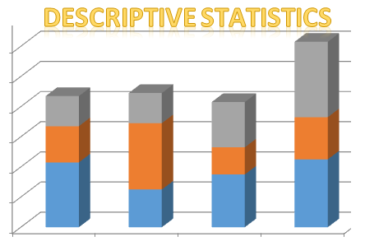
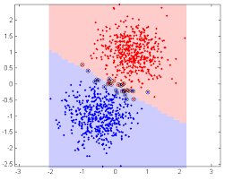
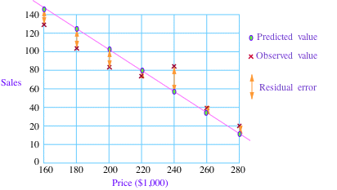
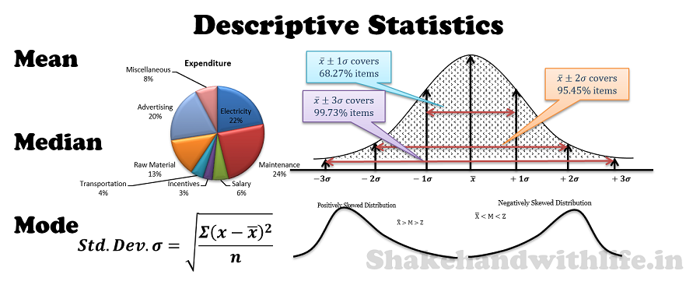
Descriptive statistics and Predictive statistics work hand in hand to bring greater business value
Notes:
Descriptive statistics, especially when done on big and complex data can yield great value. Predictive statistics is really built on the foundation and hand in hand with findings from descriptive analysis. Through iterations of modeling and really divining into the data, slicing and dicing different ways, we can uncover bigger and better and questions. It is never a one way street of analytic process or tools, or of information from analyst to user, but the back and forth flow of information that yields the greatest value.
Data alone will not build the right model. Must partner up to build these models.
So we don’t take the wrong turn.

Slide 6
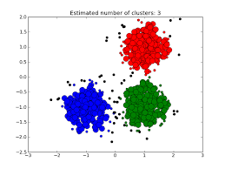
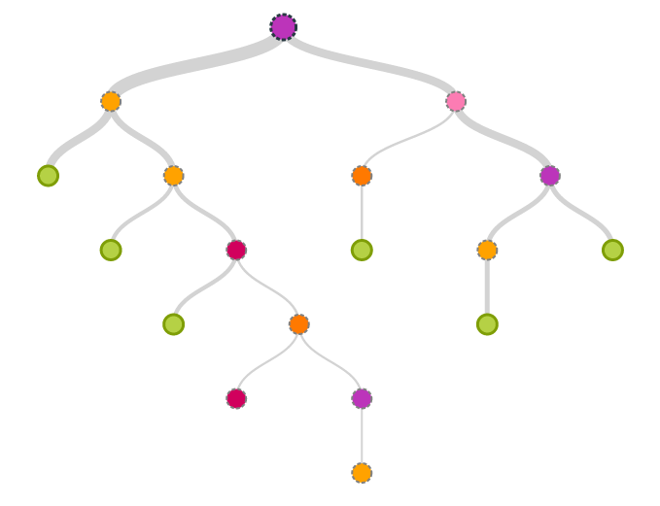
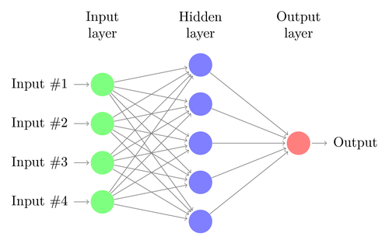
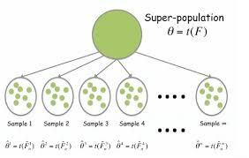
Predictive model examples
Support vector machine
Regression with residuals
K-means clustering
Decision Tree
Neural Nets
Bootstrapping modeling strategy
Notes:
Depending on the input data and the problem you are solving, different machine learning or predictive models are appropriate.
If you have continuous data, such as price in dollars and number of units sold, then a regression model works well for a continuous outcome, or you can classify the outcome, such as with a support vector machine. If you data is more categorical then things like a decision tree or clustering may work well.
How complex data of many types or when the data has complex relationships which are hard to define, a neural net may appropriate.
Bootstrapping is just one of a whole arsenal of methods to improve model performance, and to reduce over fitting or under fitting the model.

Slide 7
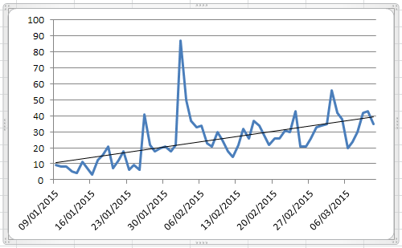
Supervised learning
X values “features” have a y “outcome” label which is known
Use known, or historical data to build a model that can predict the category or value of next observation
Probabilistic in nature, no outcome is 100%
Non-parametric
X₁ | X₂ | X₃ | Y (outcome)
A | Yellow | 70 | Red
B | Orange | 3 | Blue
A | Orange | 4 | Green
B | purple | 2 | ?
Parametric
Time 1 | Time 2 | Time 3 | Y (outcome)
1 | 2 | 3 | 4
3 | 4 | 5 | 6
8 | 9 | 10 | 11
5 | 6 | 7 | ?
Notes:
Probabilistic model, not deterministic, somewhat random.
Q1, Q2, Q3, what happened in Q4.
Or year 1, year2, year 3, what happened in year 4.
parametric vs. non parametric

Slide 8
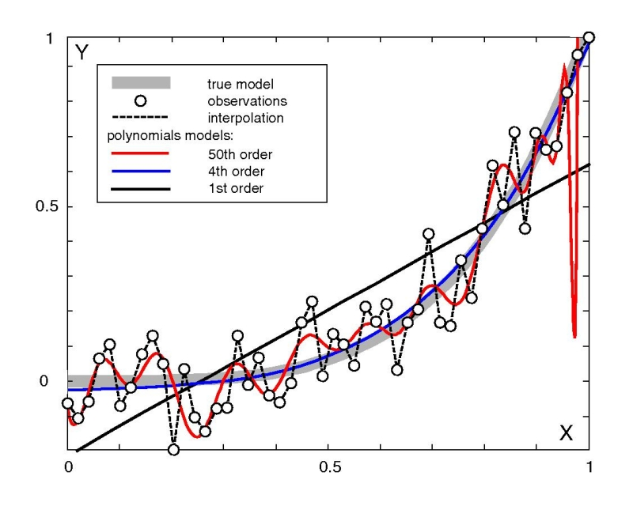
Bias/variance tradeoff, or Over-fitting and under-fitting
Bias - The “snow globe” effect
-Under- fit
Variance – the universe effect (or infinite possibilities)
-Over-fit
Over-fit
Best fit
Under-fit
Notes:
Bias is the idea that you always build your model in a “snow globe” you cant see the observations not included in the training data- leads to under fitting the model
Variance- too many stars in the sky. Touches on the idea that there are really an infinite number of models which can be build with any particular data training set. The goal is to reduce the variance, or possible number of models, while not increasing bias too much, essentially need a tradeoff of under fitting or over fitting so that the best model can be achieved for the new observations not seen by the model. This is why having a hold out dataset for testing is important. You can build a perfect model- but that’s not the point, the point is build the best model for new data.

Slide 9
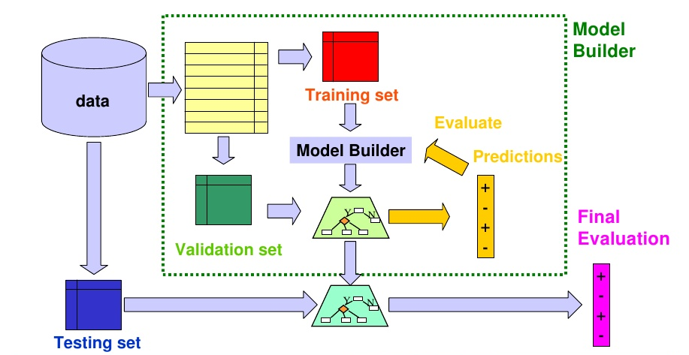
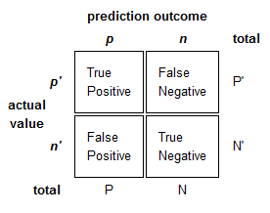
Predictive statistics training, cross validation and test data set: validation is integrated
70-80%
20-30%
Confusion Matrix
Or “hold-out” set. This dataset is purely used to report the results of the prediction made by the model. Answers the question: how would this model perform in real time?
Ref: http://www.slideshare.net/pierluca.lanzi/machine-learning-and-data-mining-14-evaluation-and-credibility
Notes:
Building model for two proposes, to explain the data and to predict future data.

Slide 10
Important questions when building a predictive machine learning model
Which input variables or “Features” do we include in our model-building training dataset?
How do we define the outcome, if not explicitly defined in the dataset?
How do the features correlate with the outcome?
How do the features correlate with each other? If some “autocorrelate” i.e. are redundant, can they be removed?
How can we combine the features together, or permutate them (square, add together, multiply, etc.) to get better predictive value of the outcome? (Feature Engineering)
Notes:
combined concept- interpretability – why did something happen?
Correlation vs. causality

Slide 11
Roadmap example
Stage | Description | Problems/questions | Progress
Build dataset step 1. Get data | Define data to be included, access all data and link/merge data into one cohesive dataset | Make sure merging does not create duplicates Make sure entities are uniquely identified Define granularity of data
Build dataset step 2. Select Features | Define variables to include What looks promising? Which ones should be engineered? | Communicate often with subject matter experts to define first pass inclusion and exclusion, get definitions, etc.
Build dataset step 3. Link data over time | Pull historical datasets into one master dataset | Almost all data has some sort of time component. Historical data can be used to build a predictive model
Build dataset step 4. Classify outcome | Find/define outcome | If outcome is not explicitly defined, may need to define it with subject matter experts
Build dataset step 5. Feature Engineering | Engineer features and test possible correlations with outcome and each other | Be creative, test, play, experiment…
Build Model step 1,2,and 3. Train, Test and Iterate model | Random Forest or GBM is very good with highly categorical data | This is the easy part, but needs to be done over and over… ensemble models help improve accuracy
Implement and show value | Sell your work, sell your model, make sure everyone understand how you got there… | Align that we are working on the right problem (repeat)

