Slide 1
HOUSING_PRICE_PREDICTION FlipRobo Technologies
D.MARY SHEREESHA

Slide 2
Problem Statement
Understand the parameters which influence the housing price in a new market, which the company has not played its role still
What to understand how these features would influence the pricing, how to manage the investment for good ROI.
If a machine Learning model can predict on what actual price the property will be sold by Local people, The company can buy the property, based on its margin and expected ROI(Return on investment)margins.

Slide 3
Exploratory Data Analysis
I would Studied
Step 1)How the data is in the Dataset- Individually, Its distribution, The people preference for that feature by count plots and distribution plots
Step 2)How the data features is related to Sale Price , strips plots and Scatter plots

Slide 4
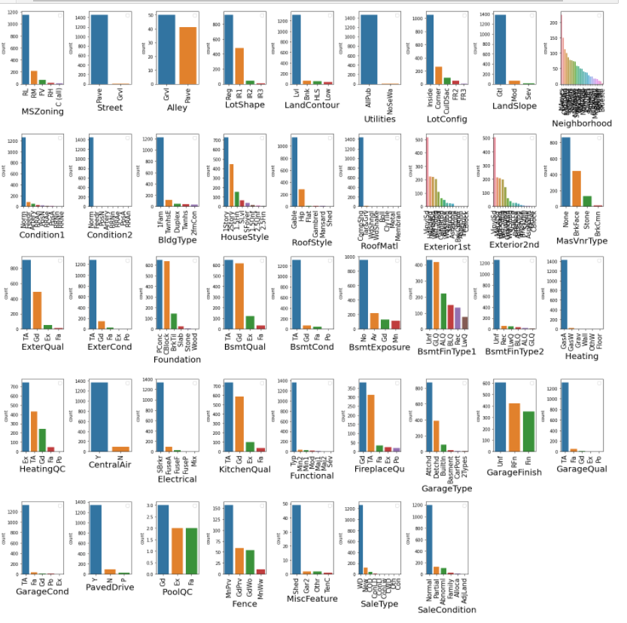
Step 1
Understand Sale/People Preferences
Categorical data

Slide 5
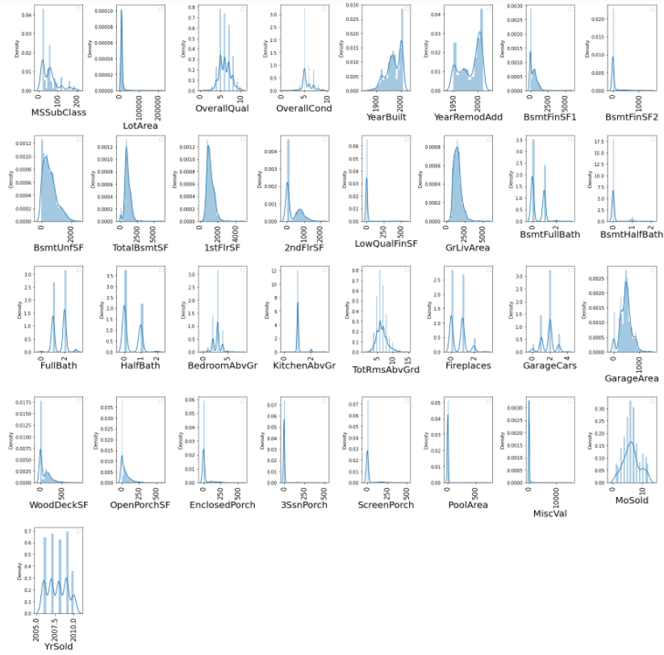
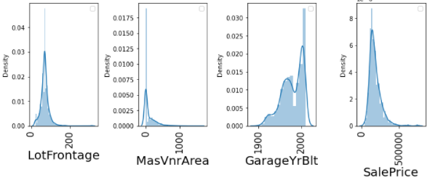
Step 1
Understand Sale/People Preferences
Numeric Data

Slide 6
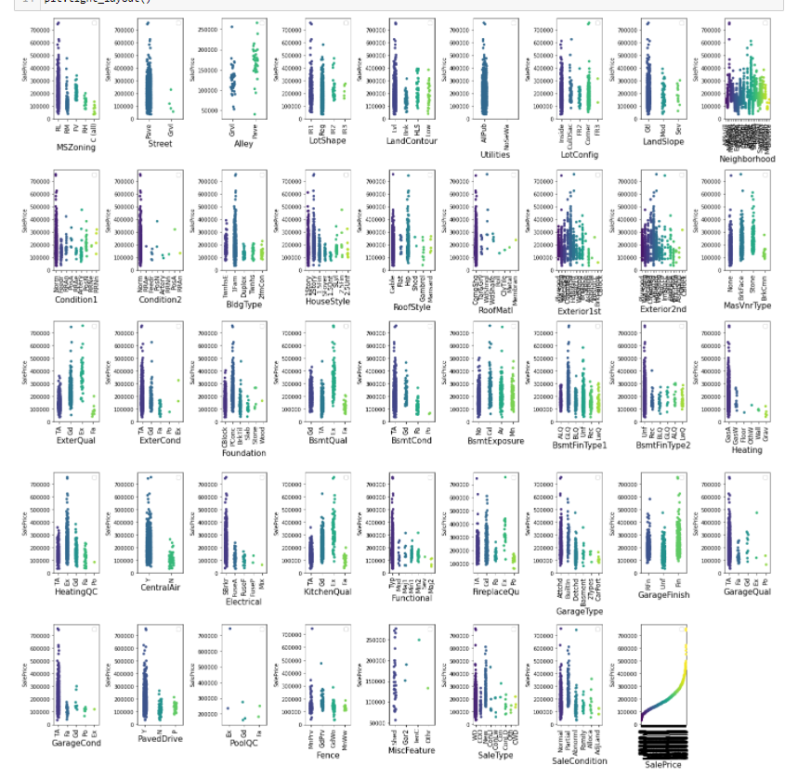
Step 2
Understand feature Vs Sale Price
Categorical data

Slide 7
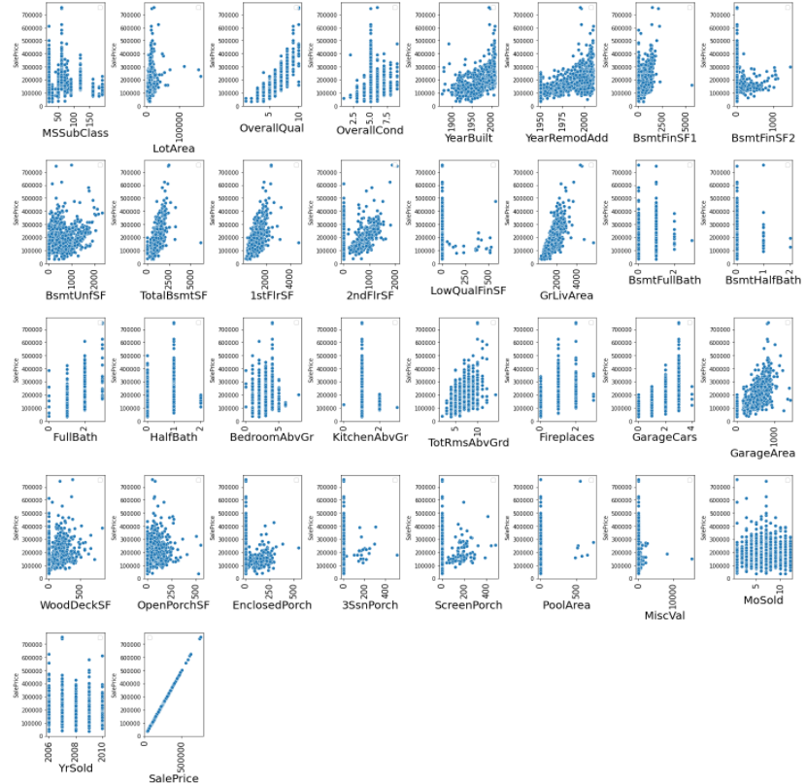
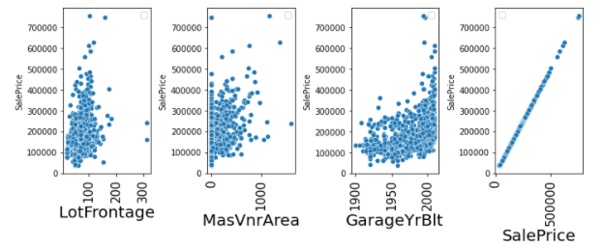
Step 2
Understand feature Vs Sale Price
Numeric data

Slide 8
## The features which add sales Price significantly are-make the sale Price High- Can Invest on these properties having these features
Residential Low Density
Paved Street
All public Utilities (E,G,W,& S)
having all Normal Conditions
Single-family Detached- have high Sales
Gable, Hip, Roofs have high price
Fair Basement (70-79 inches), Average garage Quality- start high sales price
SBrkr-Standard Circuit Breakers & Romex Electricity is expected to have high sales
Overall quality- attracts more price
Floor square feet- positively influence the price
Average Overall condition show more price
New Houses have slightly more price
Average basement set is expected more
TotRmsAbvGrd: Total rooms above grade-Good Grade is expected to give more price
GrLivArea: Above grade (ground) living area square feet- Give more price
Size of garage in car capacity- higher the better
CONCLUSIONS

Slide 9
## The features which do not have sale impact- Can inore these faetures when investing
alley
Neighborhood
LotConfig
Exterior1st: Exterior covering on house, Exterior covering on house (if more than one material)
MasVnrType
BsmtExposure: Refers to walkout or garden level walls
GarageFinish: Interior finish of the garage
SaleType: Type of sale
SaleCondition: Condition of sale
Month Sold
Yr sold
OpenPorchSF area
EnclosedPorch area
Wood deck area do not influence the price
Total rooms above grade
CONCLUSIONS

Slide 10
IMPUTING and ENCODING
Step 1) Encoded the Numeric value with Mean-Simple Imputer from SkLearn
Step 2)Encoded the categorical value
a)Nominal Data- One Hot Encoder-Making Dummies features
b)Ordinal Data- by Ordinal Encoder from SkLearn

Slide 11
PRINCIPLE COMPONENT ANALYSIS
Dimension reduction technique
PCA is applied for dimensionality reduction to improve classification/regression accuracy by selecting the optimal set of lower dimensionality features.
Typical Applications of PCA
Data Visualization.
Data Compression.
Noise Reduction.
Data Classification.
Image Compression.
Face Recognition.

Slide 12
RANDOM FOREST REGRESSOR
MACHINE LEARNING ALGORITHM
I used multiple MACHINE LEARNING ALGORITHMS TO PREDICT THE PRICE OF HOUSE, which is a regression problem
THE BEST MODEL WHICH SHOWED BEST ACCURARCY WAS RANDOM FOREST
Random Forest grows multiple decision trees which are merged for a more accurate prediction.
The logic behind the Random Forest model is that multiple uncorrelated models (the individual decision trees) perform much better as a group than they do alone. When using Random Forest for classification, each tree gives a classification or a “vote.” The forest chooses the classification with the majority of the “votes.” When using Random Forest for regression, the forest picks the average of the outputs of all trees.
The key here lies in the fact that there is low (or no) correlation between the individual models—that is, between the decision trees that make up the larger Random Forest model. While individual decision trees may produce errors, most of the group will be correct, thus moving the overall outcome in the right direction.

Slide 13
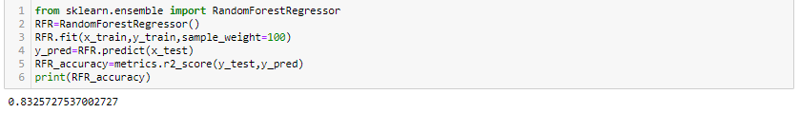
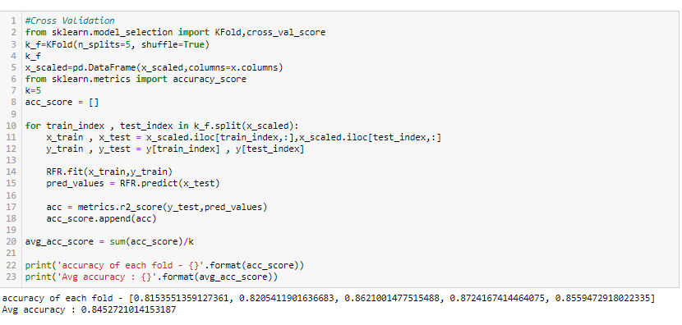
RANDOM FOREST PREDICTION RESULTS
MACHINE LEARNING ALGORITHM- CROSS VALIDATION ACCURACY

