Slide 1
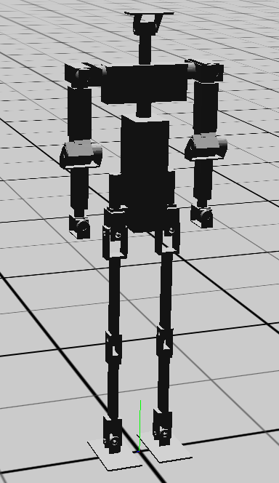
Transforms
head
neck
chest
(r/l)_shoulder_pitch_brkt
_shoulder_roll_brkt
_upper_arm
_lower_arm
_wrist
_hand
torso
_hip_yaw_brkt
_hip_roll_brkt
_thigh
_shin
_ankle_pitch_brkt
_foot

Slide 2
Servos
head_pitch
_shoulder_pitch
_shoulder_roll
_shoulder_yaw
(co-located)
head_yaw
waist_yaw
_elbow_pitch
_hip_yaw
_hip_roll
_hip_pitch
(co-located)
_wrist_yaw
_wrist_roll
_knee_pitch
_ankle_pitch
_ankle_roll

