Slide 1
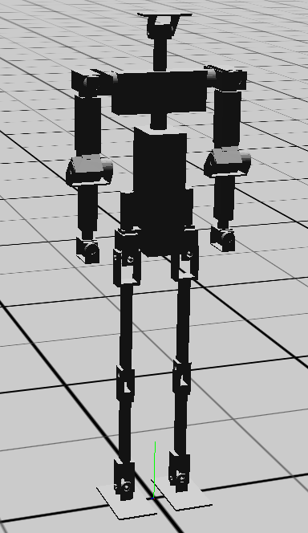
Transforms
head
neck
chest
(r/l)_shoulder_pitch_brkt
_shoulder_roll_brkt
_upper_arm
_lower_arm
_wrist
_hand
torso
_hip_yaw_brkt
_hip_roll_brkt
_thigh
_shin
_ankle_pitch_brkt
_foot

Slide 2
Servos
head_pitch
_shoulder_pitch
_shoulder_roll
_shoulder_yaw
(co-located)
head_yaw
waist_yaw
_elbow_pitch
_hip_yaw
_hip_roll
_hip_pitch
(co-located)
_wrist_yaw
_wrist_roll
_knee_pitch
_ankle_pitch
_ankle_roll

Slide 3
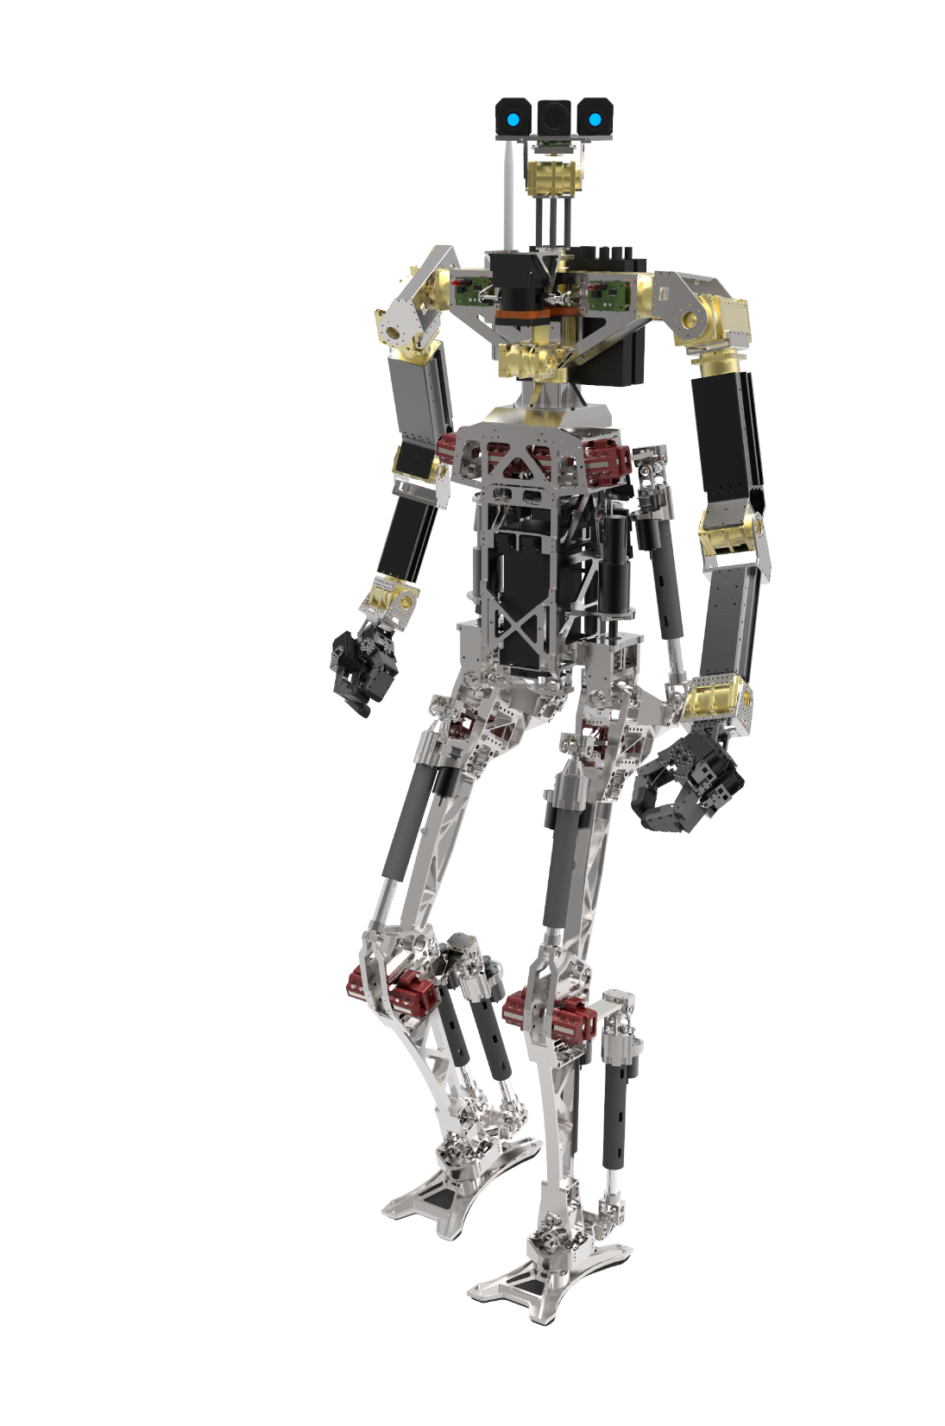
Body Link Definitions
Head
Neck
Chest
Arm
Torso
Forearm
Thigh
Hand
Foot
Shin

Slide 4
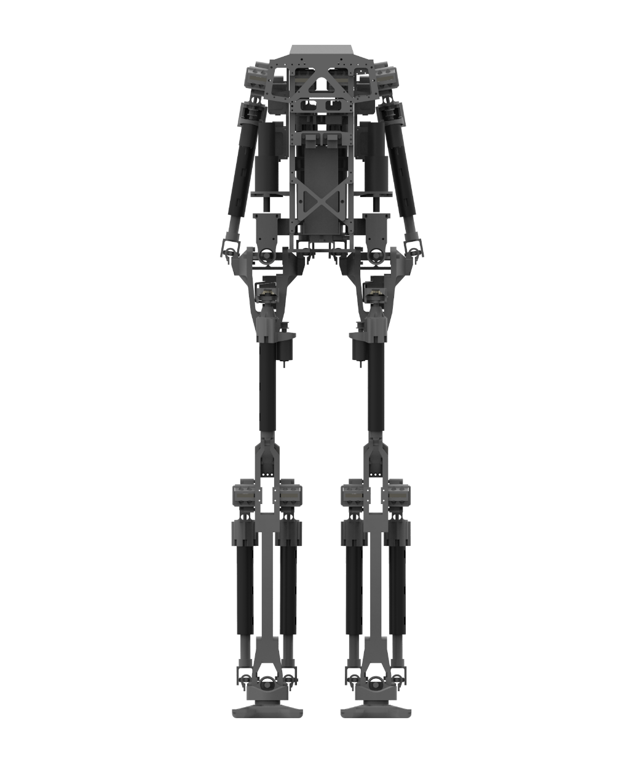
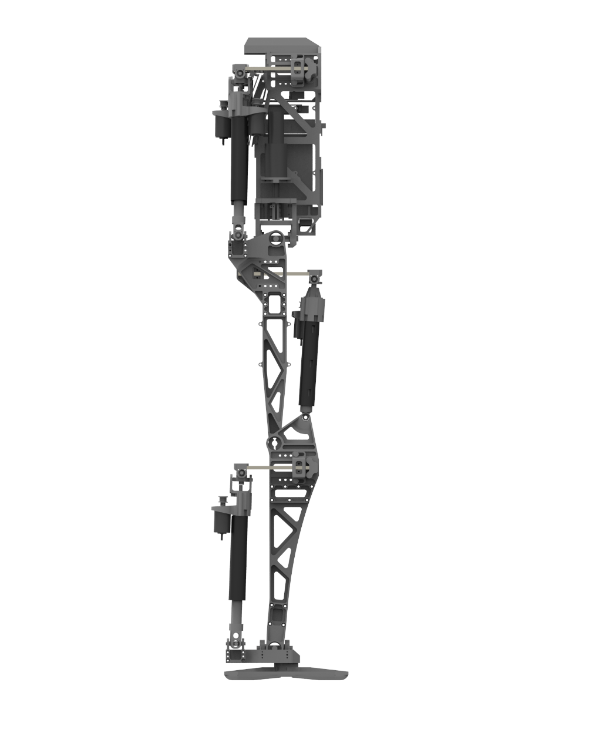
Lower Body
Joint Coordinate Definitions
waist_yaw
waist_pitch
(co-located)
hip_yaw
hip_roll
hip_pitch
(co-located)
knee_pitch
Z
Z
ankle_pitch
ankle_roll
(co-located)
X
Y
Symmetric joints will be differentiated by a “r_” or “l_” prefix for “right” and “left”

Slide 5
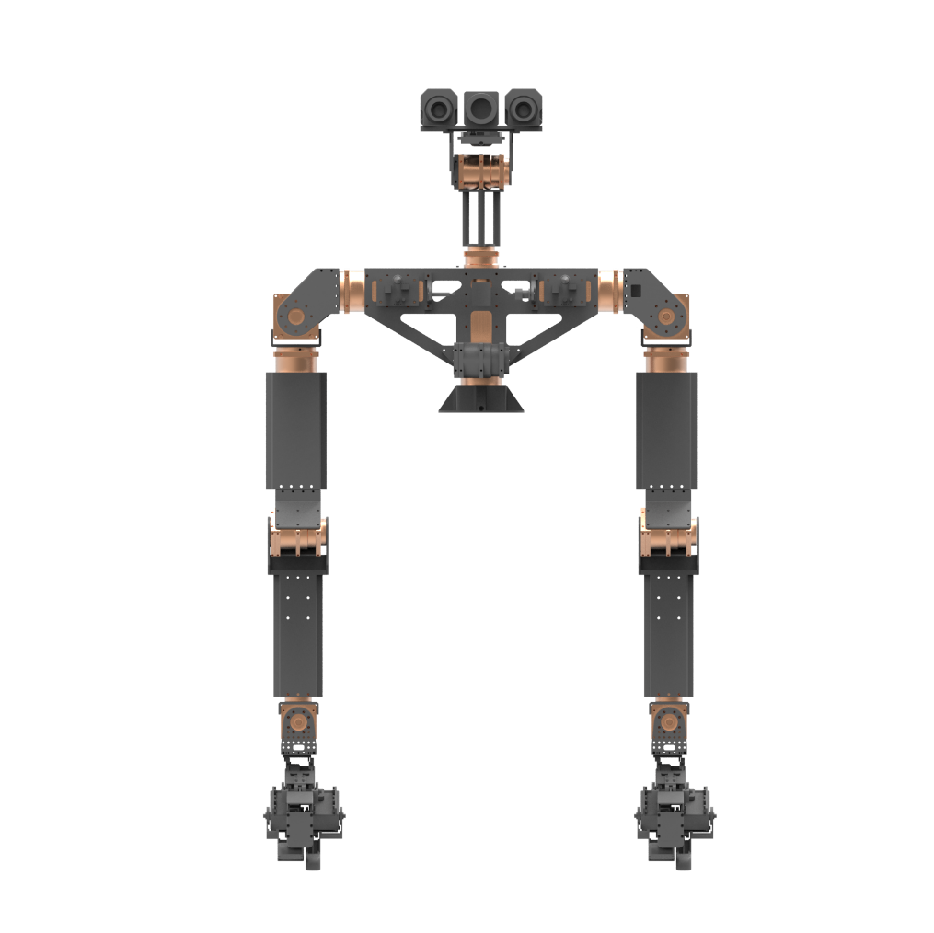
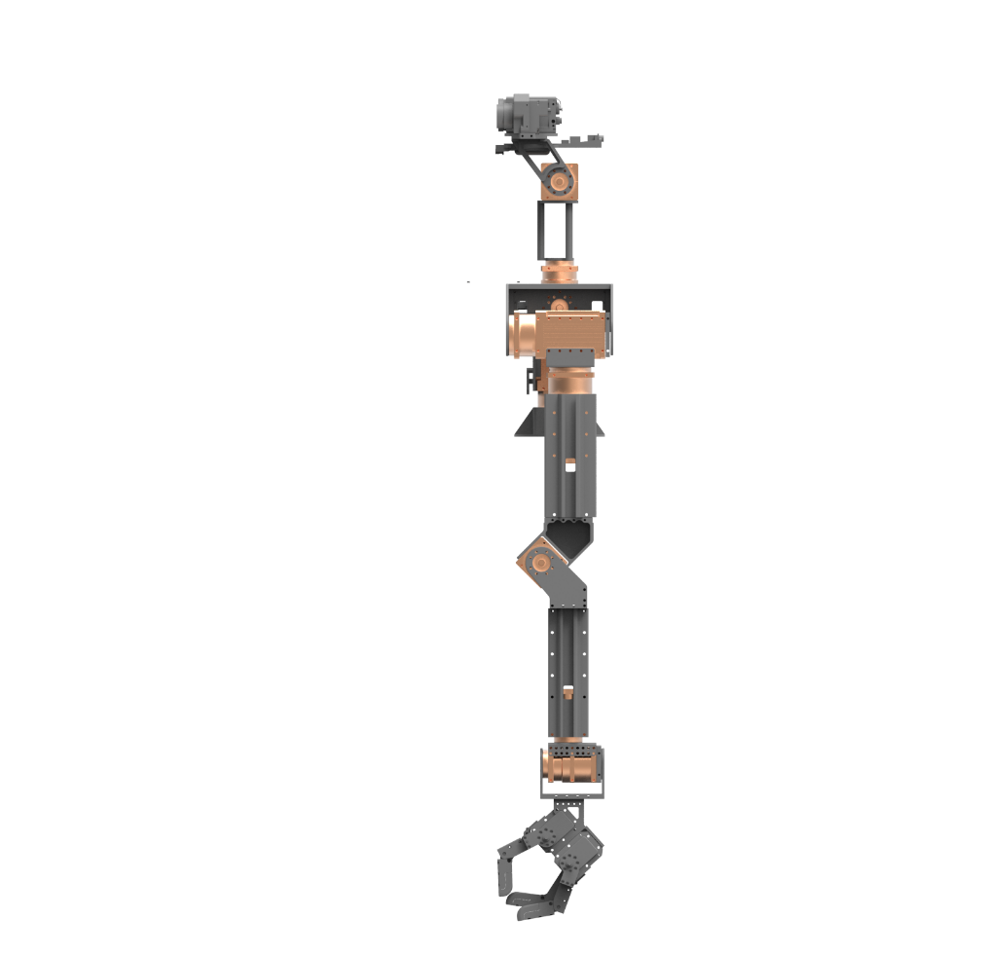
Upper Body
Joint Coordinate Definitions
head_pitch
head_yaw
(co-located)
shoulder_pitch
shoulder_roll
shoulder_yaw
(co-located)
elbow_pitch
wrist_yaw
wrist_roll
Z
Z
Y
X
Symmetric joints will be differentiated by a “r_” or “l_” prefix for “right” and “left”

Slide 6
Task Space Coordinate Definitions

