Slide 1
MALIGNANT COMMENTS CLASSIFICATION

Slide 2
1. Problem Definition:
The proliferation of social media enables people to express their opinions widely online. However, at the same time, this has resulted in the emergence of conflict and hate, making online environments uninviting for users. Although researchers have found that hate is a problem across multiple platforms, there is a lack of models for online hate detection.
Online hate, described as abusive language, aggression, cyberbullying, hatefulness and many others has been identified as a major threat on online social media platforms. Social media platforms are the most prominent grounds for such toxic behaviour.
There has been a remarkable increase in the cases of cyberbullying and trolls on various social media platforms. Many celebrities and influences are facing backlashes from people and have to come across hateful and offensive comments. This can take a toll on anyone and affect them mentally leading to depression, mental illness, self-hatred and suicidal thoughts.
Internet comments are bastions of hatred and vitriol. While online anonymity has provided a new outlet for aggression and hate speech, machine learning can be used to fight it. The problem we sought to solve was the tagging of internet comments that are aggressive towards other users. This means that insults to third parties such as celebrities will be tagged as unoffensive, but “u are an idiot” is clearly offensive.
Our goal is to build a prototype of online hate and abuse comment classifier which can used to classify hate and offensive comments so that it can be controlled and restricted from spreading hatred and cyberbullying

Slide 3
Data Set Description
The data set contains the training set, which has approximately 1,59,000 samples and the test set which contains nearly 1,53,000 samples. All the data samples contain 8 fields which includes ‘Id’, ‘Comments’, ‘Malignant’, ‘Highly malignant’, ‘Rude’, ‘Threat’, ‘Abuse’ and ‘Loathe’.
The label can be either 0 or 1, where 0 denotes a NO while 1 denotes a YES. There are various comments which have multiple labels. The first attribute is a unique ID associated with each comment.
The data set includes:
Malignant: It is the Label column, which includes values 0 and 1, denoting if the comment is malignant or not.
Highly Malignant: It denotes comments that are highly malignant and hurtful.
Rude: It denotes comments that are very rude and offensive.
Threat: It contains indication of the comments that are giving any threat to someone.
Abuse: It is for comments that are abusive in nature.
Loathe: It describes the comments which are hateful and loathing in nature.
ID: It includes unique Ids associated with each comment text given.
Comment text: This column contains the comments extracted from various social media platforms.

Slide 4
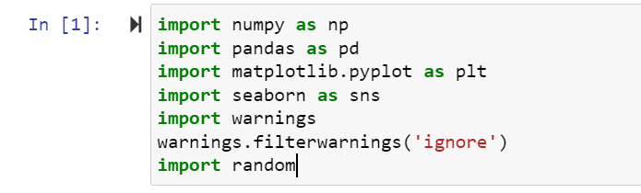
Dataset:
Here there are two dataset was present train dataset and test dataset

Slide 5
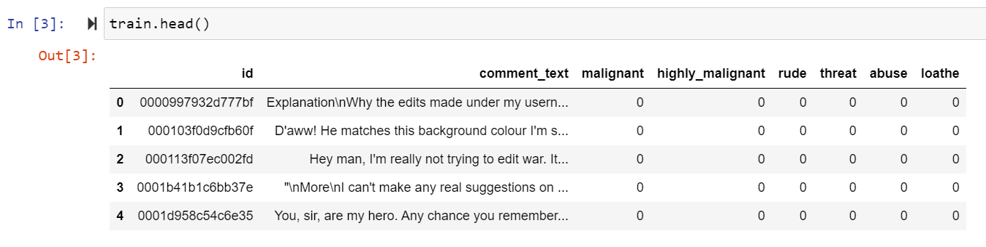
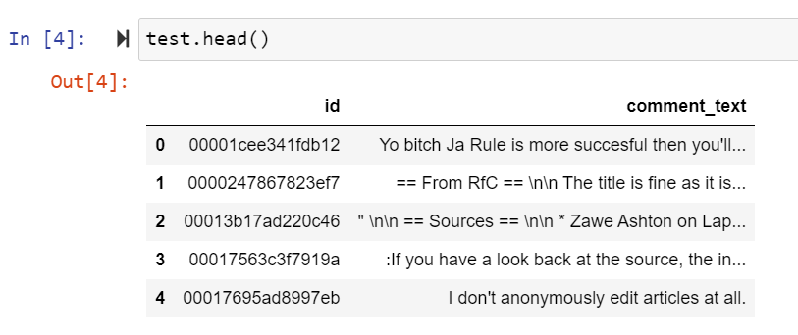

Slide 6
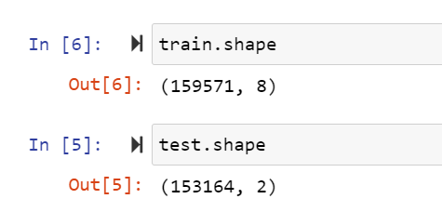
2. Data Analysis:
Check the how much columns and rows present in dataset using df.shape() is use to check the rows and columns count in this above dataset there are 159571 rows and 8 columns are present in train dataset and 153164 rows and 2 columns are present in test dataset.

Slide 7
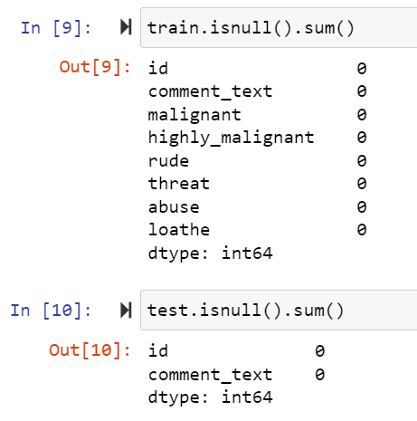
Check the null values present in dataset or not:
Check the how much missing values present in dataset using df.isnull() is use to check the missing values in dataset in this train dataset there was no missing values are present in train and test dataset.

Slide 8
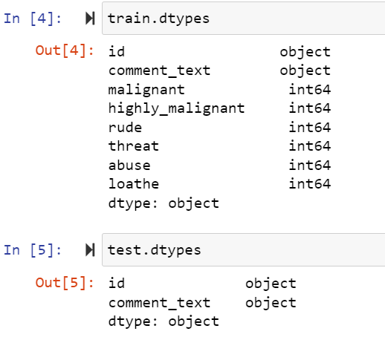
Here we check the datatypes of all the columns in dataset :
In above code df.dtypes is used to check the data types of all the column In above train and test dataset.

Slide 9
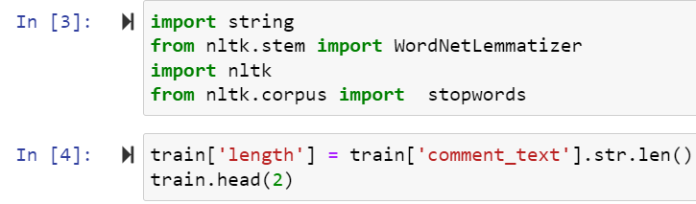
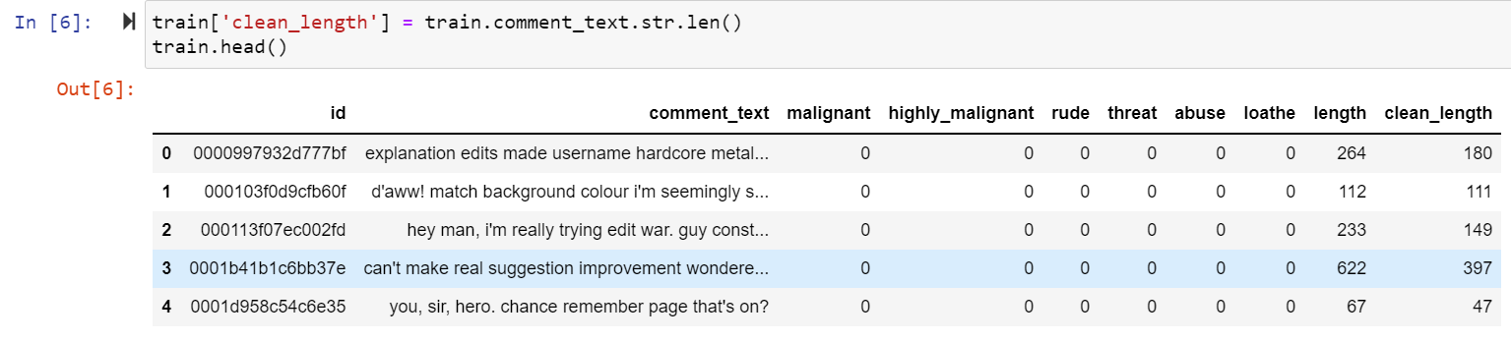
3.Data Preprocessing:

Slide 10
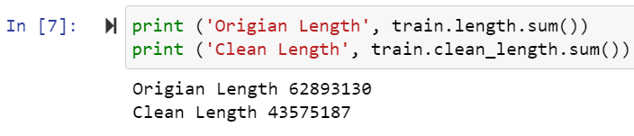
Above using Lemmatising clean the data. After clean data check original length and clean length.

Slide 11
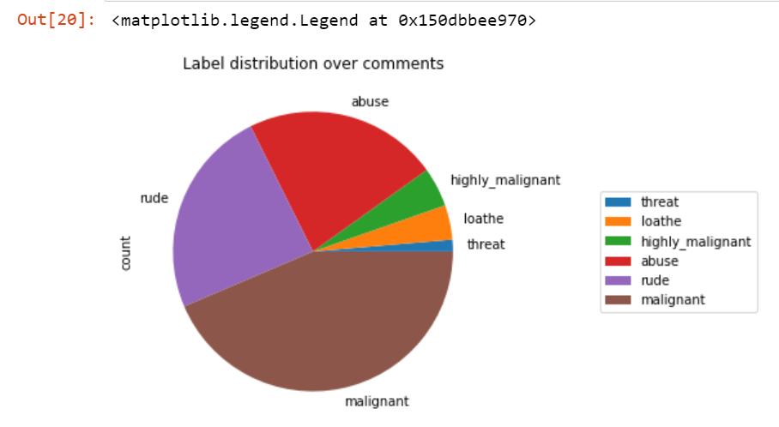
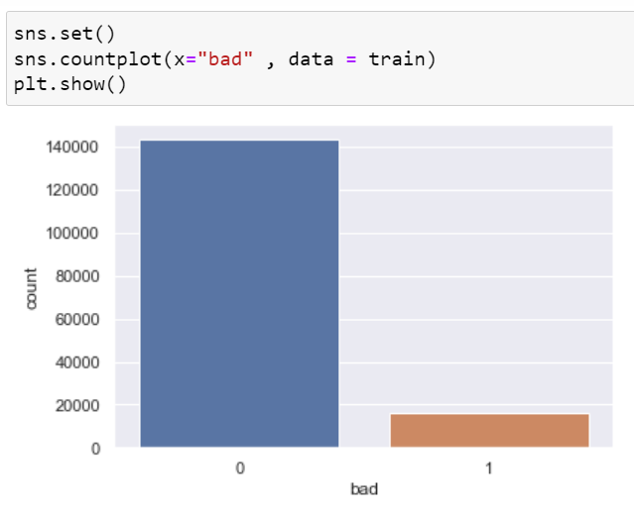
Above are the pie chart distribution of columns in train dataset.
Above are the count plot of bad column.

Slide 12
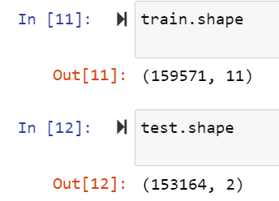
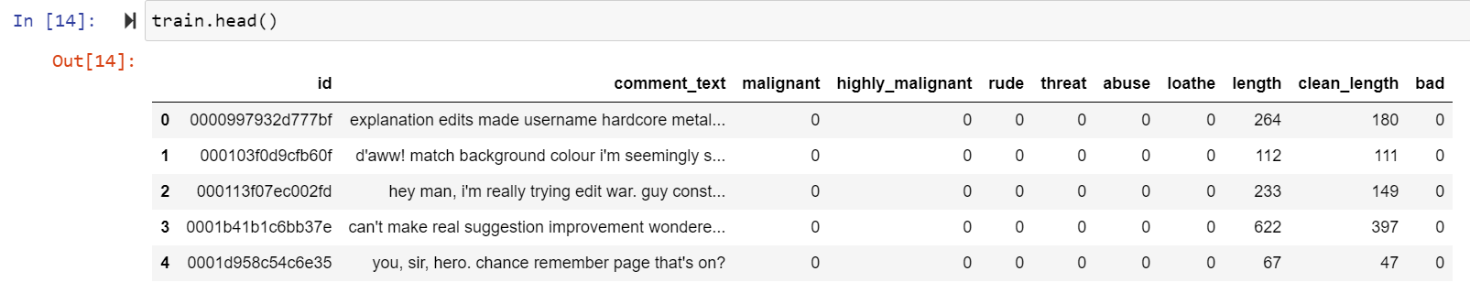
After the checking shape of train and test dataset.
After that checking train dataset.

Slide 13
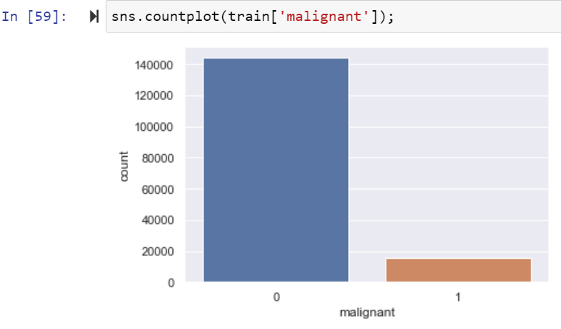
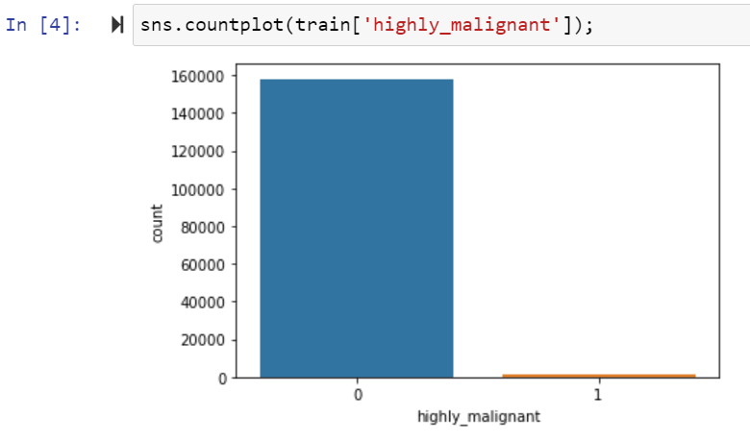
4. EDA:
Univarient Analysis of Train Dataset:
Univarient analysis of ‘malignant’, and ‘highly_malignant’ column in train dataset.

Slide 14
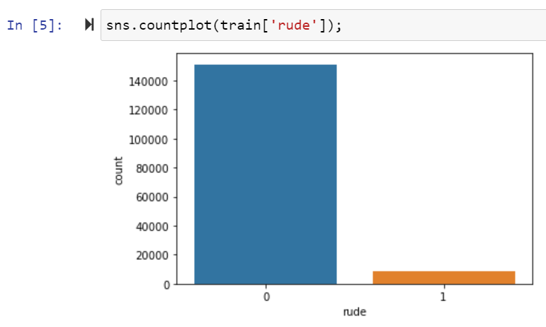
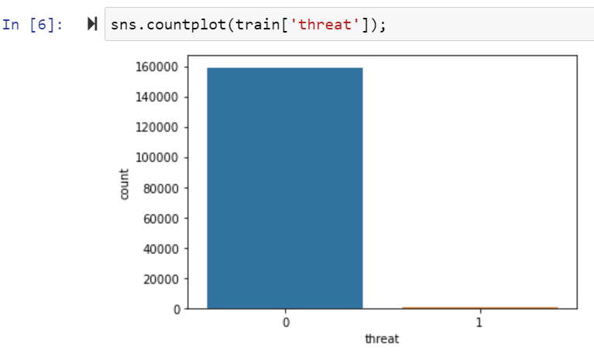
Univarient analysis of ‘rule’, ‘threat’ column in train dataset.

Slide 15
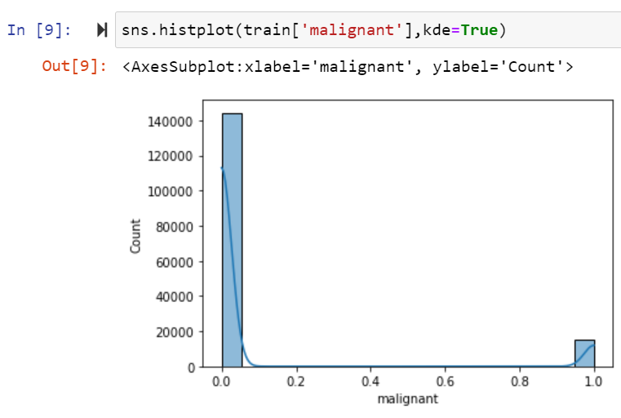
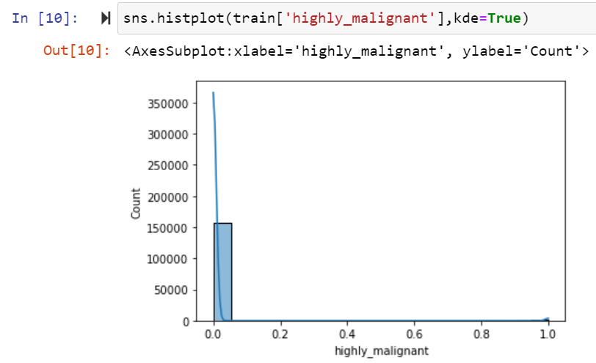
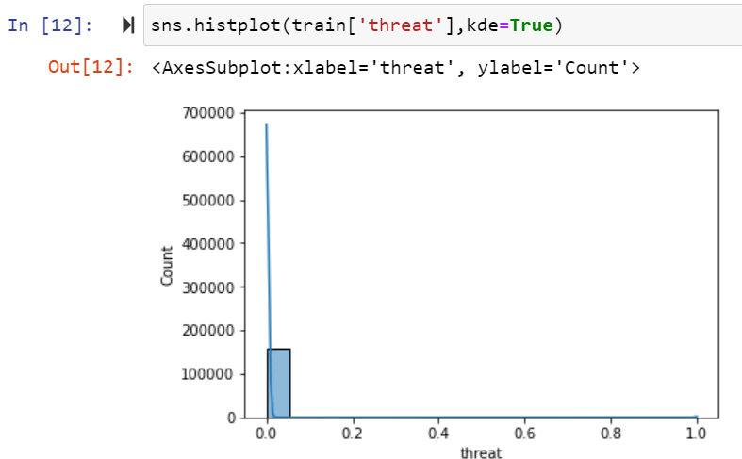
Checking Distribution of Train Dataset:

Slide 16
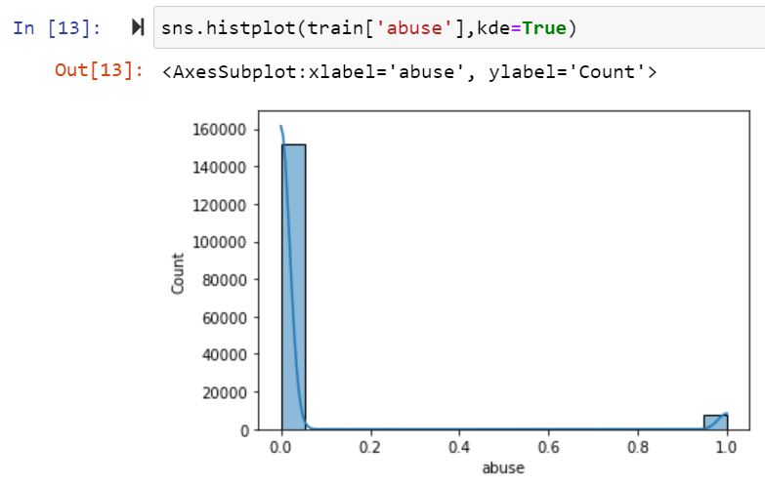
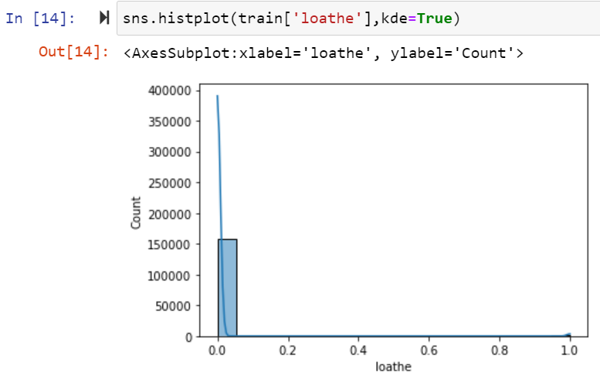
Here data columns are not normally distributed.

Slide 17
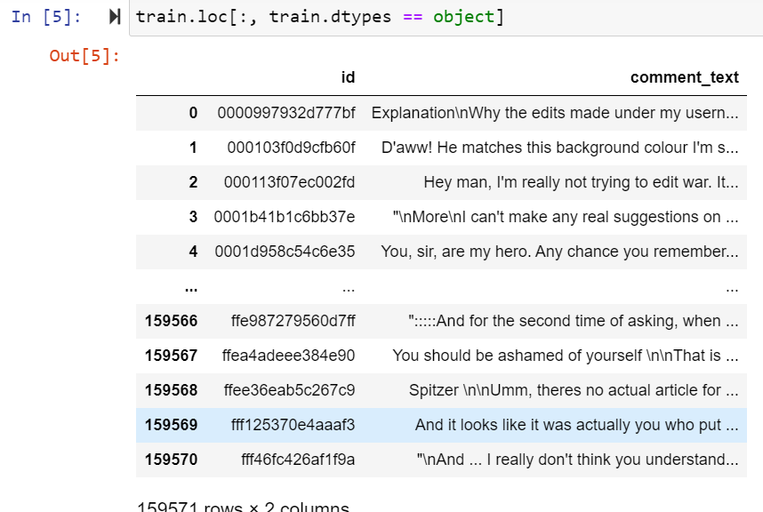
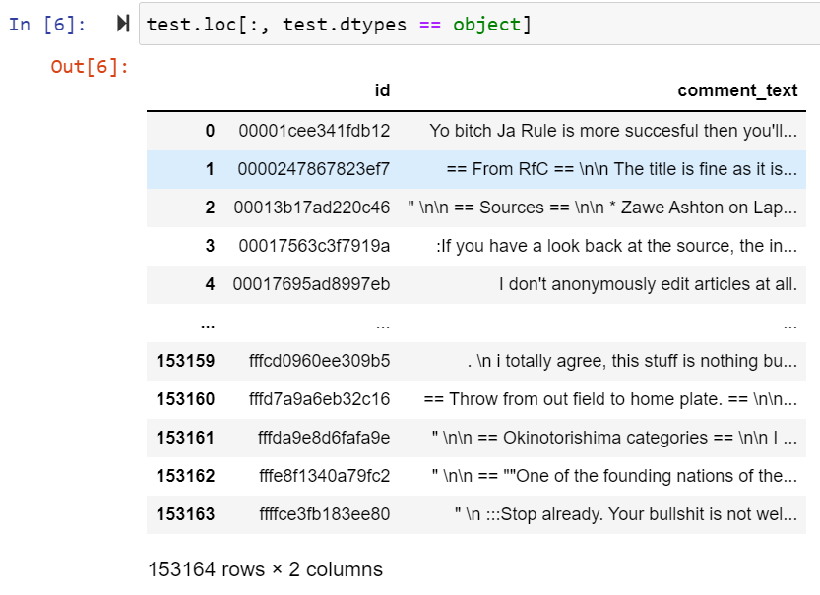
Here above are the object data types columns in train and test.

Slide 18
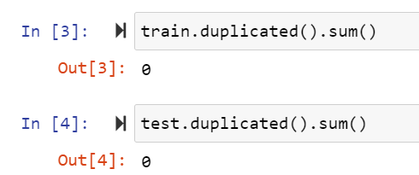
Here checking duplicate values in train and test dataset.

Slide 19
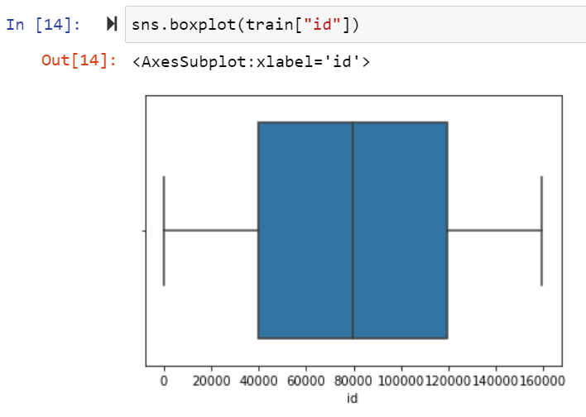
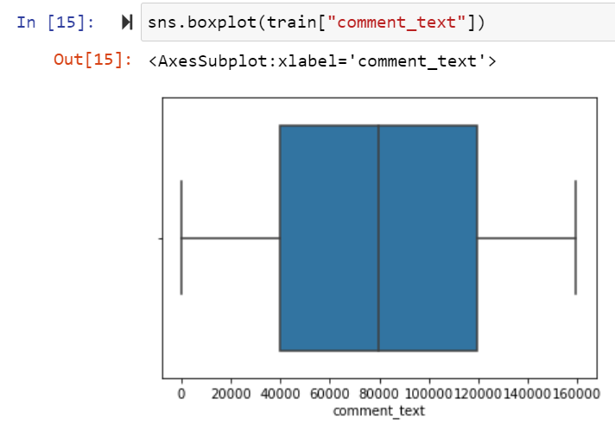
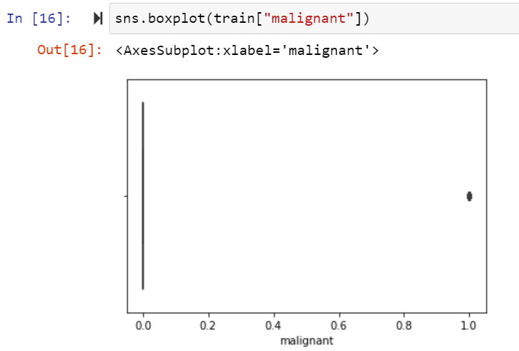
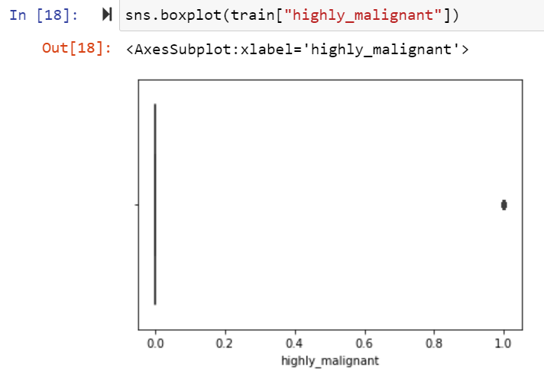
Checking Outliers of Train Dataset:

Slide 20
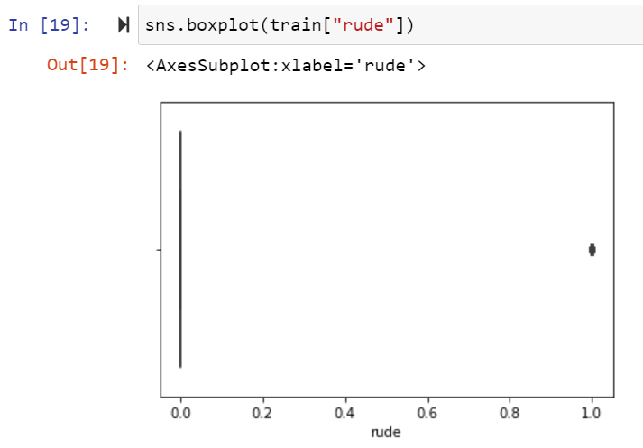
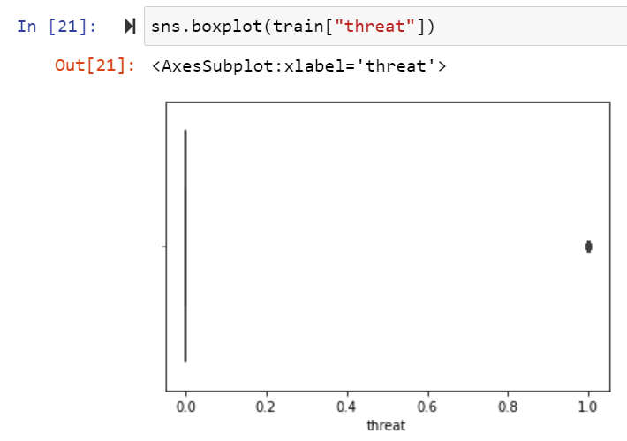
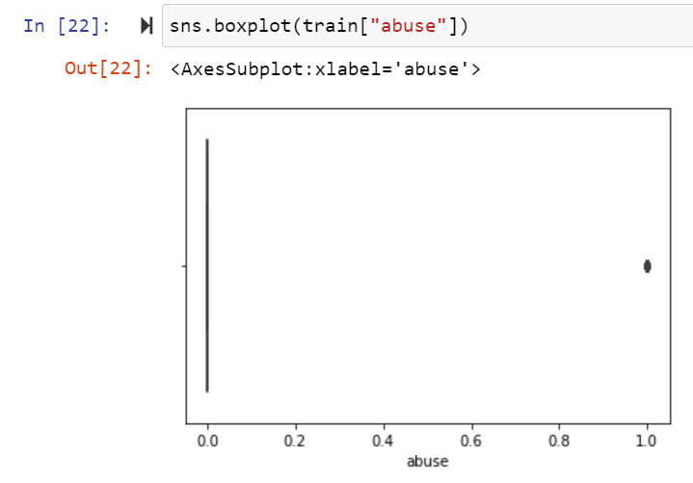
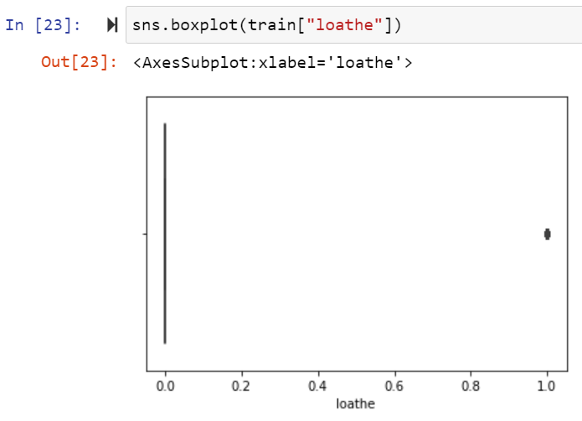

Slide 21
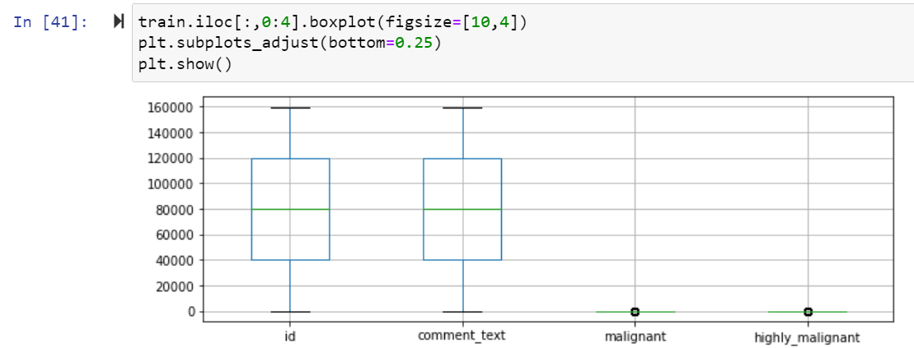
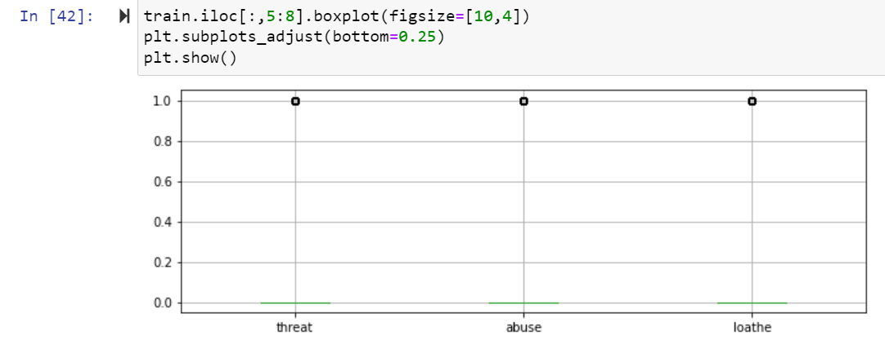
Here many Column outliers are present in Train dataset

Slide 22
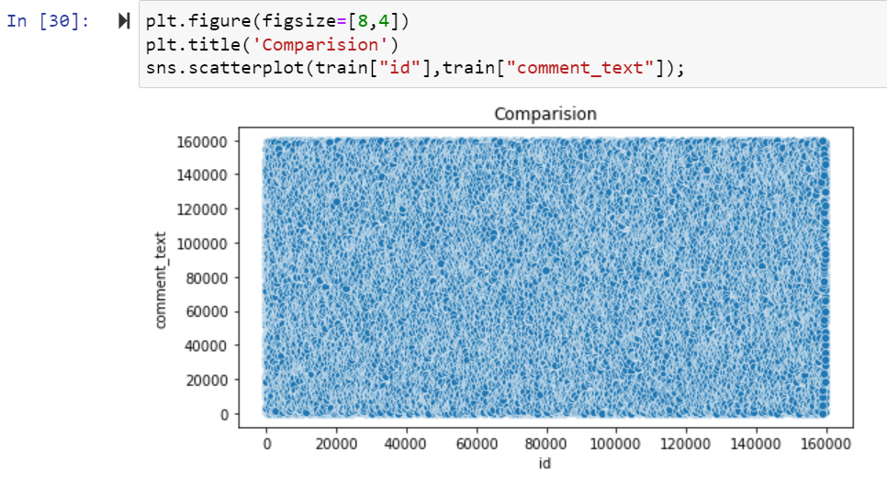
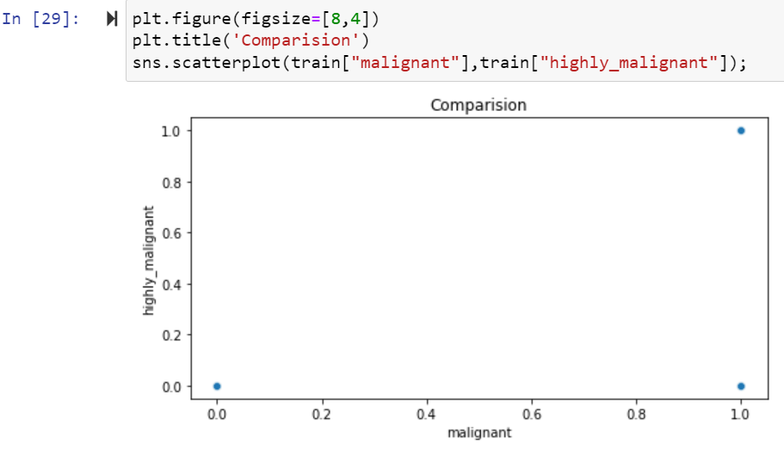
Bi varient Analysis of Train Dataset:
Scatter Plot

Slide 23
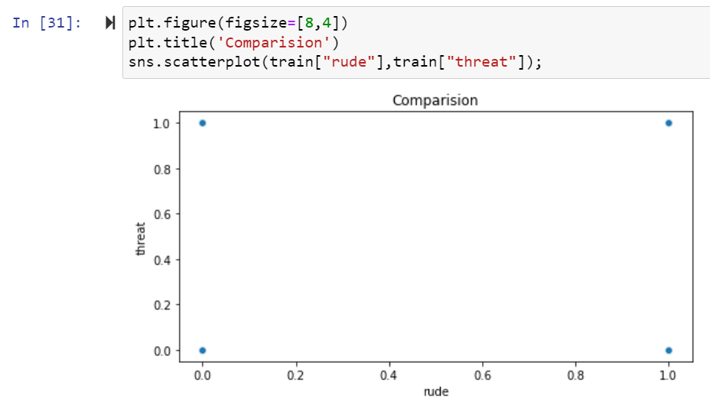
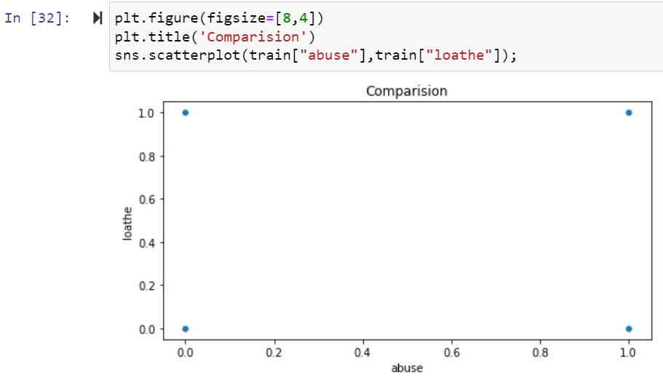

Slide 24
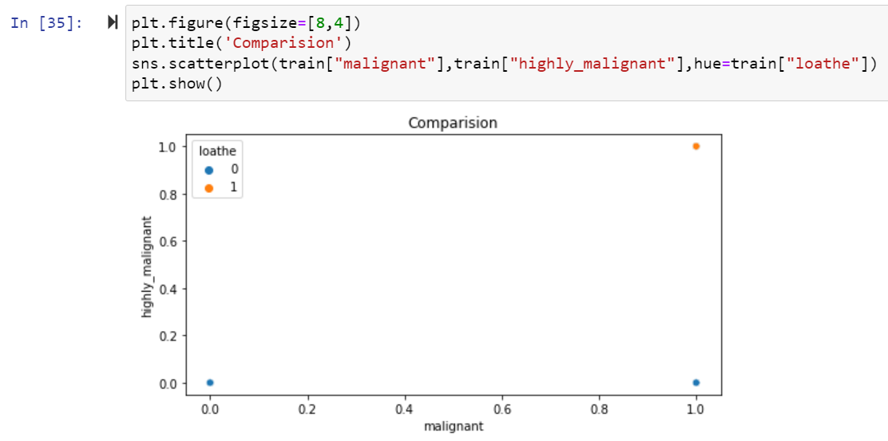
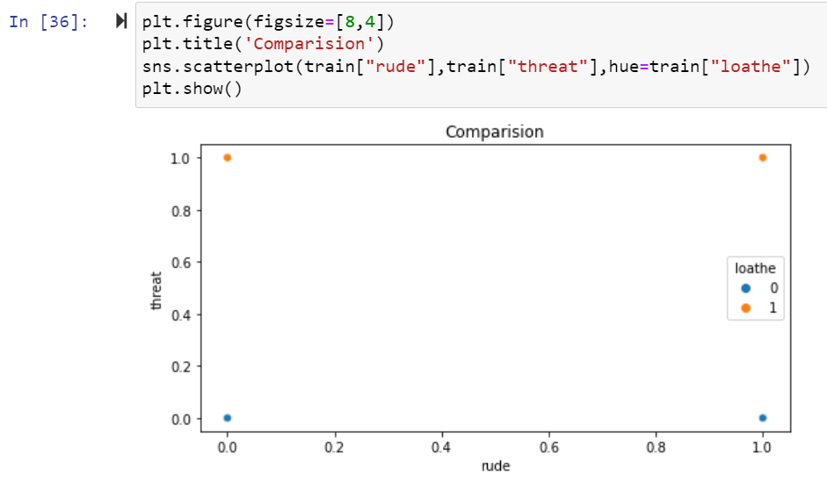

Slide 25
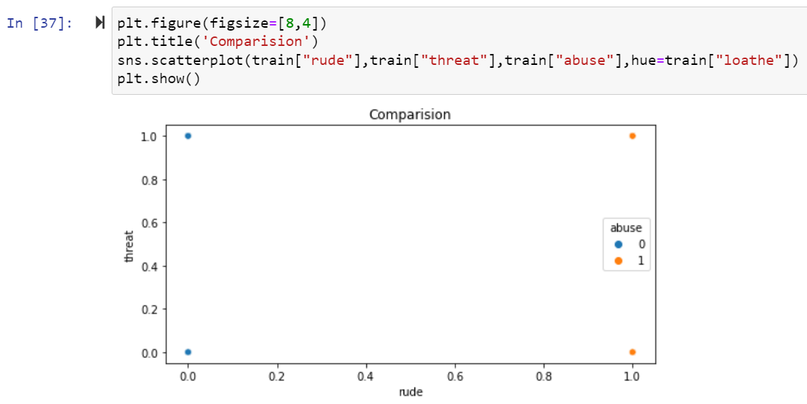
Here Above Scatterplot shows the comparison between columns in train Dataset.

Slide 26
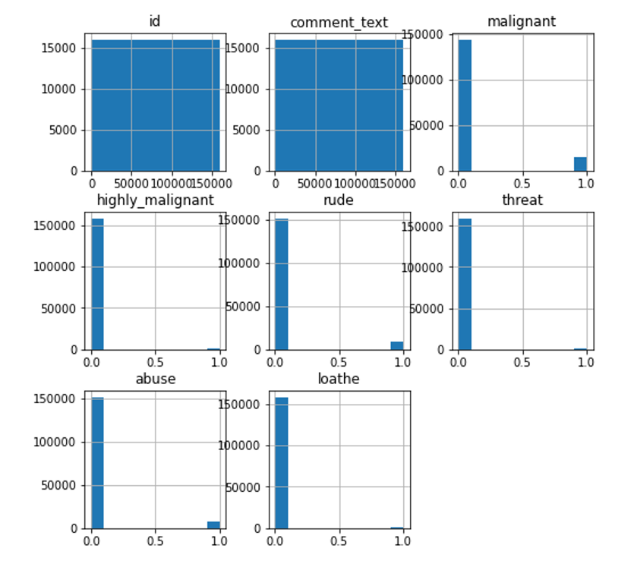
Multi Varient Analysis of Train Dataset:
HistPlot:
Above are the histplot of train dataset.

Slide 27
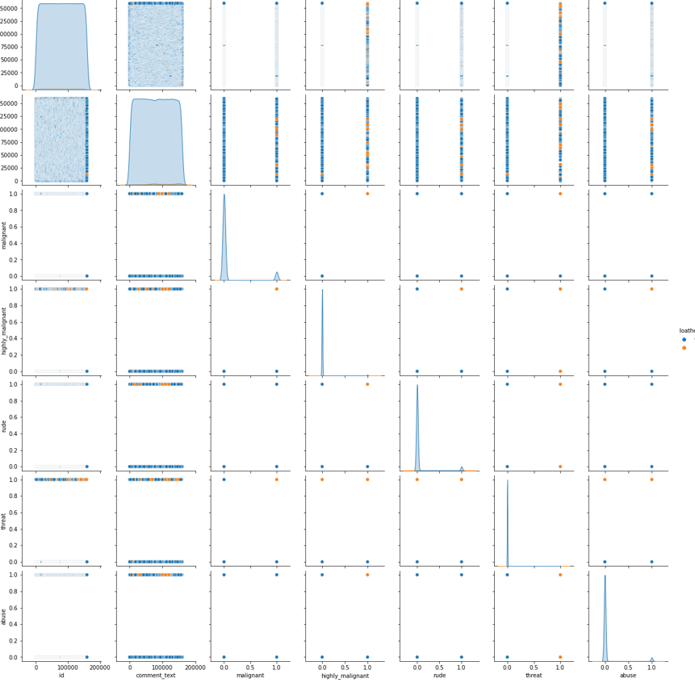
PairPlot of Train Dataset:
Above are the pairplot of train dataset.

Slide 28
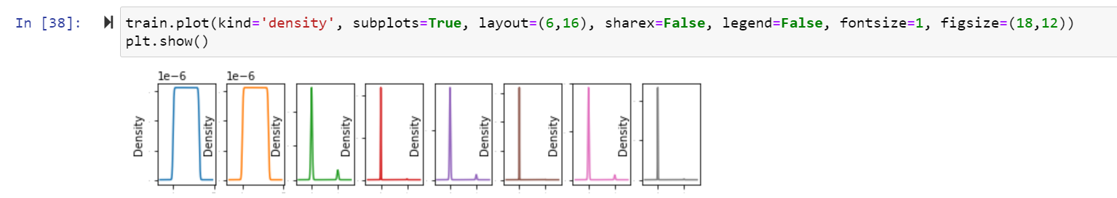
Here distribution of all columns in Train Dataset.

Slide 29
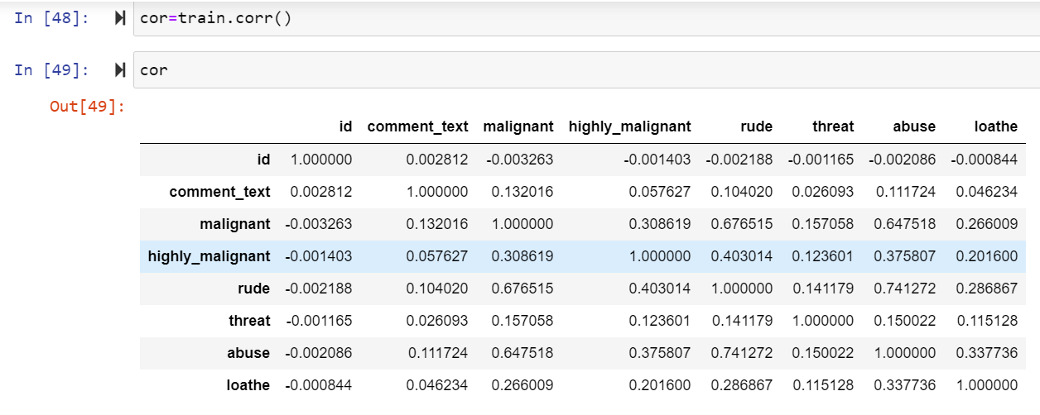
Correlation:
Heatmap of Train Dataset:
cor=df_tr.corr()
cor
After that Checking Correlation of all independent columns with Target column in train dataset.

Slide 30
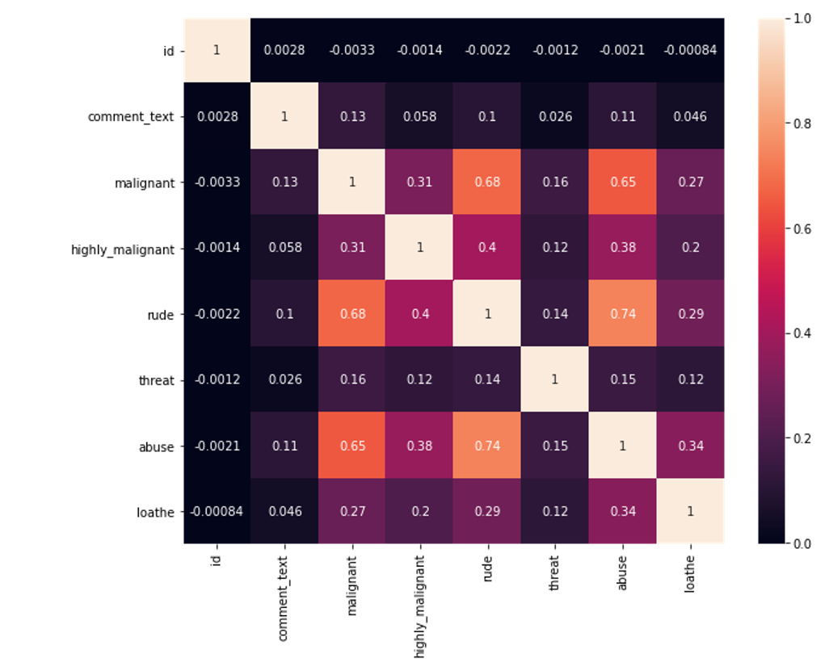
plt.figure(figsize=(15,10))
sns.heatmap(df_tr.corr(),annot=True)
Heat map shows the correlation of every independent variable in dataset with target variable. Here above heatmap the every independent variable check correlation with target variable.

Slide 31
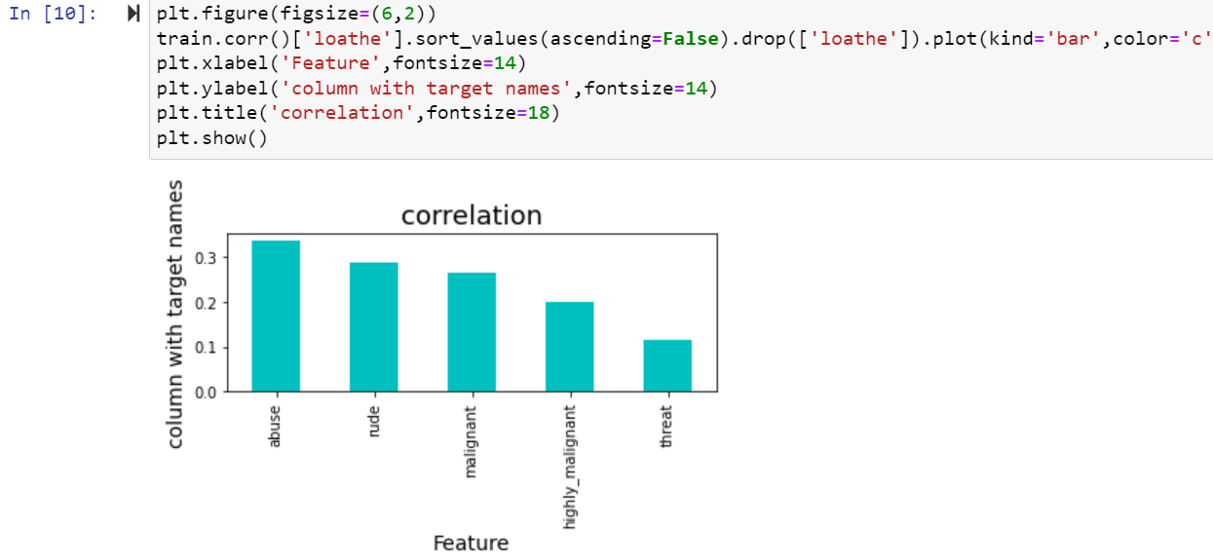
Here we shows the correlation in another way in this above we show all columns are positively correlated with target variable

Slide 32
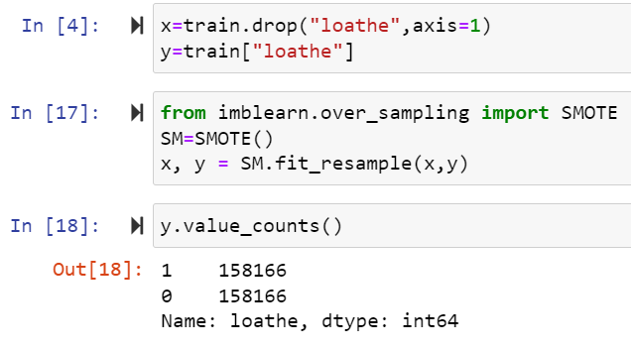
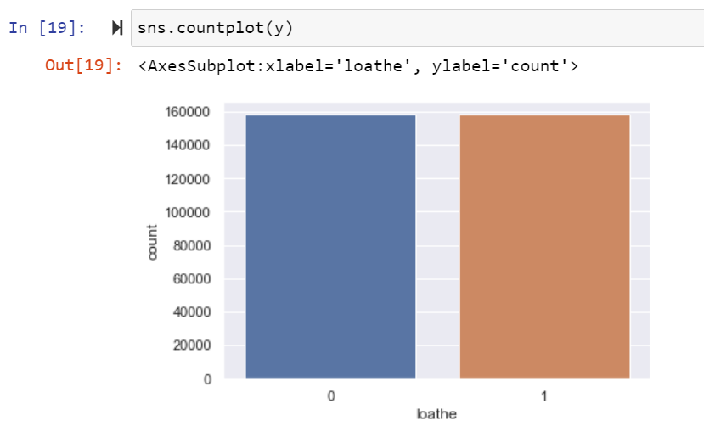
Oversampling:
SMOTE:
After using oversampling SMOTE method now imbalance class are balance.

Slide 33

Use zScore Check the dataloss:
After that Cheking Data loss of the dataset after using preprocessing steps here using zscore method checking dataloss here after zscore there 10.17 is dataloss.

Slide 34

Use IQR Check the dataloss:
Here After Applying IQR method checking dataloss here using IQR method same dataloss.

Slide 35


Checking Skewness:

Slide 36

To remove skewness use Power Transformer and log transform technique in dataset

Slide 37


5.Building Machine Learning Models:

Slide 38

LogisticRegression:
Here Accuracy score is 0.95 for train dataset and 0.95 for test dataset and cross validation score is 0.44 in LogisticRegression algorithm.

Slide 39

Decision tree classifier
Here Accuracy score is 0.99 for train dataset and 0.94 for test dataset in DecisionTree Classification algorithm.

Slide 40

Random Forest Classifier:
Here Accuracy score is 0.99 for train dataset and 0.95 for test dataset in RandomForest Classification algorithm.

Slide 41

AdaBoost Classifier:
Here Accuracy score is 0.95 for train dataset and 0.94 for test dataset in AdaBoost Classifier algorithm.

Slide 42

KNeighborsClassifier:
Here Accuracy score is 0.92 for train dataset and 0.91 for test dataset in KNeighbors Classification algorithm.

Slide 43

Here cross validation score is 0.99 for train dataset and 0.95 for test dataset so high accuracy score and cross validation score so Random Forest Classifier is the best model so apply hyperparameter tunning on it.

Slide 44


Here after use different parameter list the best parameter list is select. Above are the best parameter list RandomForestClassifier. Put this parameters into the model so output is finally best score os RandomForestClassifier is 89 so it is the best score.

Slide 45

Finally Load the model and predict the values.

Slide 46


AUC and ROC Curve:

Slide 47
6.Conclusion
Harmful or maliganat comments in the social media space have many negative impacts to society. The ability to readily and accurately identify comments as toxic could provide many benefits while mitigating the harm. Also, our research has shown the capability of readily available algorithms to be employed in such a way to address this challenge.

Slide 48
Future Work
We also suggest using SVM for text processing and text classification. It requires a grid search for hyper-parameter tuning to get the best results.

