Slide 1


INDIVIDUAL PROJECT · INFORMATION SYSTEMS
AI-Powered
Scholarship Matching System
Helping post-SPM students find the right scholarship, course & higher institution (IPT)
23
30
1
100%
SCHOLARSHIPS
INSTITUTIONS
PLATFORM
FREE

Slide 2
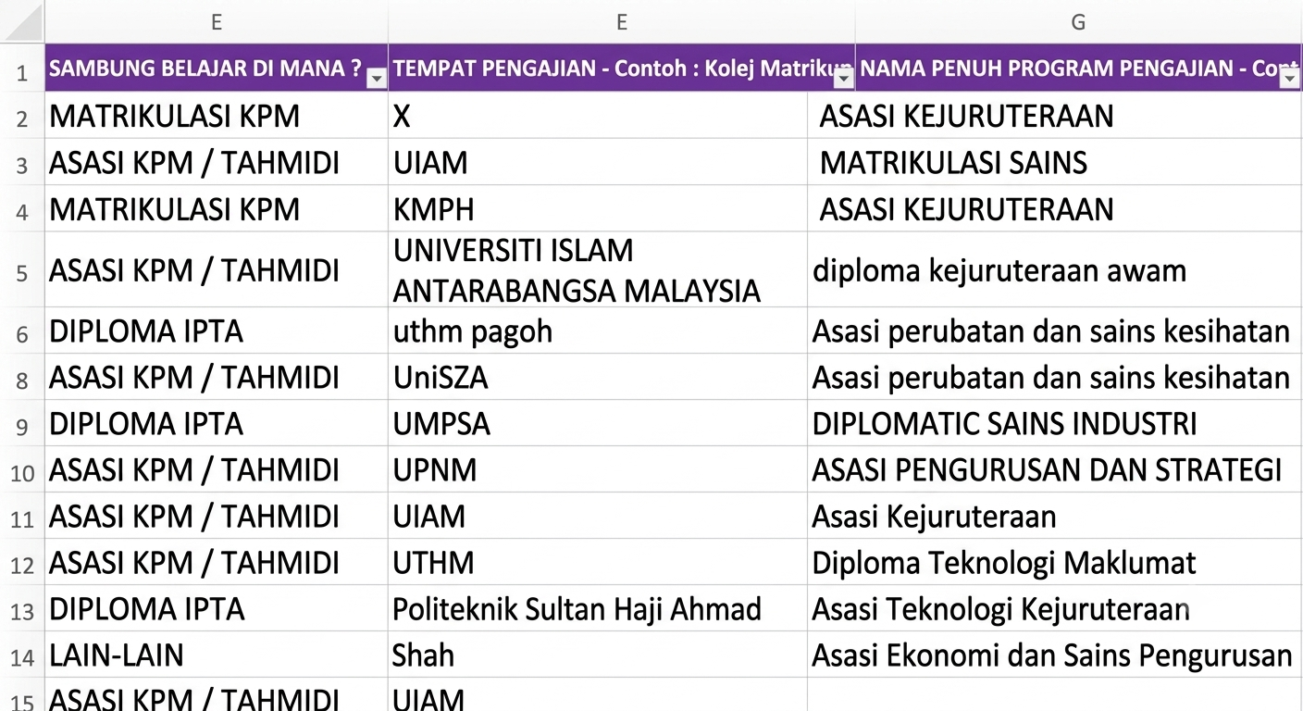
Where It All Started
02 / 10
?
The Real Problem
Real Evidence
After SPM results were released, the school counsellor had to manually call each student one by one to collect information on their further education plans, every single student, phone call by phone call. There was no system.
Actual data collected by the counsellor manually, via phone calls to every student after SPM
Manual Process
No System
Time Consuming
3 Key Questions That Sparked This Project
1
Continuing studies?
Did the student pursue higher education after SPM?
2
Which institution (IPT)?
Key Insight
Where did they enrol public uni, private, polytechnic, or others?
Many students in this data are from B40 families. The counsellor had no way to know which scholarships they qualified for this sparked the idea for an AI-powered matching system.
3
Scholarship or loan?
Are B40 students receiving the financial support they need?

Slide 3
The Problem, Solution & Impact
03 / 10
Challenges
DELIMa
Impact
THE CHALLENGE
OUR SOLUTION
THE OUTCOME
Scholarship Choices
Smart Analysis
Confident Students
Students do not know which scholarships they qualify for or how to apply correctly
The system automatically and thoroughly analyses each student profile
Making decisions based on data and their own personal profile
Institution Selection
Precise Matching
Reassured Parents
Confusion when choosing the right Higher Education Institution and course based on SPM results
>
23 scholarships & 30 institutions matched with a suitability score
>
A clear picture of all available options for their child
Parents in the Dark
Personal Report
Empowered Educators
No complete information to help their children make the best academic decision
A recommendation report is automatically generated for every student
An effective and accurate student guidance support tool

Slide 4
System Overview
04 / 10
DELIMa
What We Built
A complete system covering student registration, profile analysis, scholarship eligibility checking, Higher Education Institution matching, and automatic personal report generation — all in one integrated platform.
Core Platform
Full-stack Web App
Node.js + PostgreSQL
Who Uses It
All students across Malaysia regardless of school type, income group, or academic background. The system is designed to be fair and accessible to every student.
Malaysia Scholarship
& Higher Education Institution
Matching System
All SPM Students
B40 / M40 / T20
23 Scholarships
System Content
30 Higher Education Institution Institutions
23 scholarships and 30 Higher Education Institution loaded with complete criteria. Student profiles cover SPM results, co-curricular score, preferred field, and family income for comprehensive data.
100% Free
Node.js + PostgreSQL
23 Full Scholarships
30 Higher Education Institution Institutions

Slide 5
Technology Stack
05 / 10
HTML5 · CSS3 · JavaScript
Node.js
Architecture
FRONTEND
BACKEND
Student portal, dashboard & real-time bilingual UI : no framework, runs in any browser
Lightweight HTTP server : handles all API routing and business logic without a framework
Browser / Client
HTML + CSS + JS
Node.js Server
API · Routing · Logic
DATABASE
PostgreSQL
AI ENGINE
Groq API (LLaMA 3)
Stores student profiles, SPM results, PAJSK scores, all scholarship & Higher Education Institution data
Generates personalised scholarship recommendation reports in Bahasa Melayu per student
PostgreSQL
Data Layer
Groq API
AI Report Generator
AGENT SCRIPTS
Python
BILINGUAL
Custom JS Engine
Scholarship matching agent (agent2.py) and automated PDF report generator (agent3.py)
Live BM ↔ EN switching via data-ms / data-en attributes with no page reload required
Python Agents
Match · PDF Scripts
100% Open Source · Zero Licence Cost

Slide 6
How It Works
06 / 10
1
STEP ONE
2
STEP TWO
3
STEP THREE
Student Profile
System Analyses & Matches
Student Receives Recommendations
SPM examination results for all subjects
Profile compared against 23 scholarships in the database
Personal report generated automatically
Co-curricular score (scale 0 – 100)
Score = Academic SPM (90%) + Co-curricular PAJSK (10%)
Best scholarships listed in ranked order
>
>
Preferred field of study (Science / Arts / Technical)
Income category determines scholarship eligibility (B40/M40/T20)
Course recommendations based on field and SPM results
Higher Education Institution type preference: Public / Private / Polytechnic / Others
30 Higher Education Institution filtered against student profile criteria
Higher Education Institution suggested with full match scores
Household income level: B40 / M40 / T20
All options ranked by highest suitability score
33% Complete
66% Complete
Complete!

Slide 7
Matching Engine (How the System Scores)
07 / 10
OK
Each student receives a suitability score from two main components: SPM academic marks (90%) and co-curricular achievement (10%). Family income category determines scholarship eligibility B40 students qualify for more scholarships.
Score Breakdown
Academic Score (SPM)
90%
Score
5 core subjects + 3 best electives · A+ = 18 pts, A = 16 pts, A− = 14 pts
Formula
90%
Co-Curricular Score (PAJSK)
10%
Based on highest achievement level at school level
Academic SPM
90%
10%
Co-Curricular
10%
Income Category : Eligibility Factor:
Score =
B40 qualifies for more scholarships · M40 — standard · T20 — merit-based only
SPM(90%) + PAJSK(10%)

Slide 8
Challenges, Solutions & Lessons Learned
08 / 10
Challenges Faced
How We Solved It
Lessons Learned
Bilingual Issue
Bilingual System
Rule-Based Matching
Scholarship criteria exist in both Malay and English with inconsistent formats across multiple data sources used
A language-aware normalisation layer was built to correctly handle scholarship criteria in both languages
Accurate, auditable, and fast , operates in milliseconds without requiring AI or Machine Learning
Inconsistent Data
Data Cleaning
Persistent Sessions
Data from various sources with differing formats, including duplicate record problems that needed full cleaning
Data cleaning scripts were used alongside unique IDs to prevent duplicate records from entering the system
Student profiles are saved across visits , no need to re-enter information each time they return
Matching Accuracy
Multi-Layer Logic
Layered Higher Education Institution Match
Ensuring matches are precise and relevant without showing scholarships students are not eligible to apply for
Multi-criteria matching ensures only genuinely eligible options are shown to each student
Higher Education Institution matching uses multiple criteria: field + grade + income + type for higher precision

Slide 9
Current Project Status
09 / 10
OVERALL PROGRESS
SPRINT ACHIEVEMENTS
v
Database schema & data fully loaded
Complete — 40%
v
Student registration & login working
40%
In Progress — 60%
v
Scholarship matching engine built & tested
Matching engine, portal,
and database are live.
v
Multi-layer Higher Education Institution matching complete
Complete
Bilingual portal BM / EN active
v
Core System Live
~
PDF report export (in progress)
CURRENT SPRINT
RISK STATUS
Done
In Progress
Up Next
Core matching logic
Low
Auth system
Integration tests
Email to student
Scholarship data coverage
Moderate
Database
Data review
Deployment
Project scope
Controlled
Score engine
UI refinement
Portal UI
Student data security
Low
No critical risks, development is on track and within schedule.

Slide 10
Decision Intelligence for Malaysian Students
Thank You
This system was built to ensure that every post-SPM student in Malaysia receives clear direction, the right scholarship, the right course, and the best Higher Education Institution for their future.
23
30
100%
1
SCHOLARSHIPS
IPT INSTITUTIONS
FREE
PLATFORM
Information Systems Project · 2025 – 2026

