Slide 1
Basic exception handling

Slide 2
Learning objectives
After the completion of this topic, participants will be able to
Understand exception
Handle exception in programs
Understand the flow of exception
Understand differences between error and exception.

Slide 3
Introduction to exception
An error that happens at execution time of a program is called Exception.
The programming languages have some construct to deal with exceptions are called Exception Handlers.
Example : Java, C++ and Python are providing built-in support.
Exception handler saves the state of execution at the time the error occurred or it provides some special functions to proceed the execution without any interruption.
Built-in exceptions
ZeroDivisionError
BufferError
LookUpError
ImportError

Slide 4


Exception
Example :
Exception because the denominator is zero.

Slide 5
Exception handling
Let us see how to handle the exception in Python and what are the keywords used.
Keywords used to handle exception :
try
except
else
finally

Slide 6
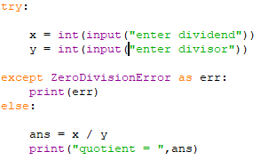
Exception
Getting input for x and y
Handles ZeroDivisionError
If there is no exception the else part is executed.
In the try part, two inputs are given. If y value is zero then the exception part will be executed. If not the else part will be executed.

Slide 7
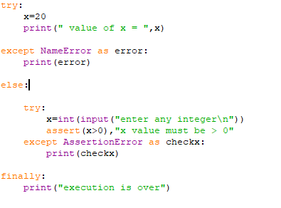
exception
It is possible to write try clause and except inside else clause .
Ex:
try and except clause inside else.

Slide 8

Exception
Output:
In the previous example, there is no Name error. So, else part is executed. Inside else, the value of x is asserted. When the assert fails the assertion error is handled.

Slide 9
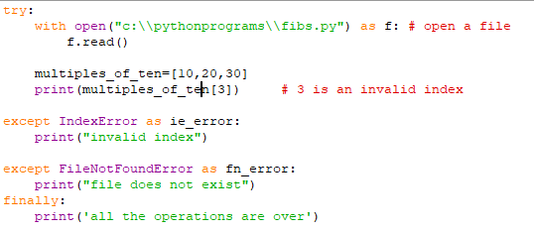

exception
Suppose, inside try clause, there are two or more exceptions, it is possible to write more than one except clause.
Ex:
Output:

Slide 10
exception
In the previous example, there was no problem in opening the file.
But, when trying to access the third element, there was an error. The exception was handled and finally also executed. (Either there is an exception or not, finally will be executed).
Alternatively, if there is an exception raised in the statement 1, ie. The file does not exist, then the rest of the statements will not be executed.
The control comes directly to the corresponding except clause.
Let us see example in the next slide.

Slide 11
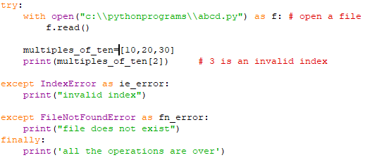

exception
Example :
Output:
The file abcd.py does not exist. So, the control comes out of try clause and FileNotFoundError except clause is executed.

Slide 12

exception
except clause without exception
We can also write except without any exception. If there is any exception in try clause, this except can catch all exceptions.
Suppose, there is another statement inside try which raises exception that also will be caught by this except. But the message would be the same. Example is given in the next slide.
Therefore, this type of except is not a good programming practice. The programme should handle the specific exception always.

Slide 13

exception
The output is import error. But the actual exception is divide by zero. So, the except without specific exception is not a good programming practice.

Slide 14


exception
try without except, with finally
try can be written only with finally, without except clause.
Ex:
Output:
If there is an exception, the exception is raised. Example in next slide.

Slide 15

exception
Exception

Slide 16
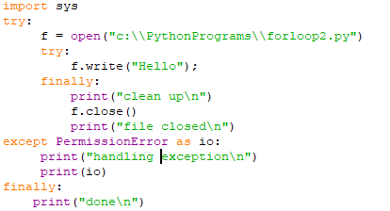
exception
try inside another try.
Ex:

Slide 17
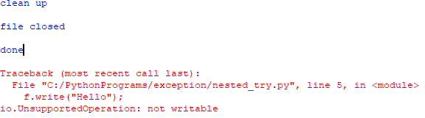
exception
In the previous example, the file is read only.
When write method is called, exception is raised. It is not handled in the inner try.
But, the finally block is executed. The clean up operation is done. Again the exception is raised.
Now, the outer except clause is handling this exception.
Output:

Slide 18

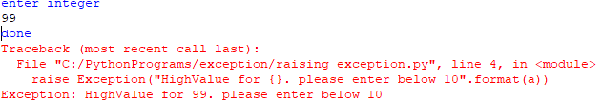
exception
Raising exception
Exception can also be raised with optional message.
Output:

Slide 19
exception
Custom Exception :
Apart from the built-in exception, we can also create application oriented exceptions.
To create custom exception, we should have knowledge of Object Oriented Programming in Python.
After OOP in Python, we can create custom exception.

Slide 20
Activities
Create a list and try to use the index which exceeds the length of the list. Find out the exception and handle the same. - 10 mins.
Create a program to import some package which does not exist. - 5 mins
Write a program to handle NameError. - 10 mins
Create a function to accept only positive value for age. If it is negative raise exception. - 15 mins
What is NotADirectoryError. Write a program to handle this exception - 15 mins

Slide 21
summary
Now, the participants should be able to
Understand exception
Handle exception in programs
Understand the flow of exception
Understand differences between error and exception.

Slide 22
References
https://docs.python.org/3/tutorial/

