Slide 1
Iterators and generators

Slide 2
Learning objectives
After the completion of this topic, participants will be able to
Understand iterators and generators
Write programs using iterators
Understand built in iterators
Understand co-routines and subroutines
Understand generators
Write programs using generators.

Slide 3

introduction
You might have used “for” loop to traverse a collection. ( Array, list etc).
Traversing a collection means, accessing an element, fetching next element until the last element is reached or until no more elements in the container. This is called iteration.
Example:
In this example, the data structure mylst is iterated. Every time, the “ele” variable is assigned a new value and next value is fetched from the list till the end of the list.
Iterator is an object which allows us to iterate the elements of a collection.

Slide 4
iterators
In Python, an iterator is an object which implements iterator protocol.
It has two methods.
__iter__ -> returns the iterator object.
__next__ -> returns the next element from the sequence.
Following are the built in objects which implement the iterator protocol.
List
Dictionary
Tuple
Strings

Slide 5
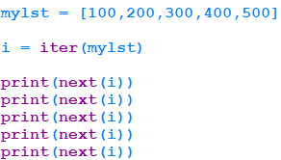

Iterator
Example :
Output:

Slide 6
iterator
We can also create Iterator objects, by implementing
__next__ method and __iter__method.
In our example in the next slide, an iterator object is created which produces elements from 100 to 1000.
When the maximum limit exceeds(1000) it raises an exception called “StopIteraton”

Slide 7
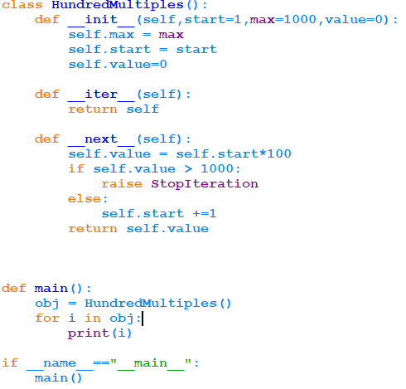

iterator
Output:

Slide 8
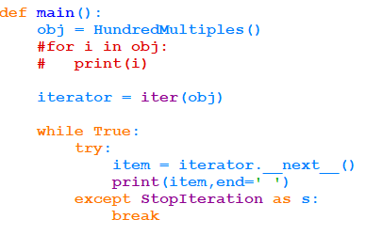
Iterator
Using iter, get the iterator and traverse the object.
Output:

Slide 9
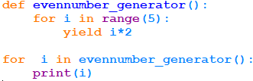
generators
Generators are type of iterators which can iterate only once.
They don’t store values in memory.
We can also compare with a function that returns array of values. Function returns the whole array. But generator yields one value at a time. So, it needs very less memory.
Generators are implemented as function. They don’t return value, but “yield” values.
Output:

Slide 10
generators
In the previous example, when the loop reaches yield statement, the value(i*2) is returned and the state is suspended.
For the next call, the generator is resumed from where it froze. The for loop is continued and again it comes to “yield” .
Usage :
When we have to work with lots of data generators are useful.
When all the data need not be loaded in memory, generator can be used which will pass a piece of data at a time.

Slide 11
Co-routines
Normally, when a function is called, the control is transferred to the function.
The function is executed till the return statement or catching exception or the end of the function. ( return None).
After the control is returned to the caller, the values stored in local variables are lost.
If a call to a function is made again, function creates everything from the beginning. This is called Subroutine.

Slide 12
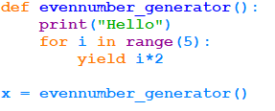
Co-routines
When we discussed generator functions, when the function encounters “yield” , it returns the value to the caller and it is suspended. All the values are stored.
Again when a call is made, it resumes from the place where it suspended and continues with the retained local values.
This line will not printed.

Slide 13
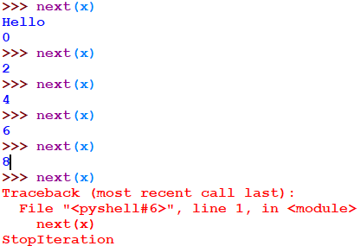
Co-routines
They run only when the next method is called.

Slide 14
summary
Now, participants should be able to
Understand iterators and generators
Write programs using iterators
Understand built in iterators
Understand co-routines and subroutines
Understand generators
Write programs using generators.

Slide 15
references
http://book.pythontips.com

