Slide 1
Python modules and packages

Slide 2
Learning Objectives
After the the completion of this topic, participants will be able to
Understand global and local scope
Understand modules
Create custom modules
Create package
Program using modules and packages

Slide 3
introduction
Part of a program where a variable is accessible -> scope.
The duration for which the variable exists -> lifetime.
Variables declared in a function do not exist outside that function
Example square2.py def square(n): m = n*n return m print "The square of 3 is ", print square(3) print m m can not be accessed as it is local to square2.py. Output: File "./square2.py", line 9, in <module> print m NameError: name 'm' is not defined

Slide 4
scope
Variables assigned at the top of a module are global to that module;
The variable is “global” within a module.
Within a function, Python will try to match a variable name to one assigned locally within the function.
If that fails, it will try within enclosing function-defining (def) statements (if appropriate); if that fails, it will try to resolve the name in the global scope (but the variable must be declared global for the function to be able to change it).
If none of these match, Python will look through the list of built-in names

Slide 5
Scope
scope.py a = 5 # global def func(b): c = a + b return c print func(4) # gives 4+5=9 print c # not defined

Slide 6
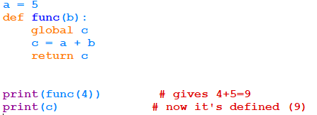
Scope
c is defined as global. So, it can be accessed outside.

Slide 7
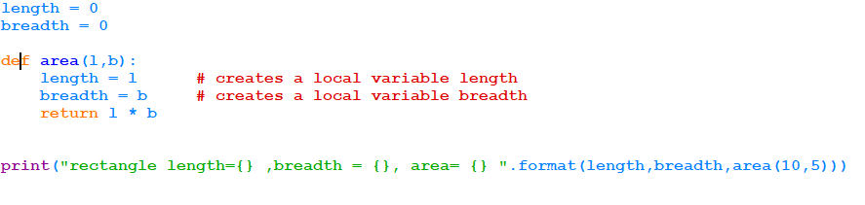
Global statement
Output:
Length and breadth are zero because inside the area function, the length and breadth are initialized.
They are treated as local variables. In order to refer the global variable “global” keyword must be used. This is called global statement.

Slide 8
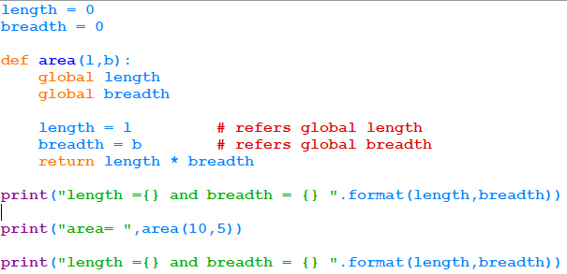

Global statement

Slide 9
Module basics
Each file in Python is considered a module. Everything within the file is encapsulated within a namespace (which is the name of the file)‏
To access code in another module (file), import that file, and then access the functions or data of that module by prefixing with the name of the module, followed by a period
To import a module: import sys (note: no file suffix)‏
Can import user-defined modules or some “standard” modules like sys and random
Any python program needs one “top level” file which imports any other needed modules

Slide 10
module
Need of modules :
If a project has database, business code and GUI, these three are put in a different file.
It is easy to reuse, maintain and enhance.
To access code from one file to another file, Python provides a mechanism called modules.
The code defined in one file can be called in another file by using import.
There are many built-in modules available in Python.
Ex :sys, math, random, os etc.

Slide 11
module
An import statement does three things:
Finds the file for the given module
Compiles it to bytecode
Runs the module's code to build any objects (top-level code, e.g., variable initialization)‏
The module name is only a simple name; Python uses a module search path to find it. It will search:
(a) the directory of the top-level file,
(b) directories in the environmental variable PYTHONPATH,
(c) standard directories or @ installation dependent path, and
(d) directories listed in any .pth files (one directory per line in a plain text file); the path can be listed by printing sys.path

Slide 12
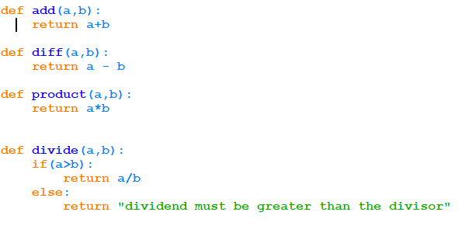
module
Creating own module : Module is also Python file with extension .py. It contains declarations of variables, classes and functions etc.
The following code is stored as calculator.py. There is nothing special extension required to create a module.

Slide 13
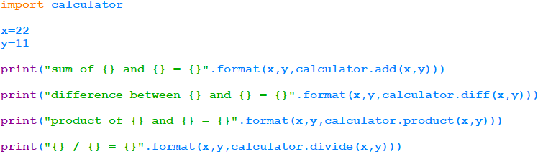

module
How to import the module that is created in the previous example?. It has to be imported as calculator.(without py extension)
Importing module
module name.function name

Slide 14
module
Alias name can be given to modules by using as keyword as follows. Inside the programme the alias name
Must be used to call the functions.
You can rename a module (from the point of view of the importer) by using the following syntax:
import longmodulename as shortname, where shortname is the alias for the original module name.
Using this syntax requires you to use the short name thereafter, not the long name
Can also do from module import longname as name

Slide 15
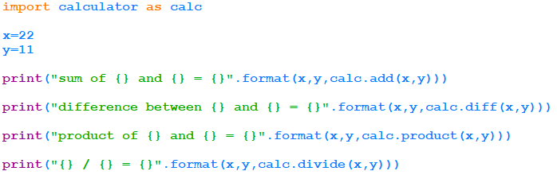
module
calc is the alias name.

Slide 16
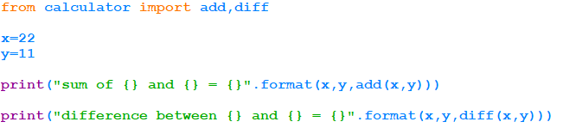
module
Specific modules can be imported from module by using keywords from and import.
Now, the module name need not be prefixed.
Ex :
Only add and diff are imported.
Need not use module name.

Slide 17
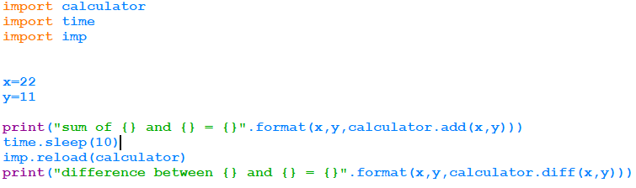
Reloading modules
If the source code of the module is modified using external editor and new code has to be tested without leaving the Python interpreter, reload(module) can be used.
Ex:
when time.sleep(10) is encountered, modified the module.
The changes will be reloaded in the next statement.

Slide 18
packages
When using import, we can give a directory path instead of a simple name. A directory of Python code is known as a “package”:
import dir1.dir2.module or from dir1.dir2.module import x will look for a file dir1/dir2/module.py
Note: dir1 must be one of the directories in the PYTHONPATH
Note: dir1 and dir2 must be simple names, not using platform-specific syntax (e.g., no C:\)‏

Slide 19
Package __init__.py files
When using Python packages (directory path syntax for imports), each directory in the path needs to have an __init__.py file
The file could be blank.
If not blank, the file contains Python code; the first time Python imports through this directory, it will run the code in the __init__.py file.
In the dir1.dir2.module example, a namespace dir1.dir2 now exists which contains all names assigned by dir2's __init__.py file
The file can contain an “__all__” list which specifies what is exported by default when a directory is imported with the from* statement

Slide 20

packages
In the following example, the package name is mynumber and modules inside are checknumber and positivenegative.
It should be imported as package.module. The functions can be called using the alias or package.module.function also.
Example :

Slide 21
Data encapsulation
By default, names beginning with an underscore will not be copied in an import statement.
Alternatively, one can list the names to be copied on import by assigning them to a list called __all__: __all__ = [“x1”, “y1”, “z1”] # export only these
This list is only read when using the from * syntax

Slide 22
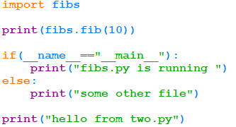

__name__ and __main__
When a file is run as a top-level program, it's __name__ is set to “__main__” when it starts.
If a file is imported, __name__ is set to the name of the module as the importer sees it.
Can use this to package a module as a library, but allow it to run stand-alone also, by checking if __name__ == '__main__':
do_whatever( ) # run in stand-alone mode
Example: The file name is two.py
The __main__ here is fibs.py

Slide 23
Reload may not affect “from” imports
“from” (keyword in from module import ) copies names, and does not retain a link back to the original module.
When reload is run, it changes the module, but not any copies that were made on an original from module import xx statement.
If this is xxa problem, import the entire module and use name qualification (module.xx) instead.

Slide 24
Loaders and finders
when we import a module, Python presents the name to the finder.
The finder checks whether they can import the particular module.
If yes, then they return a loader object. The loader object loads the module.

Slide 25
Attributes of module
Attribute | Usage
__loader__ | is an attribute that is set on the module by the loader. It returns the loader object.
__doc__ | The docstring of a module, class and functions can be put into this attribute by the compiler.
__name__ | The name of the module
__package__ | The package to which the module belongs to. If the module is not a part of any package, then this attribute is set to ‘ ’.

Slide 26


Attributes of module
Output:
Output:

Slide 27
summary
Now, participants should be able to
Understand global and local scope
Understand modules
Create custom modules
Create package
Program using modules and packages

Slide 28
references
https://www.python.org/dev/peps/pep-0257/

