Slide 1
Object oriented programming

Slide 2
Learning objectives
After completion of this topic, participants will be able to
Understand Object Oriented Programming concepts
Create classes and objects
Understand and implement abstraction and encapsulation
Write programs using inheritance
Understand static methods and private attributes

Slide 3
Object oriented programming
In this topic, we will be discussing about object oriented programming (OOP) and the important characteristics.
To solve problem, there are many approaches in programming.
Ex. Procedural, Object Oriented, Functional, Database approach etc.
In object oriented programming, programs are written as classes and objects.
Object-oriented programming is a method of implementation in which programs are organized as cooperative collections of objects, each of which represents an instance of some class, and whose classes are all members of a hierarchy of classes united via inheritance relationships.
Grady Booch

Slide 4
oop
Characteristics of OOP:
Object
Class
Abstraction
Encapsulation
Inheritance
Polymorphism

Slide 5
Self study
https://www.codeproject.com/Articles/22769/Introduction-to-Object-Oriented-Programming-Concep
Participants have to use this link and go through the concepts. Upon completion, try the following activities.

Slide 6
activities
Identify classes and objects in the following list:
1. Human being
2. Lion
3. A boy whose roll number is 1002 and his name is Ram. He is writing exam now.
4. SSN College
5. Vandaloor Zoo
6. Flight
7. Trainer

Slide 7
activities
2. Design a Mobile phone class.
3. Create an inheritance hierarchy for smart phone, Nokia, telephone and Samsung
4. In the following list, identify abstract class and concrete classes.
Car, Bus, Bike, Vehicle, Flight, Ship
Write some attributes and methods for each class.
Identify some abstract methods.

Slide 8
class
In Python, there are many data structures. Ex. List, tuple, dictionary, set etc.
Class is used to create user defined data structure with any kind of information.
Class describes the characteristics of real world things.
For example, we could create a Student class with rollno, name, age, course name, marks scored and functions to calculate total marks, percentage of marks, grade etc.
Likewise, we can create many classes such as Employee, Product, Item, Car, Project, Vehicle etc.
Class encapsulates the data and its functions .
Variables and functions inside a class are called members of the class. The variables are called data members and the functions are called methods.

Slide 9
Class
Class diagram of Account class.
Account
Name of class
account_number
name
balance
Account_type
Attributes
deposit
withdraw
methods

Slide 10
class
Since, the class provides only the structure, not the values, it is called “blueprint”.
For example, Student class does not provide the value of rollno, age or any other values.
Syntax :
class Student (): class is a keyword and Student is a user defined class name.
The CamelCase notation is used for name of a class.
Attributes and functions can be added inside a class.

Slide 11
object
Object can also be called an instance of a class. In this material we may use object and instance interchangeably.
Instance has the real values for the attributes defined in a class.
Ex.
1. The instance of the Student class is , student name is John, age 21 and doing commerce course. It has values for all the attributes.
2. A Book with ISBN No.2038AB3, titled Java Programming, written by Peterson, 5th edition, Oxford University publication and price $25.
3. A Car with registration number TN-02-5648, white colour, Jaguar company and 6 safety balloons.

Slide 12

class
Here company is a class attribute.
Class attribute means, all instances of Car class have the same value for company attribute.
But each car has attributes which are having different values.
Example: Vehicle Identification number , Registration Number etc., are unique to each car. They are not common to all cars. These attributes cannot be declared in the class like company attribute.
They must be initialized in a special method called __init__ method.(double underscore) .
Name of the class is Car.
Class attribute. This is not instance variable.

Slide 13
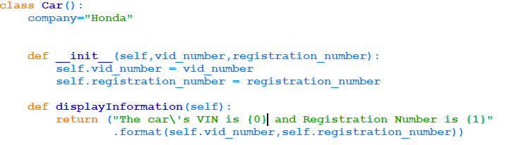
class
__init__ method is used to initialize object with its attributes. This method has an argument called self which refers to the object itself.
Ex.

Slide 14

Creating instance of a class
c1 is an object of car class. When two parameters are passed, it calls the __init__ method to and initializes c1 with these values.
self keyword doesn’t have any values. As said earlier, it is the keyword to refer the object itself.
To invoke the class attribute or method use . (dot) operator.
Any other methods

Slide 15
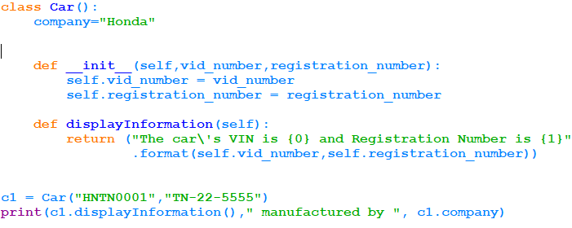
Creating instance of a class
output:

Slide 16
activities
Create a book class with isbn number, name, publications, subject, author, edition and prize.
Assume isbn number 5 digit number. Provide method to generate it.
Create methods for the following :
For first edition, 40% of discount is given. Other editions are given 20% discount.
For other subjects standard discount 50%.
If the total number of books ordered exceeds 5, then 10% of discount is given.
Calculate the total prize.

Slide 17
Built-in attributes in python
In Python, Class and instance of a class have some built-in attributes.
They can be accessed using . (dot) operator.
Below are the list of attributes of a class.
Attribute | Usage
__dict__ | dictionary used to store objects attributes
__class__ | Name of the class to which the instance belongs
__name__ | Name of the class, function, etc.,
__module__ | Name of a module a class belongs to.
__bases__ | The tuple of base classes of a class.

Slide 18
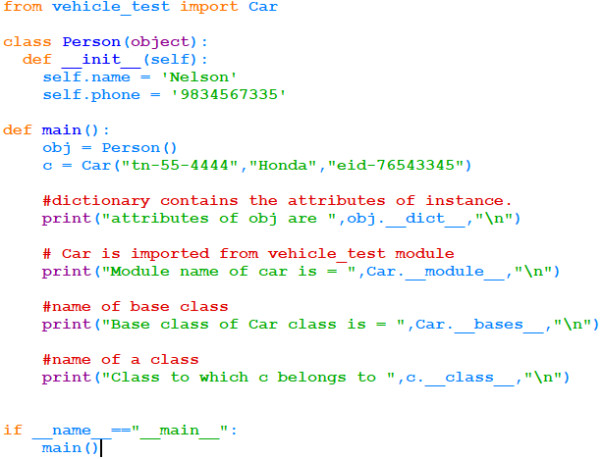
Built-in attributes in python

Slide 19
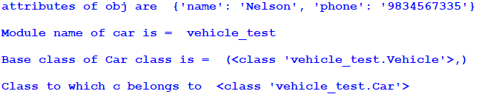
Built-in attributes in python
Output:

Slide 20
Encapsulation in python
Encapsulation is one of the OOP characteristics. (Already discussed in OOP)
Object’s variables should not be accessed directly from outside the class. But it can be accessed by its member functions. i.e inside the class all the methods can access.
It should be accessed from outside only via methods in order to prevent from the accidental changes.
Providing methods to access the variables ensure the correctness of data. i.e value of the variable can be validated through the method.
In Python, there is no “access modifier” (like private in Java language). Instead, it provides some naming convention.
If a variable has a leading double underscore then it cannot be accessed outside the class directly.

Slide 21
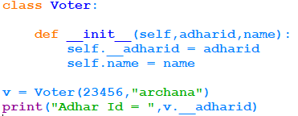

Encapsulation in python
Since __adharid is a private, can not be accessed outside.

Slide 22
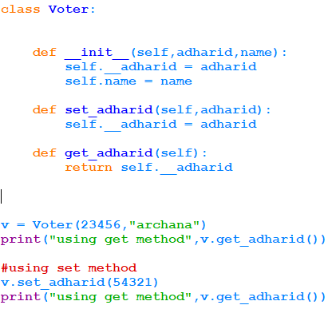

Encapsulation in python
But, it can be accessed using getter and setter method. Getter method is used to retrieve and setter method is used to modify the private variable.
Ex.
Output:

Slide 23
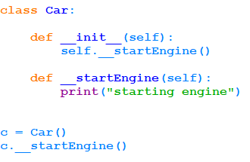

Encapsulation in python
Method can also be private method. It can be accessed only inside the class. In this example __startEngine is a private method.

Slide 24
abstraction
It is one of the characteristics of OOP.
IEEE defines abstraction as “a view of a problem that extracts the essential information relevant to a particular purpose and ignores the remainder of the information.”
Displaying only the essential attributes and hiding the details is called abstraction.
Encapsulation binds the data and functions that operate on data inside the class. Abstraction hides the implementation detail from the user.

Slide 25
abstraction
Example :
Assume that Employee class has a data member named employee_number. The requirement in the project is that It should not be assigned or modified from outside the class.
It is autogenerated by a function inside a class. The detailed implementation of generation of employee_number is hidden from the user.
Ie. The user can get the employee number without knowing the implementation detail. User has to call the object of the class and call the method by passing appropriate number of parameters.

Slide 26
abstraction
Real time examples for abstraction:
Applying break in vehicle without knowing the internal mechanisms.
Changing channels in TV using remote control.
We get power supply for our computer(or any devices) just by using plug and switch. But we don’t know internally from where the electricity is passed and how the electricity network is done.
Opening a file in windows by double clicking the icon hides the storage detail of files in secondary storage.

Slide 27
activities
Implement encapsulation for Book class created in the activities given in here
Ensure the price of any book should not be below 500.
Create a Class called Consultant with Id, Name, Per Day Consulting Fees, Number of days worked in a month and tds (10% deduction in total fees) as properties. Calculate Gross and Net remuneration.
Make sure the number of days worked must be <= 20.

Slide 28
inheritance
Inheritance is, one class can derive the properties and functions of another class.
The class from which the attributes and functions are inherited is called Superclass. The class which inherits from Superclass is called Subclass.
Advantages of inheritance:
1. Reusability :
a. The duplication of code is avoided.
b. Reduces the time consumption of software development.
We can say that it is used to adhere “don’t repeat yourself”(DRY) software development
principle.
2. Extensibility : New functionalities can be added to Subclasses in addition to inherited properties and function. New functionalities can be added without any impact in the existing code. This helps in enhancement of projects.

Slide 29
Single inheritance in python
Person
adhair_id
first_name
last_name
displayPersonDetail
Employee
id
desg
company_name
displayEmployeeDetail

Slide 30
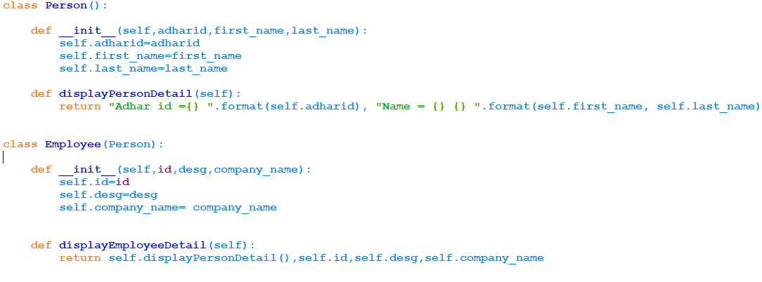
inheritance
Super class is Person

Slide 31
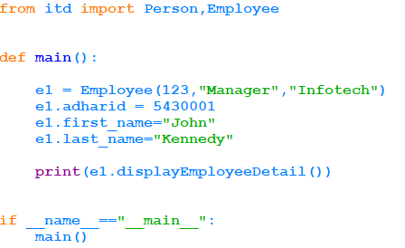
inheritance
output:

Slide 32
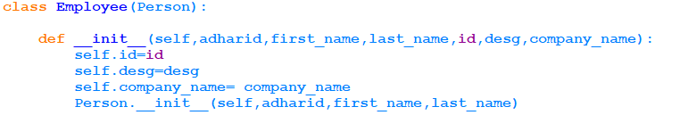
inheritance
Super class constructor called

Slide 33
Multiple inheritance
Land Vehicle
Water Vehicle
Amphibious Vehicle
The Amphibious Vehicle inherits the properties from Land vehicle and water vehicle. This is called multiple inheritance. The class must be created as
class AmphbiousVehicle( LandVehicle , WaterVehicle )

Slide 34
activities
In a company, some employees are given salary with breakup(basic,da,hra) and rest of the employees are given consolidated pay with a standard deduction of 10%.
Implement the above problem in Python.
In a forest, there are many plants. These plants must be classified as Trees, shrubs and herbs by observing their common properties and special properties and behaviour.
Develop inheritance hierarchy for the above scenario.

Slide 35
Abstract class
When some common functionality has to be implemented in all classes in the same class hierarchy,
abstract class can be used.
A class which contains abstract method is called an abstract class.
A method without definition (only skeleton) is called an abstract method.
Abstract classes cannot be instantiated.
In python, there is a module named ABC which provides base for defining Abstract Base Classes.
ABC module provides a decorator @abstractmethod.
When a method of a class is decorated with @abstractmethod, then the method becomes an abstract method.

Slide 36
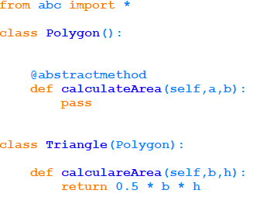
Abstract class

Slide 37
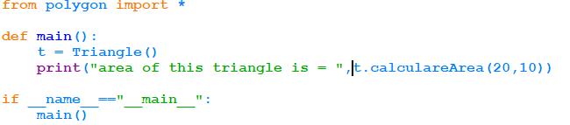
Abstract class
Output:

Slide 38
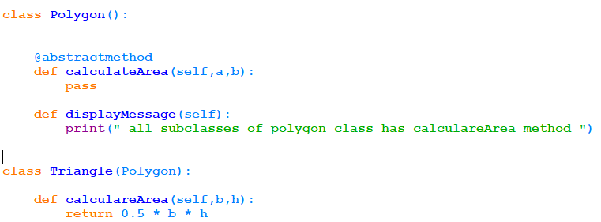
Abstract class
Abstract base classes are useful in providing common API for all its subclasses.
Even if the abstract method is not implemented in the subclass there will not be any error.
Concrete method.

Slide 39
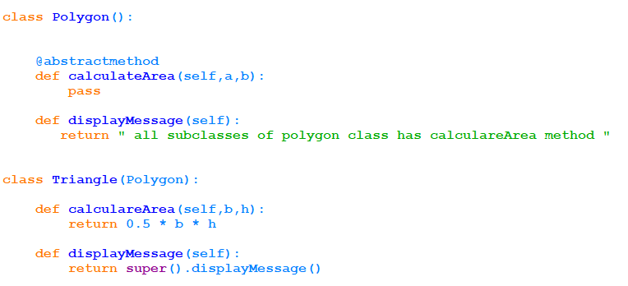
Abstract class
To call base class method super() is used.
concrete method
Base class method is called

Slide 40
activities
Exercise No.1 in Slide No.31 , for both type of employees must be given 12% of PF and also calculate net salary.

Slide 41
Static method
A static method is a class method. Meaning it is bound to the class, not the object of the class.
Static method cannot change the class variables.
We can say that static methods are used like utility functions.
To create a static method, @staticmethod decorator is used.

Slide 42
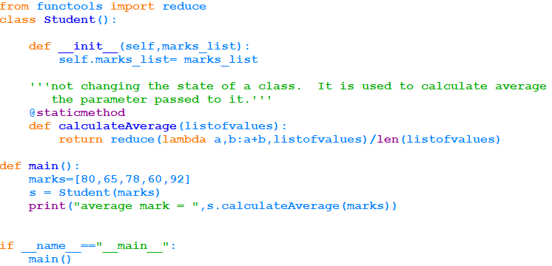
Static method
Output:

Slide 43
activities
Create a class called Student with name, date of birth and course opted for. Create a static method to calculate age of a student.

Slide 44
polymorphism
Polymorphism is one of the characteristics of OOP.
The meaning of polymorphism is many forms.
Ex. We use buttons to draw rectangle, triangle, line and circle etc.
The common method is Onclick(). But they draw different pictures because of different definition.

Slide 45
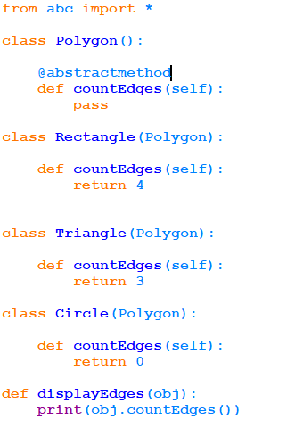
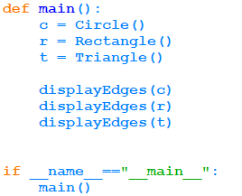

polymorphism
Output:

Slide 46
polymorphism
displayEdges() is an outside function. It has a parameter called obj. Based on the calling object, the corresponding method is called.
This is implementation of polymorphism with functions and objects.

Slide 47
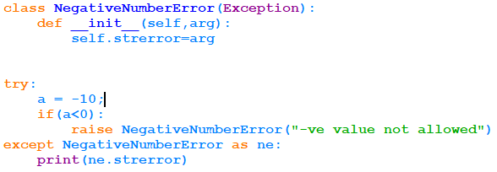
Custom exception
When the built in exception is not suitable for our application, Custom exception can be created.
or example, my application does not allow negative numbers, the custom exception can be created as below.

Slide 48
Custom exception
Exception is a base class.
NegativeNumberError is a subclass extending the base class.
Refer the following link to know the Python Exception hierarchy.
https://airbrake.io/blog/python-exception-handling/class-hierarchy

Slide 49
activities
Create a list where 4 names can be stored. If the program inserts 5th element, then TooManyElementsError must be raised.
Hint : Create a custom exception class. Inherit from Exception base class.
Write a program to accept four elements in a list. If the 5th element is appended, raise
the exception.

Slide 50
summary
Now the participants should be able to
Understand Object Oriented Programming concepts
Create classes and objects
Understand and implement abstraction and encapsulation
Write programs using inheritance
Understand static methods and private attributes
Create custom exception

Slide 51
references
https://docs.python.org/3/tutorial/

