Slide 1
Functions

Slide 2
Learning objectives
After the completion of this topic, participants will be able to
Understand function
Define function in python
Pass different types of argument to functions
Understand variable number of arguments
Write function to return more than one values
Understand anonymous function
Write program using lambda function
Write program using map, filter and reduce functions

Slide 3
Introduction
A function can be defined as the organized block of reusable code which can be called whenever required.
A Function can be called multiple times to provide reusability.
By using functions, we can avoid rewriting same logic/code again and again in a program
Reusability is the main achievement of functions.

Slide 4
Types of Functions
Built-in functions, such as help() to ask for help, min() to get minimum value, print() to print an object to the terminal.
User-Defined functions (UDFs), are the functions created by the user.
Anonymous functions, also called as lambda functions because they are not declared with the standard ‘def’ keyword.

Slide 5

Creating and Calling a Function
Creating a Function:
Function can be created by using ‘def’ keyword.
Calling a Function:
Function can be called from command prompt or from an another function by using name of the function followed by parenthesis().
ex: my_function()

Slide 6
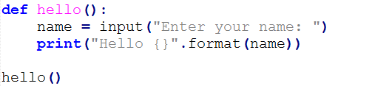


Function With / Without Parameters
Parameters of a function should be defined within parenthesis
Function without parameters
Function with parameters
Output:
Output:

Slide 7
Types of Parameters
Required arguments
Keyword arguments
Default arguments
Variable-length argument

Slide 8
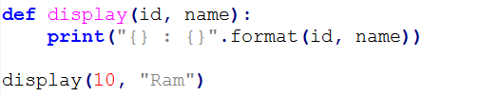
Required Arguments
Arguments which are required to be passed at the time of function calling with the exact match of their positions in the function call and function definition.
If either of the arguments is not provided in the function call, or the position of the arguments is changed, then the python interpreter will show the error.
Output:

Slide 9
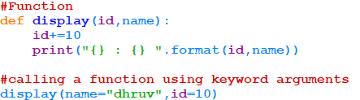
Keyword Arguments
Python allows us to call the function with the keyword arguments. This kind of function call will enable us to pass the arguments in the random order.
The name of the arguments are treated as the keywords and matched in the function calling and definition. If the same match is found, the values of the arguments are copied in the function definition.
Output:

Slide 10
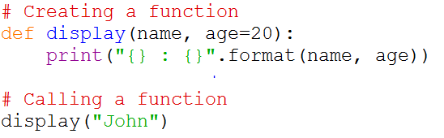
Default Arguments
Python allows us to initialize the arguments at the function definition. If the value of any of the argument is not provided at the time of function call, then that argument can be initialized with the value given in the definition even if the argument is not specified at the function call.
The parameter with default value is called Optional Parameter. Optional Parameters should come after
all the required parameters. Here, age is optional parameter which comes after name.
Suppose, the value is provided for age, then default value will be overridden.

Slide 11
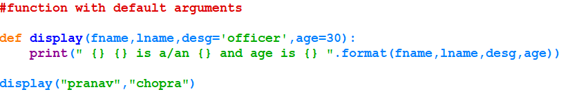
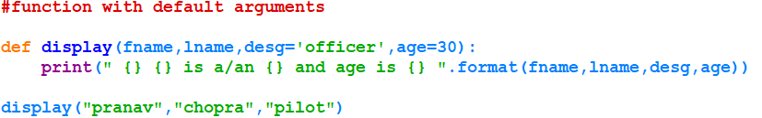
Default Arguments
Output:
Output:

Slide 12
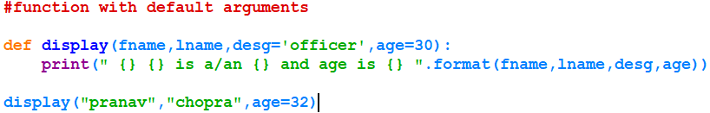
Default Arguments
Suppose we want to pass second optional parameter, but not the first one.
In this case, keyword arguments can be used. It is allowed to mix both positional parameter and keyword parameters.
Ex:
Output:
The desg parameter has been skipped and passed age by using keyword. The rule to be followed is the keyword parameters should come after positional parameters.

Slide 13
Variable Length of Arguments
In the large projects, sometimes we may not know the number of arguments to be passed in advance. In such cases, Python provides us the flexibility to provide the comma separated values which are internally treated as tuples at the function call.
The special syntax, *args and **kwargs in function definitions is used to pass a variable number of arguments to a function.
Single asterisk form (*args) is used to pass a non-keyworded, variable-length argument list.
Double asterisk form is used to pass a keyworded, variable-length argument list.
Note: Always declare *args and *kwargs parameters should be declared at the end in parameter list.

Slide 14
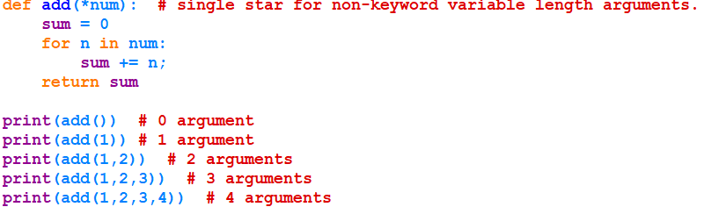

Variable Length of Arguments
*args Method Example
Output:

Slide 15
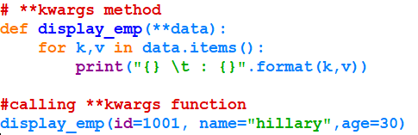

Variable Length of Arguments
**kwargs Method Example - keyword arguments
Output:

Slide 16
Lambda Functions
In Python, anonymous function is a function that is defined without name.
Simple one-line function
While normal functions are defined using the ‘def’ keyword and anonymous functions are defined using the ‘lambda’ keyword.
Returns, function object, which needs to be assigned to an identifier.
Sytax: lambda arguments : expression
ex: double = lambda x : x * 2 # doubles input argument
print(double(5))

Slide 17


Lambda Functions
In Python, we generally use it as an argument to a higher-order function (a function that takes in other functions as arguments). Lambda functions are used along with built-in functions like filter(), map() etc.
parameter
return

Slide 18
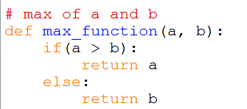
Lambda Functions
Examples: Finding bigger number
Output:

Slide 19
activities
Create a list with numbers(include duplicates also). Write a function to store only unique element in another list.
Create a function to count number of vowels in a given string.’
Write a function to check whether a given number is perfect number or not.
Hint : Perfect number is a number whose sum of divisors is equal to that number.
For example, 6 is a perfect number. The divisors of 6 are 1, 2 and 3. The sum is 1+2+3 = 6.

Slide 20
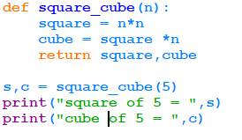

Function returning multiple values
A function can return more than one values.
It can be written as return value1, value2, etc.
When more than one values are placed after return separated by commas, they will be automatically converted into tuple.
Ex: output:
Receiving two values from the function

Slide 21
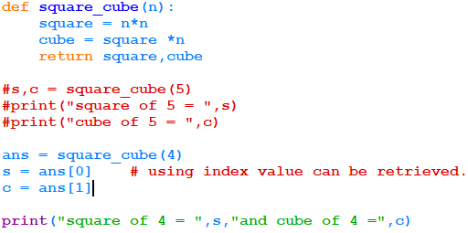
Function returning multiple values
Multiple values can also be received in the following method:

Slide 22
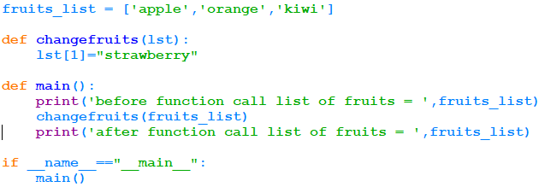
call by reference
In Python, if a variable is passed to a function , a new reference object is created. If there is any changes in the new reference object, it will be reflected in the original variable also.
Example :
lst is a new reference object. index “1” is modified.

Slide 23
call by reference
Output:
In this example, fruits_list is a original parameter passed to the function changefruits. In the function, the formal parameter “lst” is created as a new reference to fruits_list.
When the index position “1” of “lst” is modified, it is reflected in the original list.
That is, the changes are made in the same location. No copy has been made in the function.
This is called “call by reference”.

Slide 24
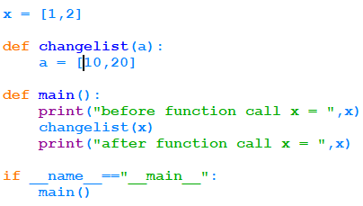

Call by value
Output:
In the above program, the value of the formal parameter “a” is reassigned new values. In this case, it does not refer to the original object x.
From the output, it is understood that the original parameter x is not changed.

Slide 25
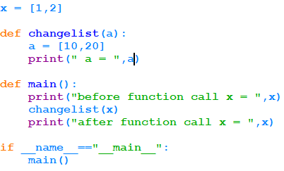

Call by value
Output:
Here, the value of a is reassigned to [10,20]. So, the list “x” is not modified.

Slide 26
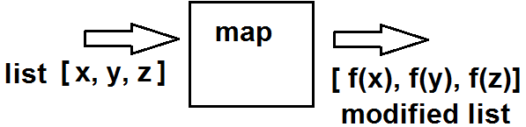
Map() function
map() function returns a list of the results after applying the given function to each item of a given iterable (list, tuple etc.)
Note: return value of map is map object, apply list() or set() to create a list or set.
f()

Slide 27
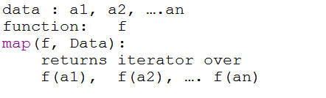
map() function
Syntax: map(function, iteration)
Example: check the list of numbers either odd or even.
method and list has been passed as parameters. The method is applied to each and every element in the list.
Result is converted into list.

Slide 28
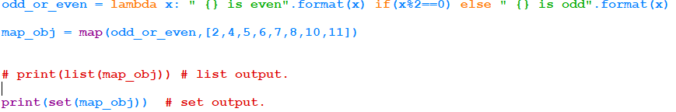
Map() function
List output:
set output:

Slide 29

Map() function
Example : multiplying two lists using lambda function.
Output:

Slide 30

Filter() function
Syntax:
filter( function, list )
“filter” function helps to filter out all the elements of a list (the second argument in the syntax), for which the function(the first argument in the syntax) returns “True” .
Example:
Here, lamda function is applied to num_list. When the return value is True, the element is added to final_list.
Output:

Slide 31

Reduce function
Syntax:
reduce(function , sequence)
This function (first argument) is applied continually to the sequence(second argument) and the result is returned.
This function is present in “functools” module. It should be imported.
Example:

Slide 32
Reduce function
In the previous example, the lambda function is applied as follows:
(1000//2) (500//4) (125//2) 25
Hence, the continual application of the lambda function to the list is reduced to “25” as a single value.
Output:

Slide 33
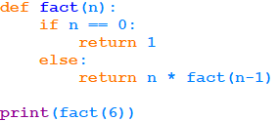
Recursive function
A function that calls itself is called recursive function.
It requires a base condition. Otherwise, it will continue to execute and ends in infinite loop.
Popular example of Recursive function is finding factorial of a given number.
This is a base condition or termination condition.
Output:

Slide 34
activities
Generate a list of 10 random numbers between 1 to 1000. Filter only the multiples of 100.
Find the product of all numbers in a list.
Store names of students in a list. Write a function to filter whose names are having length > 5.
actor=['salman','sharukh'], movie=['ekta tiger','ddlj']. Write function to a create a new list to map the actors to their movie.
Generate Fibonacci series using recursive function.

Slide 35
summary
Now, participants should be able to
Understand function
Define function in python
Pass different types of argument to functions
Understand variable number of arguments
Write function to return more than one values
Understand anonymous function
Write program using lambda function
Write program using map, filter and reduce functions

Slide 36
references
https://docs.python.org/3/tutorial/
https://python-reference.readthedocs.io/en/latest/docs/functions/map.html

