Slide 1
Basic programming

Slide 2
Learning objectives
After the completion of this topic, participants will be able to
Understand simple basic data types in Python
Write simple program using data types
Understand variables in Python
Write program using variables, datatypes, operators etc.

Slide 3
Introduction to basic programming
In this topic, we will discuss
Print statement
Data types in python
How to create variables and initialize
Operators (Arithmetic, Relational, Logical)
Comment

Slide 4

Print statement
Let's get started! Here's an example of a python program run as a script:
If this is saved to a file “hello.py”
When run, this program prints

Slide 5
print Statement
Elements separated by commas print with a space between them
A comma at the end of the statement (print ‘hello’,) will not print a newline character
>>> print('hello‘)
hello
>>> print ('hello', 'there’)
hello there

Slide 6


print
\t is the tab character

Slide 7
Data Types
Numeric
Integers
Floating point numbers
Complex numbers
String
Boolean

Slide 8
Data Types // integer
An integer is a number without decimal point.
‘ int’ represents integer.
There is no limit on the size of integer in python. It can be of size as big as the system’s memory.
Ex. 345346345392343493458252345258345
To represent the numbers other than decimal – Binary, Octal and Hexadecimal should be prefixed with zero and b or o or x.
Ex. 0o - > for Octal number – 0o6
0b -> for Binary number – ob10
0x -> for Hexadecimal number – 0xA

Slide 9


Data types

Slide 10

Data Types // float
To represent floating point numbers ‘float’ is used.
Ex. 6.87, 3.567
Float value is represented as 64 – bit double precision values that follows IEEE standard.
To represent very big numbers exponentiation is used.

Slide 11
Data Types // complex
Complex number has two parts:
1) real part and
2) imaginary part
Ex. 5 + 6i
5 -> real part
6 -> imaginary part

Slide 12
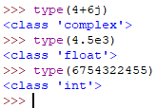
Type function
Example:
type() function in python used to get the datatype.

Slide 13
Data types // String
String is a sequence of characters.
We can use single quotes or double quotes.
Ex. ‘Python’ “Python”

Slide 14
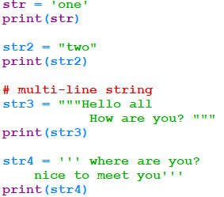
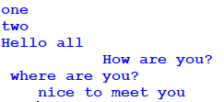
Data types //string
Multiline string
Triple quotes are used for multi-line strings.
Ex. ‘’’ Python is a programming
language ‘’’

Slide 15
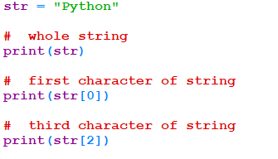
Data types //string
String is a sequence of characters. It can be accessed by using index.
Like an array, it starts with 0.

Slide 16
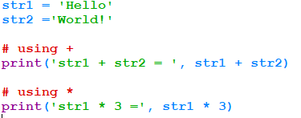

Data types //string
Operations in String:-
Concatenation - +
Repetition - * operator

Slide 17
Data types //string
Membership test in string
>>> ‘r’ in ‘training’ - >returns true
>>> ‘x’ in ‘training’ -> returns false

Slide 18
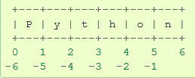
string
>>> x='python'
>>> print(x[-2]) # Negative Indexing -1 for the last position.
o
>>> print(x[-1])
n
>>> print(x[0:5]) # positive index starts with 0 like an array.
pytho

Slide 19

Data types // Raw string
If the escape sequences should not be translated in a string, the string literal should be preceded by R or r.
Ex.
\n is the escape sequence translated into new line.
When it is preceded by r it is not translated.

Slide 20

Data types // boolean
Boolean provides either true or false value.
Ex.

Slide 21
activities
1. Check whether ‘l’ is in String “Hello” .
2. Write a program to print “ Hello” , “How are you” and “where are you” in three different lines.
3. print reverse of a string “Python” (as “nohtyP” )using negative index. – 10 min
4. Print a complex number. Display the data type of the same.
5. Print hexadecimal numbers from A to F.
6. Print 4500000.0 in exponent form.
7. In Python interpreter show that “Python is very interesting programming language “ -> True

Slide 22
activities
8. print I don’t like apple.
9. Find the length of the string “Python”.
10. check whether the string and its reverse are equal. (10 mins)

Slide 23
Variables
No need to declare the variables but It should be initialized. ( data type is not necessary)
Using unassigned/uninitialized variables will raise exception
Declaration is automatic when you initialize/assign
Multiple variable assignment can be made in single line
When you create a variable you reserve some space in memory
Variables are not typed
A variable assigned with string can be assigned with numerical values
Everything is a variable
Classes, Objects, Modules, Packages etc.,
Variable definition => variable = value
Python Data Types :
Numbers, String, List, Tuple, Dictionary

Slide 24
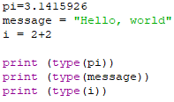

Variable types
pi is not declared as float. Directly it has been assigned value. Since float value is assigned pi is float variable.
In some other statement it may be assigned integer value. At that point pi is treated as integer variable.
Output:

Slide 25
Variable types
In the previous example, “pi” and “message” are variables, but one is a floating point number, and the other is a string.
Notice we didn't declare the types in our example. Python has decided types for the variables, however.
Actually, “variables” in python are really object references. The reason we don't need to declare types is that a reference might point to a different type later. references.py: x=42 y=”hello” y is a string variable since string value is assigned. print (x,y) # prints 42 hello
y=42 Now y is an integer. Depending on the value assigned the type of
the variable changes.
print(x,y) # prints 42 42

Slide 26
Variable names
Can contain letters, numbers, and underscores
Must begin with a letter
Cannot be one of the reserved Python keywords:
and, as, assert, break, class, continue, def, del, elif, else, except, exec, finally,
for, from, global, if, import, in, is, lambda, not, or, pass, print, raise, return,
try, while, with, yield.

Slide 27
More on variable names
Names starting with one underscore (_V) are not imported from the module import * statement
Names starting and ending with 2 underscores are special, system-defined names (e.g., __V__)‏
Names beginning with 2 underscores (but without trailing underscores) are local to a class (__V)‏
A single underscore (_) by itself denotes the result of the last expression

Slide 28
Numbers (No Long Integer with 3.6)
Int/Long Int | Float | Complex
Integers | Floating Point Numbers | Complex Numbers
10 | 80.2 | 3+14j
-786 | -21.9 | 4.53e-7j
a=10 | c=80.2 | d=3+14j
b=int(a) | b=float(c) | b=complex(a,c)
>>> type(a) <class ‘int’> >>> | >>> type(c) <class ‘float’> >>> | >>> type(d) <class ‘complex’> >>>
Multiple variable assignment & Typing of Variables
a=b=c=10
a,b = 5,10
a=float(b)
c=complex(a,b)

Slide 29
Operators
+ addition
- subtraction
/ division
** exponentiation
% modulus (remainder after division)‏
Comparison operators

Slide 30


Operators
Example operators.py
Output:
If integer answer is needed, put // instead of /. This is floor division. Which discards fractional part.
This will print 0.

Slide 31
Operators
Operation | Result
x + y x – y x * y x / y x % y x**y -x | Sum of x and y Difference of x and y Product of x and y Quotient of x and y Remainder of x and y x raised to the power of y Negated x
x // y | Floored quotient of x and y (integer division)
abs(x) | Absolute value of x
bool(x) | Returns True if argument is True
cmp(x,y) | Returns 0, if x=y Returns +ve, if x > y Returns –ve, if x < y
** Please nte that, there are many more built-in functions, keep learning

Slide 32
Arithmetic Operations
SAMPLE PROGRAM TO ADD TWO NUMBERS
x = int(input('Enter operand 1\n'))
y = int(input('Enter operand 2\n'))
z = x + y
print (x,' + ', y, '=',z)

Slide 33
Logical/Relational/Bitwise Operations
Relational Operators | Assignment Operators | Bitwise Operators | Logical Operators | Membership Operators
== (a==b) | = (a=b) | & (a&b) | and (a and b) | is (a is b)
!= (a!=b) | += (a+=b is a=a+b) | | (a|b) | or (a or b) | not (a is not b)
<> (a<>b) | -= (a-=b is a=a-b) | ^(a^b) | not not(a and b)
> (a>b) | *= (a*=b is a=a*b) | ~ (~b)
< (a<b) | /= (a/=b is a=a/b) | << (a<<b)
>= (a>=b) | %= (a%=b is a=a%b) | >> (a>>b)
<= (a<=b) | **= (a**=b is a=a**b)
 | //= (a//=b is a=a//b)

Slide 34
Operators Precedence
Operator
**
~ + - (unary)
* / % //
+ -
>> <<
Operator
&
^
<= < >= >
<> != ==
= %= /= //= -= += *= **=
is is not
in not in
not or and

Slide 35
Variables i/o Formatting
Similar to C language, printf statement, two formatting methods
“this is %s training” % my_var
print(“Am %d years %d months experienced” %(years,months))
“Am %s years %s months experienced” %(years,months)
(or)
print(“{0} is {1} years old”.format(name,age))
“{name} is {age} years old”.format(name=“Rahul”,age=30)

Slide 36
Comments
Anything after a # symbol is treated as a comment
Comments are used for documentation purpose only and are ignored by Python interpreter.
>>> 'this will be printed'
'this will print'
>>> #'this will not'
>>>

Slide 37

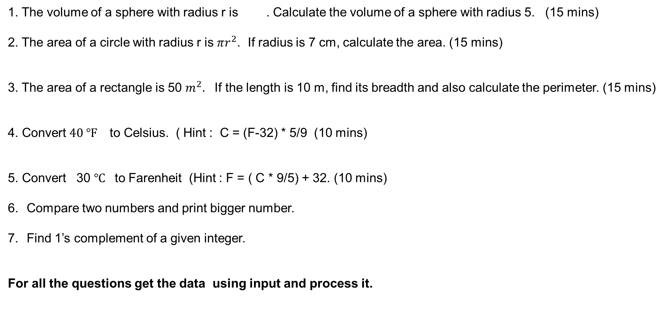
activities
1. The volume of a sphere with radius r is . Calculate the volume of a sphere with radius 5. (15 mins)
2. The area of a circle with radius r is $πr^{2}$. If radius is 7 cm, calculate the area. (15 mins)
3. The area of a rectangle is 50 $m^{2}.$ If the length is 10 m, find its breadth and also calculate the perimeter. (15 mins)
4. Convert $40 ℉$ to Celsius. ( Hint : C = (F-32) * 5/9 (10 mins)
5. Convert 30 $℃$ to Farenheit (Hint : F = ( C * 9/5) + 32. (10 mins)
Compare two numbers and print bigger number.
Find 1’s complement of a given integer.
For all the questions get the data using input and process it.

Slide 38
activities
8. Write a program to find a >> b , a<<b, a ^ b (get input for a and b).
9. Find product of 630 and 8 without using arithmetic operator *.
10. Find the quotient when 450 is divided by 4.

Slide 39
summary
Now, the participants should be able to
Understand simple basic data types in Python
Write simple program using data types
Understand variables in Python
Write program using variables, datatypes, operators etc.

Slide 40
references
https://docs.python.org/3/tutorial/

