Slide 1
Introduction - python language

Slide 2
Learning objectives
  After the completion of this topic, participants will be able to
  Understand the use of Python Language
  Explain the features
  Install Python and verify
  Use Python interpreter
  Work with IDLE – IDE
  Configure PyDev into Eclipse.

Slide 3
What ?
Python is a general purpose programming language created by Guido Van Rossum.
The current release of Python is 3.7.2.
https://www.python.org/ - The official home of the Python Programming Language.

Slide 4
Where?
It is used in the following areas:
GUI development,
Web application,
System administration tasks
Financial calculation,
Data Analysis
Visualization
Building Script for Test Automation

Slide 5
Why?
Readable and Maintainable Code
In Python concept can be expressed without any additional code.
There is no special method or signature in which the code has to be encapsulated to execute. ( in C main() method, in java public static void main) or a class write code.
The readable and clean code base will help you to maintain and update the software without putting extra time and effort.
ex. Reading a file.
with open(“c:\\python\\sample.txt”) as f:
print(f.read())

Slide 6
Why?
Cross platform:
Python is an interpreted language. Python interpreters can be used to run the code on specific platforms. Also, It allows to run the same code on multiple platforms without recompilation. Hence, it is not required to recompile the code after making any alteration. This feature makes it easier to make changes to the code without increasing development time.

Slide 7
Why ?
Multiple Programming Paradigm: Supports Object Oriented and Structured Programming. Python also features a dynamic type system and automatic memory management. This helps us to develop large and complex software applications.
Open Source: Python is a open source programming language.

Slide 8
Why ?
Robust and Standard library : It has large and robust standard library. According to the requirement the modules can be used. Each module further enables us to add functionality to the Python application without writing additional code. For instance, while writing a web application in Python, we can use specific modules to implement web services, perform string operations, manage operating system interface or work with internet protocols.
Information about various modules can be understood by browsing through the Python
Standard Library documentation.

Slide 9
Why?
Supports exception handling: Python supports exception handling which means we can write less error prone code and can test various scenarios that can cause an exception later on.
Dynamically Typed : In python no need to define variable data type ahead of time, python automatically guesses the data type of the variable based on the type of value it contains.
Ex. greet=“welcome” . Here greet is a string variable. Later, if
greet=1 , Now greet is treated as int.

Slide 10
Popular Users of python
  Google
  YouTube
  Quora
  Dropbox
  Yahoo!
  Reddit
  Instagram
  Spotify.
  SurveyMonkey
  Bitley

Slide 11
Installation of python
Requirements :
25 Mb of disk space.
Additional 90 Mb of disk space.
Download python 3.7.2 from the following link:
https://www.python.org/downloads

Slide 12
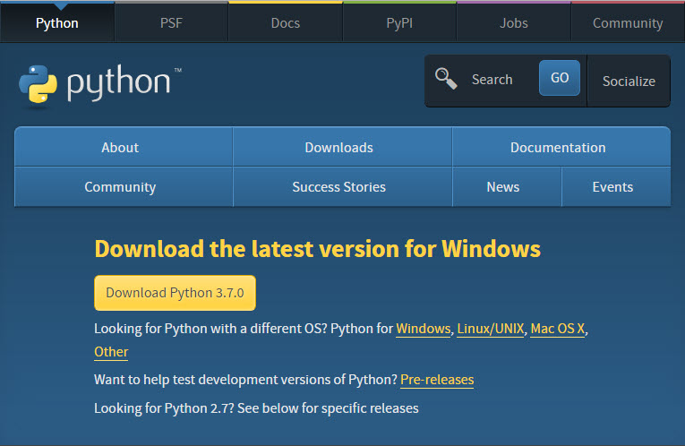
Installation of python

Slide 13
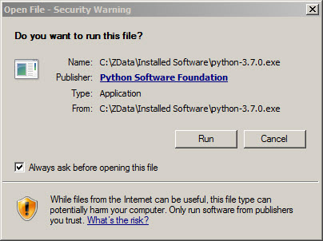
Installation of python
When Download 3.7.2. is clicked, the python-3.7.2.exe is downloaded.
Double click it, the below window appears.
Click Run.

Slide 14
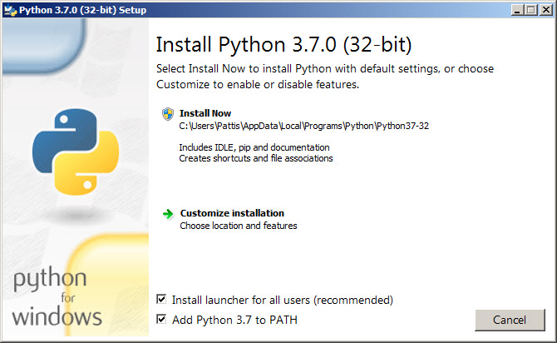
Installation of python
Enable Install launcher for all users and Add Python 3.7 to PATH.
Highlight Install now.

Slide 15
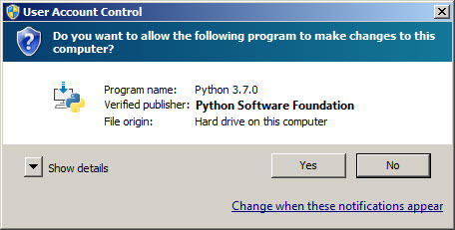
Installation of python
A User Account Conrol pop-up window will appear.
Click Yes.

Slide 16
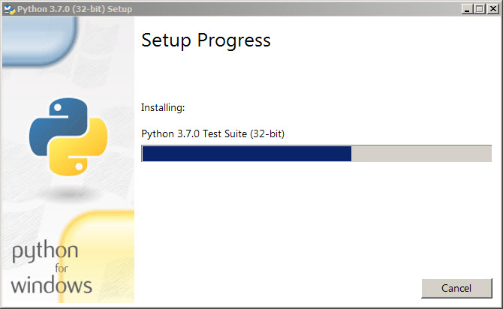
Installation of python
A Setup pop-up window will appear with a Setup Progress message and a progress bar.

Slide 17
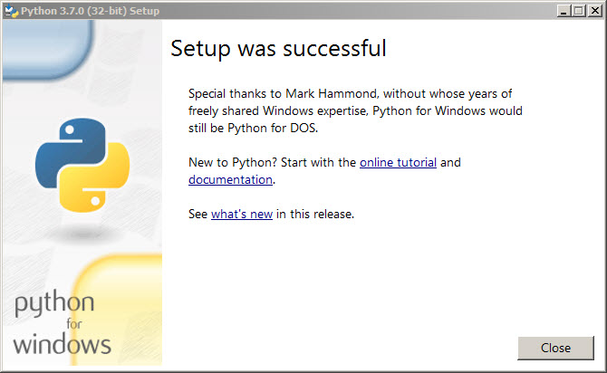
Installation of python
Setup pop-up window will appear with a Setup was successfuly message.

Slide 18
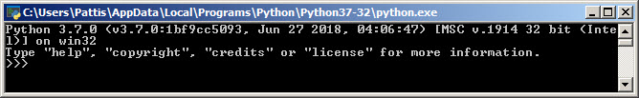
Installation of python
Verifying Python installation.
Navigate to the directory where Python is installed. For ex. (C:\Python34\)
Double-click the icon/file python.exe.
In the prompt(>>>) exit() to terminate python.
Keep the .exe file safely, reinstallation is easy in case required.

Slide 19
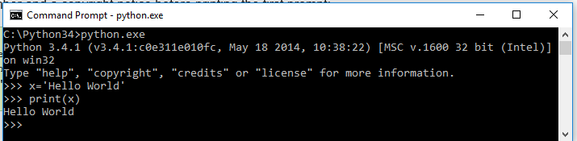
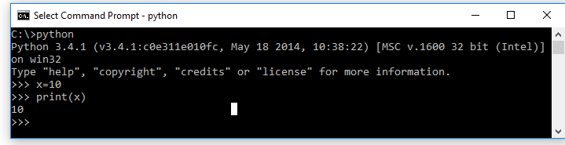
Python interpreter
In windows the Python interpreter is installed in c:\Python37
It can be added to the directory path as set path=%path%;c:\Python37
Ctrl Z -> to quit or type quit().

Slide 20
The whitespace in python
In Python white space represents a tab. It is equivalent to curly braces in other languages to represent the block of code.
For ex.
for x in range(0,50): # Line 1
print(x) # Line 2
print('the value of x = ',x) # Line 3
In Line 2 there is a space – the print statement is in the for loop.
Line 3 is not having white space. It means this line is not inside the for loop.

Slide 21
Python in built Ide - idle
IDEs(Integrated Development Environment) are software very useful for development.
Used to write source code, compile, debug and test.
It helps us to write the code with less time.

Slide 22
Ide Requirements for python coding
To create, save and load files.
Automatic formatting
Execute code
Syntax highlighting
Popular Python IDEs.
PyCharm , Spyder, IDLE, Eclipse + PyDev

Slide 23
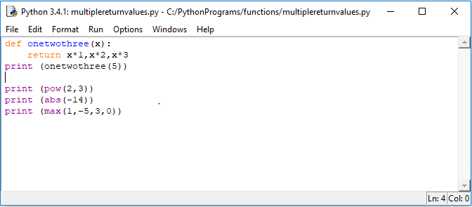
IDLE – in built ide
There are menus available in IDLE.
The source code can be created and executed.

Slide 24
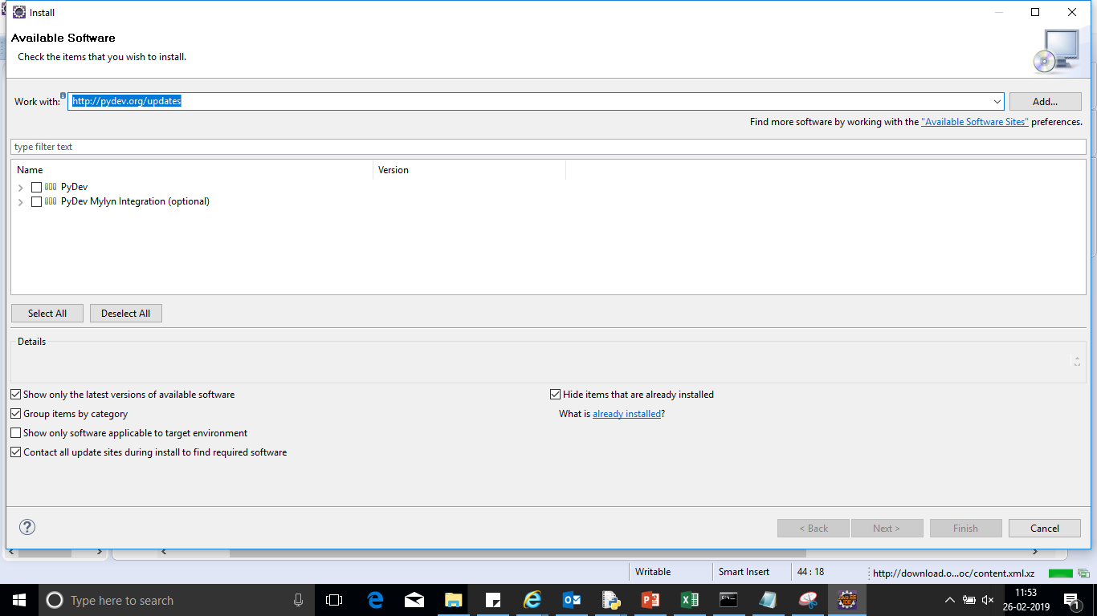
Eclipse – pydev configuration

Slide 25
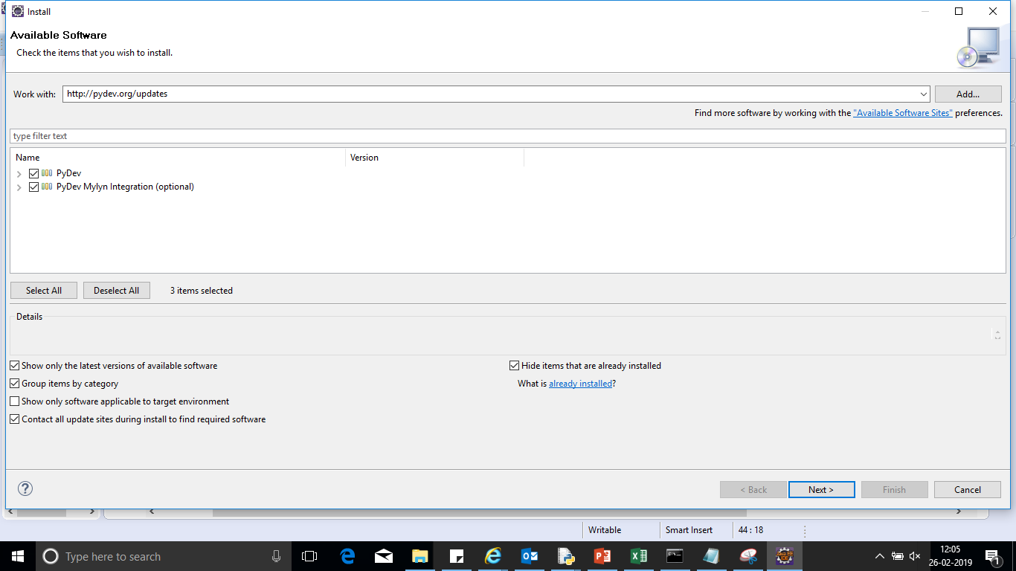
Eclipse pydev configuration

Slide 26
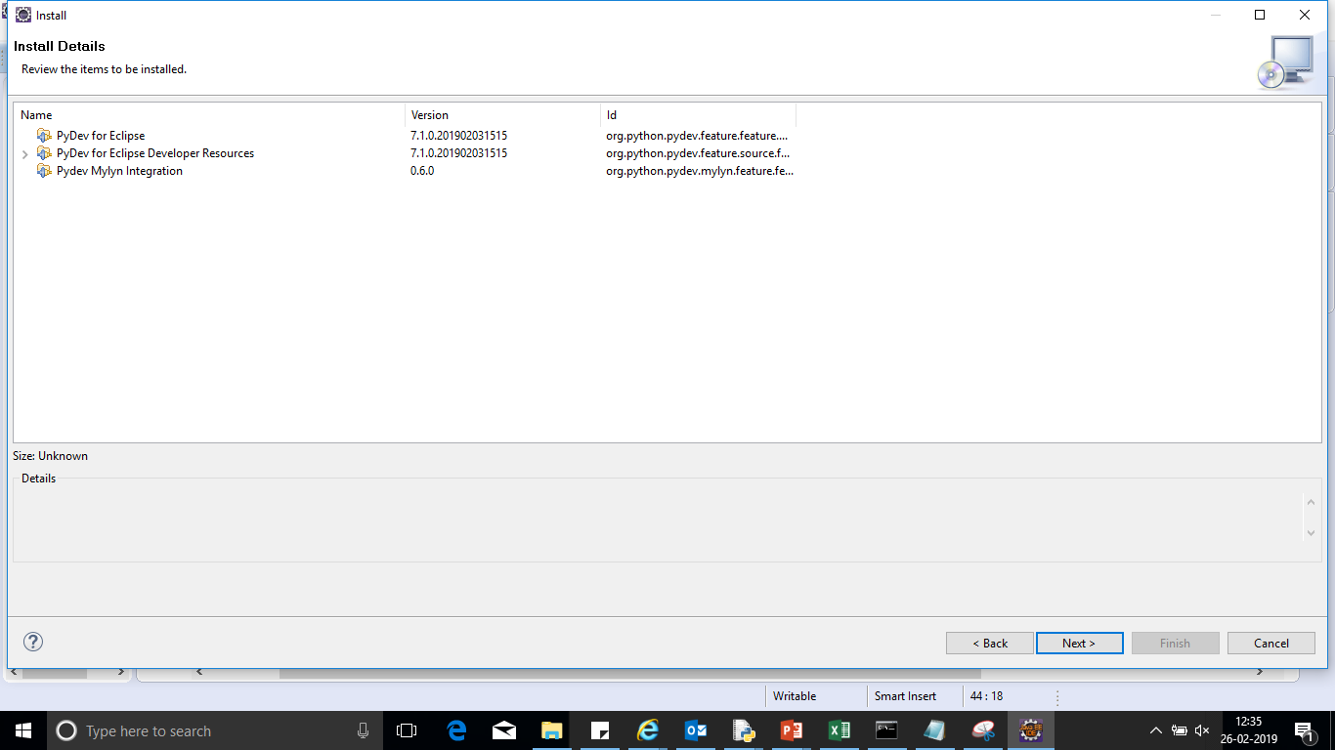
Eclipse pydev configuration

Slide 27
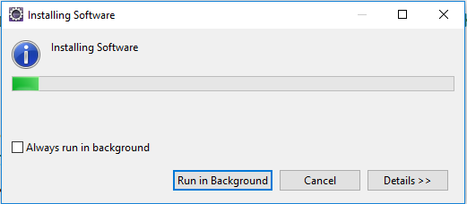
Eclipse pydev configuration
After the installation is completed, restart eclipse.

Slide 28
Configuration of pydev in eclipse
Python must have been installed.
Go to Window → Preferences.
In the Preferences window, expand PyDev and select Interpreter-Python.
Select new and choose the python.exe file in the installed path.
Click ok and another window called selection needed will be opened.
Select all the options and click ok.
The interpreter is setup and eclipse is ready to run python code.

Slide 29
References
https://docs.python.org/3/tutorial/

