Slide 1
Introduction to function and methods

Slide 2
Learning objectives
After the completion of this topic, participants will be able to
Understand functions, built in modules
Write programs using functions and getting input from user
Understand type conversion
Use built in modules in program

Slide 3
Introduction
Programming languages use function to avoid duplication of code and increase the reusability of code.
In this topic, we will discuss
How to create user defined function
What are the built-in functions
Calling user defined functions and built-in functions in program.

Slide 4
function
Function is a set of statements used to perform a particular task. Usually functions are used for mathematical calculations.
Function can be reused.
It avoids the repetition of code.
The function will(in most of the cases) return values to the caller.
The function can return more than one values in Python.
Syntax : def function_name(parameter list):
statement 1
statement 2 etc.

Slide 5

Function
Example : function to calculate the average of three numbers.
To call the function, use the function name and pass the appropriate number of parameters.

Slide 6


Getting user input
}
getting input from user and are of type integers.

Slide 7
activities
Calculate simple interest ( ( p * n * r ) / 100 , where p-> principal amount, n->number of years,
r-> rate of interest. Get user input for p,n and r) -15 mins
Calculate area of a triangle (( 0.5 * b * h) . Pass b (base) and h(height) as parameters) – 10 mins
Check whether string and its reverse are same. ( do not use if statement. The function has to return true or false). – 15 mins.

Slide 8
Type conversion
In python one data type can be directly converted into another data type easily.
Example :
int(a) -> converts a into integer.
float(f) -> converts f into float.
str(s) - > converts s into string
complex(a,b) converts a and b into complex number
ord() -> converts character to integer
hex() -> converts integer to hexadecimal.
oct() – converts integer to octal.

Slide 9
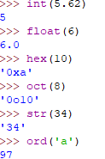
Type conversion
Example:

Slide 10
Built in modules
Modular design is breaking the complex system into smaller components.
It can be created independently and unit tested.
Some modules can be used in other system also.
In python, modules are python files ( with extension .py like other program files) without any special syntax.
It can have any objects like classes, functions, attributes etc.
Python provides many built in modules.
Deep dive of modules and custom modules are discussed in the Module Topic.

Slide 11
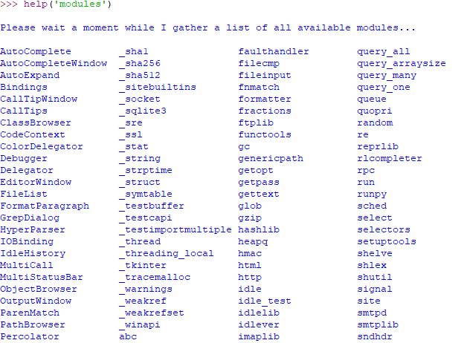
Built in modules
Example of Python built in modules are :
Sys, math, rand, os etc. Below example shows all the modules available in Python.

Slide 12
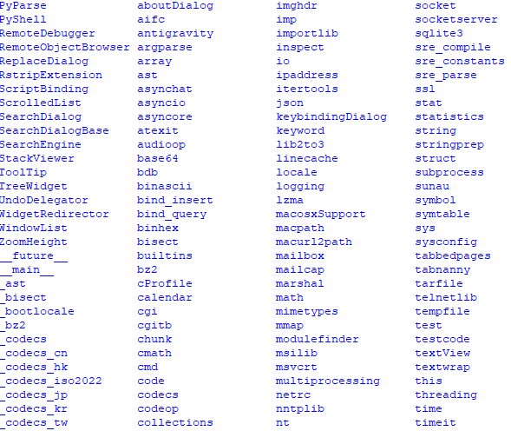
Built in modules

Slide 13
Built in modules
os module – It is used to perform Operating Systems related tasks such as creation, deletion, display the content of directory etc.
sys module – used to manipulate the python runtime environment.
math module – Most popular mathematical functions are available in math module. It has functions related to trigonometry, logarithm and conversion functions etc.
random module – It has functions to generate random numbers.

Slide 14

Built in modules
Import os module. mkdir function is in os.
Creates a directory named sampledir in c drive.
The other functions are :
listdir - list directories and subdirectories.
removedir - remove directory
chdir – change the current directory

Slide 15
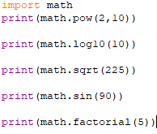

Built in modules
Math module example:
Output :

Slide 16
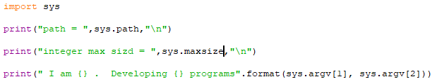
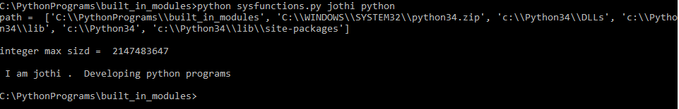
Built in modules
sys module example:

Slide 17


Built in modules
random module example:

Slide 18
activities
List the files and directories present in the current working directory. (use os module)
Write a program to find out the operating system name.
Write a program to list the environment variables. (use os module)
Find factorial of a number. ( using built in modules)
Calculate hypotenuse of a right angled triangle whose opposite side and adjacent side is given as 12cm and 5 cm respectively.
Generate random numbers of length 4.
Display the String arguments passed to the Python script.

Slide 19
activities
List the copyright information of the currently installed python version.
Write a python script to display the PYTHONPATH variable value.
Write a Python script to rename a file name in the current path.

Slide 20
references
https://docs.python.org/3/tutorial/

