Slide 1
Python

Slide 2
Learning objectives
Understand Python language
Write simple program using data types in python
Write program using different data structures
Write program using functions.

Slide 3
What ?
Python is a general purpose programming language created by Guido Van Rossum.

Slide 4
Where?
It is used in the following areas:
GUI development,
Web application,
System administration tasks
Financial calculation,
Data Analysis
Visualization

Slide 5
Why?
Readable and Maintainable Code
In Python concept can be expressed without any additional code.
The readable and clean code base will help you to maintain and update the software without putting extra time and effort.
ex. Reading a file.
with open(“c:\\python\\sample.txt”) as f:
print(f.read())

Slide 6
Why?
Cross platform:
Python is an interpreted language. Python interpreters can be used to run the code on specific platforms. Also, It allows to run the same code on multiple platforms without recompilation. Hence, it is not required to recompile the code after making any alteration. This feature makes it easier to make changes to the code without increasing development time.

Slide 7
Why ?
Multiple Programming Paradigm: Supports Object Oriented and Structured Programming. Python also features a dynamic type system and automatic memory management. This helps us to develop large and complex software applications.
Open Source: Python is a open source programming language.

Slide 8
Why ?
Robust and Standard library : It has large and robust standard library. According to the requirement the modules can be used. Each module further enables us to add functionality to the Python application without writing additional code. For instance, while writing a web application in Python, we can use specific modules to implement web services, perform string operations, manage operating system interface or work with internet protocols.
Information about various modules can be understood by browsing through the Python
Standard Library documentation.

Slide 9
Why?
Supports exception handling: Python supports exception handling which means we can write less error prone code and can test various scenarios that can cause an exception later on.
Dynamically Typed : In python no need to define variable data type ahead of time, python automatically guesses the data type of the variable based on the type of value it contains.
Ex. greet=“welcome” . Here greet is a string variable. Later, if
greet=1 , Now greet is treated as int.

Slide 10
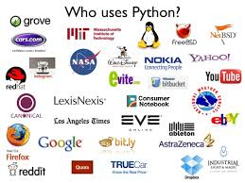
Who?

Slide 11
Installation of python

Slide 12
Learning objectives
Understand installation of python
Use inbuilt IDE – IDLE

Slide 13
Installation of python
Requirements :
25 Mb of disk space.
Additional 90 Mb of disk space.
Download python 3.7.2 from the following link:
https://www.python.org/downloads

Slide 14
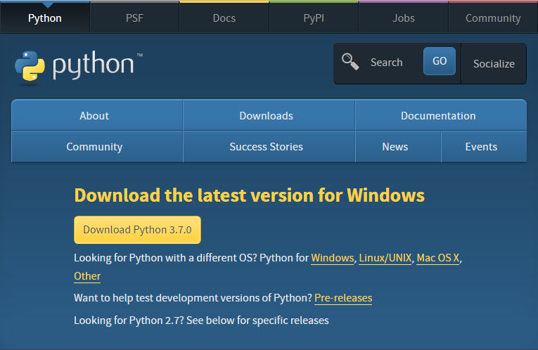
Installation of python

Slide 15
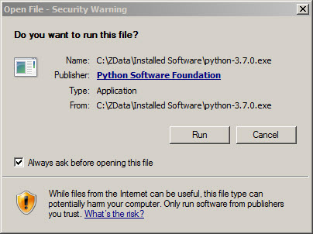
Installation of python
When Download 3.7.2. is clicked, the python-3.7.2.exe is downloaded.
Double click it, the below window appears.
Click Run.

Slide 16
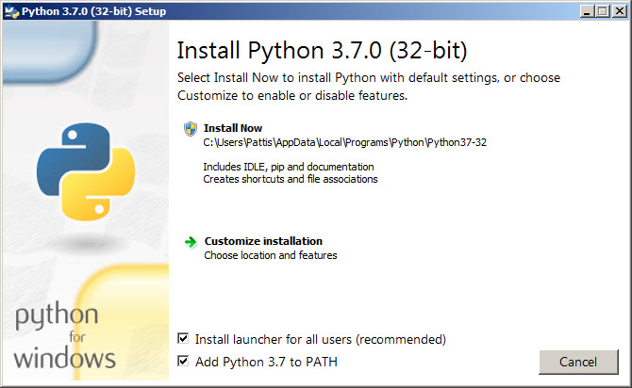
Installation of python
Enable Install launcher for all users and Add Python 3.7 to PATH.
Highlight Install now.

Slide 17
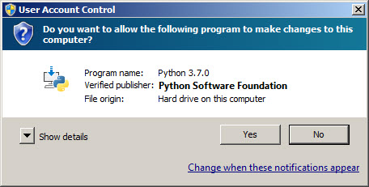
Installation of python
A User Account Conrol pop-up window will appear.
Click Yes.

Slide 18
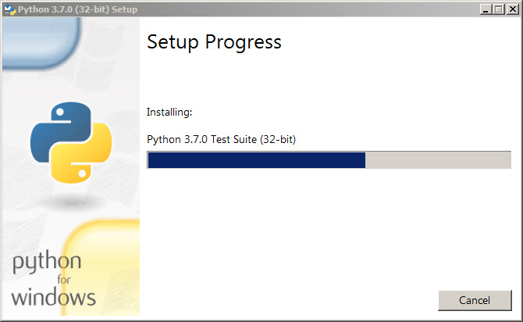
Installation of python
A Setup pop-up window will appear with a Setup Progress message and a progress bar.

Slide 19
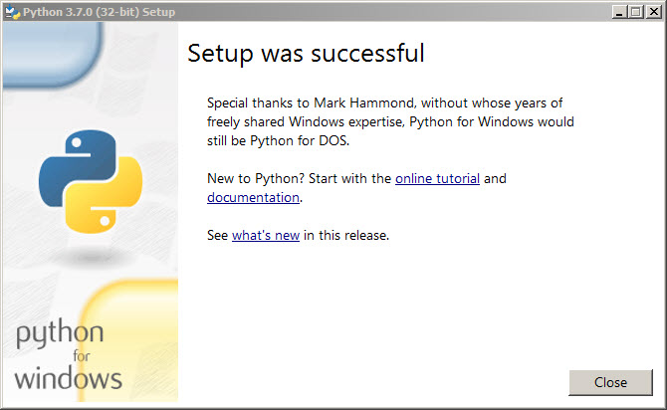
Installation of python
Setup pop-up window will appear with a Setup was successfuly message.

Slide 20
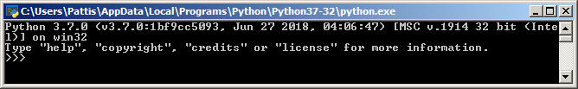
Installation of python
Verifying Python installation.
Navigate to the directory where Python is installed. For ex. (C:\Python34\)
Double-click the icon/file python.exe.
In the prompt(>>>) exit() to terminate python.
Keep the .exe file safely, reinstallation is easy in case required.

Slide 21
Python interpreter

Slide 22
Learning objectives
Understand Python interpreter
Use Python interpreter

Slide 23
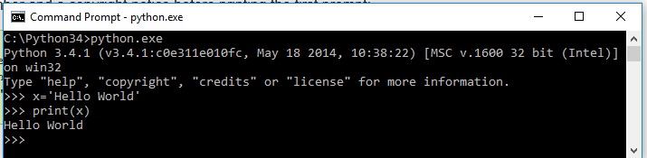
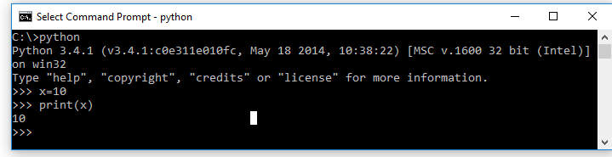
Python interpreter
In windows the Python interpreter is installed in c:\Python37
It can be added to the directory path as set path=%path%;c:\Python37
Ctrl Z -> to quit or type quit().

Slide 24
The whitespace in python
In Python white space represents a tab. It is equivalent to curly braces in other languages to represent the block of code.
For ex.
for x in range(0,50): # Line 1
print(x) # Line 2
print('the value of x = ',x) # Line 3
In Line 2 there is a space – the print statement is in the for loop.
Line 3 is not having white space. It means this line is not inside the for loop.

Slide 25
Ide

Slide 26
Learning objectives
Understand different IDE used for Python application development.
Work with IDLE – the built in IDE of Python.

Slide 27
Python in built Ide - idle
IDEs(Integrated Development Environment) are software very useful for development.
Used to write source code, compile, debug and test.
It helps us to write the code with less time.

Slide 28
Ide Requirements for python coding
To create, save and load files.
Automatic formatting
Execute code
Syntax highlighting
Popular Python IDEs.
PyCharm , Spyder, IDLE, Eclipse + PyDev

Slide 29
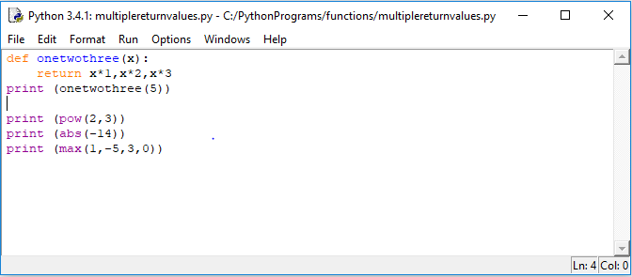
IDLE – in built ide
There are menus available in IDLE.
The source code can be created and executed.

Slide 31
How?
Let us study
Data types
Syntax
Programming constructs
Functions
Modules
Threads

Slide 32
Data Types
Numbers
int
long (use L or l)
float
complex
String
List
Tuple
Dictionary

Slide 33
Data Types
An integer (int) is a number without decimal point.
Ex. 1,2,3 etc.
A float is a number with decimal point.
Ex. 5.9, 10.67 , 45.78 etc.
A complex number has a real part and imaginary part.
Ex. 5+6j, 9+10j etc.

Slide 34
Data Types // String
String is a sequence of characters.
We can use single quotes or double quotes.
Ex. ‘Python’ “Python”
Triple quotes are used for multi-line strings.
Ex. ‘’’ Python is a programming
language ‘’’
sample

Slide 35
Data Types // String
String is a sequence of characters. It can be accessed by using index.
Like an array, it starts with 0.
sample

Slide 36
Data Types // String
Operations in String:-
Concatenation - +
Repetition - * operator
sample

Slide 37
Data Types // String
Membership test in string
>>> ‘r’ in ‘training’ - >returns true
>>> ‘x’ in ‘training’ -> returns false

Slide 38
Data Structures

Slide 39
Learning objectives
Understand different data structures in Python
Differentiate the data structures
Write simple programs using different data structures

Slide 40
List
List is data type where elements can be placed elements inside a square bracket [ ], separated by commas.
It can have any number of items and they may be of different types (integer, float, string etc.).
Ex.
sample_list=[1, ‘abcd’, 30.04]
sample_list=[]

Slide 41
List
Nested List:
A list can have another list as member.
Ex.
sample_list=[‘earth’, [8, 4, 6], [‘sky’,’blue']]
ListDemo

Slide 42
List
Index operator is used to access the elements.
Sample_list[0] – to access first element – outputs earth
Sample_list[1] – outputs [8,4,6]
ListDemo

Slide 43
LISt
Slicing List
The range of items in a list can be accessed using slice operations.
Ex. even_list=[2,4,6,8,10,12,14,18,20]
Print(even_list[2:5]) # prints from 3rd to 5th item.

Slide 44
list
even_list=[2,4,6,8,10,12,14,16,18,20]
#print 2nd to 5th item
print(even_list[2:5])
#print last item to 5th last item
print(even_list[-5])
#print elements begining to end
print(even_list[:])

Slide 45
List // methods
append() - Add an element to the end of the list
extend() - Add all elements of a list to the another list
insert() - Insert an item at the defined index
remove() - Removes an item from the list
pop() - Removes and returns an element at the given index
clear() - Removes all items from the list
index() - Returns the index of the first matched item
count() - Returns the count of number of items passed as an argument
sort() - Sort items in a list in ascending order
reverse() - Reverse the order of items in the list
copy() - Returns a shallow copy of the list

Slide 46
Control structures

Slide 47
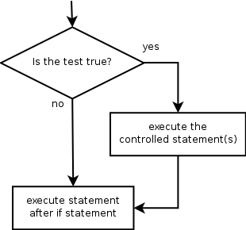
if
if statement: Executes a group of statements only if a certain condition is true. Otherwise, the statements are skipped.
Syntax:
if condition:
statements
Example:
gpa = 3.4
if gpa > 2.0:
print "Your application is accepted."

Slide 48
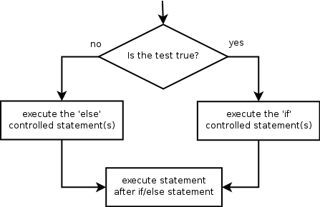
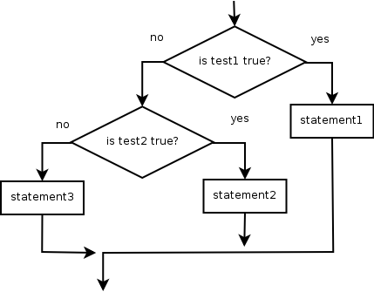
if/else
if/else statement: Executes one block of statements if a certain condition is True, and a second block of statements if it is False.
Syntax:
if condition:
statements
else:
statements
Multiple conditions can be chained with elif ("else if"):
if condition:
statements
elif condition:
statements
else:
statements

Slide 49
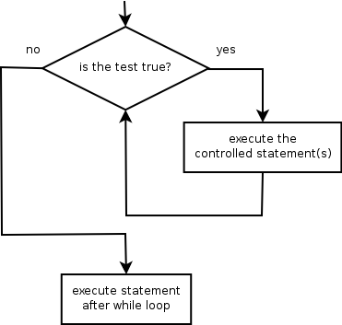
while
while loop: Executes a group of statements as long as a condition is True.
good for indefinite loops (repeat an unknown number of times)
Syntax:
while condition:
statements
Example:
number = 1
while number < 200:
print number,
number = number * 2
Output:
1 2 4 8 16 32 64 128

Slide 50
Logic
Many logical expressions use relational operators:
Logical expressions can be combined with logical operators:
.
Operator | Meaning | Example | Result
== | equals | 1 + 1 == 2 | True
!= | does not equal | 3.2 != 2.5 | True
< | less than | 10 < 5 | False
> | greater than | 10 > 5 | True
<= | less than or equal to | 126 <= 100 | False
>= | greater than or equal to | 5.0 >= 5.0 | True
Operator | Example | Result
and | 9 != 6 and 2 < 3 | True
or | 2 == 3 or -1 < 5 | True
not | not 7 > 0 | False

Slide 51
The for loop
for loop: Repeats a set of statements over a group of values.
Syntax:
for variableName in groupOfValues:
statements
We indent the statements to be repeated with tabs or spaces.
variableName gives a name to each value, so you can refer to it in the statements.
groupOfValues can be a range of integers, specified with the range function.
Example:
for x in range(1, 6):
print x, "squared is", x * x
Output:
1 squared is 1
2 squared is 4
3 squared is 9
4 squared is 16
5 squared is 25

Slide 52
range
The range function specifies a range of integers:
range(start, stop) - the integers between start (inclusive)
and stop (exclusive)
It can also accept a third value specifying the change between values.
range(start, stop, step) - the integers between start (inclusive)
and stop (exclusive) by step
Example:
for x in range(5, 0, -1):
print x
print "Blastoff!"
Output:
5
4
3
2
1
Blastoff!

Slide 53
Cumulative loops
Some loops incrementally compute a value that is initialized outside the loop. This is sometimes called a cumulative sum.
sum = 0
for i in range(1, 11):
sum = sum + (i * i)
print "sum of first 10 squares is", sum
Output:
sum of first 10 squares is 385

Slide 54
Working with Functions

Slide 55
Functions
Define them in the file above the point they're used
Body of the function should be indented consistently (4 spaces is typical in Python)‏
Example: square.py def square(n): return n*n print "The square of 3 is ", print square(3) Output: The square of 3 is 9

Slide 56
The def statement
The def statement is excecuted (that's why functions have to be defined before they're used)‏
def creates an object and assigns a name to reference it; the function could be assigned another name, function names can be stored in a list, etc.
Can put a def statement inside an if statement, etc!

Slide 57
More about functions
Arguments are optional. Multiple arguments are separated by commas.
If there's no return statement, then “None” is returned. Return values can be simple types or tuples. Return values may be ignored by the caller.
Functions are “typeless.” Can call with arguments of any type, so long as the operations in the function can be applied to the arguments. This is considered a good thing in Python.

Slide 58
Function variables are local
Variables declared in a function do not exist outside that function
Example square2.py def square(n): m = n*n return m print "The square of 3 is ", print square(3) print m Output: File "./square2.py", line 9, in <module> print m NameError: name 'm' is not defined

Slide 59
Scope
Variables assigned within a function are local to that function call
Variables assigned at the top of a module are global to that module; there's only “global” within a module
Within a function, Python will try to match a variable name to one assigned locally within the function; if that fails, it will try within enclosing function-defining (def) statements (if appropriate); if that fails, it will try to resolve the name in the global scope (but the variable must be declared global for the function to be able to change it). If none of these match, Python will look through the list of built-in names

Slide 60
Scope example
scope.py a = 5 # global def func(b): c = a + b return c print func(4) # gives 4+5=9 print c # not defined

Slide 61
Scope example
scope.py a = 5 # global def func(b): global c c = a + b return c print func(4) # gives 4+5=9 print c # now it's defined (9)‏

Slide 62
By value / by reference
Everything in Python is a reference. However, note also that immutable objects are not changeable --- so changes to immutable objects within a function only change what object the name points to (and do not affect the caller, unless it's a global variable)‏
For immutable objects (e.g., integers, strings, tuples), Python acts like C's pass by value
For mutable objects (e.g., lists), Python acts like C's pass by pointer; in-place changes to mutable objects can affect the caller

Slide 63
Example
passbyref.py def f1(x,y): x = x * 1 y = y * 2 print x, y # 0 [1, 2, 1, 2] def f2(x,y): x = x * 1 y[0] = y[0] * 2 print x, y # 0 [2, 2] a = 0 b = [1,2] f1(a,b) print a, b # 0 [1, 2] f2(a,b) print a, b # 0 [2, 2]

Slide 64
Multiple return values
Can return multiple values by packaging them into a tuple def onetwothree(x): return x*1, x*2, x*3 print onetwothree(3) 3, 6, 9

Slide 65
Built-in Functions
Several useful built-in functions. Example math.py print pow(2,3) print abs(-14) print max(1,-5,3,0) Output: 8 14 3

Slide 66
Functions of Functions
Example funcfunc.py def iseven(x,f): if (f(x) == f(-x)): return True else: return False def square(n): return(n*n) def cube(n): return(n*n*n) print iseven(2,square) print iseven(2,cube)‏
Output: True False

Slide 67
Default arguments
Like C or Java, can define a function to supply a default value for an argument if one isn't specified def print_error(lineno, message=”error”): print “%s at line %d” % (message, lineno) print_error(42) error at line 42

Slide 68
Functions without return values
All functions in Python return something. If a return statement is not given, then by default, Python returns None
Beware of assigning a variable to the result of a function which returns None. For example, the list append function changes the list but does not return a value: a = [0, 1, 2] b = a.append(3) print b None

Slide 69
Text Processing

Slide 70
Strings
string: A sequence of text characters in a program.
Strings start and end with quotation mark " or apostrophe ' characters.
Examples: "hello" "This is a string" "This, too, is a string. It can be very long!"
A string may not span across multiple lines or contain a " character. "This is not a legal String."
"This is not a "legal" String either."
A string can represent characters by preceding them with a backslash.
\t tab character
\n new line character
\" quotation mark character
\\ backslash character
Example: "Hello\tthere\nHow are you?"

Slide 71
Indexes
Characters in a string are numbered with indexes starting at 0:
Example:
name = "P. Diddy"
Accessing an individual character of a string:
variableName [ index ]
Example:
print name, "starts with", name[0]
Output:
P. Diddy starts with P
index | 0 | 1 | 2 | 3 | 4 | 5 | 6 | 7
character | P | . |  | D | i | d | d | y

Slide 72
String properties
len(string) - number of characters in a string
(including spaces)
str.lower(string) - lowercase version of a string
str.upper(string) - uppercase version of a string
Example:
name = "Martin Douglas Stepp"
length = len(name)
big_name = str.upper(name)
print big_name, "has", length, "characters"
Output:
MARTIN DOUGLAS STEPP has 20 characters

Slide 73
input
input : Reads a string of text from user input.
Example:
name = input(‘what\’s your name?’)
print(name,’... what a silly name!’)
Addtwonumbers(c:\\pythonprograms\\stringsamples\\five.py)

Slide 74
Text processing
text processing: Examining, editing, formatting text.
often uses loops that examine the characters of a string one by one
A for loop can examine each character in a string in sequence.
Example:
for c in "booyah":
print c
Output:
b
o
o
y
a
h

Slide 75
Strings and numbers
ord(text) - converts a string into a number.
Example: ord("a") is 97, ord("b") is 98, ...
Characters map to numbers using standardized mappings such as ASCII and Unicode.
chr(number) - converts a number into a string.
Example: chr(99) is "c"

