Slide 1
Python Introdcution

Slide 2
Module Meta Data
S. No. | Module Meta Data | Details | Remarks
1. | Author | Pramod Dhiman
2. | Reviewer | Pramod Dhiman
3. | Version Number | V1.0
4. | Release Date | 24-Sep-2016

Slide 3
Course Objectives
To prepare Scholars understand the concepts of Python

Slide 4
Course Outcomes
Trainees will be able to understand the concept of Python

Slide 5
Features Overview
Python is a clear and powerful object-oriented programming language, comparable to Perl, Ruby, Scheme, or Java.
Some of Python's notable features:
Uses an elegant syntax, making the programs you write easier to read.
Is an easy-to-use language that makes it simple to get your program working. This makes Python ideal for prototype development and other ad-hoc programming tasks, without compromising maintainability.
Comes with a large standard library that supports many common programming tasks such as connecting to web servers, searching text with regular expressions, reading and modifying files.
Python's interactive mode makes it easy to test short snippets of code. There's also a bundled development environment called IDLE.

Slide 6
Features Overview (Contd.)
Some more of Python's notable features:
Is easily extended by adding new modules implemented in a compiled language such as C or C++.
Can also be embedded into an application to provide a programmable interface.
Runs on many different computers and operating systems: Windows, MacOS, many brands of Unix, OS/2, ...
Is free software in two senses. It doesn't cost anything to download or use Python, or to include it in your application. Python can also be freely modified and re-distributed, because while the language is copyrighted it's available under an open source license.

Slide 7
Programming Features
A variety of basic data types are available: numbers (floating point, complex, and unlimited-length long integers), strings (both ASCII and Unicode), lists, and dictionaries.
Python supports object-oriented programming with classes and multiple inheritance.
Code can be grouped into modules and packages.
The language supports raising and catching exceptions, resulting in cleaner error handling.
Data types are strongly and dynamically typed. Mixing incompatible types (e.g. attempting to add a string and a number) causes an exception to be raised, so errors are caught sooner.
Python contains advanced programming features such as generators and list comprehensions.
Python's automatic memory management frees you from having to manually allocate and free memory in your code.

Slide 8
Python Language Basics

Slide 9
Very Basic Stuff
You can run python programs from files, just like perl or shell scripts, by typing “python program.py” at the command line. The file can contain just the python commands.
Or, one can invoke the program directly by typing the name of the file, “program.py”, if it has as a first line something like “#!/usr/bin/python” (like a shell script... works as long as the file has execute permissions set)‏
Alternatively, you can enter a python shell and run python commands interactively, by typing “python”

Slide 10
The print Statement
Elements separated by commas print with a space between them
A comma at the end of the statement (print ‘hello’,) will not print a newline character
>>> print 'hello'
Hello
>>> print 'hello', 'there'
hello there

Slide 11
Hello, world!
Let's get started! Here's an example of a python program run as a script: #!/usr/bin/python print “Hello, world”
If this is saved to a file hello.py, then set execute permissions on this file, and run it with “./hello.py”
When run, this program prints Hello, world

Slide 12
More about printing
>>> print 'hello:', x, x**2, x**3 hello: 4 16 64
\t is a tab character >>> print "2**2 =","\t",2**2 2**2 = 4
Ending a print statement with a comma suppresses the newline, so the next print statement continues on the same line
Can print to an open file (later) like this: print >> outfile, message

Slide 13
Example
Example basics.py #!/usr/bin/perl print 1+3 pi = 3.1415926 print pi message = "Hello, world" print message Output: 4 3.1415926 Hello, world

Slide 14
Variable types
In the previous example, “pi” and “message” are variables, but one is a floating point number, and the other is a string. Notice we didn't declare the types in our example. Python has decided types for the variables, however.
Actually, “variables” in python are really object references. The reason we don't need to declare types is that a reference might point to a different type later. references.py: x=42 y=”hello” print x,y # prints 42 hello print x,y # prints 42 42

Slide 15
Variable types
Example types.py: pi = 3.1415926 message = "Hello, world" i = 2+2 print type(pi) print type(message) print type(i) Output: <type 'float'> <type 'str'> <type 'int'>

Slide 16
Variable names
Can contain letters, numbers, and underscores
Must begin with a letter
Cannot be one of the reserved Python keywords: and, as, assert, break, class, continue, def, del, elif, else, except, exec, finally, for, from, global, if, import, in, is, lambda, not, or, pass, print, raise, return, try, while, with, yield

Slide 17
More on variable names
Names starting with one underscore (_V) are not imported from the module import * statement
Names starting and ending with 2 underscores are special, system-defined names (e.g., __V__)‏
Names beginning with 2 underscores (but without trailing underscores) are local to a class (__V)‏
A single underscore (_) by itself denotes the result of the last expression

Slide 18
Operators
+ addition
- subtraction
/ division
** exponentiation
% modulus (remainder after division)‏
Comparison operators

Slide 19
Operators
Example operators.py print 2*2 print 2**3 print 10%3 print 1.0/2.0 print 1/2 Output: 4 8 1 0.5 0
Note the difference between floating point division and integer division in the last two lines

Slide 20
Type conversion
int(), float(), str(), and bool() convert to integer, floating point, string, and boolean (True or False) types, respectively
Example typeconv.py: print 1.0/2.0 print 1/2 print float(1)/float(2) print int(3.1415926) print str(3.1415926) print bool(1) print bool(0)‏
Output: 0.5 0 0.5 3 3.1415926 True False

Slide 21
Operators acting on strings
>>> "Ni!"*3 'Ni!Ni!Ni!‘
>>> "hello " + "world!" 'hello world!'

Slide 22
Input from keyboard
Example input.py i = raw_input("Enter a math expression: ") print i j = input("Enter the same expression: ") print j
Output: localhost(workshop)% ./input.py Enter a mathematical expression: 3+2 3+2 Enter the same expression: 3+2 5

Slide 23
Comments
Anything after a # symbol is treated as a comment
Comments are used for documentation purpose only and are ignored by Python interpreter.
>>> 'this will print'
'this will print'
>>> #'this will not'
>>>

Slide 24
Repetition (loops) and Selection (if/else)

Slide 25
The for loop
for loop: Repeats a set of statements over a group of values.
Syntax:
for variableName in groupOfValues:
statements
We indent the statements to be repeated with tabs or spaces.
variableName gives a name to each value, so you can refer to it in the statements.
groupOfValues can be a range of integers, specified with the range function.
Example:
for x in range(1, 6):
print x, "squared is", x * x
Output:
1 squared is 1
2 squared is 4
3 squared is 9
4 squared is 16
5 squared is 25

Slide 26
range
The range function specifies a range of integers:
range(start, stop) - the integers between start (inclusive)
and stop (exclusive)
It can also accept a third value specifying the change between values.
range(start, stop, step) - the integers between start (inclusive)
and stop (exclusive) by step
Example:
for x in range(5, 0, -1):
print x
print "Blastoff!"
Output:
5
4
3
2
1
Blastoff!

Slide 27
Cumulative loops
Some loops incrementally compute a value that is initialized outside the loop. This is sometimes called a cumulative sum.
sum = 0
for i in range(1, 11):
sum = sum + (i * i)
print "sum of first 10 squares is", sum
Output:
sum of first 10 squares is 385

Slide 28
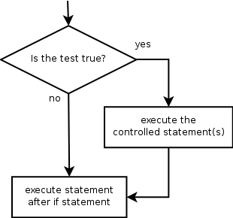
if
if statement: Executes a group of statements only if a certain condition is true. Otherwise, the statements are skipped.
Syntax:
if condition:
statements
Example:
gpa = 3.4
if gpa > 2.0:
print "Your application is accepted."

Slide 29
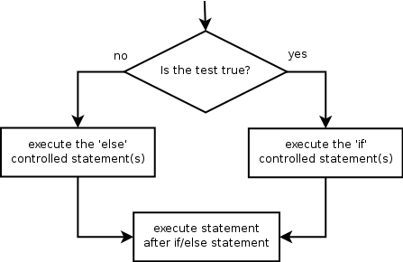
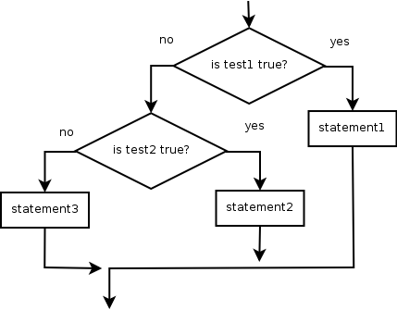
if/else
if/else statement: Executes one block of statements if a certain condition is True, and a second block of statements if it is False.
Syntax:
if condition:
statements
else:
statements
Multiple conditions can be chained with elif ("else if"):
if condition:
statements
elif condition:
statements
else:
statements

Slide 30
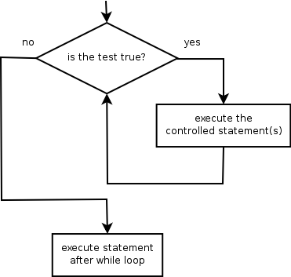
while
while loop: Executes a group of statements as long as a condition is True.
good for indefinite loops (repeat an unknown number of times)
Syntax:
while condition:
statements
Example:
number = 1
while number < 200:
print number,
number = number * 2
Output:
1 2 4 8 16 32 64 128

Slide 31
Logic
Many logical expressions use relational operators:
Logical expressions can be combined with logical operators:
.
Operator | Meaning | Example | Result
== | equals | 1 + 1 == 2 | True
!= | does not equal | 3.2 != 2.5 | True
< | less than | 10 < 5 | False
> | greater than | 10 > 5 | True
<= | less than or equal to | 126 <= 100 | False
>= | greater than or equal to | 5.0 >= 5.0 | True
Operator | Example | Result
and | 9 != 6 and 2 < 3 | True
or | 2 == 3 or -1 < 5 | True
not | not 7 > 0 | False

Slide 32
Working with Functions

Slide 33
Functions
Define them in the file above the point they're used
Body of the function should be indented consistently (4 spaces is typical in Python)‏
Example: square.py def square(n): return n*n print "The square of 3 is ", print square(3) Output: The square of 3 is 9

Slide 34
The def statement
The def statement is excecuted (that's why functions have to be defined before they're used)‏
def creates an object and assigns a name to reference it; the function could be assigned another name, function names can be stored in a list, etc.
Can put a def statement inside an if statement, etc!

Slide 35
More about functions
Arguments are optional. Multiple arguments are separated by commas.
If there's no return statement, then “None” is returned. Return values can be simple types or tuples. Return values may be ignored by the caller.
Functions are “typeless.” Can call with arguments of any type, so long as the operations in the function can be applied to the arguments. This is considered a good thing in Python.

Slide 36
Function variables are local
Variables declared in a function do not exist outside that function
Example square2.py def square(n): m = n*n return m print "The square of 3 is ", print square(3) print m Output: File "./square2.py", line 9, in <module> print m NameError: name 'm' is not defined

Slide 37
Scope
Variables assigned within a function are local to that function call
Variables assigned at the top of a module are global to that module; there's only “global” within a module
Within a function, Python will try to match a variable name to one assigned locally within the function; if that fails, it will try within enclosing function-defining (def) statements (if appropriate); if that fails, it will try to resolve the name in the global scope (but the variable must be declared global for the function to be able to change it). If none of these match, Python will look through the list of built-in names

Slide 38
Scope example
scope.py a = 5 # global def func(b): c = a + b return c print func(4) # gives 4+5=9 print c # not defined

Slide 39
Scope example
scope.py a = 5 # global def func(b): global c c = a + b return c print func(4) # gives 4+5=9 print c # now it's defined (9)‏

Slide 40
By value / by reference
Everything in Python is a reference. However, note also that immutable objects are not changeable --- so changes to immutable objects within a function only change what object the name points to (and do not affect the caller, unless it's a global variable)‏
For immutable objects (e.g., integers, strings, tuples), Python acts like C's pass by value
For mutable objects (e.g., lists), Python acts like C's pass by pointer; in-place changes to mutable objects can affect the caller

Slide 41
Example
passbyref.py def f1(x,y): x = x * 1 y = y * 2 print x, y # 0 [1, 2, 1, 2] def f2(x,y): x = x * 1 y[0] = y[0] * 2 print x, y # 0 [2, 2] a = 0 b = [1,2] f1(a,b) print a, b # 0 [1, 2] f2(a,b) print a, b # 0 [2, 2]

Slide 42
Multiple return values
Can return multiple values by packaging them into a tuple def onetwothree(x): return x*1, x*2, x*3 print onetwothree(3) 3, 6, 9

Slide 43
Built-in Functions
Several useful built-in functions. Example math.py print pow(2,3) print abs(-14) print max(1,-5,3,0) Output: 8 14 3

Slide 44
Functions of Functions
Example funcfunc.py def iseven(x,f): if (f(x) == f(-x)): return True else: return False def square(n): return(n*n) def cube(n): return(n*n*n) print iseven(2,square) print iseven(2,cube)‏
Output: True False

Slide 45
Default arguments
Like C or Java, can define a function to supply a default value for an argument if one isn't specified def print_error(lineno, message=”error”): print “%s at line %d” % (message, lineno) print_error(42) error at line 42

Slide 46
Functions without return values
All functions in Python return something. If a return statement is not given, then by default, Python returns None
Beware of assigning a variable to the result of a function which returns None. For example, the list append function changes the list but does not return a value: a = [0, 1, 2] b = a.append(3) print b None

Slide 47
Text Processing

Slide 48
Strings
string: A sequence of text characters in a program.
Strings start and end with quotation mark " or apostrophe ' characters.
Examples: "hello" "This is a string" "This, too, is a string. It can be very long!"
A string may not span across multiple lines or contain a " character. "This is not a legal String."
"This is not a "legal" String either."
A string can represent characters by preceding them with a backslash.
\t tab character
\n new line character
\" quotation mark character
\\ backslash character
Example: "Hello\tthere\nHow are you?"

Slide 49
Indexes
Characters in a string are numbered with indexes starting at 0:
Example:
name = "P. Diddy"
Accessing an individual character of a string:
variableName [ index ]
Example:
print name, "starts with", name[0]
Output:
P. Diddy starts with P
index | 0 | 1 | 2 | 3 | 4 | 5 | 6 | 7
character | P | . |  | D | i | d | d | y

Slide 50
String properties
len(string) - number of characters in a string
(including spaces)
str.lower(string) - lowercase version of a string
str.upper(string) - uppercase version of a string
Example:
name = "Martin Douglas Stepp"
length = len(name)
big_name = str.upper(name)
print big_name, "has", length, "characters"
Output:
MARTIN DOUGLAS STEPP has 20 characters

Slide 51
raw_input
raw_input : Reads a string of text from user input.
Example:
name = raw_input("Howdy, pardner. What's yer name? ")
print name, "... what a silly name!"
Output:
Howdy, pardner. What's yer name? Hilton
Hilton ... what a silly name!

Slide 52
Text processing
text processing: Examining, editing, formatting text.
often uses loops that examine the characters of a string one by one
A for loop can examine each character in a string in sequence.
Example:
for c in "booyah":
print c
Output:
b
o
o
y
a
h

Slide 53
Strings and numbers
ord(text) - converts a string into a number.
Example: ord("a") is 97, ord("b") is 98, ...
Characters map to numbers using standardized mappings such as ASCII and Unicode.
chr(number) - converts a number into a string.
Example: chr(99) is "c"

Slide 54
Module Basics

Slide 55
Module basics
Each file in Python is considered a module. Everything within the file is encapsulated within a namespace (which is the name of the file)‏
To access code in another module (file), import that file, and then access the functions or data of that module by prefixing with the name of the module, followed by a period
To import a module: import sys (note: no file suffix)‏
Can import user-defined modules or some “standard” modules like sys and random
Any python program needs one “top level” file which imports any other needed modules

Slide 56
Python standard library
There are over 200 modules in the Standard Library
Consult the Python Library Reference Manual, included in the Python installation and/or available at http://www.python.org

Slide 57
What import does
An import statement does three things: - Finds the file for the given module - Compiles it to bytecode - Runs the module's code to build any objects (top-level code, e.g., variable initialization)‏
The module name is only a simple name; Python uses a module search path to find it. It will search: (a) the directory of the top-level file, (b) directories in the environmental variable PYTHONPATH, (c) standard directories, and (d) directories listed in any .pth files (one directory per line in a plain text file); the path can be listed by printing sys.path

Slide 58
The sys module
Printing the command-line arguments, print-argv.pl import sys cmd_options = sys.argv i = 0 for cmd in cmd_options: print "Argument ", i, "=", cmd i += 1 output: localhost(Chapter8)% ./print-argv.pl test1 test2 Argument 0 = ./print-argv.pl Argument 1 = test1 Argument 2 = test2

Slide 59
The random module
import random guess = random.randint(1,100) print guess dinner = random.choice([“meatloaf”, “pizza”, “chicken pot pie”]) print dinner

Slide 60
Import vs from ... import
Import brings in a whole module; you need to qualify the names by the module name (e.g., sys.argv)‏
“import from” copies names from the module into the current module; no need to qualify them (note: these are copies, not links, to the original names) from module_x import junk junk() # not module_x.junk() from module_x import * # gets all top-level # names from module_x

Slide 61
Changing data in modules
Reassigning a new value to a fetched name from a module does not change the module, but changing a mutable variable from a module does: from module_x import x,y x = 30 # doesn't change x in module_x y[0] = 1 # changes y[0] in module_x
This works just like functions
To actually change a global name in another file, could use import (without “from”) and qualify the variable: module_x.x = 30 (but this breaks data encapsulation)

Slide 62
Reloading modules
A module's top-level code is only run the first time the module is imported. Subsequent imports don't do anything.
The reload function forces a reload and re-run of a module; can use if, e.g., a module changes while a Python program is running
reload is passed an existing module object reload(module_x) # module_x must have been # previously imported
reload changes the module object in-place
reload does not affect prior from..import statements (they still point to the old objects)‏

Slide 63
Module Packages
When using import, we can give a directory path instead of a simple name. A directory of Python code is known as a “package”: import dir1.dir2.module or from dir1.dir2.module import x will look for a file dir1/dir2/module.py
Note: dir1 must be within one of the directories in the PYTHONPATH
Note: dir1 and dir2 must be simple names, not using platform-specific syntax (e.g., no C:\)‏

Slide 64
Package __init__.py files
When using Python packages (directory path syntax for imports), each directory in the path needs to have an __init__.py file
The file could be blank
If not blank, the file contains Python code; the first time Python imports through this directory, it will run the code in the __init__.py file
In the dir1.dir2.module example, a namespace dir1.dir2 now exists which contains all names assigned by dir2's __init__.py file
The file can contain an “__all__” list which specifies what is exported by default when a directory is imported with the from* statement

Slide 65
Data encapsulation
By default, names beginning with an underscore will not be copied in an import statement (they can still be changed if accessed directly)‏
Alternatively, one can list the names to be copied on import by assigning them to a list called __all__: __all__ = [“x1”, “y1”, “z1”] # export only these this list is only read when using the from * syntax

Slide 66
__name__ and __main__
When a file is run as a top-level program, it's __name__ is set to “__main__” when it starts
If a file is imported, __name__ is set to the name of the module as the importer sees it
Can use this to package a module as a library, but allow it to run stand-alone also, by checking if __name__ == '__main__': do_whatever() # run in stand-alone mode

Slide 67
Import as
You can rename a module (from the point of view of the importer) by using: import longmodulename as shortname,
where shortname is the alias for the original module name
Using this syntax requires you to use the short name thereafter, not the long name
Can also do from module import longname as name

Slide 68
Reload may not affect “from” imports
From copies names, and does not retain a link back to the original module
When reload is run, it changes the module, but not any copies that were made on an original from module import XX statement
If this is a problem, import the entire module and use name qualification (module.XX) instead

Slide 69
File Handling

Slide 70
Files
File is also one of built-in type in Python
The built-in OPEN function creates a Python file object, which servers as a link to a file
After calling open, you can read or write the associated external file

Slide 71
Common FILE operations
INPUT
Input=open(‘file_name.txt’, ‘r’)
Input.readlines()
Input.close()

Slide 72
Split() function
>>> string= ‘a b c d e’
>>> string.split()
['a', 'b', 'c', 'd', 'e']

Slide 73
Let’s try to read in a file!!
input=open('file.txt','r')
all=[]
for line in input.readlines():
temp=line.split()
all.append(temp)
input.close()

Slide 74
File in Action
Then we can calculate the average score for each student
for i in range(len(all)):
sum=0.0
for j in range(1,len(all[i])):
sum=sum+int(all[i][j])
average=sum/5
print average

Slide 75
File in Action
Output
Output=open(‘file_name.txt’, ‘w’)
Output.write()
Output.close()

Slide 76
Object Orientation in Python

Slide 77
What is OOP
To qualify as being truly object-oriented objects generally need to also participate in something called an inheritance hierarchy
Inheritance --- a mechanism of code customization and reuse, above and beyond anything we’ve seen so far

Slide 78
Class tree
Two key words need to define:
1. Classes
Serve as instance factory
2. Instances
Represent the product generate from classes

Slide 79
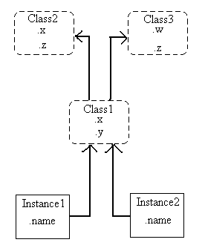

Class tree

Slide 80
Class tree
We usually call class higher in the tree (like c2 and c3) superclasses; classes lower in the tree (like c1) are known as subclasses
The search procedure (try to look up some specific function belongs to which class) proceeds bottom-up, starting from left to right

Slide 81
Class tree
Suppose we build up the tree
If we say: I2.w
It indicates we have an instance2 and it calls the function w
now, we need to search where does the function w defined
Therefore, the Python will search the linked objects in the order:
I2, C1, C2, C3 and stop at the first .w it finds
In OOP, I2 “inherits” w from C3

Slide 82
Class tree
I1.x and I2.x both find x in C1 and stop, since C1 is lower than C2
I1.y and I2.y both find y in C1, since that’s the only y
I1.z and I2.z both find z in C2, since C2 is more to the left than C3
I2.name finds name in I2, without climbing the tree at all

Slide 83
Class vs. Modules
All of the class and instance objects we put in these trees are just package of names.
If that sounds like modules, it should;
The only difference here is that objects in class tree also have “automatically-search” links to other namespace objects.

Slide 84
Coding the Class Tree
Each “class” statement generates a new class object
Each time a class is called, it generates a new “instance” object
Instances are automatically linked to the class they are created from
Classes are linked to their superclasses

Slide 85
Coding the Class Tree
To build the class tree we just saw, we would run Python code in this form:
class C2: …
class C3: …
class C1 (C2,C3): …
I1=C1()
I2=C2()

Slide 86
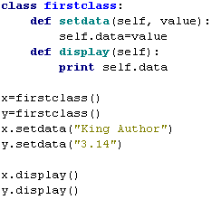
A First Example

Slide 87
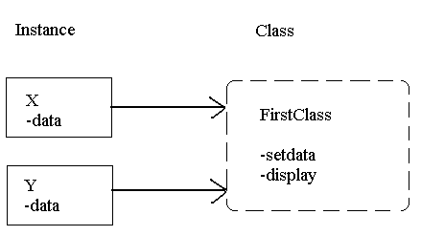
Class Tree

Slide 88
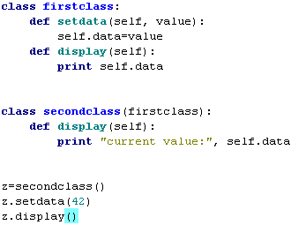
A Second Example

Slide 89
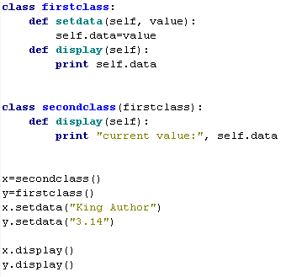
A Second Example

Slide 90
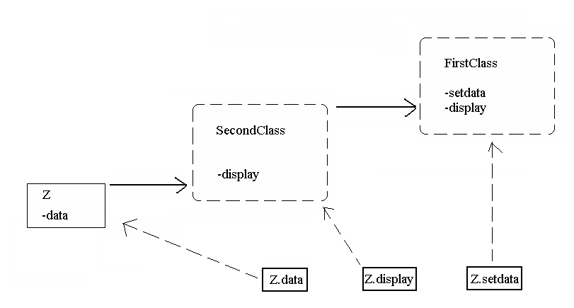
Class Tree

Slide 91
Using Collection Data Types

Slide 92
Tuples
Tuples are a collection of data items. They may be of different types. Tuples are immutable like strings. Lists are like tuples but are mutable. >>>“Tony”, “Pat”, “Stewart” ('Tony', 'Pat', 'Stewart') Python uses () to denote tuples; we could also use (), but if we have only one item, we need to use a comma to indicate it's a tuple: (“Tony”,).
An empty tuple is denoted by ()‏
Need to enclose tuple in () if we want to pass it all together as one argument to a function

Slide 93
Lists
Like tuples, but mutable, and designated by square brackets instead of parentheses: >>> [1, 3, 5, 7, 11] [1, 3, 5, 7, 11] >>> [0, 1, 'boom'] [0, 1, 'boom']
An empty list is []
Append an item: >>> x = [1, 2, 3] >>> x.append(“done”) >>> print x [1, 2, 3, 'done']

Slide 94
Lists and Tuples Contain Object References
Lists and tuples contain object references. Since lists and tuples are also objects, they can be nested >>> a=[0,1,2] >>> b=[a,3,4] >>> print b [[0, 1, 2], 3, 4] >>> print b[0][1] 1 >>> print b[1][0] ... TypeError: 'int' object is unsubscriptable

Slide 95
List example
list-example.py: x=[1,3,5,7,11] print x print "x[2]=",x[2] x[2] = 0 print "Replace 5 with 0, x = ", x x.append(13) print "After append, x = ", x x.remove(1) # removes the 1, not the item at position 1!! print "After remove item 1, x = ", x x.insert(1,42) print "Insert 42 at item 1, x = ", x Output: [1, 3, 5, 7, 11] x[2]= 5 Replace 5 with 0, x = [1, 3, 0, 7, 11] After append, x = [1, 3, 0, 7, 11, 13] After remove item 1, x = [3, 0, 7, 11, 13] Insert 42 at item 1, x = [3, 42, 0, 7, 11, 13]

Slide 96
Indexing
Indexing for a list >>> x=[1,3,5,7,11] >>> x[2] 5 >>> x[2]=0 >>> x [1, 3, 0, 7, 11]
Can index a tuple the same way, but can't change the values because tuples are immutable
Slices work as for strings (recall last index of slice is not included) >>> x[2:4] [0,7]

Slide 97
The += operator for lists
>>> a = [1, 3, 5] >>> a += [7] # a += 7 fails >>> a [1, 3, 5, 7] >>> a += [“the-end”] # put this in [] also! >>>a [1, 3, 5, 7, 'the-end']

Slide 98
Dictionaries
Unordered collections where items are accessed by a key, not by the position in the list
Like a hash in Perl
Collection of arbitrary objects; use object references like lists
Nestable
Can grow and shrink in place like lists
Concatenation, slicing, and other operations that depend on the order of elements do not work on dictionaries

Slide 99
Dictionary Construction and Access
Example: >>> jobs = {'David':'Professor', 'Sahan':'Postdoc', 'Shawn':'Grad student'} >>> jobs['Sahan'] >>> 'Postdoc‘
Can change in place >>> jobs['Shawn'] = 'Postdoc' >>> jobs['Shawn'] 'Postdoc‘
Lists of keys and values >>> jobs.keys() ['Sahan', 'Shawn', 'David'] # note order is diff >>> jobs.values() ['Postdoc', 'Postdoc', 'Professor'] >>> jobs.items() [('Sahan', 'Postdoc'), ('Shawn', 'Postdoc'), ('David', 'Professor')]

Slide 100
Common Dictionary Operations
Delete an entry (by key) del d['keyname']
Add an entry d['newkey'] = newvalue
See if a key is in dictionary d.has_key('keyname') or 'keyname' in d
get() method useful to return value but not fail (return None) if key doesn't exist (or can provide a default value) d.get('keyval', default)‏
update() merges one dictionary with another (overwriting values with same key) d.update(d2) [the dictionary version of concatenation]

Slide 101
Dictionary example
Going through a dictionary by keys:
bookauthors = {'Gone with the Wind': 'Margaret Mitchell',
'Aeneid': 'Virgil',
'Odyssey': 'Homer'}
for book in bookauthors:
print book, 'by', bookauthors[book] output: Gone with the Wind by Margaret Mitchell
Aeneid by Virgil
Odyssey by Homer

Slide 102
Constructing dictionaries from lists
If we have separate lists for the keys and values, we can combine them into a dictionary using the zip function and a dict constructor: keys = ['david', 'chris', 'stewart'] values = ['504', '637', '921'] D = dict(zip(keys, vals))‏

Slide 103
More general keys
Keys don't have to be strings; they can be any immutable data type, including tuples
This might be good for representing sparse matrices, for example Matrix = {} # start a blank dictionary Matrix[(1,0,1)] = 0.5 # key is a tuple Matrix[(1,1,4)] = 0.8

Slide 104
Length of collections
len() returns the length of a tuple, list, or dictionary (or the number of characters of a string): >>>len((“Tony”,)) 1 >>>len(“Tony”) 4 >>>len([0, 1, 'boom']) 3

Slide 105
The “is” operator
Python “variables” are really object references. The “is” operator checks to see if these references refer to the same object (note: could have two identical objects which are not the same object...)‏
References to integer constants should be identical. References to strings may or may not show up as referring to the same object. Two identical, mutable objects are not necessarily the same object

Slide 106
is-operator.py
x = "hello" y = "hello" print x is y True here, not nec. x = [1,2] y = [1,2] print x is y False (even though ident) x = (1,2) y = (1,2) print x is y False (even though identical, immutable) x = [] print x is not None True (list, even though empty)‏

Slide 107
“in” operator
For collection data types, the “in” operator determines whether something is a member of the collection (and “not in” tests if not a member): >>> team = (“David”, “Robert”, “Paul”) >>> “Howell” in team False >>> “Stewart” not in team True

Slide 108
Iteration: for ... in
To traverse a collection type, use for ... in >>> numbers = (1, 2, 3) >>> for i in numbers: print i, ... 1 2 3

Slide 109
Copying collections
Using assignment just makes a new reference to the same collection, e.g., A = [0,1,3] B = A # B is a ref to A. Changing B will # change A C = A[:] # make a copy B[1] = 5 C[1] = 7 A, B, C ( [0, 5, 3], [0, 5, 3], [0, 7, 3])
Copy a dictionary with A.copy()‏

Slide 110
Using Regular Expression

Slide 111
Regular Expressions
Regular expressions are a way to do pattern-matching. The basic concept (and most of the syntax of the actual regular expression) is the same in Java or Perl.
Common regular expression syntax: . Matches any char but newline (by default) ^ Matches the start of a string $ Matches the end of a string
* Any number of what comes before this + One or more of what comes before this | Or \w Any alphanumeric character \d Any digit \s Any whitespace character
(Note: \W matches NON-alphanumeric, \D NON digits, etc)‏
[aeiou] matches any of a, e, i, o, u junk Matches the string 'junk'

Slide 112
Simple Regexp Example
import re #import the regular expression module
infile = open("test.txt", 'r')‏
lines = infile.readlines()‏
infile.close()‏
# replace all PSI3's with PSI4's
matchstr = re.compile(r"PSI3", re.IGNORECASE)‏
for line in lines:
line = matchstr.sub(r'PSI4', line)‏
print line,

Slide 113
Simple Regexp Example
In the previous example, we open a file and read in all the lines, and we replace all PSI3 instances with PSI4
The regular expression module needs to be imported
We need to “compile” the regular expression with re.compile(). The “r” character here and below means treat this as a “raw” string (saves us from having to escape backslash characters with another backslash)‏
re.IGNORECASE (re.I) is an optional argument. Another would be re.DOTALL (re.S; dot would match newlines; by default it doesn't). Another is re.MULTILINE (re.M), which makes ^ and $ match after and before each line break in a string

Slide 114
More about Regexps
The re.compile() step is optional (more efficient if doing a lot of regexps
Can do re.search(regex, subject) or re.match(regex, subject) as alternative syntax
re.match() only looks for a match at the beginning of a line; does not need to match the whole string, just the beginning
re.search() attempts to match throughout the string until it finds a match
re.findall(regex, subject) returns an array of all non-overlapping matches; alternatively, can do for m in re.finditer(regex, subject)‏
Match(), search(), finditer(), and findall() do not support the optional third argument of regex matching flags; can start regex with (?i), (?s), (?m), etc, instead

Slide 115
re.split()‏
re.split(regex, subject) returns an array of strings.
The strings are all the parts of the subject besides the parts that match.
If two matches are adjacent in the subject, then split() will include an empty string.
Example: line = “Upgrade the PSI3 program to PSI4. PSI3 was an excellent program.” matchstr = re.split(“PSI3”, line) for i in matchstr: print i >>> Upgrade the >>> program to PSI4. >>> was an excellent program.

Slide 116
Match Object Functions
Search() and match() return a MatchObject. This object has some useful functions.
group(): return the matched string
start(): starting position of the match
end(): ending position of the match
span(): tuple containing the (start,end) positions of the match

Slide 117
Match Object Example
line = "Now we are upgrading the PSI3 program"
matchstr = re.search("PSI3", line)‏
print "Match starts at character ", matchstr.start()‏
print "Match ends at character ", matchstr.end()‏
print "Before match: ", line[0:matchstr.start()]
print "After match:", line[matchstr.end():]

Slide 118
Capture Groups
Parentheses in a regular expression denote “capture groups” which can be accessed by number or by name to get the matching (captured) text
We can name the capture groups with (?P<name>)‏
We can also take advantage of triple-quoted strings (which can span multiple lines) to define the regular expression (which can include comments) if we use the re.VERBOSE option

Slide 119
Capture Groups Example
infile = open("test.txt", 'r')‏
lines = infile.readlines()‏
infile.close()‏
# triple quoted string can span multiple lines
restring = """[ \t]* # optional whitespace at beginning
(?P<key>\w+) # name the matching word 'key'
[ \t]*=[ \t]* # equals sign w/ optional whitespace
(?P<value>.+) # some non-whitespace after = is 'value'
"""
matchstr = re.compile(restring, re.IGNORECASE | re.VERBOSE)‏
for line in lines:
for match in matchstr.finditer(line):
print "key =", match.group("key"),
print ", value =", match.group("value")‏

Slide 120
Performing Unit Testing in Python

Slide 121
Why is unit testing important?
Quality
Regression
Safety Net
Integration with build and CI tools
Documentation

Slide 122
Attributes of good tests
Fast
Clear
Isolated
Reliable

Slide 123
What to Unit Test?
Smallest unit of functionality possible
Why?
better chance you're testing what you think you're testing
less chance of two wrongs making a right
Each type of behaviour
make sure edge cases are covered

Slide 124
The unittest module
Python's unit testing framework
Added in Python 2.1
Based on PyUnit
which was based on JUnit

Slide 125
How to Write a Test
The code we want to test
def reverse(aList):
aList.reverse()
return aList
The test
import unittest
class ReverseTests(unittest.TestCase):
def test_normal(self):
# do import here, makes test independent
from example1 import reverse
# can use python's normal asserts
assert reverse([1,2,3])==[3,2,1]
# or more robust and informative unittest options
self.assertEqual(reverse([1,2,3]),[3,2,1])

Slide 126
How to Run a Test
unittest provides several ways
Here's one
import unittest
class ReverseTests(unittest.TestCase):
def test_normal(self):
# do import here, makes test independent
from example1 import reverse
# can use python's normal asserts
assert reverse([1,2,3])==[3,2,1]
# or more robust and informative unittest options
self.assertEqual(reverse([1,2,3]),[3,2,1])
if __name__=="__main__":
unittest.main()

Slide 127
Helpful Methods
fail(message)
assertEquals(x,y)
failUnless(expression)
failIfExpression
assertRaises(Exception,callable,arg1,arg2,...)

Slide 128
setUp and tearDown
Unit Tests should be...
Atomic
Independent
Discrete
Concurrent
How do we do this?
start “from fresh” for each script
write tests carefully

Slide 129
Generators, Iterators, decorators, Context Managers

Slide 130
Generators and Iterators
Sometimes it may be useful to return a single value at a time, instead of an entire sequence.
A generator is a function which is written to return values one at a time.
The generator can compute the next value, save its state, and then pick up again where it left off when called again.
Syntactically, the generator looks just like a function, but it “yields” a value instead of returning one (a return statement would terminate the sequence)‏

Slide 131
Generator example
>>> def squares(x): ... for i in range(x): ... yield i**2 >>> for i in squares(4): ... print i, ... 0 1 4 9
Can get next element in sequence from the next() function: z = squares(4) z.next() 0 z.next() 1

Slide 132
Decorators
Decorators provide a simple syntax for calling higher-order functions. By definition, a decorator is a function that takes another function and extends the behavior of the latter function without explicitly modifying it.
Let’s look at the simplest decorator we can that might help us understand how all of this works — the identity decorator.
def identity_decorator(func):
def wrapper():
func()
return wrapper
def a_function():
print "I'm a normal function."
# `decorated_function` is the function that `identity_decorator` returns, which
# is the nested function, `wrapper`
decorated_function = identity_decorator(a_function)
# This calls the function that `identity_decorator` returned
decorated_function()
# >> I'm a normal function

Slide 133
Context Managers
A basic issue in programming is resource management: a resource is anything in limited supply, notably file handles, network sockets, locks, etc., and a key problem is making sure these are released after they are acquired.
If they are not released, you have a resource leak, and the system may slow down or crash. More generally, you may want cleanup actions to always be done, other than simply releasing resources.
Python provides special syntax for this in the with statement, which automatically manages resources encapsulated within context manager types, or more generally performs startup and cleanup actions around a block of code.
You should always use a with statement for resource management.

Slide 134
Context Managers
The simplest example is file access:
with file("/tmp/foo", "w") as foo:
print >> foo, "Hello!“
This is essentially equivalent to:
foo = file("/tmp/foo", "w")
try:
print >> foo, "Hello!"
finally:
foo.close()

Slide 135
Threading in Python

Slide 136
Introduction to Threads
Threads often called “light-weight” process because operating systems generally require fewer resources to create and manage threads than to create and manage processes
Python’s threading capabilities depend on whether the operating system supports multithreading
Python’s threading module provides its multithreading capabilities

Slide 137
Thread States: Life Cycle of a Thread
Python interpreter controls all program threads
Python’s global interpreter lock (GIL) ensures that the interpreter runs only one thread at any given time
Thread is said to be in one of several thread states at any time
Python programs can define threads by inheriting from class threading.Thread and overriding its functionality

Slide 138
Thread States: Life Cycle of a Thread
Newly created thread begins its lifecycle in the born state
Invoking the thread’s start method places the thread in the ready state
The thread’s run method, which implements the tasks that the thread performs, obtains the GIL and enters the running state
Thread enters the dead state when its run method returns or terminates for any reason (e.g., an uncaught exception)

Slide 139
Thread States: Life Cycle of a Thread
A running thread that calls another thread’s join method forfeits the GIL and waits for the joined thread to die before proceeding
Thread enters the blocked state while it waits for a requested, unavailable resource (e.g. I/O device)
When a running thread calls function time.sleep, it releases the GIL and enters the sleeping state

Slide 140
Thread States: Life Cycle of a Thread
Deadlock occurs when one or more threads wait forever for an event that cannot occur
In indefinite postponement, one or more threads is delayed for some unpredictably long time

Slide 141
Thread States: Life Cycle of a Thread
State diagram showing the life cycle of a thread.

Slide 142
Thread States: Life Cycle of a Thread
Module threading provides ways for a program to obtain information about its threads, including their current states
Function threading.currentThread returns reference to currently running Thread object
Function threading.enumerate returns list of currently active Thread objects
Function threading.activeCount returns length of list returned by threading.enumerate
Method isAlive returns 1 if the Thread object’s start method bas been invoked and the Thread object is not dead
Methods setName and getName allow programmer to set and get a Thread object’s name, respectively

Slide 143
threading.Thread example
Threads can be created by defining a class that derives from threading.Thread and instantiating objects of that class

Slide 144
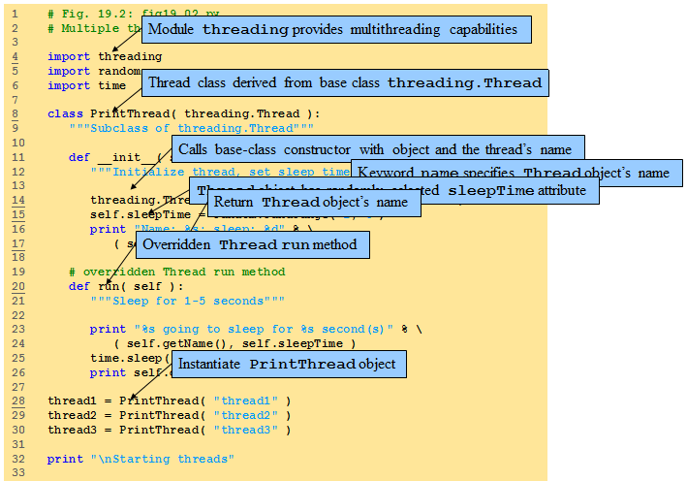
threading.Thread example

Slide 145
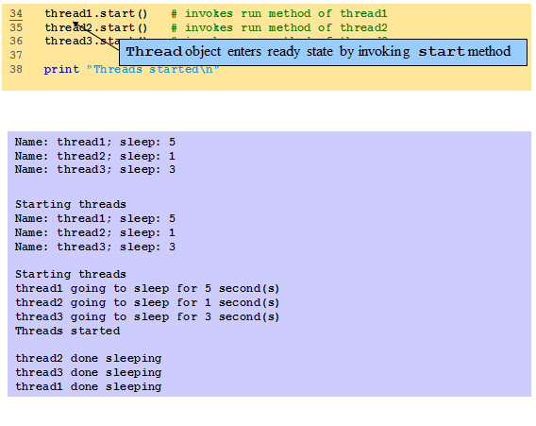
threading.Thread example

Slide 146
Networking in Python

Slide 147
IP Characteristics
Datagram-based
Connectionless
Unreliable
Best efforts delivery
No delivery guarantees
Logical (32-bit) addresses
Unrelated to physical addressing
Leading bits determine network membership
Notes:
The network layer of TCP/IP makes no guarantees of delivery: at any hop along the way a packet may be discarded, either because transmission errors have been detected or simply because the receiving equipment does not have the capacity to process it.
In such circumstances the originating host may or may not receive an ICMP (Internet Control Message Protocol) message detailing the reason for non-delivery. ICMP messages can be useful in helping hosts to change to more appropriate behavior, but are not always actioned even when raised.
Since different physical network use different addressing schemes it's important that IP provides a unified scheme independent of the underlying hardware. This is crucial when building large internets (an "internet" with a small "I" is any interconnected collection of IP networks). You can find a detailed description of IP addressing at
http://www.holdenweb.com/students/3comip.pdf

Slide 148
UDP Characteristics
Also datagram-based
Connectionless, unreliable, can broadcast
Applications usually message-based
No transport-layer retries
Applications handle (or ignore) errors
Processes identified by port number
Services live at specific ports
Usually below 1024, requiring privilege
Notes:
You can think of UDP as similar to the postal service – packets go out, they can be lost along the way if an intermediate router runs out of resources or if they are mangled by noise, no acknowledgements are issued. UDP applications are therefore usually simpler messaging-style applications, where the only recovery action will be a fixed number of retries.
DNS is a good example -- although it can use TCP, most DNS traffic is carried by UDP. If a server does not reply, or if the reply (or the request) gets lost, the consequences are usually not tragic. If you fail to resolve a host name because of such an error you (as a user) will usually be quite happy to try again, and this failure will not have been significant.
As you will see later, a server binds to a specific port when it starts up. Originally a client had to "just know" what port the server would be listening on, and so default port numbers were allocated: 80 for HTTP, 25 for SMTP and so on. Later on, services like the PortMapper were introduced so that a server could use any port, and register it with the Portmapper – the clients would start with a PortMapper enquiry to find out which port their server was listening on.

Slide 149
Client/Server Concepts
Server opens a specific port
The one associated with its service
Then just waits for requests
Server is the passive opener
Clients get ephemeral ports
Guaranteed unique, 1024 or greater
Uses them to communicate with server
Client is the active opener
Notes:
Although not all client/server systems are based around the idea of a passive and an active opener this is currently the dominant paradigm for networking, used by FTP, Telnet, DNS, SMTP, SNMP and many others.
The client and the server will typically use the socket API, originally devised as part of the bsd Unix implementation, to interact with the networking features of their host operating system. A socket gives the application code access to the network interface using convenient calls to transmit and receive data. Python standardizes access to sockets to eliminate the need to worry about platform differences -- network programming is remarkably consistent among Linux, UNIX and Windows.
The fact that a client port number is guaranteed unique on its host allows traffic to be multiplexed and demultiplexed over shared network paths. Even when two telnet clients on the same host are in touch with telnet servers on the same host the client address/port number combination is unique, allowing the traffic to be delivered to the correct process.

Slide 150

Connectionless Services
socket()
socket()
bind()
bind()
recvfrom()
sendto()
[blocked]
recvfrom()
[blocked]
sendto()
SERVER
CLIENT
Notes:
When UDP is used, the server creates a socket and binds address(es) and a port number to it. The server then waits for incoming data (remember: UDP is connectionless).
The clients also create a socket, then they bind it to the appropriate interface – typically allowing the transport layer to choose an epehemeral (short-lived) port number rather than specifying a particular port.
The client sends data to the server, which awakes from its blocked state and starts to compute its response. Meantime the client has issued a recvfrom() using the same address it sent the data to, and is blocked awaiting the response which should eventually arrive from the server.
When the server sends its result back, it goes to the address and port number the incoming data was received from. The server then loops around to wait for another request. The arrival of the server’s data unblocks the client, which can then continue.
This is something of a simplification: using a library based on the select() system call it is possible to use sockets in a non-blocking fashion. This does complicate the code somewhat, however.

Slide 151
Simple Connectionless Server
from socket import socket, AF_INET, SOCK_DGRAM
s = socket(AF_INET, SOCK_DGRAM)
s.bind(('127.0.0.1', 11111))
while 1: # nowadays, "while True"
data, addr = s.recvfrom(1024)
print "Connection from", addr
s.sendto(data.upper(), addr)
How much easier does it need to be? Note that the bind() argument is a two-element tuple of address and port number
Notes:
It's more usual to import the whole socket library and use qualified names, but the from statement is a convenient way to access only specific names from a module. I did this to keep code lines on the slide shorter, and hence more readable. The following code is an equivalent but rather more conventional way to create the socket:
import socket
s = socket.socket(socket.AF_INET, socket.SOCK_DGRAM)
This achieves exactly the same ends. Which style you use is largely a matter of taste and readability. The remainder of the code will run unchanged since the other features it uses are attributes of the socket, and are accessed the same way no matter how the socket was created.
Note carefully that the bind() call takes a single argument, a tuple containing an IP address string and a port number. If the IP address is the empty string then the code will bind to all interfaces, which is how most servers actually start up. The example above is a little more secure, since only local processes can connect via the local loopback interface.
The code on this slide is on your CD as udpserv1.py if you want to run it now.

Slide 152
Simple Connectionless Client
from socket import socket, AF_INET, SOCK_DGRAM
s = socket(AF_INET, SOCK_DGRAM)
s.bind(('127.0.0.1', 0)) # OS chooses port
print "using", s.getsocketname()
server = ('127.0.0.1', 11111)
s.sendto("MixedCaseString", server)
data, addr = s.recvfrom(1024)
print "received", data, "from", addr
s.close()
Relatively easy to understand?
Notes:
The client specifies port number zero to indicate that it simply wants an ephemeral port – this is more efficient than attempting to use a specific port number because the port requested might already be in use and then the bind() call would fail.
The getsocketname() call tells the user the address and port number being used for the client end of the communication. While this isn't an essential part of the program it's useful debugging data.
The client simply sends the data and (usually) receives a reply from the server. This particular program is somewhat inadequate in terms of error checking: if the server's response is somehow lost then the client will hang forever. The socket library was recently (2.3) updated to include timeout features that previously had only been available in third-party additions.

Slide 153
Connection-Oriented Services
socket()
Server
Client
bind()
socket()
listen()
connect()
accept()
write()
[blocked]
read()
read()
[blocked]
[blocked]
write()
When interaction is over, server loops to accept a new connection
Notes:
A connection-oriented server creates a socket, binds it to one or more local ports on which it will listen for connections, and then puts the socket into the listening state to wait for incoming connections. At this point the server process blocks until a connection request arrives.
A client creates its own socket, usually without specifying any particular port number, and then connects to the endpoint the server is listening on. The server’s accept() call returns a new socket that the server can use to send data across this particular connection..
The two parties then exchange data using read() and write() calls.
The major limitation of this structure is the non-overlapped nature of the request handling in the server. Theoretically it's possible for the server to use its original socket to listen for further requests while the current request is being handled, but that isn't shown here. You will learn how to overcome this limitation using standard library classes.

Slide 154
Connection-Oriented Server
from socket import \ socket, AF_INET, SOCK_STREAM
s = socket(AF_INET, SOCK_STREAM) s.bind(('127.0.0.1', 9999))
s.listen(5) # max queued connections
while 1:
sock, addr = s.accept() # use socket sock to communicate # with client process
Client connection creates new socket
Returned with address by accept()
Server handles one client at a time
Notes:
Connection-oriented servers are a little more complex because the connection allows clients and servers to interact across multiple send() and recv() calls.
The server blocks in accept() until a server connects. The return value from accept() is a tuple consisting of a socket and the client address (which is the usual (address, port) tuple).
The server can, if it chooses, use multitasking techniques such as creating a new thread or forking a new process to allow it to handle several concurrent connections. Either solution allows the connection to be processed while the main control loop returns to execute another accept() and deal with the next client connection.
Since each connection generates a new server-side socket there is no conflict between the different conversations, and the server can continue to use the listen()ing socket to listen for incoming connections while it serves already-connected clients.

Slide 155
Connection-Oriented Client
s = socket(AF_INET, SOCK_STREAM) s.connect((HOST, PORT)) s.send('Hello, world') data = s.recv(1024) s.close() print 'Received', `data`
This is a simple example
Sends message, receives response
Server receives 0 bytes after close()
Notes:
This very simple client just sends a single message and receives a single response.
More typical code will send a request and use its understanding of the application protocol to determine when the response to that request has been completed.
Protocols like HTTP 1.0 use a separate connection for each request. Protocols like telnet can exchange thousands of messages before the connection is closed, and the code tends to be more complex iin that case.
Under normal circumstances a recv() call guarantees that at least one byte of data will be returned. When a program seems the empty string (zero bytes) returned from the recv() it knows that the other end has terminated the connection by calling close() on its socket.

Slide 156
Some socket Utility Functions
htonl(i), htons(i)
32-bit or 16-bit integer to network format
ntohl(i), ntohs(i)
32-bit or 16-bit integer to host format
inet_aton(ipstr), inet_ntoa(packed)
Convert addresses between regular strings and 4-byte packed strings
Notes:
Although there is no formal presentation layer in the TCP/IP suite, certain data types are so commonly interchanged that it is useful to be able to transmit them in network-neutral format. This makes it easy for little-endian and big-endian machines to communicate with each other.
l stands for long, a 32-bit value, and s signifies a 16-bit short.
If you need to communicate IP addresses as a part of your application, the inet_*() functions allow you to do so efficiently.

Slide 157
Handling Names & Addresses
getfqdn(host='')
Get canonical host name for host
gethostbyaddr(ipaddr)
Returns (hostname, aliases, addresses)
Hostname is canonical name
Aliases is a list of other names
Addresses is a list of IP address strings
gethostbyname_ex(hostname)
Returns same values as gethostbyaddr()
Notes:
These utility functions are useful ways to access the domain name of the host your are running on, and other DNS services.
A typical use would be as follows:
>>> import socket
>>> socket.gethostbyaddr("10.0.0.10")
('prom01.holdenweb.com', [], ['10.0.0.10'])
This shows interactive use of the Python interpreter, which is handy for debugging purposes. If you simply enter an expression, the interpreter prints out the resulting value.

Slide 158
Treating Sockets as Files
makefile([mode[, bufsize]])
Creates a file object that references the socket
Makes it easier to program to handle data streams
No need to assemble stream from buffers
Notes:
Sometimes if the protocol involves variable-length strings it's easier to use the file-based functions like readline() and write() to handle I/O.
Calling s.makefile() on a socket s yields an object sufficiently "file-like" that it allows you to write your programs in this more familiar style. Otherwise it's sometimes necessary to assemble input strings from a sequence of recv() calls, and add line terminators to the strings you pass to send().
The socket-based file object can be closed without closing the underlying socket.
This paradigm also makes it easier to adapt existing code, written to handle files, to network applications.

