Slide 1
PA165 – DELIVERY SERVICE
Tomáš Frkáň
Michal Sorentíny
Filip Volner
Ján Vorčák

Slide 2
REQUIREMENTS
Create a system for management of deliveries for a delivery service.
Deliveries
Customers
Goods (delivery items)
Couriers

Slide 3
USED TECHNOLOGIES
JPA 2
Hibernate
Spring
Stripes
jQuery
BootStrap
Travis Continuous Integration
OpenShift

Slide 4
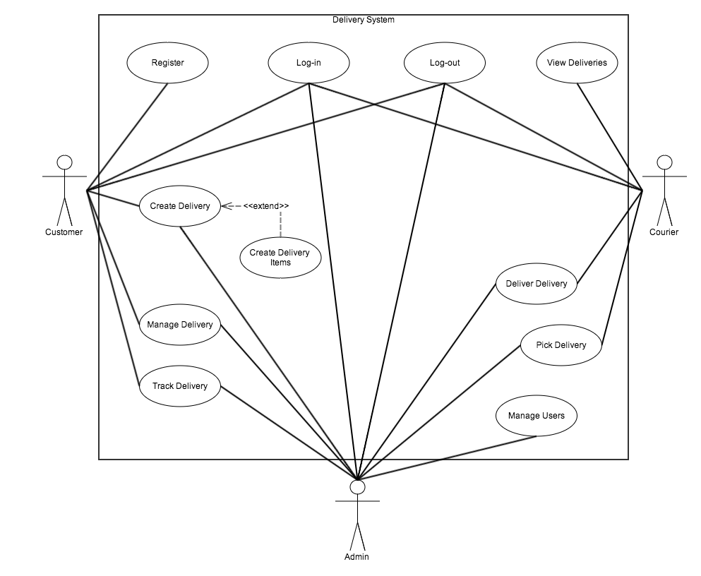
BUSINESS LOGIC

