Slide 1

DDS Analytics
Mike Gebhardt – DDS 6306
attrition and monthly income

Slide 2
AGENDA
Review Provided Data Set
Discuss Variable Correlation
Provide top factors for Employee Attrition
Provide top factors affecting Monthly Income
Create a model to predict Attrition with at least 60% Specificity and Sensitivity
Create a model to predict Monthly Income within $3000 of RMSE

Slide 3
SUMMARY STATISTICS
Observations:
HR Staffing total seems low, only 4% of overall staffing. HR tends to deal with employee issues, can help prevent attrition
JobSatisfaction mean is lower than PerformanceRating, seems as though high performing employees are not satisfied
TrainingHours seem very low for an R&D focused employee base (Max = 6). Training can lead to advancement, improvement in JobSatisfaction, etc

Slide 4
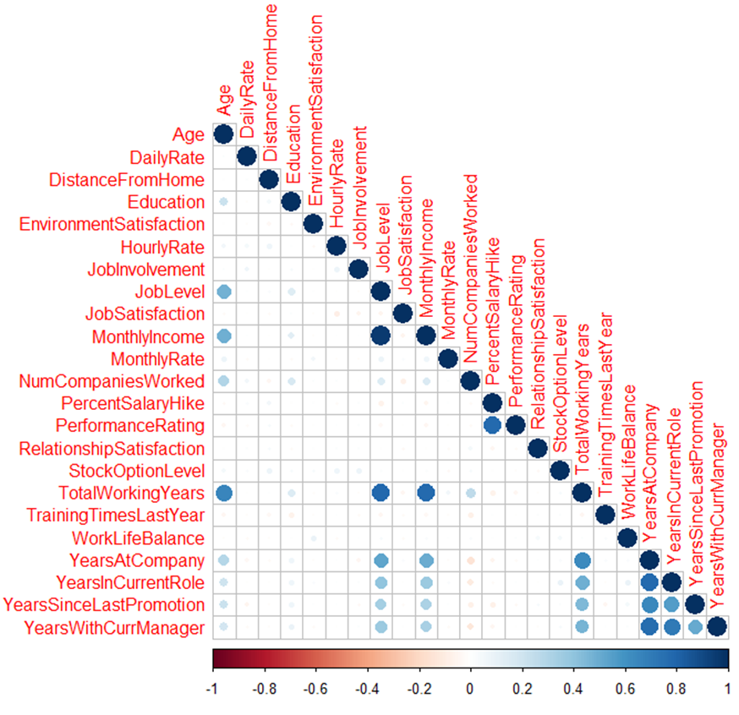
Correlation Between Numerical Variables
Variables with strong correlation:
TotalWorkingYears with Age, Job Level and Monthly Income - but these are to be expected. As someone works longer, they age and typically increase their Job Levels and Income.
Monthly Income is strongly correlated with Job Level
Performance Rating is correlated with Percent SalaryHike
YearsAtCompany is positively correlated with YearsInCurrentRole, YearsSinceLastPromotion and YearsWithCurrManager
None of these are surprising or revealing Analysis

Slide 5
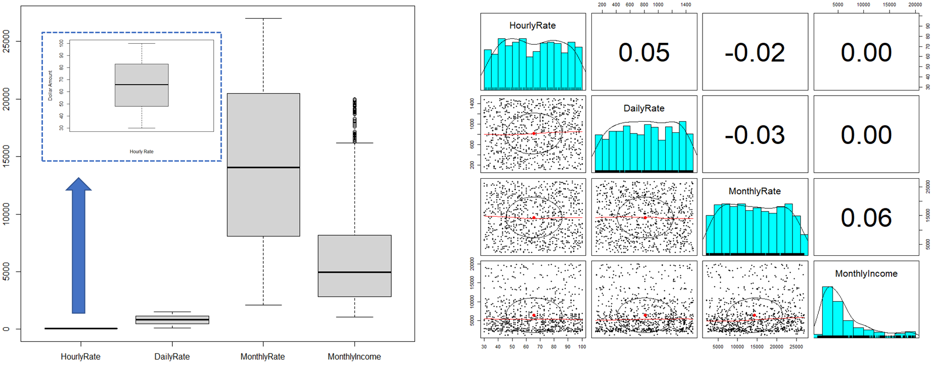
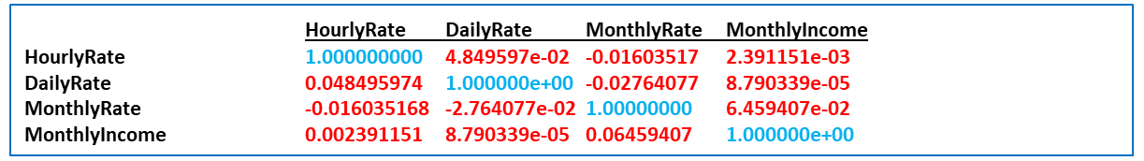
Financial Measures - Analysis

Slide 6
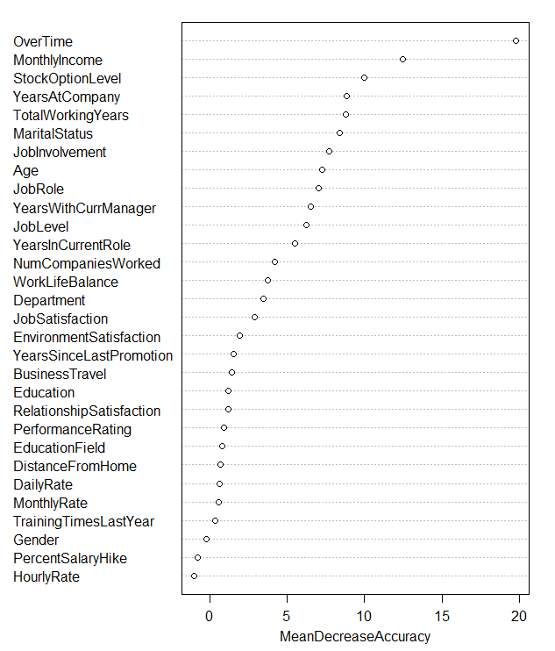
RANDOM FOREST FOR PREDICTING ATTRITION VARIABLES
Confusion Matrix and Statistics
No Yes
No 182 0
Yes 33 2
Accuracy : 0.8479
95% CI : (0.7931, 0.8929)
No Information Rate : 0.9908
P-Value [Acc > NIR] : 1
Kappa : 0.0923
Mcnemar's Test P-Value : 2.54e-08
Sensitivity : 0.84651
Specificity : 1.00000
Pos Pred Value : 1.00000
Neg Pred Value : 0.05714
Prevalence : 0.99078
Detection Rate : 0.83871
Detection Prevalence : 0.83871
Balanced Accuracy : 0.92326

Slide 7
KNN FOR PREDICTING ATTRITION VARIABLES
Confusion Matrix and Statistics
No Yes
No 182 2
Yes 29 6
Accuracy : 0.8618
95% CI : (0.8086, 0.9047)
No Information Rate : 0.9585
P-Value [Acc > NIR] : 1
Kappa : 0.27
Mcnemar's Test P-Value : 5.01e-06
Sensitivity : 0.8654
Specificity : 0.7778
Pos Pred Value : 0.9890
Neg Pred Value : 0.1714
Prevalence : 0.9631
Detection Rate : 0.8295
Detection Prevalence : 0.8387
Balanced Accuracy : 0.8056
KNN MODEL SELECTED
Higher Accuracy (+0.139)
Higher Sensitivity (+0.1889)
Specificity well above 60%

Slide 8
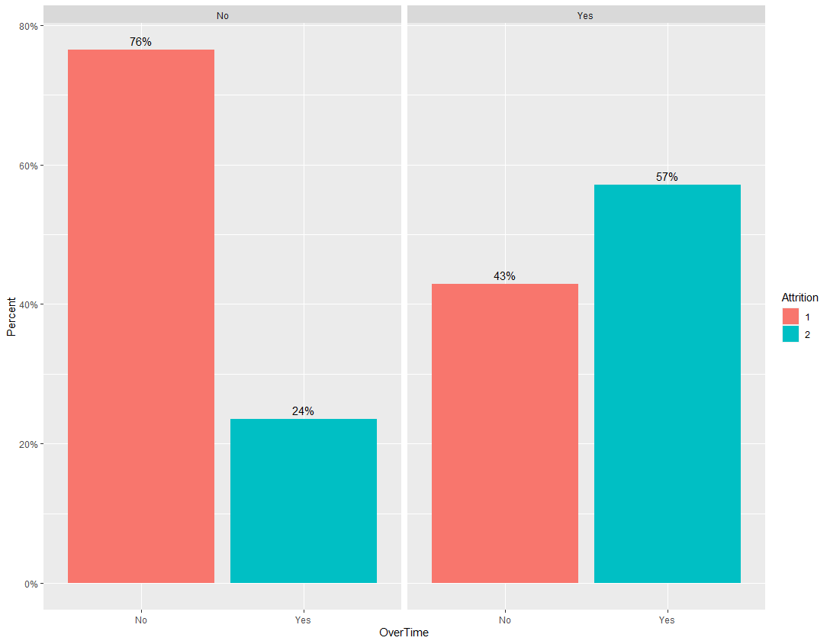
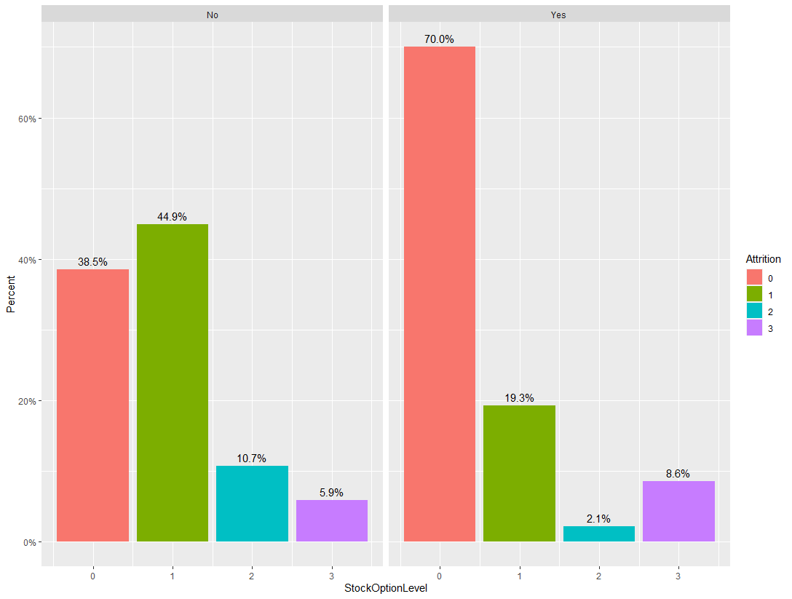
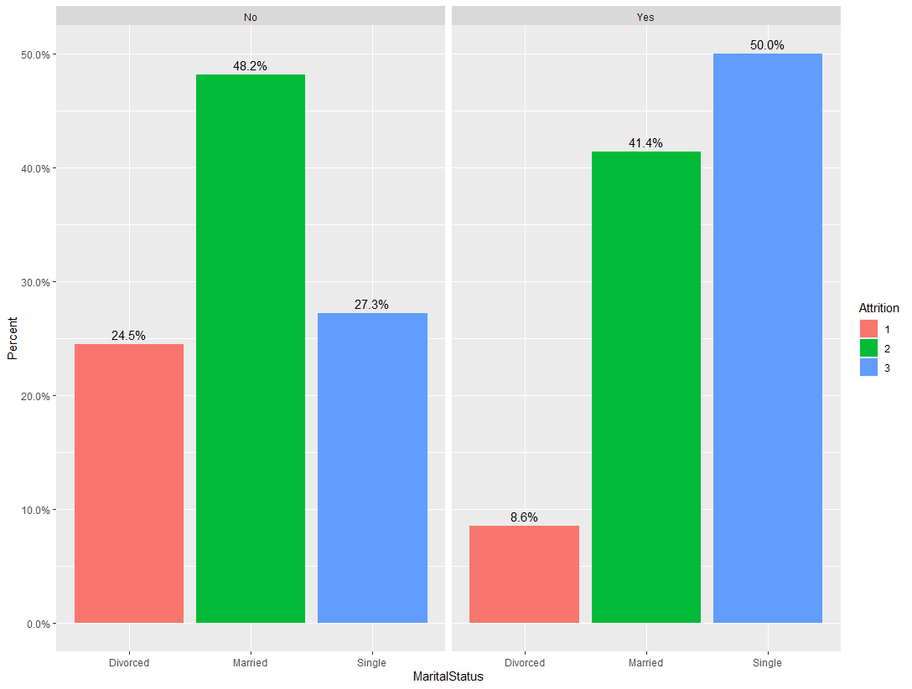
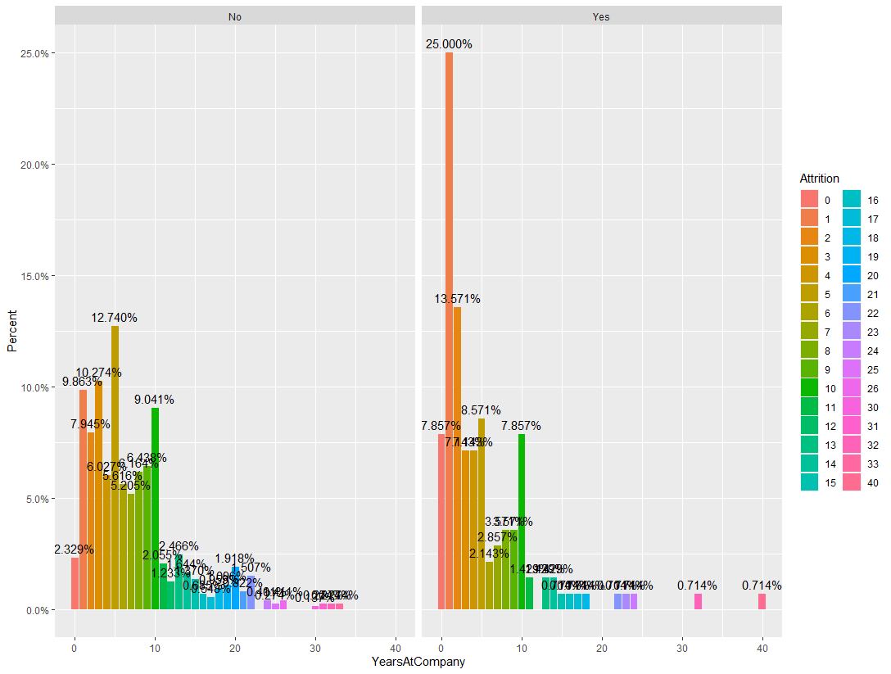
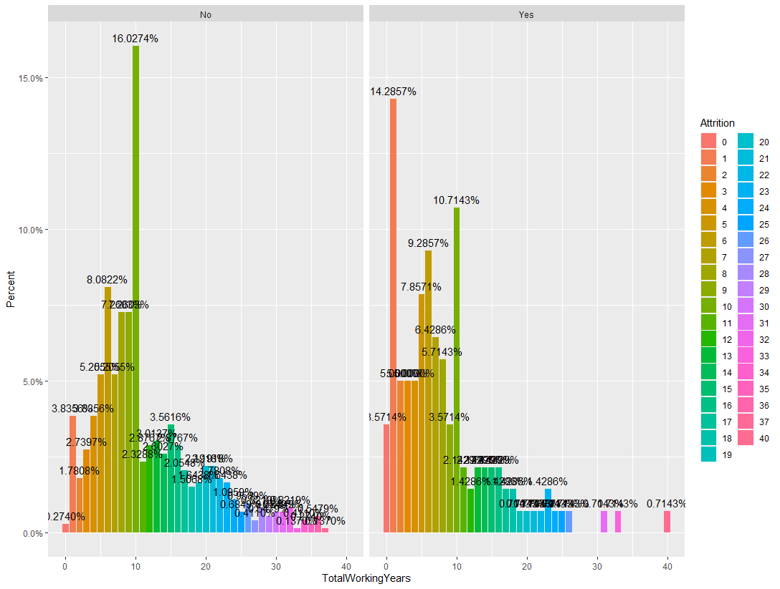
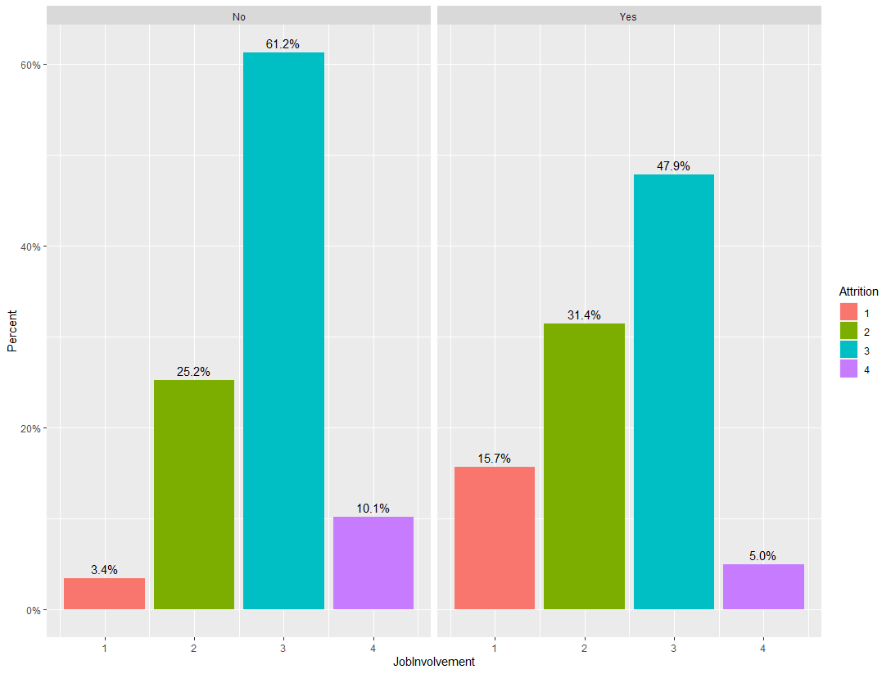
TOP ATTRITION FACTORS

Slide 9
LINEAR REGRESSION FOR PREDICTING MONTHLY INCOME
Coefficients:
 | Estimate | Std. Error | t-value | Pr(>|t|)
(Intercept) | 6.32E+01 | 7.73E+02 | 0.082 | 0.93479
JobLevel | 2.79E+03 | 8.35E+01 | 33.356 | 2.00E-16
JobRoleManager | 4.28E+03 | 2.84E+02 | 15.099 | 2.00E-16
JobRoleResearch Director | 4.06E+03 | 2.19E+02 | 18.489 | 2.00E-16
TotalWorkingYears | 5.12E+01 | 1.10E+01 | 4.661 | 3.66E-06
JobRoleLaboratory technician | -6.02E+02 | 1.72E+02 | -3.512 | 0.00047
BusinessTravelTravel_Rarely | 3.78E+02 | 1.20E+02 | 3.143 | 0.00173
JobRoleResearch Scientist | -3.48E+02 | 1.70E+02 | -2.043 | 0.04135
PerformanceRating | -3.25E+02 | 1.62E+02 | -2.008 | 0.04494
YearsSinceLastPromotion | 3.05E+01 | 1.53E+01 | 1.987 | 0.04723
MonthlyRate | -9.24E-03 | 5.15E-03 | -1.796 | 0.07294
PercentSalaryHike | 2.52E+01 | 1.58E+01 | 1.592 | 0.11187
DailyRate | 1.45E-01 | 9.14E-02 | 1.586 | 0.11312
YearsWithCurrManager | -2.58E+01 | 1.67E+01 | -1.542 | 0.12341
GenderMale | 1.11E+02 | 7.45E+01 | 1.492 | 0.13606
Residual | Standard error: $1057 on 825 degrees of freedom
Multiple | R-squared: 0.9498 |  | Adjusted R-squared: 0.9483
F-statistic: | 354.9 on 44 and 825 DF, p-value: <2.20E-16

Slide 10
STEPWISE REGRESSION FOR PREDICTING MONTHLY INCOME
Coefficients:
 | Estimate | Std. Error | t-Value | Pr(>|t|)
(Intercept) | 3.28E+02 | 4.31E+02 | 0.762 | 0.44634
JobLevel | 2.79E+03 | 7.99E+01 | 34.9 | 2.00E-16 | ***
JobRoleLaboratory Technician | -6.83E+02 | 1.38E+02 | -4.957 | 8.64E-07 | ***
JobRoleManager | 4.15E+03 | 2.27E+02 | 18.312 | 2.00E-16 | ***
JobRoleResearch Director | 3.95E+03 | 1.94E+02 | 20.303 | 2.00E-16 | ***
TotalWorkingYears | 4.82E+01 | 8.43E+00 | 5.725 | 1.44E-08 | ***
BusinessTravelTravel_Rarely | 4.04E+02 | 1.17E+02 | 3.463 | 0.00056 | ***
DepartmentSales | -5.31E+02 | 1.62E+02 | -3.272 | 0.00111 | **
JobRoleResearch Scientist | -4.40E+02 | 1.38E+02 | -3.192 | 0.00147 | **
JobRoleHuman Resources | -4.51E+02 | 2.29E+02 | -1.965 | 0.04968 | *
JobRoleSales Executive | 4.01E+02 | 1.67E+02 | 2.403 | 0.01646 | *
YearsSinceLastPromotion | 2.86E+01 | 1.36E+01 | 2.099 | 0.03612 | *
YearsWithCurrManager | -2.65E+01 | 1.23E+01 | -2.153 | 0.03156 | *
BusinessTravelTravel_Frequently | 2.29E+02 | 1.38E+02 | 1.663 | 0.0967 | .
DailyRate | 1.49E-01 | 8.94E-02 | 1.664 | 0.09651 | .
MonthlyRate | -9.19E-03 | 5.03E-03 | -1.827 | 0.0681 | .
PerformanceRating | -3.09E+02 | 1.59E+02 | -1.945 | 0.05214 | .
DistanceFromHome | -6.65E+00 | 4.40E+00 | -1.511 | 0.13107
GenderMale | 1.09E+02 | 7.30E+01 | 1.497 | 0.1348
PercentSalaryHike | 2.40E+01 | 1.55E+01 | 1.544 | 0.12308
Residual standard error: | $1046 on 850 degrees of freedom
Multiple R-squared: | 0.9494, | Adjusted R-squared: 0.9483
F-statistic: | 839.5 on 19 and 850 DF, p-value: < 2.2e-16
LINEAR REGRESSION MODEL SELECTED
Stepwise is prone to overfitting
Difference between the standard error was very small ($11)
R Squared higher for LM
Adjusted RSME identical
Both were well below the $3000 threshold required

Slide 11
Monthly income factors
Based on the output of both models, the variables with the highest level of significance to Monthly Income (lowest p-values) were the following:
JobLevel
JobRoleManager
JobRoleResearch Director
TotalWorkingYears
JobRoleLaboratory Technician

Slide 12
CONCLUSION
FACTORS AFFECTING ATTRITION
OverTime
MonthlyIncome
StockOptionLevel
YearsAtCompany
TotalWorkingYears
FACTORS AFFECTING MONTHLY INCOME
JobLevel
JobRoleManager
JobRoleResearchDirector,
TotalWorkingYears
JobRoleLaboratoryTechnician
BusinessTravelTravel_Rarely
To prevent Attrition, consider the following:
Increase HR Staff
Improve Employee Training initiatives
Try to restrict Overtime when possible
Focus on newly hired employees

