Slide 1
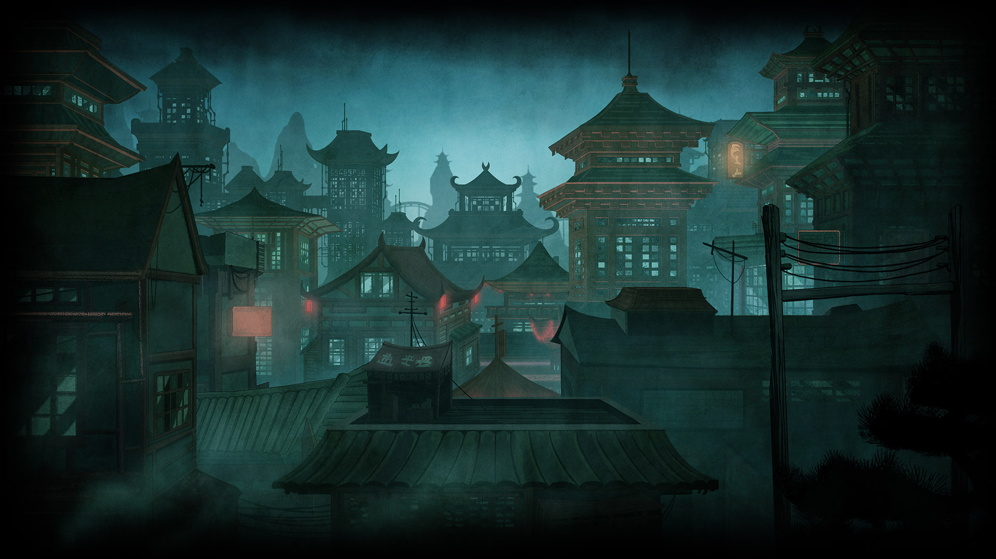

Author: Minh Duong, Thompson Nguyen, Bao Nguyen
UA Hackathon!

Slide 2
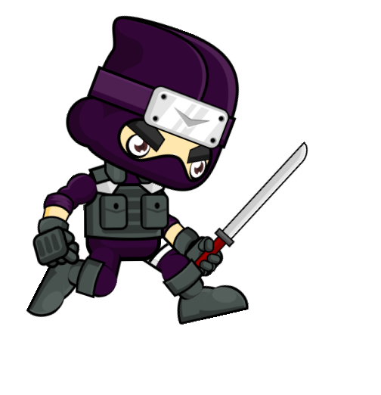
Introduction
You play as a ninja slashing clouds of words as they approaches you.
Link: https://word-slash.vercel.app

Slide 3
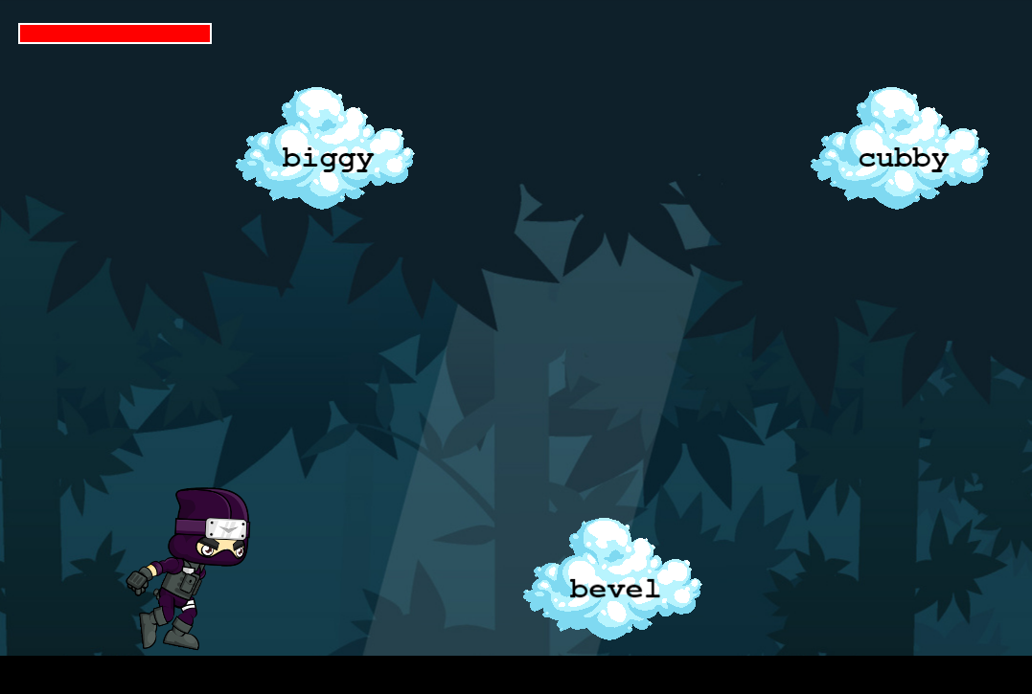
Instruction
Slash the Words: Type the word shown in the cloud and press Enter to slash it.
Jump and Glide: Press the Space bar to jump. If a word cloud is above, jump and then type the word to slash while in the air.
Stay Healthy: You start with 100 HP. Each missed cloud reduces your health by 10 points. If your health reaches 0, it's game over!
Speed Challenge: As you progress, the game speed increases, challenging your typing and reflexes.

Slide 4

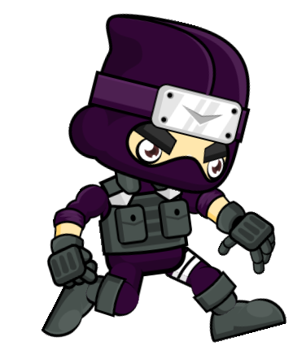
Technologies
Core Technology: React + Phaser.JS + TypeScript
Sprite: https://www.gameart2d.com/
Sprite Edit: Texture Packer

Slide 5
Thank you!

