Slide 1













Care Lens AI
AI-Powered Health Monitoring for Early Anomaly Detection
Aligned with UN SDG 3 – Good Health and Well-Being

Slide 2

SDG Focus
Goal: SDG 3 – Good Health and Well-Being
Problem:
Many individuals lack continuous, accessible health monitoring, leading to late detection of anomalies and preventable health complications.

Slide 3
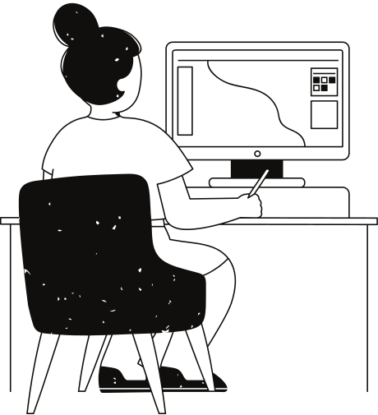
AI Approach
Software Engineering Skills Applied:
Automation: Automated collection & processing of health metrics from datasets.
Testing: Unit & integration tests to ensure data accuracy and interface reliability.
Scalability: Modular Flask application for future integration with IoT/wearables.
Technical Solution:
Use Python & Pandas to process live health metrics.
Flask dashboard to visualize heart rate, oxygen levels, and activity trends.
AI logic to flag anomalies & suggest recommendations.

Slide 4
Tools & Frameworks
01.
AI/ML & Data: Pandas, NumPy, Scikit-learn (future predictive features).
CareLensAI was developed using a combination of modern programming languages, AI frameworks, and development tools to ensure efficiency, scalability, and accuracy.
Python served as the core programming language, leveraging libraries such as TensorFlow and PyTorch for deep learning and computer vision tasks. OpenCV was used for image processing, while FastAPI enabled the creation of a lightweight and responsive backend.
Development and version control were managed through Git and GitHub, with testing and deployment facilitated by VS Code and cloud hosting platforms. This toolkit allowed for rapid prototyping, seamless collaboration, and robust model performance.
02.
Software Engineering: Flask, GitHub (version control), Docker (deployment-ready).
03.
Data Sources: Health metrics dataset (data/README.md).

Slide 5
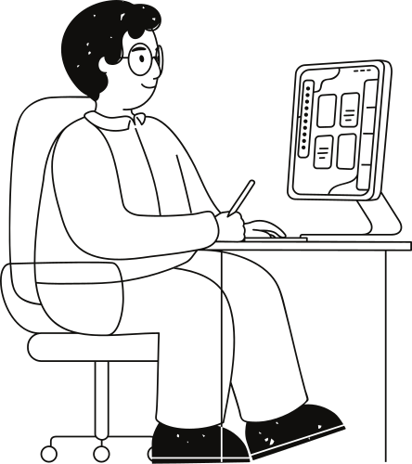
Deliverables
Code: Modular, documented Python scripts.
Deployment: Flask web app for real-time health monitoring.
Report: Outlining SDG alignment, ethical considerations, and technical design.

Slide 6
01.
Bias Mitigation: Use diverse datasets to avoid skewed results.
Ethical & Sustainability Checks
02.
Environmental Impact: Lightweight models for energy efficiency.
03.
Accessibility: Ensure compatibility with low-resource devices.

Slide 7
Development Phases
01
02
03
04
05
Ideation:
Define SDG 3 health challenge, design prototype concept.
Development:
Build Flask app, integrate CSV data pipeline.
Testing:
Validate dashboard accuracy, simulate anomaly cases.
Deployment:
Run locally via Flask / Docker container.
Monitoring:
Track usability, collect feedback for improvements.

Slide 8
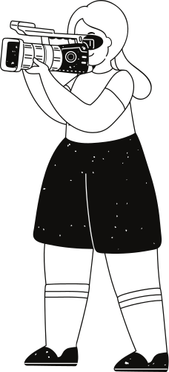
Automated Testing:
CI/CD Pipelines:
How AI for Software Engineering Applies
Enables quick updates to the health dashboard.
Ensures anomaly detection works consistently.
Version Control (Git):
Modular Code:
Manages team collaboration and feature tracking.
Facilitates future integration with wearable devices.

Slide 9
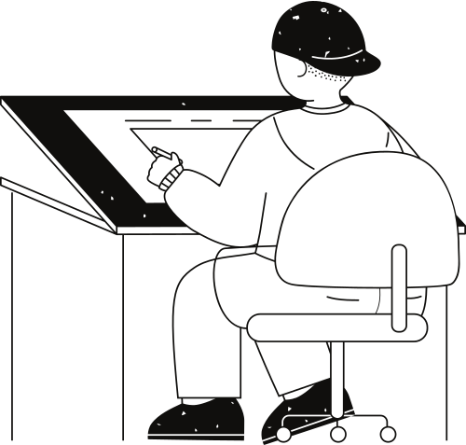
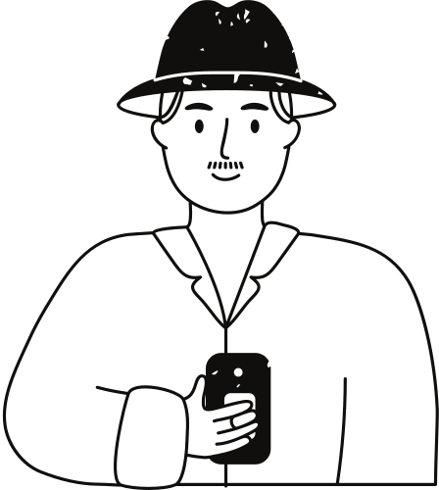




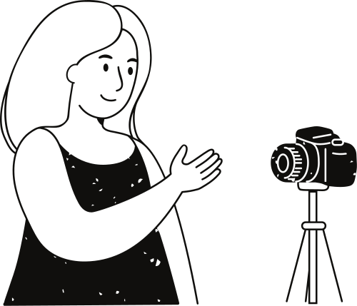
The most challenging part was integrating the AI model into the web application while ensuring accuracy and speed in real-time health monitoring. We also had to carefully manage dependencies, environment setups, and ensure that the model predictions were interpretable for non-technical users.
How well does CareLensAI address early detection for SDG 3?
What are the risks of false positives/negatives, and how can we mitigate them?
Reflection
We gained hands-on experience in AI model deployment, Flask-based backend development, and connecting machine learning models to a user-friendly interface. We also improved our skills in version control, debugging, and API integration.
Questions & Answers
How can ongoing monitoring improve the system’s long-term accuracy?
Future improvements could include expanding the AI model’s dataset to enhance accuracy, integrating live wearable device data, and adding a dashboard for historical tracking and personalized health recommendations.

Slide 10
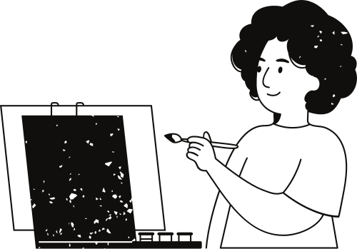
Why This Works?
Practical: Provides a working prototype for continuous health monitoring.
Adaptable: Can integrate live wearable data in future iterations.
Impact-Driven: Focused on preventing serious health events through early detection.

Slide 11
Thank you very much!
https://github.com/MykeShale/CareLensAI

