Slide 1

PART 1 / FOUNDATIONS
Practical AI for Data Analysts
HANDS-ON
DEMO SERIES
Power BI • Databricks
GitHub • Codex • Excel
A clear, analyst-controlled workflow across Excel, pandas, Power BI, Git, and Codex.
DataArt

Slide 2
PART 1
02
TODAY’S ROUTE
Agenda
01
Client context and value map
02
Analyst-controlled operating model
03
Hands-on prompts and quality review
04
Excel, pandas, and connected systems
05
Local models and responsible use
06
Select a measurable pilot
How to use this deck
Follow the checkpoints in order. Copy the prepared commands and prompts, replace only the bracketed placeholders, and stop when a checkpoint fails.
DataArt workshop structure

Slide 3
PART 1
03
CLIENT CONTEXT
One common analytics spine — different starting points
01
02
03
04
Understand
Model
Visualise
Assure quality
Translate a business question into governed metrics, grain, filters, and evidence.
Use SQL, Power BI semantic models, Excel, or Python at the right layer.
Build a concise decision view, not a collection of unrelated charts.
Profile, reconcile, test, document, and keep a human sign-off.

Slide 4
PART 1
04
VALUE MAP
Where AI changes an analyst’s day
01
02
03
Accelerate
Deepen
Assure
Draft SQL, DAX, Python, documentation, test cases, and repetitive transformations.
Generate hypotheses, segments, counter-explanations, and follow-up questions.
Review joins, edge cases, missingness, leakage, metric definitions, and reproducibility.

Slide 5
PART 1
05
TOOL CHOICE
A practical workbench: each tool has a job
1
2
3
4
5
Excel
Pandas
Databricks
Power BI
Git + Codex
→
→
→
→
Fast inspection, reconciliation, controlled business inputs.
Repeatable profiling, statistics, local prototypes.
Shared SQL, governed data, scalable processing and AI/BI.
Semantic model, measures, reports, distribution.
Versioned work, conversational changes, review and tests.

Slide 6
PART 1
06
OPERATING MODEL
Keep the analyst in control of every decision
1
2
3
4
5
Request
Evidence
Analysis
Checks
Decision
→
→
→
→
State the decision, user, period, grain, and definition.
Identify approved sources and freshness.
Generate and run code against the data.
Reconcile totals, nulls, joins, and sensitivity.
Analyst interprets, signs off, and communicates.
Rule
AI proposes and checks; the accountable analyst approves meaning and release.

Slide 7
PART 1
07
QUALITY
High-quality analysis is broader than writing correct code
A capable analyst
Analyst + Codex
Understands context
Systematic test coverage
Challenges assumptions
Faster alternative analyses
Explains trade-offs
Traceable repo changes
Owns the recommendation
More time for judgment
Guidance: https://learn.chatgpt.com/guides/best-practices

Slide 8
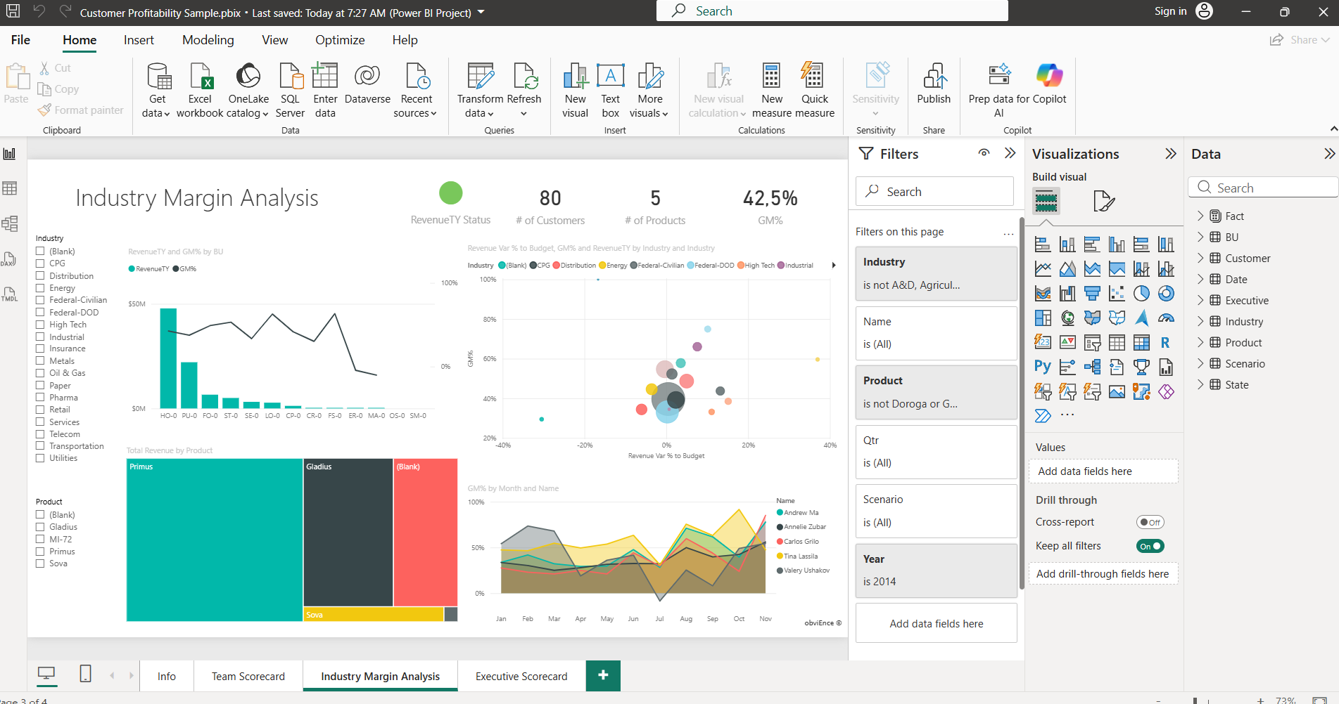
PART 1
08
HANDS-ON
Start with a familiar Power BI sample
15-minute exercise
Open a sanitized PBIX or Microsoft sample
Write three decision questions
Record the current refresh and row count
Save a baseline before changes
Samples: https://learn.microsoft.com/power-bi/create-reports/sample-datasets

Slide 9
PART 1
09
PROMPT PATTERN
Prompt 1 — profile before interpreting
PROMPT — COPY / PASTE
Checkpoint
Goal: Profile the attached dataset for an analyst review.
Context: The decision is [decision]. The grain is [grain].
Output: A concise table of row count, date range, nulls,
duplicates, outliers, and top categories; then 5 hypotheses.
Boundaries: Do not invent values. Show the code used.
Done when: Every claim points to a computed result.
The answer includes executable code, a compact profile, and separates facts from hypotheses.
Safe use
Use public or sanitized data. Remove names, emails, identifiers, and secrets before sharing.

Slide 10
PART 1
10
PROMPT PATTERN
Prompt 2 — review SQL or DAX like a peer
PROMPT — COPY / PASTE
Checkpoint
Review this [SQL/DAX] for correctness and maintainability.
Business definition: [metric definition].
Expected grain: [grain]. Filters: [filters].
Check: join cardinality, double counting, blanks/nulls,
divide-by-zero, time logic, and performance.
Return: findings by severity, corrected code, and 5 tests.
Do not change business meaning without flagging it.
The review identifies at least one test for totals, duplicates, boundary dates, and empty inputs.
Safe use
A review is evidence, not approval. Execute the tests and obtain the model owner’s sign-off.

Slide 11
PART 1
11
TOOL CHOICE
Pandas and Excel still matter
Excel
Pandas
Shared rule
Fast business review
Repeatable profiling
Keep source references
Small reconciliations
Statistical checks
Version important logic
Controlled assumptions
Testable transformations
Reconcile to a trusted total
Easy stakeholder hand-off
Notebook-to-pipeline path
Explain every manual step

Slide 12
PART 1
12
PROMPT LIBRARY
Four formats an analyst can reuse immediately
01
02
03
04
G-C-O-B-D
Role + task + evidence
Plan → execute → verify
Compare alternatives
Goal • Context • Output • Boundaries • Done when. Best default for work requests.
Useful for reviews: act as a data-quality reviewer; use only these files/results.
Ask for a plan, permit scoped execution, then require tests and a summary.
Request 2–3 approaches with assumptions, risks, effort, and a recommendation.
OpenAI Codex prompting: https://learn.chatgpt.com/docs/prompting

Slide 13
PART 1
13
CONNECTED WORK
Codex can work across approved systems
1
2
3
4
Files
GitHub
CLI / API
MCP / plugins
→
→
→
PBIP, SQL, Python, CSV, Markdown, and configuration.
Branches, diffs, pull requests, issues, and review.
Databricks CLI and other authenticated tools.
Approved connectors for Jira, Confluence, SharePoint, and more.
Governance
Availability and permissions depend on your organization, workspace policy, and administrator configuration.
Codex MCP: https://learn.chatgpt.com/docs/extend/mcp

Slide 14
PART 1
14
LOCAL MODELS
LM Studio and Ollama — useful local options
LM Studio
Ollama
Reality check
Desktop-first model discovery
CLI/service workflow
Hardware limits model size
Local chat and server
Simple local API
Local does not mean governed
OpenAI-compatible API
Good for scripting
Evaluate quality and licenses
Offline after model download
Broad open-model ecosystem
Enterprise controls still apply
Official docs: https://lmstudio.ai/docs | https://docs.ollama.com

Slide 15
PART 1
15
RESPONSIBLE USE
A release checklist for analyst work
Use approved data locations and access controls.
Evidence standard
Do not paste credentials, personal data, or client-confidential content into unapproved tools.
If a number cannot be traced to a source and reproducible computation, it is not ready for a client decision.
Cite the source table, query, file, date range, and refresh time.
Run row-count, uniqueness, null, join, and reconciliation checks.
Separate computed facts, assumptions, hypotheses, and recommendations.
Store repeatable logic in Git; record manual exceptions.
Require human review for business meaning, sensitive decisions, and publication.

Slide 16
PART 1
16
NEXT STEP
Pilot one recurring analysis — with measurable controls
Bring to Part 2
One sanitized PBIX
Recommended pilot
One metric definition
Choose one reusable KPI query or campaign-analysis workflow. Capture the baseline time, rework, defects, and review effort; then compare the assisted workflow.
One GitHub repo
One reviewer
DataArt — practical AI injection into analytics workflows

