Slide 1

PART 2 / PBIP + GIT
Power BI as Source Code
HANDS-ON
DEMO SERIES
Power BI • Databricks
GitHub • Codex • Excel
Convert PBIX to PBIP, understand every layer, and introduce Git + Codex safely.
DataArt

Slide 2
PART 2
02
TODAY’S ROUTE
Agenda
01
PBIX versus PBIP
02
Conversion and safe Git baseline
03
PBIP root and report structure
04
Semantic model and TMDL levels
05
Codex changes and review
06
End-to-end mini-demo
How to use this deck
Follow the checkpoints in order. Copy the prepared commands and prompts, replace only the bracketed placeholders, and stop when a checkpoint fails.
DataArt workshop structure

Slide 3
PART 2
03
WHY PBIP
PBIX is a package; PBIP is a versionable project
PBIX
PBIP
Single binary file
Report + semantic model folders
Easy desktop hand-off
Text-based definitions
Opaque Git diffs
Meaningful Git changes
Harder automated review
Automation and Codex-ready
Microsoft: https://learn.microsoft.com/power-bi/developer/projects/projects-overview

Slide 4
PART 2
04
READINESS
Before converting a report
Install a current Power BI Desktop on Windows.
Preview warning
PBIP capabilities and file schemas are preview features. Validate on a copy and keep Power BI Desktop as the authoritative save path.
Create a backup copy of the original PBIX.
Use a short local path; avoid saving the PBIP directly into OneDrive or SharePoint.
Enable the required Power BI Project / TMDL / enhanced report-format preview features, then restart Desktop.
Prepare Git, a private repository, and a branch for the conversion.
Use a sanitized sample first; document custom visuals and data-source dependencies.
Microsoft PBIP overview (preview): https://learn.microsoft.com/power-bi/developer/projects/projects-overview

Slide 5
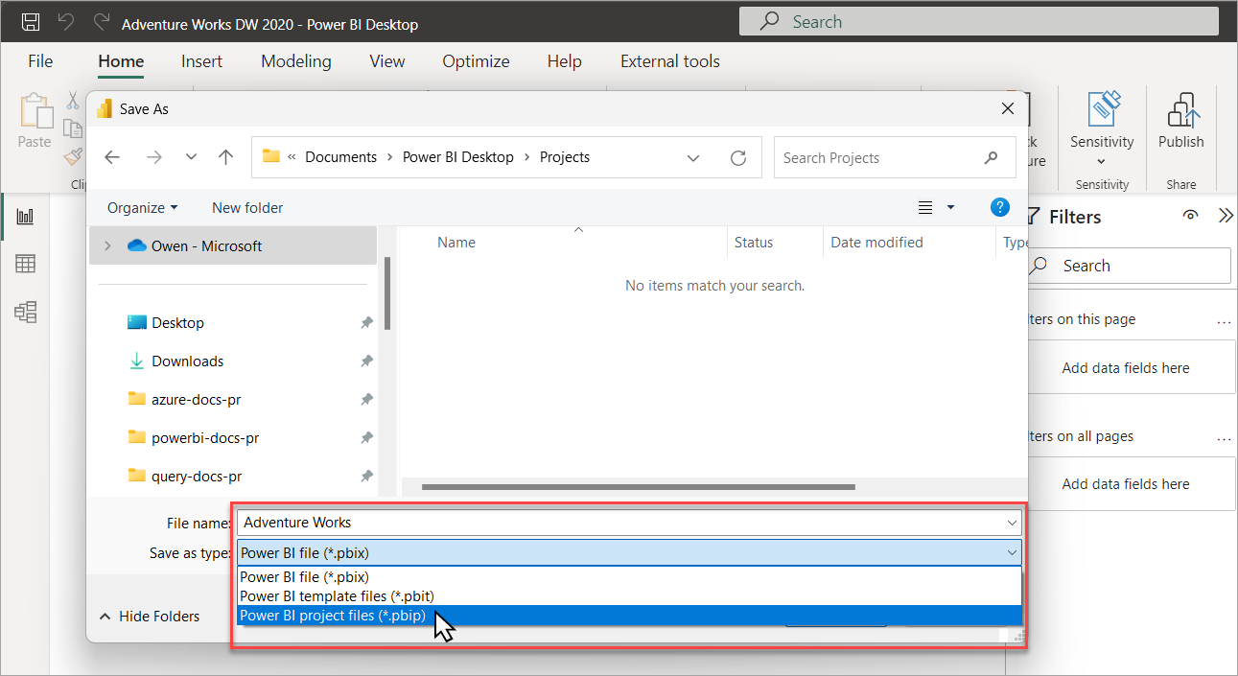
PART 2
05
HANDS-ON
Convert PBIX → PBIP in Power BI Desktop
Exact steps
File → Save As
Choose Power BI Project (.pbip)
Save to a short local folder
Close and reopen the project
Official Microsoft screenshot and guidance: https://learn.microsoft.com/power-bi/developer/projects/projects-overview

Slide 6
PART 2
06
GIT BASELINE
Create a safe first commit
POWERSHELL / GIT — COPY / PASTE
Checkpoint
cd C:\work\analytics-demo
git init
@"
**/.pbi/localSettings.json
**/.pbi/cache.abf
"@ | Set-Content .gitignore
git add .
git status
git commit -m "Convert report to PBIP baseline"
Only project definitions and intended assets are staged. Local settings and cache.abf are absent.
Safe use
Inspect git status and the diff before every commit. Never commit credentials or connection tokens.
Microsoft .gitignore guidance: https://learn.microsoft.com/power-bi/developer/projects/projects-overview

Slide 7
PART 2
07
PROJECT ROOT
PBIP root structure
CustomerProfitability.pbip
CustomerProfitability.Report/
definition.pbir
definition/
StaticResources/
.pbi/
CustomerProfitability.SemanticModel/
definition.pbism
definition/
.pbi/
.gitignore
Two linked projects
The .pbip entry point opens a report project and its referenced semantic model project. Keep the relative relationship intact.
Local-only
The .pbi folder can contain user and cache state. Commit only items explicitly documented as source.
Microsoft PBIP overview: https://learn.microsoft.com/power-bi/developer/projects/projects-overview

Slide 8
PART 2
08
REPORT PROJECT
Report folder — all important levels
Report/
├─ definition.pbir [required]
├─ definition/ [enhanced PBIR]
│ ├─ report.json
│ ├─ pages/
│ │ ├─ pages.json
│ │ └─ <page>/
│ │ ├─ page.json
│ │ └─ visuals/<visual>/visual.json
│ ├─ bookmarks/<name>.bookmark.json
│ └─ version.json
├─ StaticResources/RegisteredResources/
├─ CustomVisuals/
└─ .pbi/localSettings.json
Enhanced PBIR
Each page, visual, and bookmark becomes a separate text file, making diffs and targeted edits easier.
Do not improvise schema
Use the schema URL and Desktop validation. Unsupported external edits can stop the project opening.
Microsoft report project: https://learn.microsoft.com/power-bi/developer/projects/projects-report

Slide 9
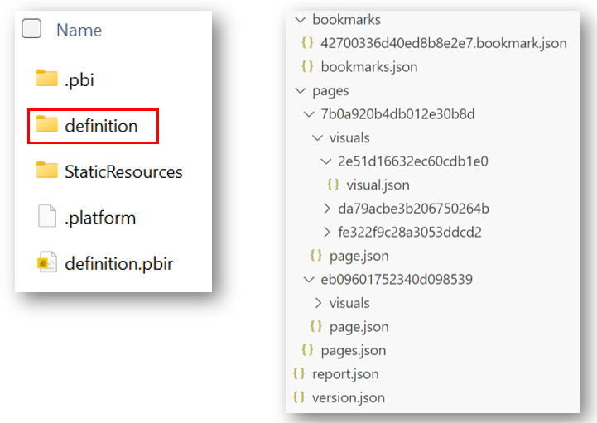
PART 2
09
ENHANCED PBIR
Pages and visuals become diffable files
What changes
One folder per page
One folder per visual
Readable JSON properties
Better conflict isolation
Official Microsoft screenshot: https://learn.microsoft.com/power-bi/developer/projects/projects-report

Slide 10
PART 2
10
SEMANTIC MODEL
SemanticModel folder — all important levels
SemanticModel/
├─ definition.pbism [required]
├─ definition/ [TMDL]
│ ├─ database.tmdl
│ ├─ model.tmdl
│ ├─ relationships.tmdl
│ ├─ expressions.tmdl
│ ├─ dataSources.tmdl
│ ├─ tables/<table>.tmdl
│ ├─ roles/<role>.tmdl
│ ├─ cultures/<culture>.tmdl
│ └─ perspectives/<view>.tmdl
├─ diagramLayout.json
├─ DAXQueries/
├─ TMDLScripts/
└─ .pbi/
Source of semantic meaning
Tables, measures, relationships, roles, expressions, and metadata become text that can be reviewed and tested.
Compatibility
A project may use TMDL or model.bim depending on configuration and conversion history.
Microsoft semantic model + TMDL: https://learn.microsoft.com/power-bi/developer/projects/projects-dataset

Slide 11
PART 2
11
TMDL
TMDL root and folder hierarchy
definition/
├─ database.tmdl
├─ model.tmdl
├─ relationships.tmdl
├─ dataSources.tmdl
├─ expressions.tmdl
├─ functions.tmdl
├─ tables/
│ ├─ Date.tmdl
│ └─ Sales.tmdl
├─ roles/
├─ cultures/
└─ perspectives/
Folder convention
The folder structure is serialized text for the tabular object model. Use Desktop and schema-aware tooling to preserve valid syntax.
Review focus
A reviewer can isolate changed measures, relationships, roles, and data-source expressions.
TMDL overview: https://learn.microsoft.com/analysis-services/tmdl/tmdl-overview

Slide 12
PART 2
12
TMDL ANATOMY
A measure is human-readable source
TMDL — ILLUSTRATIVE
Checkpoint
table Sales
column Amount
dataType: decimal
sourceColumn: Amount
measure 'Total Sales' = SUM(Sales[Amount])
formatString: "$#,0.00"
measure 'Sales YoY %' =
DIVIDE([Total Sales] - [Sales PY], [Sales PY])
Open the project in Desktop. Confirm measures compile, formats remain correct, and a baseline visual reconciles.
Safe use
Treat the snippet as a pattern. Names, indentation, metadata, and expressions must match the project’s generated files.
TMDL overview: https://learn.microsoft.com/analysis-services/tmdl/tmdl-overview

Slide 13
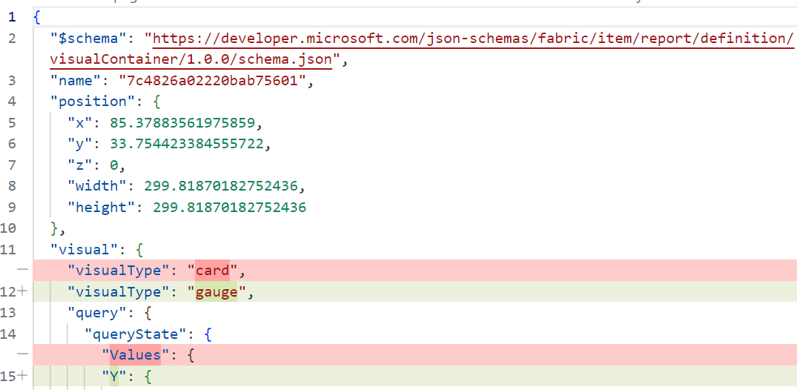
PART 2
13
GIT REVIEW
A PBIP change becomes a meaningful diff
Review questions
Which visual property changed?
Was business meaning altered?
Are generated IDs stable?
Can Desktop reopen it?
Official Microsoft screenshot: https://learn.microsoft.com/power-bi/developer/projects/projects-report

Slide 14
PART 2
14
CODEX FOR PBIP
What Codex can do — and where it must stop
01
02
03
04
Explain
Change
Review
Verify
Map folders, trace measures, summarize report pages, and build a metric dictionary.
Draft targeted TMDL/PBIR edits, SQL, documentation, and test scripts on a branch.
Inspect Git diffs for duplicated logic, naming, broken references, and risky changes.
Run available validators and tests; require Desktop reopen and analyst sign-off.

Slide 15
PART 2
15
HANDS-ON
Ask Codex for one controlled PBIP change
PROMPT — COPY / PASTE
Checkpoint
Goal: Add a measure [Repeat Customer Rate] to the PBIP.
Context: Read AGENTS.md and the existing TMDL first.
Definition: [approved business definition].
Constraints: Change only the semantic model and documentation.
Output: Plan, exact files changed, diff summary, and tests.
Verification: Check references and syntax; do not claim Desktop
validation unless the project was reopened successfully.
The diff is limited, readable, and maps directly to the approved definition. Desktop opens and the measure reconciles.
Safe use
Work on a branch. Never bulk-edit generated files without a scoped review and a recovery copy.

Slide 16
PART 2
16
MINI-DEMO
PBIX → PBIP → Git → Codex → Power BI
1
2
3
4
5
Convert
Baseline
Request
Review
Reopen
→
→
→
→
Save a sanitized PBIX as PBIP.
Commit an unchanged, reopenable project.
Give Codex one approved metric change.
Inspect the diff and run tests.
Validate in Desktop and publish only after sign-off.
Success criterion
A reviewer can explain every changed line, reproduce the metric, and reopen the project without repair.

