Slide 1

PART 3 / DATABRICKS
Databricks AI — Hands On
HANDS-ON
DEMO SERIES
Power BI • Databricks
GitHub • Codex • Excel
Free Edition setup, SQL, AI/BI, Git, classification, and a tiny language-model exercise.
DataArt

Slide 2
PART 3
02
TODAY’S ROUTE
Agenda
01
Free Edition setup and limits
02
Databricks AI capability map
03
SQL, Genie Code, and dashboard
04
GitHub integration
05
Neural classification demo
06
Tiny language-model demo
How to use this deck
Follow the checkpoints in order. Copy the prepared commands and prompts, replace only the bracketed placeholders, and stop when a checkpoint fails.
DataArt workshop structure

Slide 3
PART 3
03
CHOOSE THE RIGHT ENVIRONMENT
Free Edition is for learning — not client production
Free Edition
Free trial / training workspace
No-cost personal learning
Business evaluation
Serverless-only
Organization controls
Quota-limited
Broader product scope
Public/synthetic data only
Preferred for client demo data
Databricks: https://docs.databricks.com/aws/en/getting-started/free-trial-vs-free-edition

Slide 4
PART 3
04
ACCOUNT SETUP
Create a Databricks Free Edition account
1
2
3
4
5
Open
Register
Enter
Accept
Verify
→
→
→
→
Go to databricks.com/learn/free-edition.
Use a permitted personal email and complete verification.
Open the single provisioned workspace.
Review terms, privacy, and data-use limitations.
Open SQL Editor and confirm sample catalogs are visible.
If company policy prohibits it
Use a DataArt-provided training workspace or an approved free trial. Do not work around organizational controls.
Setup: https://docs.databricks.com/aws/en/getting-started/free-edition

Slide 5
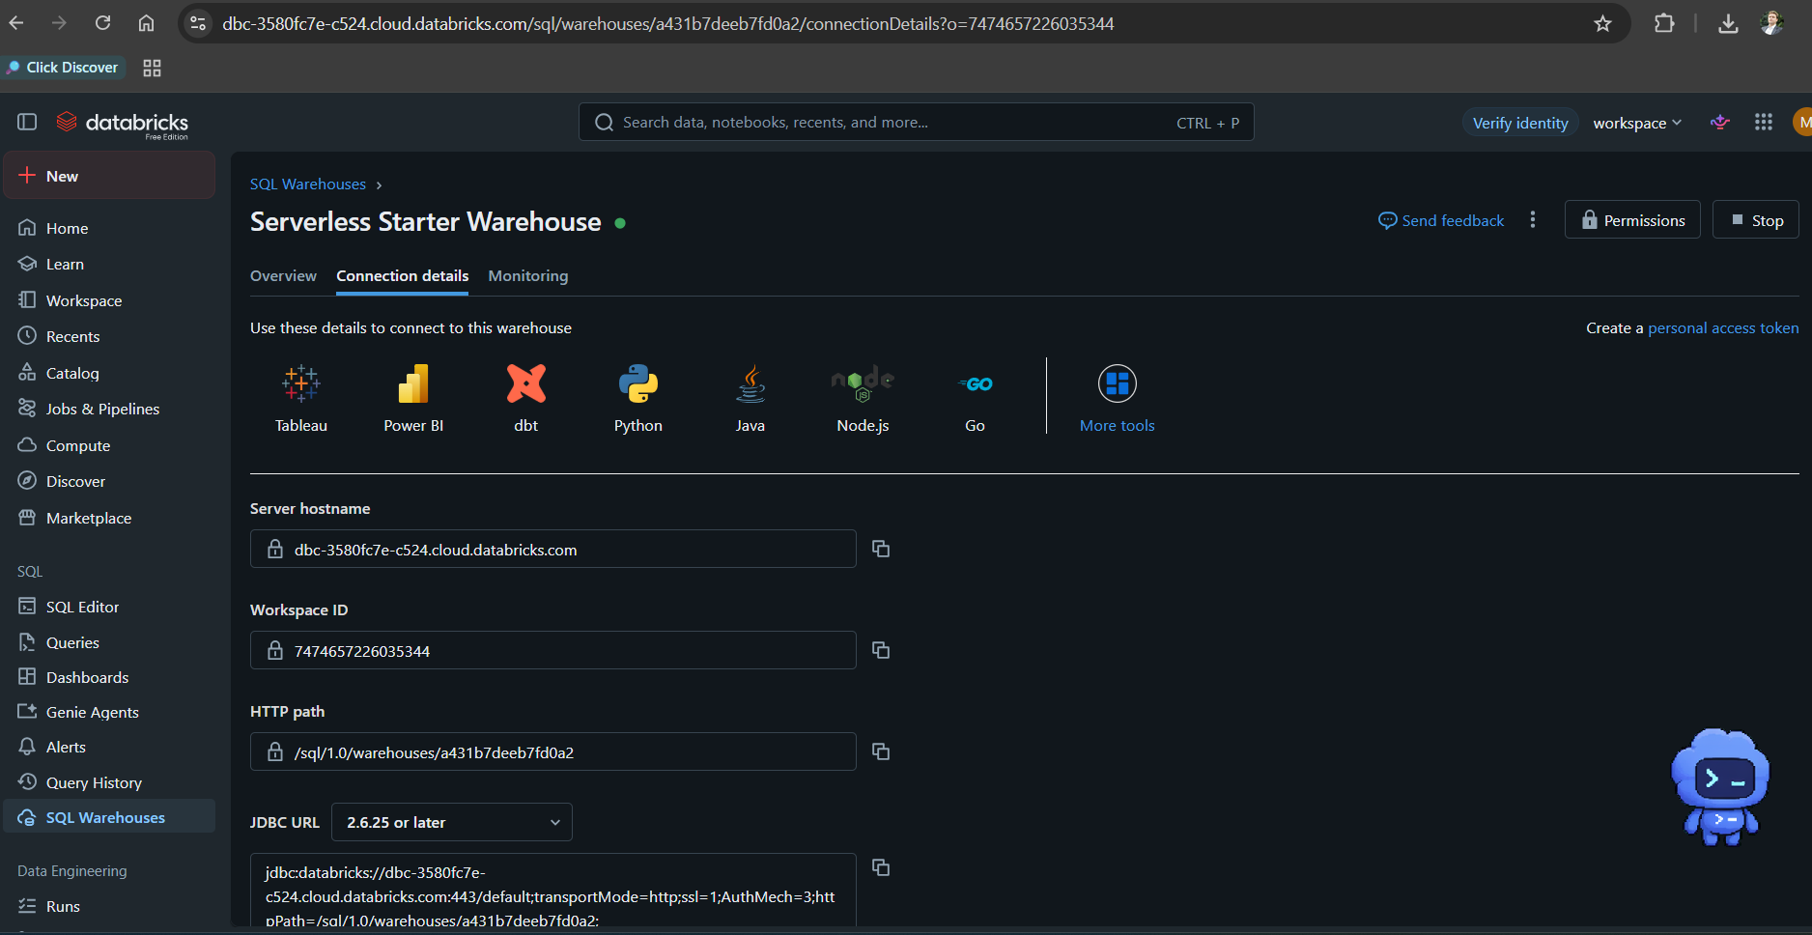
PART 3
05
WORKSPACE CHECK
Find the starter SQL warehouse
Checkpoint
Warehouse is running
Size is serverless starter
<workspace hostname>
Connection details open
<workspace ID>
<HTTP path>
No client data uploaded
<JDBC URL / workspace-specific connection string>
User-provided screenshot; workspace-specific values selectively masked

Slide 6
PART 3
06
KNOW THE LIMITS
Free Edition constraints that affect the demo
One workspace and a limited serverless environment.
Plan B
One SQL warehouse, with small maximum sizing.
Prepare screenshots and expected outputs so the workshop can continue if a quota or provisioning delay occurs.
Daily usage quotas can stop or delay exercises.
Restricted outbound internet and limited integrations.
No production SLA or enterprise support model.
Databricks describes Free Edition as non-commercial learning/prototyping.
Review the data-use terms; use only public or synthetic data.
Limitations: https://docs.databricks.com/aws/en/getting-started/free-edition-limitations

Slide 7
PART 3
07
AI CAPABILITY MAP
Databricks AI for an analyst
01
02
03
04
Genie Code
AI/BI Genie
AI/BI dashboards
AI Functions
Assist with SQL and Python in notebooks and editors.
Natural-language exploration over a curated semantic space.
Create and share governed interactive analysis.
Apply supported models from SQL for classification, extraction, and summarization.
Databricks AI/BI: https://docs.databricks.com/aws/en/ai-bi/

Slide 8
PART 3
08
HANDS-ON SQL
Query a built-in sample — no upload required
DATABRICKS SQL — COPY / PASTE
Checkpoint
SELECT pickup_zip,
COUNT(*) AS trips,
ROUND(AVG(fare_amount), 2) AS avg_fare,
ROUND(AVG(trip_distance), 2) AS avg_distance
FROM samples.nyctaxi.trips
WHERE trip_distance > 0
GROUP BY pickup_zip
ORDER BY trips DESC
LIMIT 10;
A 10-row result appears. Record warehouse, run time, row count, and the exact query.
Safe use
Sample schemas can evolve. If the table is unavailable, browse Catalog → samples and select another documented sample.
Databricks sample data: https://docs.databricks.com/aws/en/discover/databricks-datasets

Slide 9
PART 3
09
GENIE CODE
Use the assistant to improve — then verify
PROMPT — COPY / PASTE
Checkpoint
Using samples.nyctaxi.trips, write one SQL query that:
1. profiles row count, date range, null pickup ZIPs,
non-positive distance, and non-positive fare;
2. returns monthly trips and average fare;
3. comments every business assumption.
Do not invent columns. First inspect the table schema.
Compare generated column names to the catalog, run the query, and challenge any filtered rows or date assumptions.
Safe use
The assistant can draft SQL; execution results and business interpretation remain the analyst’s responsibility.

Slide 10
PART 3
10
AI/BI DASHBOARD
Turn a verified query into a dashboard
1
2
3
4
5
Create
Query
Visualize
Filter
Publish
→
→
→
→
New → Dashboard; add a dataset.
Paste the verified SQL and run it.
Add a bar chart and KPI; set labels and formats.
Add a date or ZIP filter; test interactions.
Preview permissions; publish only in the training scope.
Definition of done
A colleague can reproduce the query, understand the metric, and explain what the dashboard does not show.
Tutorial: https://docs.databricks.com/aws/en/dashboards/tutorials/create-dashboard

Slide 11
PART 3
11
GIT FOLDERS
Connect Databricks to GitHub
1
2
3
4
5
Authorize
Clone
Branch
Commit
PR
→
→
→
→
Add approved Git credentials or GitHub App access.
Workspace → Git folder → clone the private repo.
Create a workshop branch before edits.
Review changed notebooks/SQL; write a meaningful message.
Push and request review; merge only after tests.
Scope
Git folders version workspace files. Data and secrets stay outside Git.
Databricks Git folders: https://docs.databricks.com/aws/en/repos/git-folders-concepts

Slide 12
PART 3
12
CLASSIFICATION DEMO
Train a tiny neural classifier
PYTHON — COPY / PASTE
Checkpoint
from sklearn.datasets import load_breast_cancer
from sklearn.model_selection import train_test_split
from sklearn.pipeline import make_pipeline
from sklearn.preprocessing import StandardScaler
from sklearn.neural_network import MLPClassifier
from sklearn.metrics import accuracy_score, confusion_matrix
X, y = load_breast_cancer(return_X_y=True)
Xtr, Xte, ytr, yte = train_test_split(
X, y, test_size=.25, random_state=42, stratify=y)
model = make_pipeline(StandardScaler(),
MLPClassifier(hidden_layer_sizes=(32,), max_iter=1000,
random_state=42, early_stopping=True))
model.fit(Xtr, ytr)
pred = model.predict(Xte)
print("accuracy", round(accuracy_score(yte, pred), 3))
print(confusion_matrix(yte, pred))
The notebook prints an accuracy and a 2×2 confusion matrix. Re-running with seed 42 is reproducible.
Safe use
Educational dataset only. Accuracy alone is insufficient; do not use this model for clinical or business decisions.
Databricks scikit-learn guidance: https://docs.databricks.com/aws/en/machine-learning/train-model/scikit-learn

Slide 13
PART 3
13
CLASSIFICATION QA
What an analyst must check after model.fit()
Baseline: compare with a majority-class or simple linear model.
Key lesson
Split: keep test data unseen; use stratification for class balance.
A neural network is easy to call. A defensible decision process is the real work.
Leakage: ensure features would be available at prediction time.
Metrics: inspect precision, recall, confusion matrix, and business costs.
Stability: vary the seed or use cross-validation.
Fairness and privacy: identify sensitive attributes and affected groups.
Deployment: define monitoring, retraining, rollback, and human escalation.

Slide 14
PART 3
14
TINY LANGUAGE MODEL
Build a next-character neural model
PYTHON — COPY / PASTE
Checkpoint
from sklearn.neural_network import MLPClassifier
from sklearn.preprocessing import OneHotEncoder
import numpy as np
text = ("data quality before dashboard delivery. " * 60).lower()
ctx = 6
X = [list(text[i:i+ctx]) for i in range(len(text)-ctx)]
y = [text[i+ctx] for i in range(len(text)-ctx)]
enc = OneHotEncoder(handle_unknown="ignore", sparse_output=False)
Xv = enc.fit_transform(X)
chars = sorted(set(y)); to_id = {c:i for i,c in enumerate(chars)}
model = MLPClassifier((64,), max_iter=300, random_state=42)
model.fit(Xv, [to_id[c] for c in y])
seed = list("data q"); out = "".join(seed)
for _ in range(60):
nxt = chars[model.predict(enc.transform([seed]))[0]]
out += nxt; seed = (seed + [nxt])[-ctx:]
print(out)
The output imitates the small training phrase. Change the corpus and context length; observe quality and overfitting.
Safe use
This is a microscopic educational language model—not an LLM. Modern LLMs use tokens, transformers, vast corpora, and extensive evaluation.

Slide 15
PART 3
15
FROM TOY TO REAL
The demo teaches the idea — not production LLM engineering
Tiny demo
Production LLM
Databricks path
Characters
Tokenization + transformers
AI Playground
One small MLP
Large training and serving stack
Model serving
Memorizes a phrase
Safety/evaluation/monitoring
AI Functions
Runs quickly
Use managed or approved models
Mosaic AI tooling
Databricks GenAI quickstart: https://docs.databricks.com/aws/en/getting-started/gen-ai-llm-agent

Slide 16
PART 3
16
PART 3 COMPLETE
Free Edition is enough to learn the workflow
Keep ready
Sample query
Take-away
Git branch
Use built-in samples to practice SQL, assistant-supported analysis, dashboards, Git, and simple ML. Move to an approved workspace for business data and production evaluation.
Dashboard screenshot
QA results
Next: connect Codex, Databricks, GitHub, and Power BI end to end

