Slide 1

PART 4 / DELIVERY
End-to-End Analytics Delivery
HANDS-ON
DEMO SERIES
Power BI • Databricks
GitHub • Codex • Excel
Codex, Databricks, GitHub, and Power BI PBIP working as one reviewable system.
DataArt

Slide 2
PART 4
02
TODAY’S ROUTE
Agenda
01
Target architecture and repository
02
Databricks CLI + OAuth
03
Codex connection smoke test
04
Power BI connection walkthrough
05
Business requirement to reviewed PR
06
Governed pilot proposal
How to use this deck
Follow the checkpoints in order. Copy the prepared commands and prompts, replace only the bracketed placeholders, and stop when a checkpoint fails.
DataArt workshop structure

Slide 3
PART 4
03
REPOSITORY
One repo connects the full workflow
analytics-demo/
├─ AGENTS.md
├─ requirements/
│ └─ business_requirement.md
├─ databricks/
│ ├─ sql/active_supporters.sql
│ └─ tests/data_quality.sql
├─ powerbi/
│ ├─ CustomerProfitability.pbip
│ ├─ CustomerProfitability.Report/
│ └─ CustomerProfitability.SemanticModel/
└─ docs/
└─ metric_dictionary.md
Why this matters
Requirements, data logic, tests, semantic definitions, visuals, and documentation can be reviewed in one pull request.
AGENTS.md
Record project conventions, allowed commands, validation steps, and boundaries for Codex.
Codex best practices: https://learn.chatgpt.com/guides/best-practices

Slide 4
PART 4
04
DATABRICKS CLI
Install and verify the CLI on Windows
POWERSHELL — COPY / PASTE
Checkpoint
winget search databricks
winget install Databricks.DatabricksCLI
databricks -v
# The version should be 0.205 or later.
# Restart the terminal if the command is not found.
databricks -v prints an installed version. Record the version in workshop notes.
Safe use
Install software only with local IT approval. Use an approved workstation or prepared virtual machine.
Official CLI tutorial: https://docs.databricks.com/aws/en/dev-tools/cli/tutorial

Slide 5
PART 4
05
OAUTH SIGN-IN
Authenticate with browser-based OAuth
POWERSHELL — COPY / PASTE
Checkpoint
$hostUrl = "https://<your-workspace-host>"
databricks auth login --host $hostUrl
# Then verify the authenticated identity and access:
databricks auth profiles
databricks current-user me -p <profile-name>
databricks warehouses list -p <profile-name>
The current-user command returns your own identity and warehouses list returns only authorized resources.
Safe use
Do not paste tokens into prompts or source files. Browser-based OAuth keeps the credential out of the command text.
OAuth U2M: https://docs.databricks.com/aws/en/dev-tools/auth/oauth-u2m

Slide 6
PART 4
06
CODEX CONNECTION
Give Codex a read-only smoke test first
PROMPT — COPY / PASTE
Checkpoint
Goal: Verify my Databricks CLI connection.
Context: Use profile <profile-name>.
Boundaries: Read-only commands only. Do not create, edit,
start, stop, or delete resources. Never display credentials.
Tasks:
1. Run databricks current-user me.
2. List SQL warehouses.
3. Summarize the accessible names and states.
Done when: Commands and outputs are recorded without secrets.
Codex runs only the two approved read-only commands and reports the correct user and warehouse state.
Safe use
Expand permissions one task at a time. Keep destructive or costly operations behind explicit human approval.

Slide 7
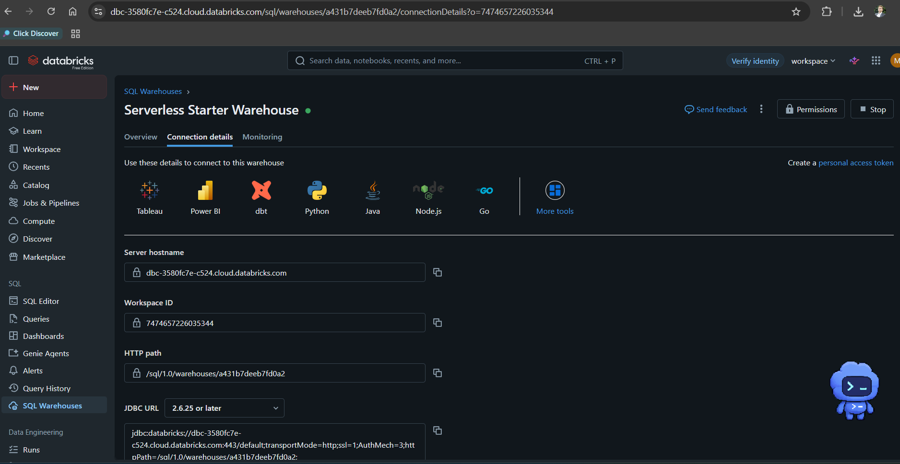
PART 4
07
CONNECTION VALUES
Locate the Server Hostname and HTTP Path
Use in Power BI
Open SQL Warehouse
Connection details
<workspace hostname>
Copy hostname
<workspace ID>
<HTTP path>
Copy HTTP path
<JDBC URL / workspace-specific connection string>
User-provided screenshot; workspace-specific values selectively masked

Slide 8
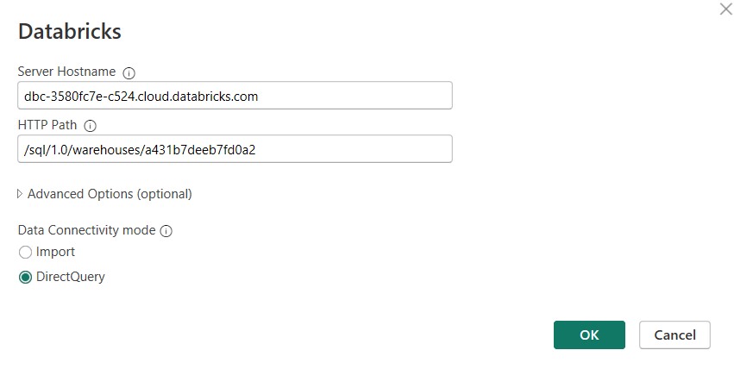
PART 4
08
POWER BI CONNECTOR
Connect Power BI Desktop to Databricks
Connector steps
<server hostname>
Get Data → Azure Databricks
<HTTP path>
Enter host and HTTP path
Choose OAuth
Prefer DirectQuery for demo
User-provided screenshot; only connection values masked

Slide 9
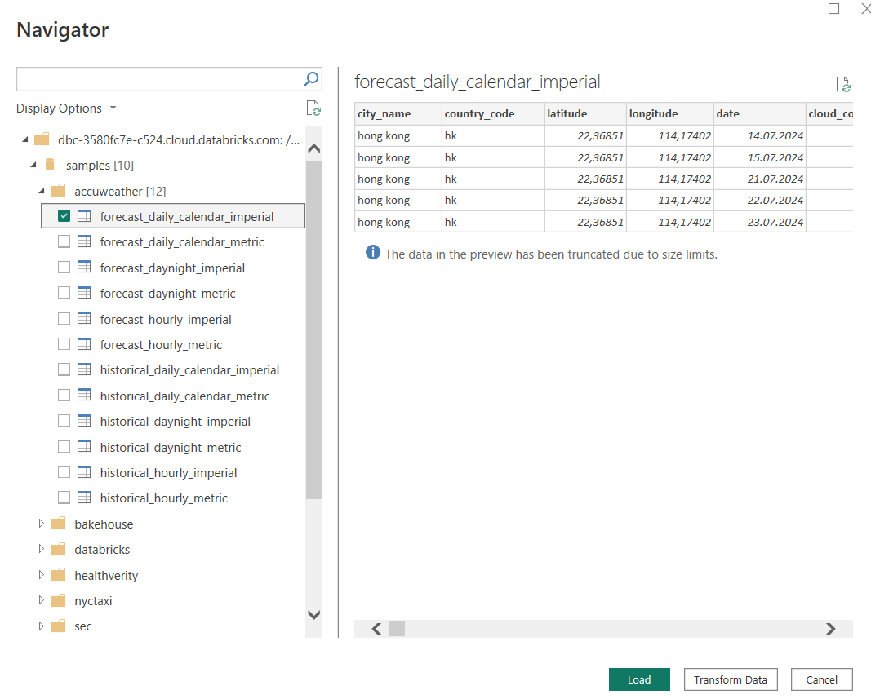
PART 4
09
NAVIGATOR
Select a sample table and verify mode
Checkpoint
Browse samples catalog
Preview intended table
Confirm DirectQuery
Load a small model
User-provided screenshot; workspace host masked

Slide 10
PART 4
10
BUSINESS REQUIREMENT
Example: identify active supporters for an email campaign
Decision: which supporters should receive the next campaign?
Open decision
Population: consented supporters with a valid email.
The client must approve the exact meaning of “active,” the qualification window, and consent rules before build.
Active definition: at least one qualifying action in the last 90 days.
Exclusions: unsubscribed, bounced, suppressed, employees, test records.
Output grain: one row per supporter with segment and reason.
Dashboard: eligible count, trend, segment, exclusion reasons, and data freshness.
Acceptance: reconcile to CRM totals and sample at least 20 records.

Slide 11
PART 4
11
CODEX WORK ORDER
Turn the requirement into a controlled implementation
PROMPT — COPY / PASTE
Checkpoint
Goal: Deliver the active-supporters dashboard change.
Read first: AGENTS.md and requirements/business_requirement.md.
Plan only first; list assumptions and blocked definitions.
After approval:
- update databricks/sql/active_supporters.sql;
- add data-quality tests;
- update PBIP measures and one report page;
- update docs/metric_dictionary.md.
Boundaries: no secrets, no production writes, no metric invention.
Done when: tests pass, diff is summarized, Desktop validation
is clearly marked run/not run, and a PR description is drafted.
The plan identifies unanswered definitions before code. Each file change maps to a requirement and a test.
Safe use
Do not let convenience silently redefine eligibility, consent, activity, or campaign exclusions.

Slide 12
PART 4
12
EXECUTION
Codex coordinates work across the repository
1
2
3
4
5
Read
Plan
Edit
Run
Review
→
→
→
→
Requirement, AGENTS.md, current SQL, model, and report.
Files, definitions, risks, tests, and validation.
Scoped branch changes across SQL, PBIP, and docs.
Read-only/sample queries and local tests.
Diff summary, PR, evidence, and human sign-off.
The promise
One conversation can coordinate many artifacts; Git provides the audit trail and review boundary.

Slide 13
PART 4
13
DATA-QUALITY GATE
No dashboard is complete without these checks
01
02
03
04
Grain
Eligibility
Time
Reconciliation
One row per supporter; duplicates quantified and resolved.
Consent, suppression, bounce, employee, and test exclusions proven.
90-day boundary, timezone, and late-arriving data tested.
Counts reconcile to approved CRM controls and explained differences.

Slide 14
PART 4
14
REPORT + PR GATE
Release evidence travels with the change
01
02
03
04
Power BI
Performance
GitHub
Business
Desktop reopens PBIP; measures compile; visuals render; interactions work.
Query plan, DirectQuery behavior, and refresh time are acceptable.
Small diff, clear commit, reviewer, screenshots, test evidence, rollback note.
Metric owner confirms definition and a user confirms the decision view.

Slide 15
PART 4
15
CAPACITY
Codex raises coverage; the analyst raises meaning
Without assistance
With Codex
Human authority
More manual repetition
Broader systematic checks
Approves definitions
Tests often deferred
Faster repeatable edits
Judges materiality
Documentation lags
Living documentation
Challenges outputs
Fewer alternatives explored
More reviewable evidence
Owns release and impact

Slide 16
PART 4
16
PROPOSED PILOT
A small, governed pilot proves value quickly
Client decisions
Pilot use case
Two-week shape
Approved workspace
Select one sanitized report and one recurring query. Convert to PBIP, connect a training Databricks source, implement one change through Git, and measure cycle time, rework, test coverage, and reviewer effort.
Data owner + reviewer
Success measures
DataArt — hands-on enablement, engineering, and governed AI adoption

