Slide 1

Introduction
Computer System Principles, Fall 2020 (IPADS, SJTU)
Complexity VS. Simplicity
Yubin Xia

Slide 2
System: What & Why
What is system? Why should I learn how to think-in-system?

Slide 3
What does "System" Mean?
1: Way to use hardware
Knowledge of OS, hardware, compiler, runtime, etc.
E.g., page table, TLB, file system
2: Way to think systematically
A way of analyzing and solving problems
E.g., system design principles

Slide 4
Why System?
For fun and profit

Slide 5
Reason-1: For Fun (Finding Problems)
Know a system by playing with it
The more you know about the system, the more likely to find interesting features (or, bugs with another name)

Slide 6
An Example: Guessing Password
checkpw (user, passwd):
acct = accounts[user]
for i in range(0, len(acct.pw)):
if acct.pw[i] ≠ passwd[i]:
return False
return True
passwd:
P
A
S
S
W
O
R
D
X
acct.pw:
P
A
S
S
w
O
R
D

Slide 7
Timing Attack: Guess One Character at a Time
Guess a password
Allocate password 1 byte away from a page boundary
Page-fault means first char is OK
Example of cross-layer interactions
Also known as “Timing Attack”

Slide 8
Timing Attack: Guess One Character at a Time
Page in Memory
a
b
c
ca
…
cs
…
Page on Disk -> Page Fault
aaaaaaa
aaaaaaa
aaaaaaa
aaaaaa
aaaaaa
Time = 1ms
Time = 1ms
Time = 10ms
Time = 1ms
Time = 10ms
Page Fault!
The 1st char is ‘c’
Page Fault!
The 2nd char is ‘s’

Slide 9


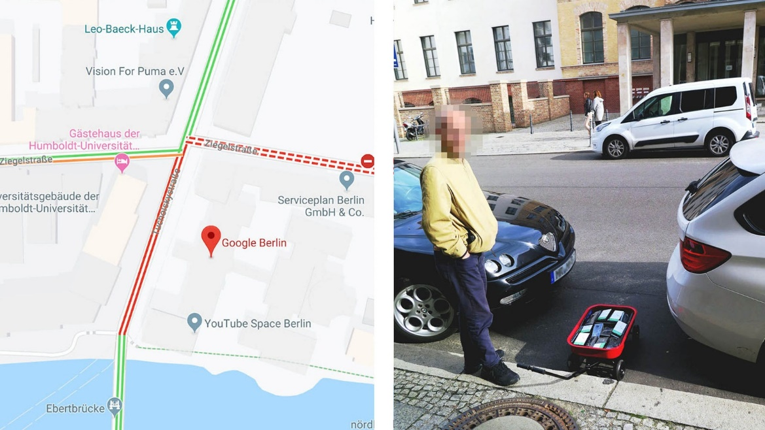

Slide 10
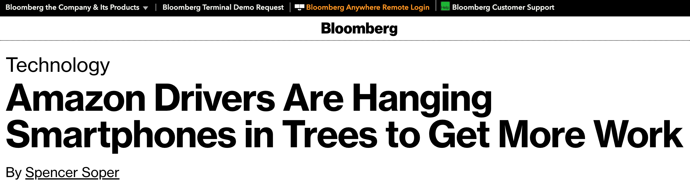

Someone places several devices in a tree located close to the station where deliveries originate. Drivers in on the plot then sync their own phones with the ones in the tree and wait nearby for an order pickup. The reason for the odd placement, according to experts and people with direct knowledge of Amazon’s operations, is to take advantage of the handsets’ proximity to the station, combined with software that constantly monitors Amazon’s dispatch network, to get a split-second jump on competing drivers.

Slide 11
Reason-2: For Profit (To Solve Problems)
System is low-level, under other components
New features: migration, snapshot, replay, fault tolerant, etc.
Performance: hardware features, kernel primitives, system-level profiling, consistency model, etc.
Security: buffer overflow, ROP/JOP, side-channel, etc.
Chance to have a start-up

Slide 12
The Principles

Slide 13
General Design Principles: 1/3
Adopt sweeping simplifications
Avoid excessive generality
Avoid rarely used components
Be explicit
Decouple modules with indirection
Design for iteration

Slide 14
General Design Principles: 2/3
End-to-end argument
Escalating complexity principle
Incommensurate scaling rule
Keep digging principle
Law of diminishing returns
Open design principle

Slide 15
General Design Principles: 3/3
Principle of least astonishment
Robustness principle
Safety margin principle
Unyielding foundations rule

Slide 16
Specific Area Principles (1/2)
Atomicity: Golden rule of atomicity
Coordination: One-writer principle
Durability: The durability mantra
Security: Minimize secrets
Security: Complete mediation
Security: Fail-safe defaults

Slide 17
Specific Area Principles (2/2)
Security: Least privilege principle
Security: Economy of mechanism
Security: Minimize common mechanism

Slide 18
Design Hints
Exploit brute force
Instead of reducing latency, hide it
Optimize for the common case
Separate mechanism from policy

Slide 19
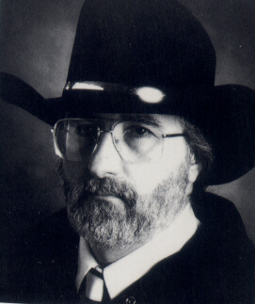
Worse Is Better
Richard P. Gabriel
https://www.dreamsongs.com/RiseOfWorseIsBetter.html

Slide 20
Worse is Better
How to handle interrupt during a system-call
Must save user states: just a single PC is not enough
There are still states in the kernel, e.g., I/O buffers
Two choices: back out or press forward?
User Program
Kernel
PUSH %ebx
PUSH %ecx
Syscall
CMP %eax
JCC
XOR %eax
IN %eax
ST %eax BUF
JCC
IRET
PC = PC+4
Interrupt

Slide 21
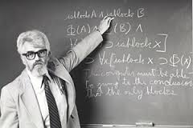
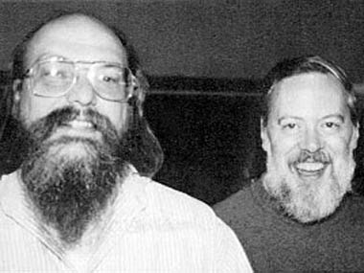
MIT Guys VS. New Jersey Guys (Bell Lab)

Slide 22
MIT Guys: We Do the Right Thing!
Back out and restore the user program PC
Re-execute the system call after resume
Rollback all the kernel states, e.g., the buffer
User Program
Kernel
PUSH %ebx
PUSH %ecx
Syscall
CMP %eax
JCC
XOR %eax
IN %eax
ST %eax BUF
JCC
IRET
Rollback kernel state
Restore user’s PC
Interrupt

Slide 23
New Jersey Guys: We Do the Simple Thing!
Sys-calls always finish, but sometimes return an error
The user needs to check the error code and retry in case
Because the right thing is too complex, and happens rarely
User Program
Kernel
PUSH %ebx
PUSH %ecx
Syscall
CMP %eax
JCC
XOR %eax
IN %eax
ST %eax BUF
JCC
IRET
User needs to check retval
and re-execute if necessary
Interrupt
Just return to user!

Slide 24
Simplicity VS. The Right Thing
 |  | MIT Guys | New Jersey Guys
Simplicity : |  | Simple implementation is more important than simple interface | Simple implementation is more important than simple interface
Correctness : |  | Incorrectness is not allowed | It’s better to be simple than correct
Consistency : |  | Inconsistency is not allowed | It can be sacrificed for simplicity
Completeness : |  | Must cover as many as possible | It can be sacrificed for simplicity
MIT : |  | Correctness = Consistency > Completeness > Simplicity
New Jersey : |  | Simplicity > Anything else

Slide 25
Case Study: Map-Reduce
MapReduce: Simplified Data Processing on Large Clusters, OSDI’04

Slide 26
What Did People Do Before MapReduce?
A user wants to analyze big data (in TB)
He will think about distributing the task to 1000 machines
Split the data to 1,000 pieces for each machine
Send the data and code to 1,000 machines
Control the 1,000 machines to run
Collect the 1,000 outputs
Calculate the 1,000 outputs to get the final result
Now, consider following scenarios:
Machine failures
Machine number scales to 10,000 (even more failures…)

Slide 27
MapReduce Provides:
Automatic parallelization and distribution
Fault-tolerance
I/O scheduling
Status and monitoring
And a simple interface to use: map() / reduce()

Slide 28
Programming Model
map (in_key, in_value) -> list(out_key, intermediate_value)
Processes input key/value pair
Produces set of intermediate pairs
reduce (out_key, list(intermediate_value)) -> list(out_value)
Combines all intermediate values for a particular key
Produces a set of merged output values (usually just one)
Inspired by similar primitives in LISP and other languages

Slide 29
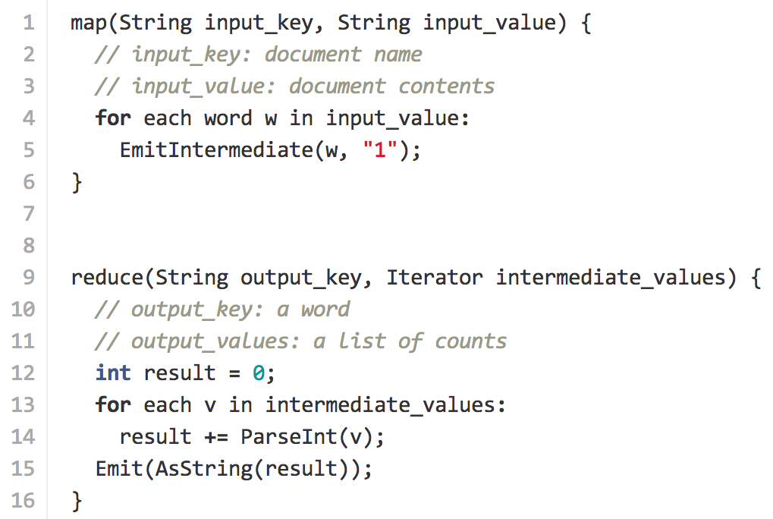
Example: Count Word Occurrences

Slide 30
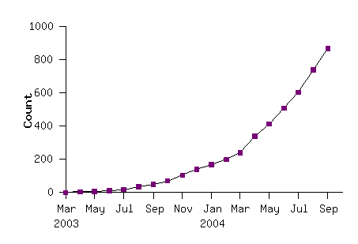
Model is Widely Applicable
Example uses: Distributed grep, distributed sort, web link-graph reversal, term-vector per host, web access log states, inverted index construction, document clustering, machine learning, statistical machine translation, …
Number of MapReduce Programs
Running in Google

Slide 31
Implementation Overview
Thousands of PC: 2-CPU, 2-4 GB memory
Limited bisection bandwidth
Storage is on local IDE disk (cheap, but likely to fail)
GFS: distributed FS managers data (SOSP’03)
Job scheduling system
Implemented as a C++ library, linked to user’s apps

Slide 32
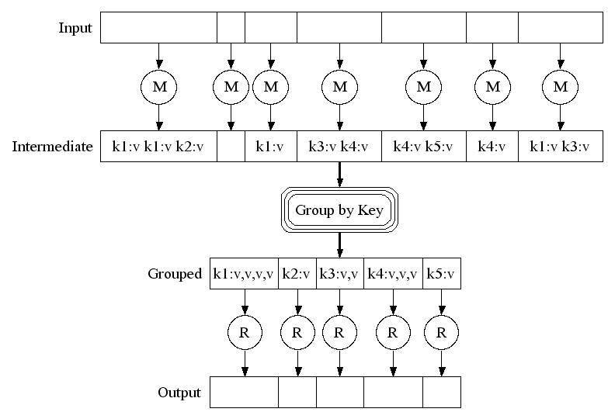
Execution

Slide 33
Architecture
Master node
Worker node

Slide 34
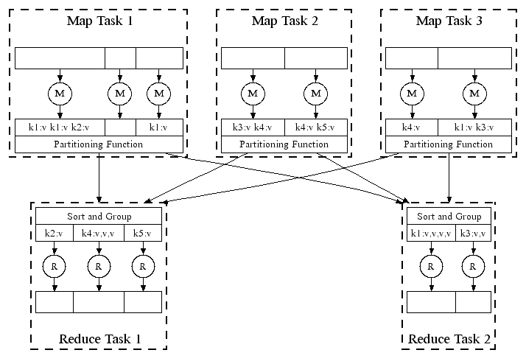
Parallel Execution

Slide 35
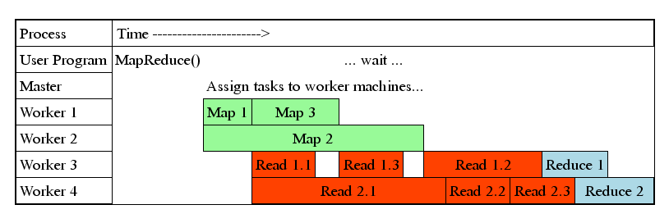
Task Granularity and Pipelining
Fine granularity tasks: many more map tasks than machines
Minimizes time for fault recovery
Can pipeline shuffling with map execution
Better dynamic load balancing

Slide 36
Fault Tolerance: Handled via Re-execution
On worker failure:
Detect failure via periodic heartbeats
Re-execute completed and in-progress map tasks
Re-execute in progress reduce tasks
Task completion committed through master
Master failure:
Could handle, but not yet (master failure unlikely)
Robust: lost 1,600 of 1,800 machines once, but finished fine

Slide 37
Refinement: Redundant Execution
Slow workers significantly lengthen completion time
Other jobs consuming resources on machine
Bad disks with soft errors transfer data very slowly
Weird things: processor caches disabled (!!)
Solution: Near end of phase, spawn backup copies of tasks
Whichever one finishes first "wins"
Effect: Dramatically shortens job completion time

Slide 38
Refinement: Locality Optimization
Master scheduling policy:
Asks GFS for locations of replicas of input file blocks
Map tasks typically split into 64MB (== GFS block size)
Map tasks scheduled so GFS input block replica are on same machine or same rack
Effect: 1,000s of machines read input at local disk speed
Without this, rack switches limit read rate

Slide 39
Refinement: Skipping Bad Records
Map/Reduce functions sometimes fail for particular inputs
Best solution is to debug & fix, but not always possible
On seg fault:
Send UDP packet to master from signal handler
Include sequence number of record being processed
If master sees two failures for same record:
Next worker is told to skip the record
Effect: Can work around bugs in third-party libraries

Slide 40
Other Refinements (see paper)
Sorting guarantees within each reduce partition
Compression of intermediate data
Combiner: useful for saving network bandwidth
Local execution for debugging/testing
User-defined counters

Slide 41
Conclusions
MapReduce has proven to be a useful abstraction
Greatly simplifies large-scale computations at Google
Fun to use: focus on problem, let library deal with messy details

Slide 42
Principles in MapReduce
Principle of least astonishment
The user only needs to define map/reduce functions
Optimize for the common case
List the most common scenarios, not all of them
Robustness principle

Slide 43


Criticism: “MapReduce: A Major Step Backwards”
Prof. David DeWitt
Wisconsin University
Michael Stonebraker
CTO of Informix
Professor in MIT
Professor in UC Berkeley
Notes:
http://blog.csdn.net/nevasun/article/details/7590882

Slide 44
Criticism: “MapReduce: A Major Step Backwards”
A giant step backward in the programming paradigm for large-scale data intensive applications
A sub-optimal implementation, in that it uses brute force instead of indexing
Not novel at all — it represents a specific implementation of well known techniques developed nearly 25 years ago
Missing most of the features that are routinely included in current DBMS
Incompatible with all of the tools DBMS users have come to depend on
Well, these are all “the right things”, but…

Slide 45

After MapReduce
Hadoop
An open-source implementation of MapReduce
Again, very bad performance at first
But widely used!
Cassandra, Hbase, Hive, PIG, Spark, ZooKeeper, …
Keep being optimized by both academy and industry
Till today

Slide 46
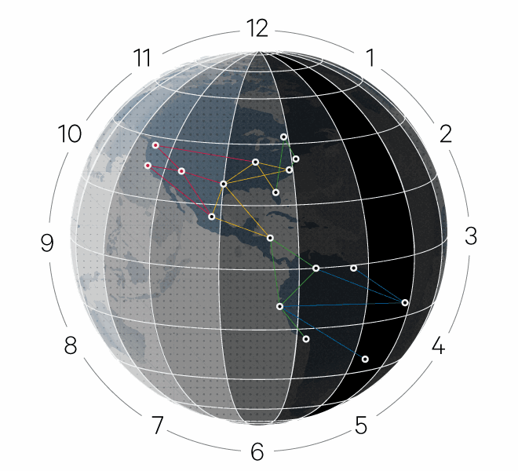
After MapReduce: Google
MapReduce retired around 2007
2010: Pregel ^{[SIGMOD’10]} for graphic computing
2012: Spanner ^{[OSDI’12]}
Global distributed database using TrueTime API
2014: DataFlow
Map-Reduce is retired in Google

Slide 47
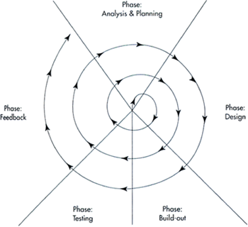
Another Principle
Design for Iteration
It’s hard, if possible, to do things right in the 1st time

Slide 48
So, how to be more “KISS”?

Slide 49

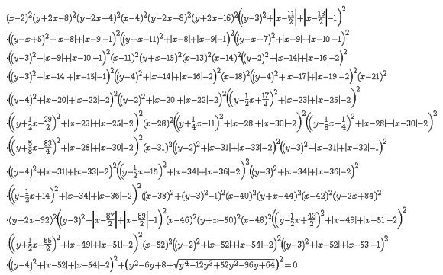
Occam's Razor
Aka., law of parsimony
Now, chose between following two equations:
E = mc²

Slide 50
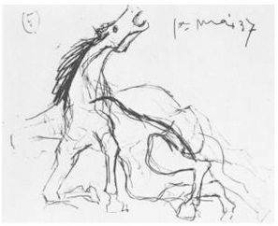
Horse, by Picasso

Slide 51
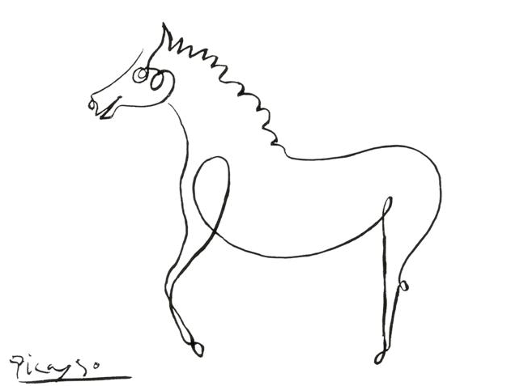
Another Horse, by Picasso

Slide 52

Yet Another Horse, by Picasso

Slide 53
CASE Study: ShellShock (Bash Attack)
What does KISS cost?

Slide 54
ShellShock Attack
Found by Stéphane Chazelas
CVE-2014-6271 & CVE-2014-7169

Slide 55
Bash Basic: Environment Variable
$ var="hello world”
$ echo $var
hello world
$ bash
$ echo $var
$
Define ‘var’ as a string
Print ‘var’
Start a new bash
No output in new bash

Slide 56
Bash Basic: Environment Variable
$ var="hello world”
$ echo $var
hello world
$ bash
$ echo $var
$
$ export var="hello world”
$ echo $var
hello world
$ bash
$ echo $var
hello world
$

Slide 57
Bash Basic: Define Function
$ foo(){ echo "hello world"; }
$ foo
hello world
$ bash
$ foo
bash: foo: command not found
$ foo(){ echo "hello world"; }
$ foo
hello world
$ export -f foo use export
$ bash
$ foo
hello world

Slide 58
Bash Basic
Each bash has different env variables
A child bash can see an env variable only if its parent uses export
A function is also a variable
Bash tells a function by “()”

Slide 59
The Vulnerability
export X='() { echo "inside X"; }; echo "outside X”;’
Define X
X is a function, which starts by ‘()’
$ export X='() { echo "inside X"; }; echo "outside X";'
$ bash
outside X

Slide 60
The Vulnerability
A function is defined in a var, which is exported
A child bash copies all of its parent’s env vars
The child will execute some code in a var during the copy!
$ export X='() { echo "inside X"; }; echo "outside X";'
$ bash
outside X
$ env
…
X=() { echo “inside X” }
…

Slide 61
The Vulnerability
env VAR='() { :;}; echo Bash is vulnerable!' bash -c "echo Bash Test”
‘:’ means ‘/bin/true’, which returns true and return
Now please explain this test by yourselves
What would be executed during bash forking?
What can an attacker do if she can define such VAR?
Notes:
Echo bash is vulnerable!

Slide 62
Why Big Deal?
On apache server, it is typical to fork a child process for each HTTP client
Use bash env variables a lot
A DHCP client may get malicious value from a malicious DHCP server
Notes:
https://securityblog.redhat.com/2014/09/24/bash-specially-crafted-environment-variables-code-injection-attack/

Slide 63
Hard to Fix
env X='() { (a)=>\' sh -c "echo date"; cat echo
‘(a)=‘ is to trigger an error
Then only ‘>\’ left in the buffer
Bash will then put ‘echo data’ in the buffer to execute
>\
echo date >echo date date >echo
Notes:
What about change echo to some other

Slide 64
Why ShellShock Ever Exist?
Three principles of UNIX programming ^{[1]}:
Write programs that do one thing and do it well
Write programs to work together
Write programs to handle text streams, because that is a universal interface
[1] http://en.wikipedia.org/wiki/Unix_philosophy

Slide 65
Interesting Shell
$ ls -l *.c
“ls”, “-l”, "*.c” # *.c =>“foo.c” “bar.c”
“ls”, “-l”, “foo.c” “bar.c”
What if a file with name “-l”?
>-1
Notes:
You can use ‘rm ./-l’ to remove the file.

Slide 66

The Simpler, The Better?
No…
The point is: how to find a right way to be simple?

Slide 67
Adopt KISS to Kernel
How to make the kernel simpler?

Slide 68
Monolithic Kernel
A monolithic kernel is an operating system architecture where the entire operating system is working in kernel space and is alone in supervisor mode
E.g., Linux, BSD…

Slide 69
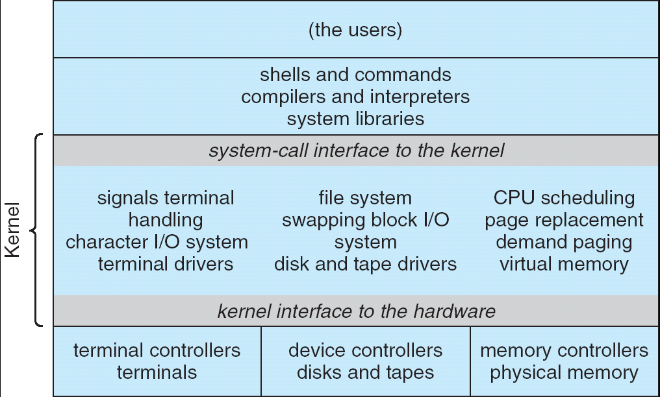
The Problem: Monolithic Kernel is Too Large

Slide 70
Micro-Kernel Came to the Rescue
Near-minimum amount of software that can provide the mechanisms needed to implement an operating system (OS)
Low-level address space management, thread management, and inter-process communication (IPC) and so on …
Mach, L4 kernel

Slide 71
Micro-Kernel
Moves as much from the kernel into “user” space
Communication between user modules using message passing
Benefits:
Easier to extend a microkernel
Easier to port the operating system to new architectures
More reliable (less code is running in kernel mode)
More secure
Detriments:
Performance overhead of user to kernel communication

Slide 72
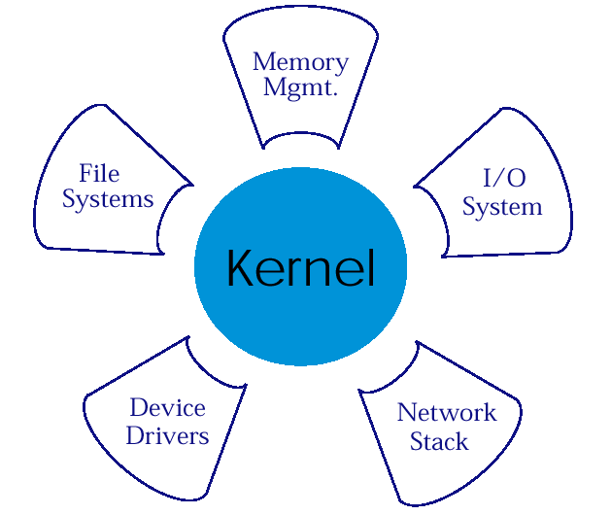
Micro-Kernel Structure & Instances
APP1
APPn
LPC
APP2
APP4
HAL
APP3

Slide 73
Hybrid-Kernel
Kernel architecture based on combining aspects of microkernel and monolithic kernel architectures used in computer operating systems
Windows NT kernel

Slide 74
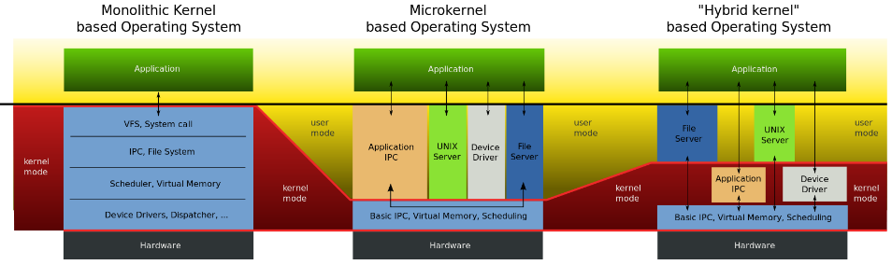
Comparison

Slide 75
Kernels
Kernel classification (wikipedia)
Kernel (architecture) | Monolithic | Microkernel | Exokernel | hybrid
https://en.wikipedia.org/wiki/Kernel_(operating_system)

Slide 76
Exokernel: Motivation
In traditional OS, only privileged servers and the kernel can manage system resources
Un-trusted applications are required to interact with the hardware via some abstraction model
File systems for disk storage, virtual address spaces for memory, etc.
Application demands vary widely!!
An interface designed to accommodate every application must anticipate all possible needs

Slide 77
Exokernel’s Idea
Give un-trusted applications as much control over physical resources as possible
To force as few abstraction as possible on developers, enabling them to make as many decisions as possible about hardware abstractions.
Let the kernel allocate the basic physical resources of the machine
Let each program decide what to do with these resources
Exokernel separate protection from management
They protect resources but delegate management to application

Slide 78
Exokernel: Design
Kernel’s new role
Tracking ownership of resources
Ensuring resource protection
Revoking resource access
Three techniques
Secure binding
Visible revocation
Abort protocol

Slide 79
Library Operating System
Most programs to be linked with libraries instead of communicating with the exokernel directly
The libraries hide low-level resources
An applications can choose the library which best suits its needs
The kernel only ensures that the requested resource is free, and the application is allowed to access it
Allow programmer to implement custom abstractions, omit unnecessary ones, most commonly to improve performance

Slide 80
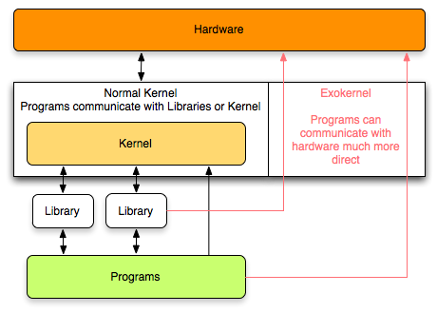
Exokernel Example 1
Exokernel give more direct access to the hardware, thus removing most abstractions

Slide 81
Exokernel Example 2
Traditional OS
Apache
SQL Server
FIXED
Abstractions
Interface
Hardware

Slide 82
Exokernel Example 2
Exokernel + Library OS
Apache
SQL Server
Library OS
chosen from available
Library OS
customized for SQL Server
Abstractions
Interface
Abstractions
Interface
Exokernel
Hardware

Slide 83
P.r.o.s.e.c.
The way to read a paper and take note

Slide 84
P.R.O.S.E.C.
Problem
Related work
Observation
Solution
Evaluation
Comments

Slide 85
P.R.O.S.E.C.
Problem: What is the motivation? Why important?
Related work: Why other work didn’t solve it?
Observation: What is the key insight? Make it simple
Solution: How does this work solve the problem?
Evaluation: Does this work really solve the problem?
Comments: What could be better? Your own opinion

Slide 86
Other Info
Web site
http://ipads.se.sjtu.edu.cn/courses/csp
TA
Bicheng Yang

