Slide 1

Nashville City Cemetery
Mylah Kate Gainey

Slide 2
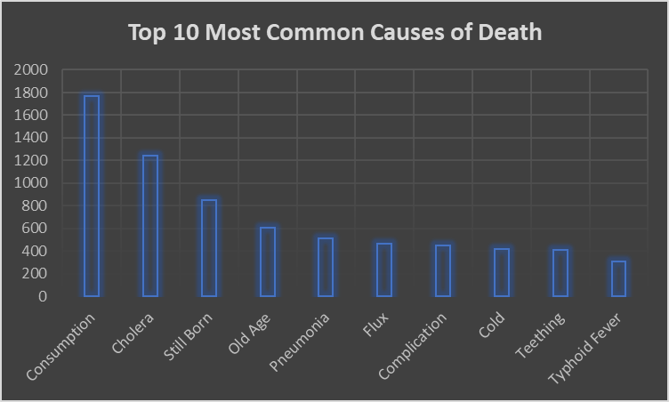
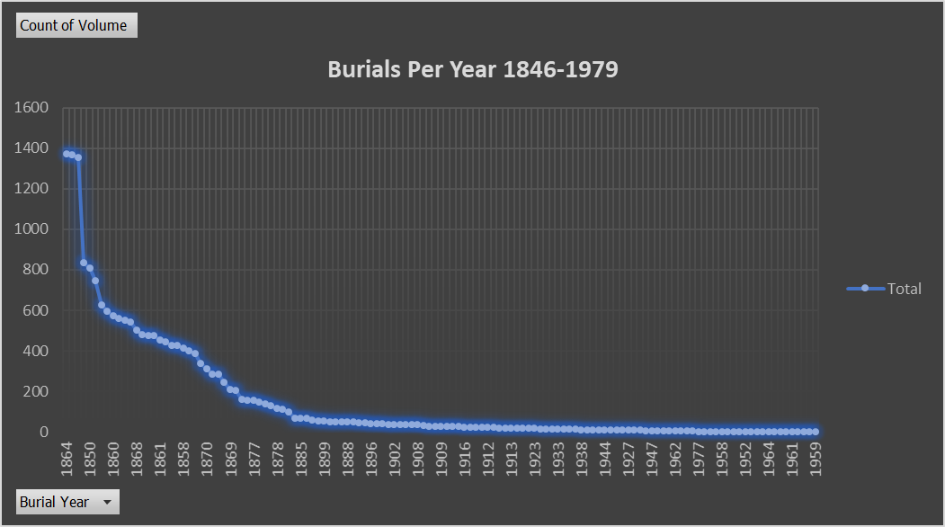
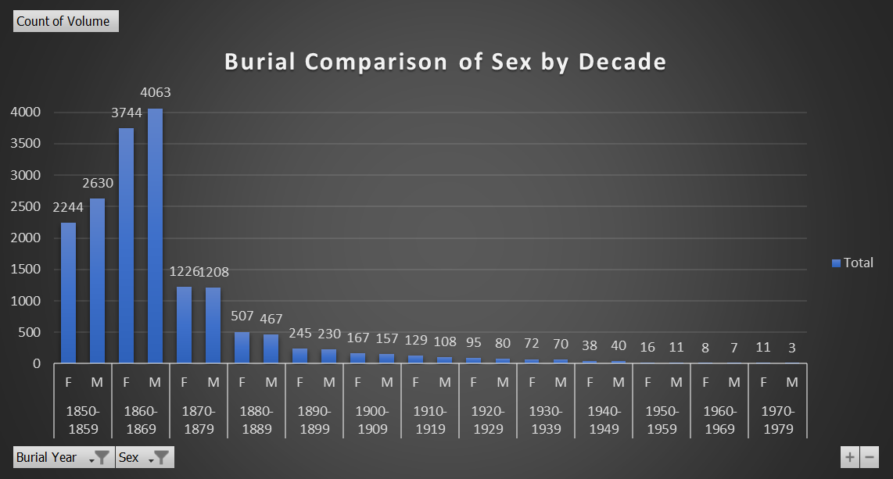

Dashboard

Slide 3
Dashboard

Slide 4
Traction
Forecasting for success​
Metrics
Revenue by year
 | clients | orders | Gross avenue | Net revenue
20XX​ | 10​ | 1,100​ | $10,000​ | $7,000​
20XX​ | 20​ | 200​ | $20,000​ | $16,000​
20XX​ | 30​ | 300​ | $30,000​ | $25,000​
20XX​ | 40​ | 400​ | $40,000​ | $30,000​

Slide 5
2-year action plan
Get volunteers​
Gather feedback​
Deliver to consumers​
20XX
Jan
Feb
Mar
Apr
May
Jun
Jul
Aug
Sep
Oct
Nov
Dec
Run focus groups​
Test with farms​
Regional launch​
20XX
Jan
Feb
Mar
Apr
May
Jun
Jul
Aug
Sep
Oct
Nov
Dec

Slide 6
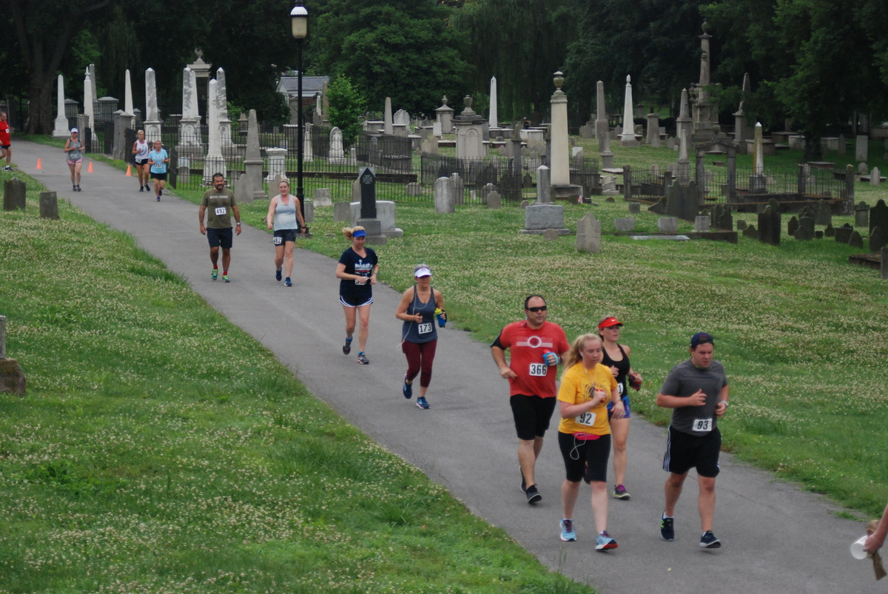
Findings & Recommendations
Revamp and utilize your social media accounts. Our society has become fully immersed in the digital era and by focusing in on this tactic your organization can reach the broad audiences you appeal to. Post engaging content that will draw interest to the history of the cemetery and activities hosted here.

Slide 7
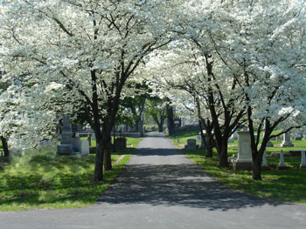
Thank you
Mylah Kate Gainey
www.linkedin.com/mylahkate​
DDA7
05/20/2022

