Slide 1
Taxi-Drones
Scala/Spark
Tuesday July 9th 2019
Lucas Vascovici
Julien Castillon
Lucas Marty

Slide 2
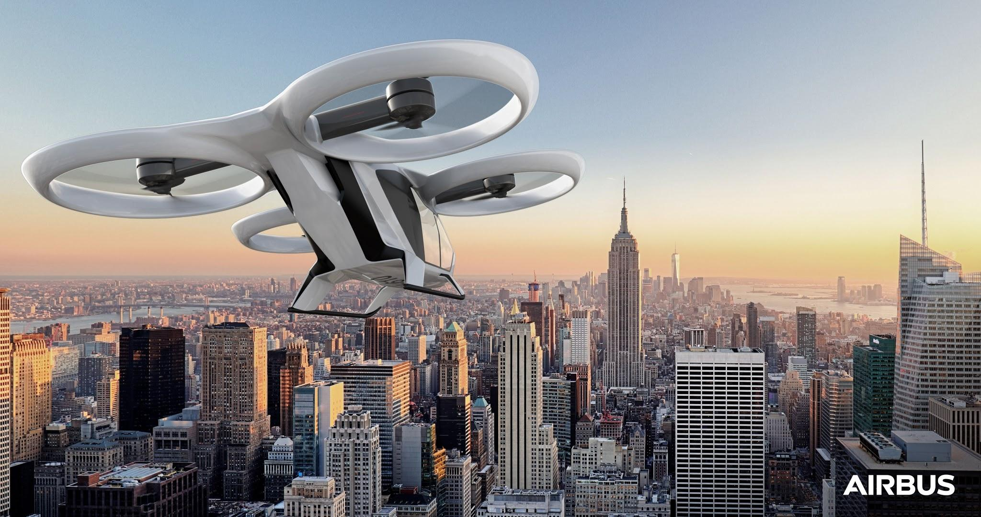
Project 0bjectives
Simulate Drone
Model the topology
Make them communicate
Monitore them

Slide 3
Drone Infos

Slide 4
Message:
id : Int
is_working : Boolean
latitutde : String
longitude : String
temperature : Int
battery : Int
weight : Int
is_occupied : Boolean

Slide 5
Exemple:
{
"id":1,
"is_working":true,
"latitude":"58°51'3W",
"longitude":"33°14'1E",
"temperature":27,
"battery":96,
"weight":1064,
"is_occupied":true
}

Slide 6
Topology

Slide 7
Centralised Topology
Client
Client
Server
Client
Client
➤ Client != Drone

Slide 8

In real life
Post 2
QG
Post1

Slide 9
Project Architecture
Client
HDFS or STREAM
Serv:
Write
stream/HDFS
Serv:
Listen stream/HDFS
Serv:
Display Infos
Client
Client

Slide 10
Simplified by:
Client
RDD -> Make aggregations
Serv:
Display Infos
Listen HDFS
Writes Updates

Slide 11
Technos

Slide 12
SPARK : -Case class Drone -> RDD[Drone]
- Aggregations
PLAY-JSON: Serialize / Deserialize
Protocol HTTP
Play-WEB: Display Informations

Slide 13
Demo

Slide 14
THANKS!
ANY QUESTIONS?

