Slide 1

Overview of Take-Home Quantitative Analysis
Myles Thomas
04/29/2025

Slide 2
Executive Summary
Objective: Assess likelihood of meeting 5-year revenue targets under deal uncertainty.
Approach: Monte Carlo simulation using 1,000,000+ simulations, dynamically adjusted probabilities, and realistic modeling of award timing and execution.
Results:
Without Upside data:
Conservative projections that ignore upside data indicate that all five years have < 1% chance of hitting revenue estimates.
With Upside data:
Strong near-term forecast (64% chance of hitting 2025 target).
Long-term forecasts suffer from increasing uncertainty and lack of macroeconomic scenario modeling and operational risk factors (< 1% chance in 2029).

Slide 3
Agenda for today
1
Methodology & Key Assumptions
2
Key Takeaways
Uncertainty Analysis & Enhancing Monte Carlo Modeling Accuracy
3

Slide 4
Agenda for today
1
Methodology & Assumptions
2
Key Takeaways
Uncertainty Analysis & Enhancing Monte Carlo Modeling Accuracy
3

Slide 5
Context
Business Problem: Anduril must assess whether its forecasted pipeline can meet aggressive 5-year revenue targets amid uncertainty in deal timing and probability.
1
Dataset Scope: The dataset includes forecasted revenue opportunities categorized by sales stage, contract type, and revenue structure, reflecting a diverse, evolving pipeline.
2
Core Challenge: Quantifying the probability of hitting annual targets requires modeling award uncertainty, execution timing, and external factors like defense budget volatility.
3

Slide 6
Methodology
1
Monte Carlo Simulation of the full pipeline:
Each opportunity was simulated 1,000,000 times, with outcomes determined by the probability of award.
Simulated wins translate into revenue, aggregated by revenue year to assess total outcomes against targets.
2
Dynamic Probability Adjustment:
Probabilities for future awards were adjusted to gradually converge toward 50%, reflecting increasing uncertainty the farther out the deal is from being awarded.¹
This approach avoids overconfidence in distant pipeline items while still respecting initial probability estimates.
3
Awarded Contracts: Opportunities with past award dates were treated as fully committed and given a 100% probability of realization.
1. Gamma = 0.1 reflects the structured nature of defense contracting, where uncertainty grows more slowly. See Appendix A for comparison across gamma values.

Slide 7
Key Assumptions
1
Revenue Year is assumed to reflect execution timing, regardless of award timing discrepancies.
2
Stage is not modeled explicitly, as its impact is already embedded in the Probability of Award ¹.
3
Revenue amounts are fixed; if a deal wins, it delivers full stated revenue.
One opportunity with a missing award date, $135M revenue, and 77% probability was assigned a random date within its 2026 revenue year.
4
Macroeconomic conditions and operational risks (e.g., inflation, protests, delays) are not modeled in this version but considered in future improvements.
5
1. See Appendix B

Slide 8
Agenda for today
1
Methodology & Key Assumptions
2
Key Takeaways
Uncertainty Analysis & Enhancing Monte Carlo Modeling Accuracy
3

Slide 9
Key Takeaways
Excluding Upside data leads to severe underestimation in the near term, with virtually no chance of meeting 2025–2027 revenue targets.
1
Including Upside opportunities yields a 64% chance of hitting the 2025 target, but probability steadily declines over time due to compounding uncertainty.
2
Long-term projections (2028–2029) remain vulnerable, with near 0% probability of meeting targets.
3
1. Full results can be found in Appendix C

Slide 10
Challenging Assumptions: Excluding Upside Understates Real Revenue Potential
“Upside” opportunities are assigned explicit probabilities and reflect real, modeled deal flow. Excluding them entirely ignores quantified potential revenue.
1
Even “Closed Won” deals carry risk of delayed or zero execution, suggesting all opportunities exist on a spectrum of uncertainty rather than a binary.
2
Incorporating Upside enables a more balanced forecast and highlights the organization’s true exposure to pipeline volatility in both directions.
3

Slide 11
Agenda for today
1
Methodology & Key Assumptions
2
Key Takeaways
Uncertainty Analysis & Enhancing Monte Carlo Modeling Accuracy
3

Slide 12
Uncertainty Analysis
Macroeconomic Volatility: The base simulation assumes stable revenue values, but defense budgets may expand or contract due to inflation, geopolitical shifts, or political decisions.
1
Execution Risk in “Won” Deals: Even closed or near-award deals carry risk of delay, scope reduction, or cancellation—real-world revenue realization is not binary.
2
Pipeline Maturity Bias: Probability estimates may overweight optimism for earlier-stage deals lacking full diligence or pricing certainty.
3

Slide 13
Enhancing Monte Carlo Modeling Accuracy
Scenario-Based Macroeconomic Layer: Introduce inflation-adjusted or budget-driven revenue scenarios ¹ layered over future pipeline years.
1
Operational Risk Adjustment: Apply random execution penalties ² to simulate contract slippage, particularly in 2025-2026.
2
CLV: Modeling Upsell / Cross-Sell Potential: Consider modeling up-sell and/or cross-sell contract probability for won deals to account for potential long-term value uplift.
3
Alternative to Monte Carlo Simulation: To quantify uncertainty using a different approach, Bayesian inference can be applied to estimate revenue distributions and update them dynamically as new data becomes available.
4
Example scenario weights: +50% growth (p = 10%), +10% growth (p = 25%), flat (p = 30%), –10% cut (p = 25%), –50% cut (p = 10%)
Example implementation: For deals in 2025–2026, randomly apply a 5–20% haircut to simulate execution risk (delays, scope reductions, or cancellations); delayed deals can shift revenue into 2027–2029, which could be modeled iteratively.

Slide 14
Appendix

Slide 15
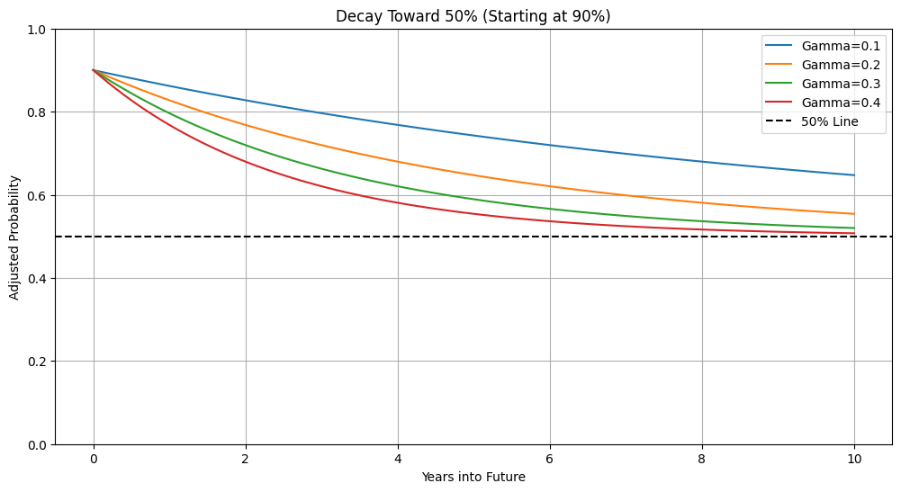
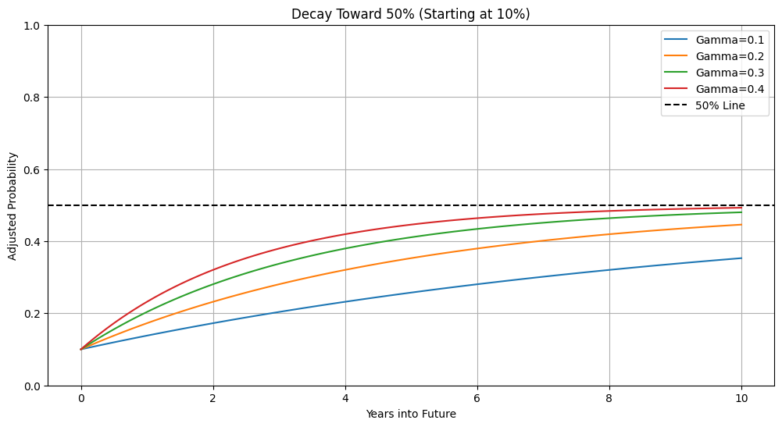
Appendix A: Exponential Decay Adjustment Toward Uncertainty
We use Gamma = 0.1 to reflect slower-growing uncertainty typical in defense contracting. Higher gammas (e.g., 0.4) may suit more volatile industries such as tech.

Slide 16
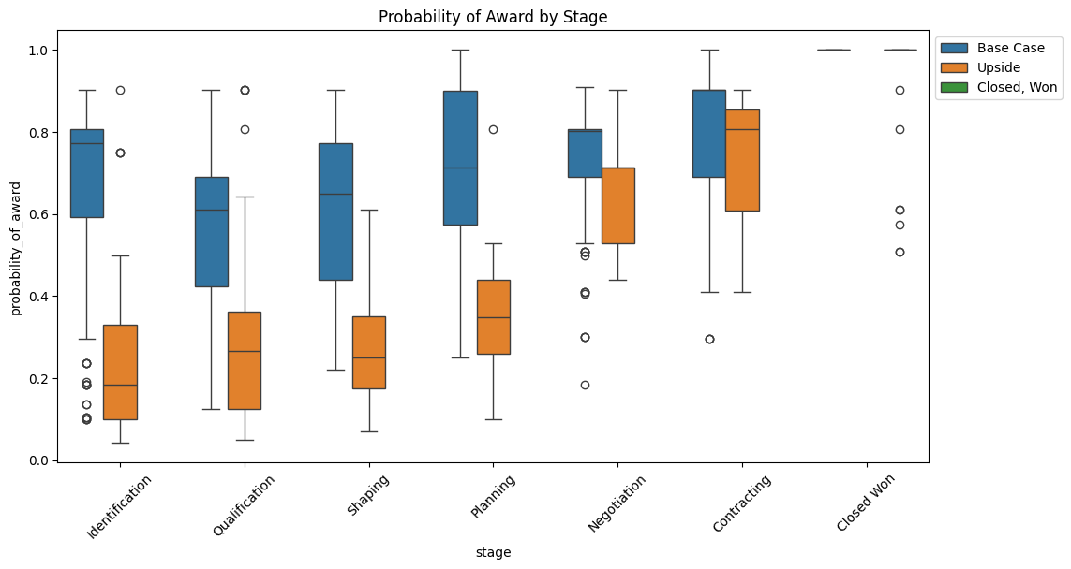
Appendix B: Distribution of Probability of Award by Stage and Forecast Category
This distribution illustrates that while stage is not explicitly modeled, its effect is captured through variation in the modeled probability of award across forecast categories—validating that the model reflects meaningful stage-based differentiation.

Slide 17
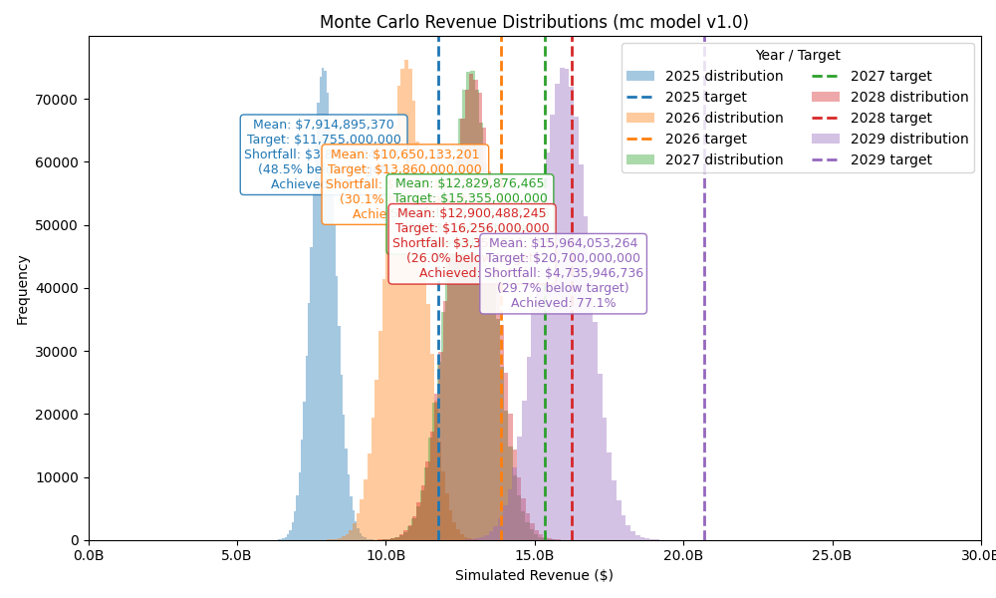
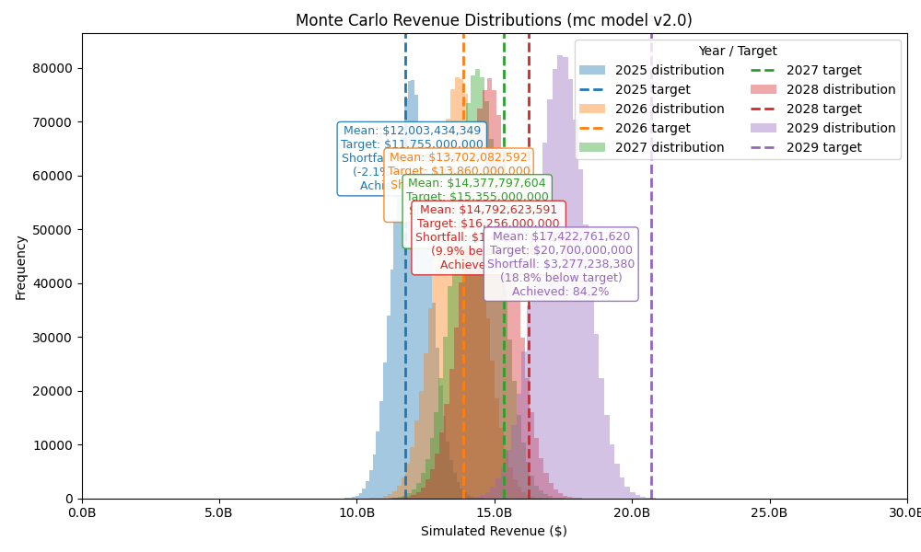
Appendix C: Revenue Forecast Accuracy
This appendix presents Monte Carlo revenue simulations under different gamma assumptions, comparing Version 1 (V1) and Version 2 (V2) forecasting approaches. V1 systematically underpredicts near-term revenue but improves over time, reflecting conservative assumptions that adjust with accumulating data. In contrast, V2 shows higher early accuracy, more consistently hitting revenue estimates, but its longer-term projections degrade due to underestimating both microeconomic shifts and broader macroeconomic volatility.
1. Easier to read, individual plots can be found on GitHub: https://github.com/MylesThomas/anduril_take_home/tree/main/data/02_output

Slide 18
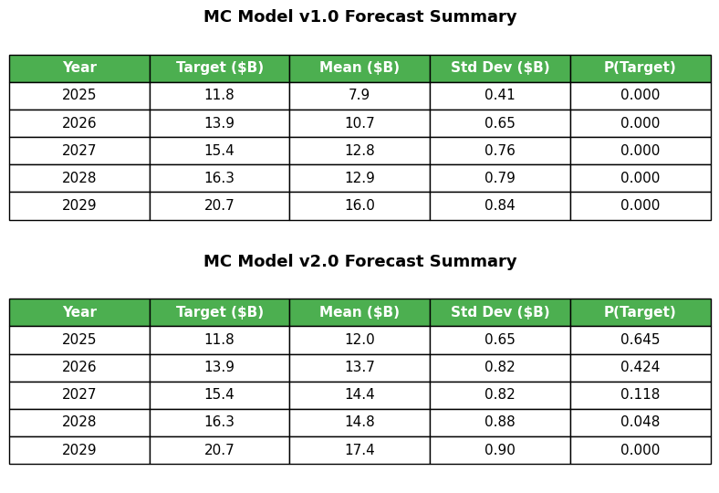
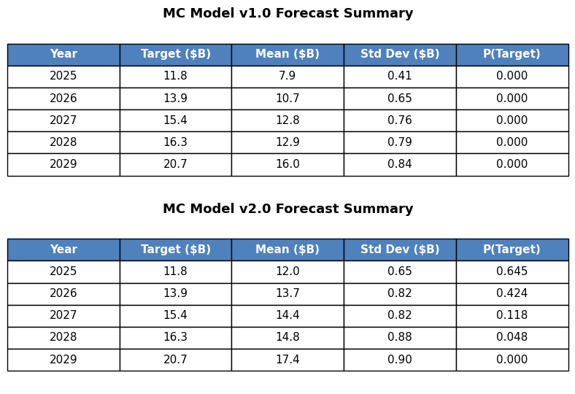
Appendix C (Continued)

