Slide 1

Assessing wine quality
Coursera Advanced Capstone

Slide 2
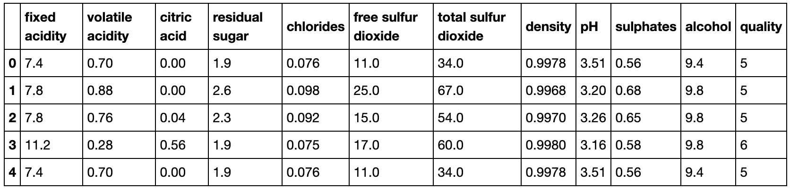
Vineyards always collect and sample their products
Dataset contains 1600 wine batches, chemically analysed (Cortez et al., 2009)

Slide 3

All stakeholders to benefit from automatic quality assessment
Today, wine batches are quality assessed manually, taking time and making them susceptible to bias
With our model, this can be made automatic based solely on the physiochemical properties(!)

Slide 4
Architectual desicions
Jupyter Notebooks
Github Repository

Slide 5
Deep-dive – Data structure, cleaning and pre-processing (I/II)
Dataset contain 1599 rows (batches), each with 11 features and 1 target variable
  All features numerical (floats) – Outliers removed and data normalized (z-score normalization)
  Target state categorical (0-10) – One-hot encoded to either 0/1 (bad/good) as
    <6 = 0
    >=6 = 1

Slide 6
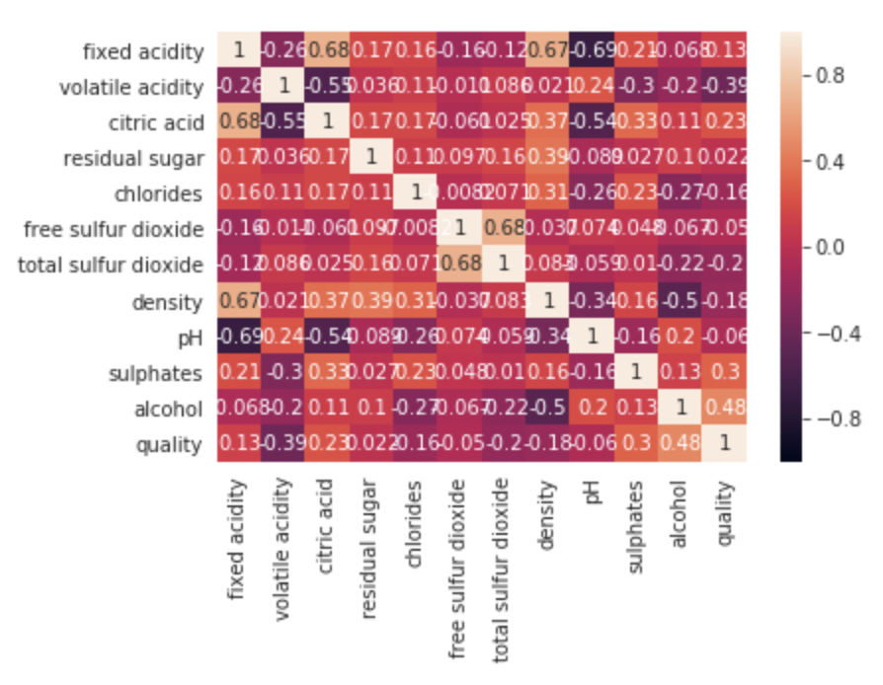
Deep-dive – Data structure, cleaning and pre-processing (II/II)
Correlation measurements and individual feature feasibility studied

Slide 7

Model selection & performance indicators
Binary classification problem (0 Bad/1 Good)
  Logistic regression
  Support Vector Machines
Highly tuneable, GridSearch used for parameter sweeps
Accuracy main performance metric
  Confusion matrices
  Correlation measures (F1)

Slide 8
Results – Best performing SVM
Used the ’rbf’ kernel with C=10 regularization
Overall accuracy of 90%
Precision 96% (0/Bad) & 71% (1/Good)

Slide 9

Outlook
Our model confidently predicts bad wines from good ones, but is not as good in the opposite (due to there being much more bad data points than good)
The models resulting from our (limited) 1600 examples, we are able to match human prediction >90% of the time
Final deliverables include the model along with its documentation

