Slide 1
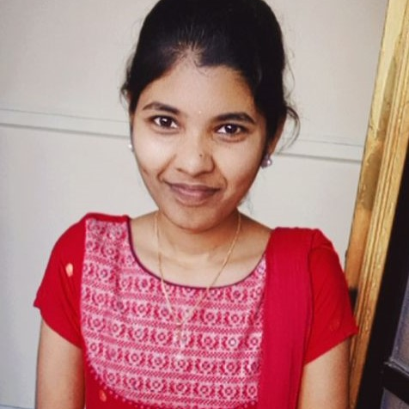



MYNA.MIRIYALA
Analyst/Software Engineer
Bachelor of Engineering
Computer Science : 2017 - 2021
Skills
Java 8 /J2EE | Java Basics, OOPS, Generics, Collections, Arrays, Loops, Lambda Exp, Stream API Junit, Mockito, Servlets
Spring core | IOC & Dependency Injection, Autowire
Spring REST | REST controllers, Implementation of GET, POST, PUT & DELETE, Bean Validation & Exception Handling, Testing Services, Controller & Repository layer
Spring Data JPA | Implement DAO layer using spring Data repositories, Transaction Management
Spring Boot Microservices | Spring Boot Starters, annotations, Messaging Service, Sync/Async comms, Swagger API documents
Spring Cloud | Eureka, Netflix Ribbon, Feign Client, Netflix Hystrix, Netflix Zuul & Config Server
React | Components, Hooks, Event handling, Redux, Reducers, Testing using Jasmin & Karma
Database | MongoDB No Sql Basics and My SQL Basics
UI Tech | HTML 5 & CSS 3,JavaScript, ES6 & TypeScript Reusable templates, Optimized UI Designed
Tools | Git, Postman, Maven, IDE
Add On skills | Communications, Team management. Peer learning
Hyderabad
xxxxxxxxxxx@capgemini.com
+91 8331820629
A4
Full Stack Developer
Hands on experience in creating microservices with SpringBoot, Spring Security, Spring Cloud API Gateway, Eureka server, resilience 4J, load balancing.
Proficient in creating Single page Web Application in REACT. React Developer with working knowledge on ReactJS(Hooks, redux).
Java Microservice Development knowledge using Spring boot and spring cloud framework on an intermediate level.
Experience in creating documentation with Java docs and swagger and in unit testing using Junit, Mockito.
Implemented Nodejs in case study and upskilling this knowledge continuously.
Experienced in practicing TDD based development using tools like Mockito, Junit, Istanbul and ensuring quality
E-Commerce Deals and coupons finder Application
Completed end to end case study of Deals and Coupons finder Application along with Eureka, Swagger and payment Gateway. Responsive UI with REACT and Bootstrap used for user interface.
Check out my work on GitHub & Video Profile

