Slide 1


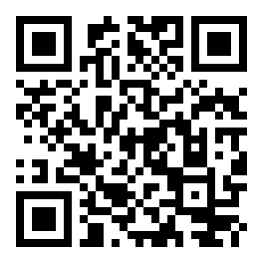

KICKOFF MEETING | FALL 2026
BaySec @ SFBU
Securing the Bay, One Byte at a Time
Welcome! Please scan the QR codes to check in and join our active channels while we set up.
Scan for Attendance
Join WhatsApp Community
Notes:
Welcome everyone to the official kickoff of BaySec @ SFBU! While everyone gets seated, take a moment to scan the QR codes on screen to mark your attendance and get plugged into our official WhatsApp group. That’s where we’ll drop lab resources, room updates, and CTF announcements.

Slide 2
INTRODUCTION & REVEAL
Welcome to BaySec
🛡️ OUR MISSION
Bridging academic computer science with real-world ethical hacking, active system defense, and modern AI security.
👥 LEADERSHIP
• Khoi Duong — Club President
mduong@student.sfbu.edu
• Joed Prudente — Faculty Advisor
joed.prudente@sfbu.edu
🔓 THE TEASER POSTERS DECODED
Did you crack the secret flyers across campus?
CIPHER 1: HEXADECIMAL STREAM
RAW: 42 61 79 53 65 63 20 69 73 20 68 65 72 65
SOLVED ➔ "BaySec is here"
CIPHER 2: ROT-13 SUBSTITUTION
RAW: Onlfrp vf urer
SOLVED ➔ "BaySec is here"
✓ Both paths converged. Welcome to the club.
Notes:
If you saw our flyers around campus, you might have tackled the ciphers. Both the hexadecimal sequence and the ROT-13 text translated to 'BaySec is here.' Today, we’re officially here. Our goal is simple: take the concepts you study in class and apply them directly to live defense, penetration testing, and security tooling.

Slide 3
CURRICULUM TRACKS
Choose Your Path (Or Explore All Three)
BLUE TEAM
Active Defense & Triage
▸ Threat detection & incident triage
▸ Network traffic analysis (Wireshark)
▸ SIEM monitoring & defensive posture
▸ Log auditing & host forensics
RED TEAM
Offense & Penetration Testing
▸ Web application security & OWASP Top 10
▸ Ethical exploitation & penetration testing
▸ Competitive Jeopardy-style CTF challenges
▸ Privilege escalation & binary analysis
EMERGING TECH
AI Security & Modern Frontiers
▸ LLM red-teaming & prompt injection
▸ Synthetic media & deepfake detection
▸ Defending autonomous agent workflows
▸ Adversarial ML attack mitigations
⚡ Zero prior experience required. You do not need to lock yourself into a single path.
Notes:
You don’t have to pick just one discipline. Whether you want to learn how attackers break into web apps, how SOC analysts hunt threats in network logs, or how prompt injection cracks AI systems, you can move between tracks based on what excites you.

Slide 4
SEMESTER ROADMAP
What We Are Building This Semester
PHASE 01
Hands-on Weekly Labs
Guided interactive sessions covering Linux fundamentals, Burp Suite proxy intercept, packet captures, and exploit isolation in sandbox environments.
PHASE 02
Campus Defense Initiative
Campus-wide Security Open House featuring phishing awareness simulations, password auditing clinics, and live social engineering defense demonstrations.
PHASE 03
BaySec CTF 2026
Our flagship 24-hour campus Capture-The-Flag competition with dedicated beginner tracks, jeopardy challenges, scoreboards, and sponsor tech prizes.
Notes:
Every session we host is designed to be hands-on. Instead of dry lectures, we run live walkthroughs, simulate defenses, and build practical skills. Later this term, we’ll host a campus-wide Security Open House and cap it off with our own BaySec CTF.

Slide 5
SKILL ACCELERATION
Your Free Security Sandbox
No paid licenses or expensive subscriptions required to become formidable.
WEB & LABS
TryHackMe (Free Tier)
Browser-accessible security rooms and guided capture-the-flag paths for solo practice. Perfect for learning web attack basics and networking fundamentals without configuring local VMs.
LINUX MASTERY
OverTheWire (Bandit)
Gamified, interactive SSH challenge rooms to master Linux command-line essentials. Levels force you to dig through permissions, pipes, hex dumps, and shell redirection.
THE SWISS ARMY KNIFE
CyberChef
The browser-based utility by GCHQ for decoding ciphers, Base64 strings, calculating hashes, and unpacking obfuscated malware payloads with simple drag-and-drop operations.
💡 SFBU provides the lab space; these free platforms give you unlimited sandbox reps outside meetings.
Notes:
Security is a rep-based craft. You don’t need expensive certifications or paid subscriptions to start. TryHackMe's free tier, OverTheWire Bandit, and CyberChef are all you need to build muscle memory right now.

Slide 6
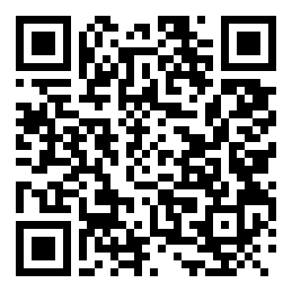
LIVE HANDS-ON CTF
Challenge 0x01: The Leaked Credential
[!] INCIDENT SCENARIO
An unauthorized operator left their credentials cached in plain sight on our public test gateway.
[*] OBJECTIVE
Inspect the target surface, extract the hidden string, and decode the payload.
[#] FLAG FORMAT
sfbu{...}
TARGET GATEWAY: https://MynameisKoi.github.io/baysec/week4/
TIME REMAINING
05:00
Scan to Open Gateway
or visit tinyurl.com/baysec-portal
Notes:
Let's put this into practice immediately. Pull out your laptop or phone and go to the URL on screen. An operator left an authorization token lingering inside this page. Your mission is to find it and extract the flag. You have 5 minutes—go!

Slide 7
DEBRIEF & WALKTHROUGH
0x01 Solution: Client-Side Exposure
STEP 1: INSPECT THE DOM
• Press F12 or Right-Click ➔ Inspect Element
• Examine HTML comments inside <body>:
<!-- The flag is here: c2ZidXt3M2xjMG0zX3QwX2I0eXMzY18yMDI2fQ== -->
Notice the trailing '==' padding — the classic tell of Base64 encoding!
STEP 2: DECODE BASE64
METHOD A: BASH CLI
$ echo "c2ZidXt3M2xjMG0zX3QwX2I0eXMzY18yMDI2fQ==" | base64 -d
METHOD B: CYBERCHEF
Paste into CyberChef ➔ Add recipe 'From Base64'
FLAG RECOVERED:
sfbu{w3lc0m3_t0_b4ys3c_2026}
⚠️ KEY TAKEAWAY: Never store secrets, comments, or sensitive auth logic inside client-rendered markup.
Notes:
Great job to everyone who caught that! The core flaw here is trusting the client side. If it ships to the user's browser—even inside an HTML comment—it’s public knowledge. Base64 is encoding, not encryption.

Slide 8
LOOKING AHEAD
Get Connected & Next Steps
🚀 NEXT WEEK: LAB 01
Linux CLI Essentials & Wireshark Traffic Analysis
📅 MEETING SCHEDULE
Weekly 60-Minute Sessions (Final weekday/time confirmed via WhatsApp & Email)
⚡ ACTION ITEM
Make sure you are in the WhatsApp Community for room announcements!
📫 CONTACTS
• Khoi Duong (President) — mduong@student.sfbu.edu
• Joed Prudente (Faculty Advisor) — joed.prudente@sfbu.edu
JOIN THE COMMUNITY
QUESTIONS?
The floor is now open for Q&A, setup help, or just chatting security.
Notes:
Next week, we kick off Lab 01 with Linux CLI survival skills and packet sniffing in Wireshark. Watch WhatsApp for the locked-in room and time slot. Thank you for coming out, and let’s open up the floor for any questions!

