Slide 1
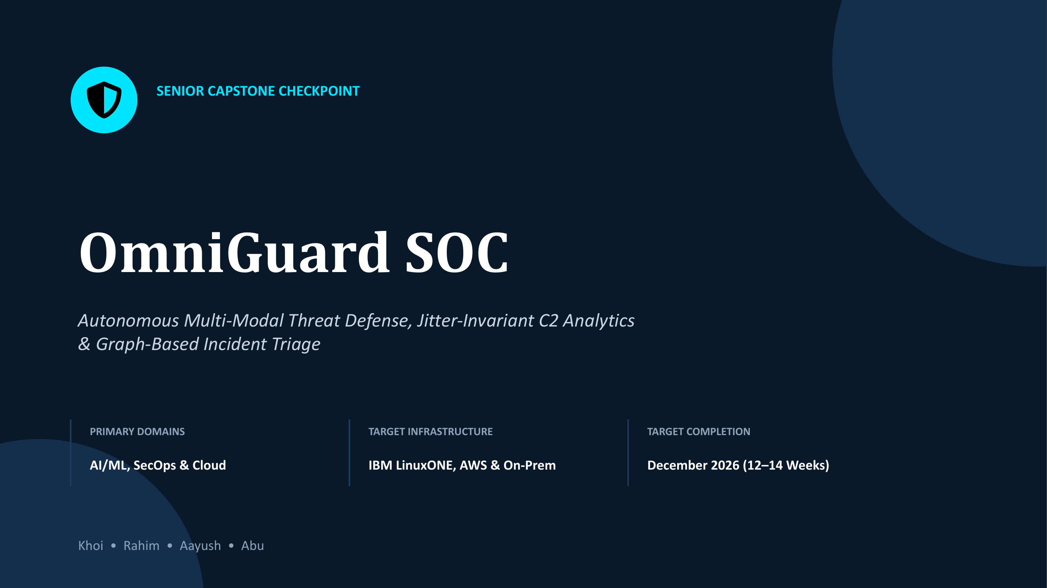

Slide 2
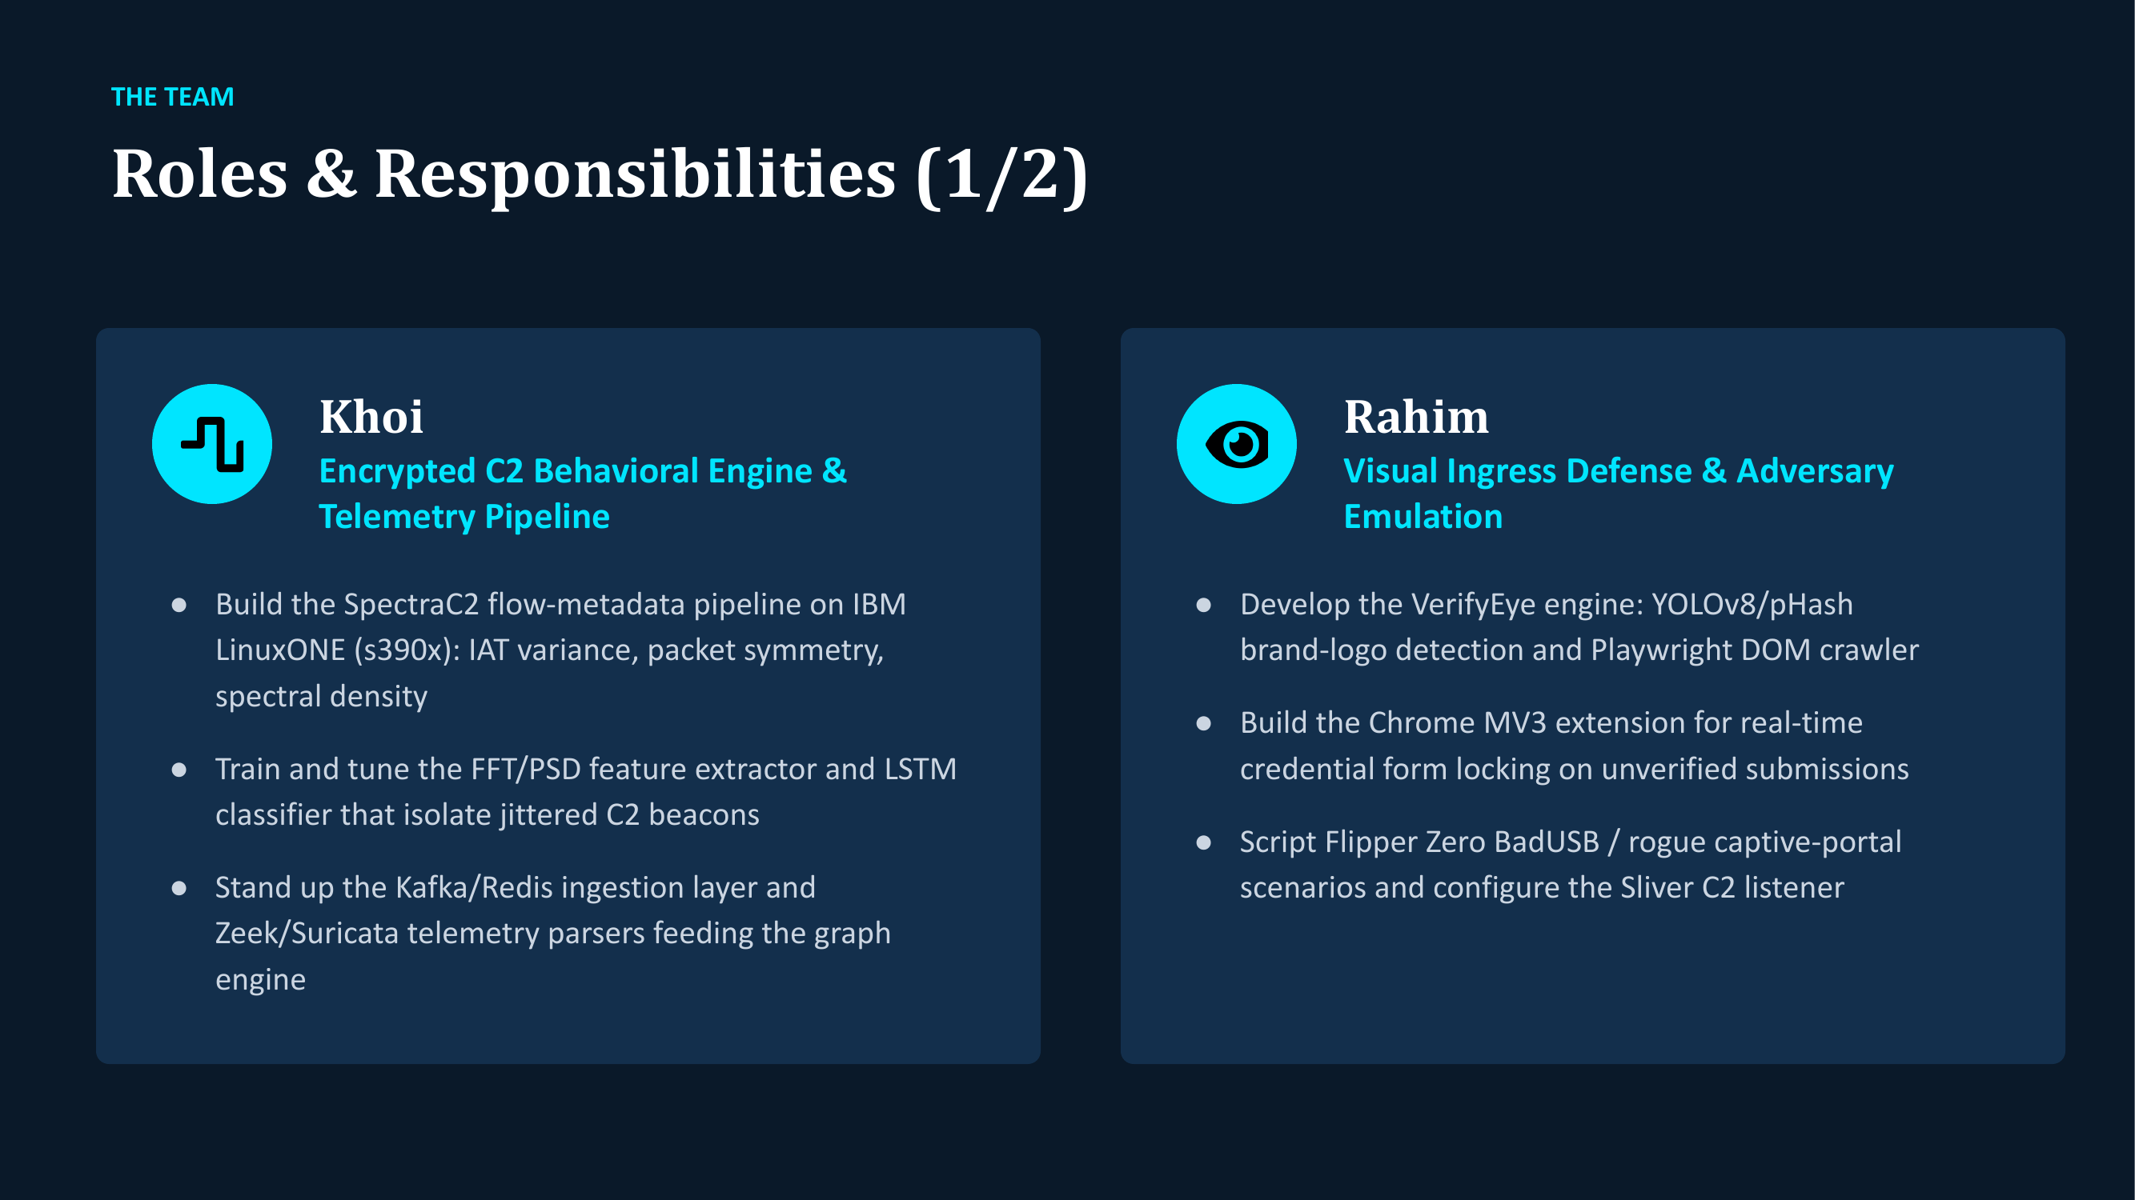

Slide 3
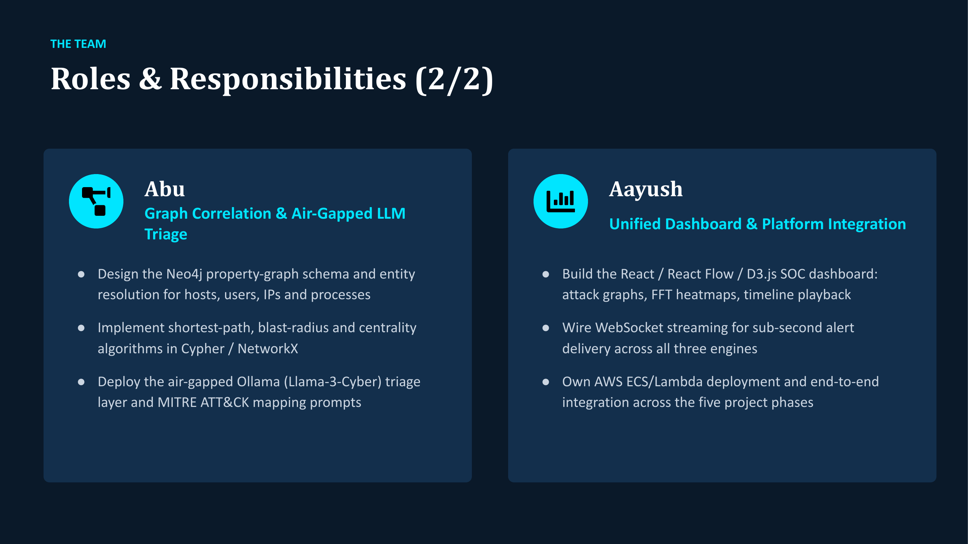

Slide 4
INDUSTRY PAIN POINTS & MARKET GAP
The Modern SOC Crisis: Disconnected Attack Vectors
Zero-Hour Phishing Gap
Active Portals Vanish in Hours
● 4–8h Lifespan: Malicious domains harvest logins and shut down before blacklists update.
● 12–48h Delay: Legacy reputation feeds update days late, leaving employees completely exposed.
● Instant Account Breach: Stolen credentials are used to breach corporate SSO portals on day one.
Encrypted C2 Blind Spot
>95% Traffic Hidden in TLS 1.3
● Camouflaged Egress: Reverse shells (Sliver, Cobalt Strike) look like legitimate web surfing.
● 10%–50% Jitter: Randomized beacon timing easily defeats fixed-threshold firewall rules.
● Decryption Penalty: Deep packet inspection invades privacy, slows networks, and breaks certs.
Alert Fatigue & Silos
Disconnected Logs & Data Leakage
● 10,000+ Daily Alerts: Analysts drown in raw tables without seeing the complete attack picture.
● 16+ Days Dwell Time: Relational databases fail to trace multi-hop lateral movements.
● Privacy Risk: Sending company telemetry to public cloud LLMs violates compliance.

Slide 5
SYSTEM ARCHITECTURE & DESIGN PHILOSOPHY
● 100% On-Premises · Zero Cloud Egress
OmniGuard Architecture: Producer–Core–Consumer
1. Detect (Producers)
Multi-Modal Threat Sensors
● VerifyEye Browser Engine: Monitors DOM changes and freezes fake login forms in real time.
● SpectraC2 Network Engine: Extracts flow timing and unmasks hidden reverse shells via FFT.
● 1 Unified Ingestion Contract: Every sensor communicates via one Pydantic schema over POST /alerts.
2. Correlate (Core Engine)
Dual-Database Persistence Split
● FastAPI Central Core: Non-blocking async ingestion with UTC monotonic timestamps.
● MongoDB (Logs & Telemetry): Durable store for full JSON payloads, DOM snapshots, and audit trail.
● Neo4j (Attack Graph): Decoupled entity topology built for microsecond lateral path discovery.
3. Act (Consumers)
Real-Time Defensive Operations
● React SOC Dashboard: Sub-second WebSocket feed (/ws/alerts) pushing live alerts to analysts.
● Local AI Analyst (Ollama): On-device Llama 3.2 briefing delivered in <3 seconds with zero cloud leaks.
● 1-Click Host Containment: Direct quarantine endpoint immediately cuts C2 channel to isolate threats.
Contract-First Design
Any new engine connects via 1 simple schema
Graph Correlation
Links isolated events into 1 coherent attack story
100% Data Sovereignty
Zero security telemetry ever leaves company network

Slide 6
NON-DECRYPTING BEHAVIORAL NETWORK AI
SpectraC2 Engine: Jitter-Invariant Beacon Detection
Mathematical Signal Processing
Fast Fourier Transform (FFT) & Spectral Density
● Frequency-Domain Conversion: Converts packet timing sequences (IAT deltas) into spectral harmonics.
● Uncovers Hidden Cycles: Exposes repetitive C2 beacon check-ins buried inside high-volume web traffic.
● Zero Decryption Needed: Preserves enterprise TLS 1.3 encryption and eliminates privacy liability.
10%–50% Jitter Invariance
Unmasking Disguised Hacker Signals
● Defeats Evasion: Catches beacons even when intervals are randomized between 7.5s and 12.5s.
● Threshold-Free: Replaces naive fixed-timer alerts with mathematical frequency harmonics.
● 94% Confidence Score: Validates true beacon period with high confidence through noisy networks.
Behavioral AI Models
Sequential Packet Order & Anomaly Inference
● LSTM & Isolation Forest: Classifies malicious reverse shells vs. standard human web browsing.
● >90% Precision Target: Proven across 200+ simulated adversary sessions to stop false alarms.
● Automated MITRE Mapping: Tags MITRE ATT&CK T1071 (Application Layer C2) on alert generation.
Enterprise LinuxONE Ready
Mainframe Speed on IBM s390x
● Mainframe Offload: Offloads heavy vector math without slowing edge network sensors.
● Zero Packet Drops: Automated memory buffers safeguard telemetry during peak traffic bursts.
● Rock-Solid Reliability: 24 out of 24 automated unit and pipeline integration tests pass.

Slide 7
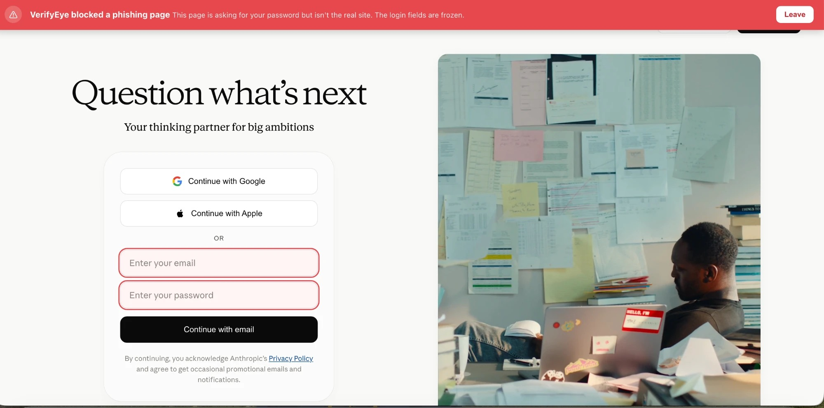
CLIENT-SIDE REAL-TIME PHISHING INTERCEPTION
VerifyEye: Zero-Hour Ingress & Credential Defense
Client-Side Inline Protection
Chrome Manifest V3 Extension
● Sub-Millisecond Inspection: Inspects web pages inside the browser at page load, eliminating the 48h blacklist lag.
● Surgical Form Freezing: Disables and locks email/password inputs with a red security banner before keystroke entry.
● Network Exfiltration Block: declarativeNetRequest rules instantly block unauthorized outgoing POST requests.
● Core Brand Whitelists: Protects Microsoft 365, Google, Okta, Apple, Netflix, Amazon, and Claude.
● Zero User Friction: Legitimate corporate navigation stays active; only deceptive impostors are frozen.
Live Ingress Demonstration
Surgically Neutralizing Phishing Lures in <500ms
● Visual Input Lock: Email and password fields disabled with clear red security alerts.
● Popup Traps Preserved: OAuth buttons stay clickable so secondary popup traps can also be caught.

Slide 8
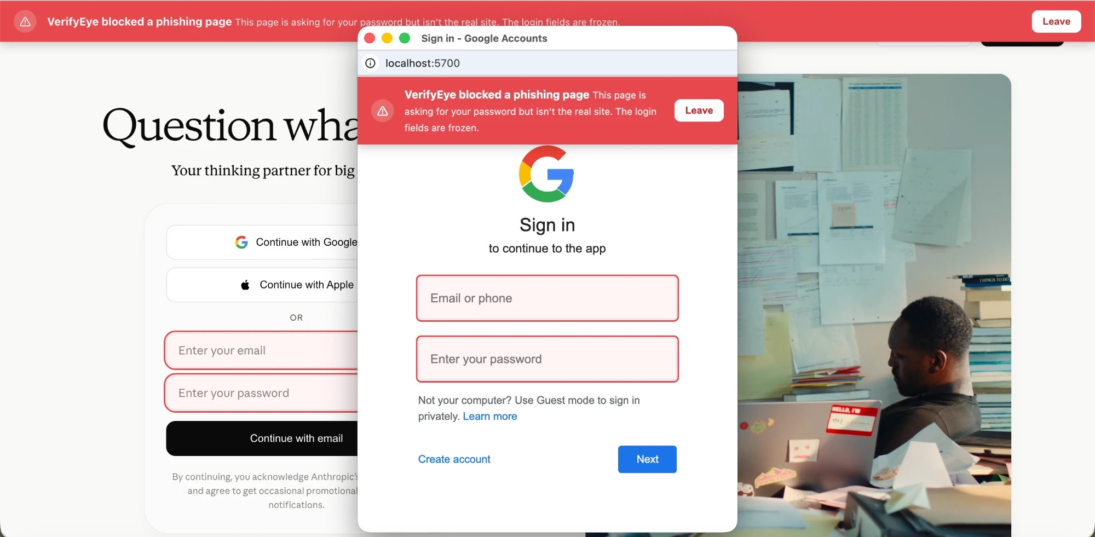
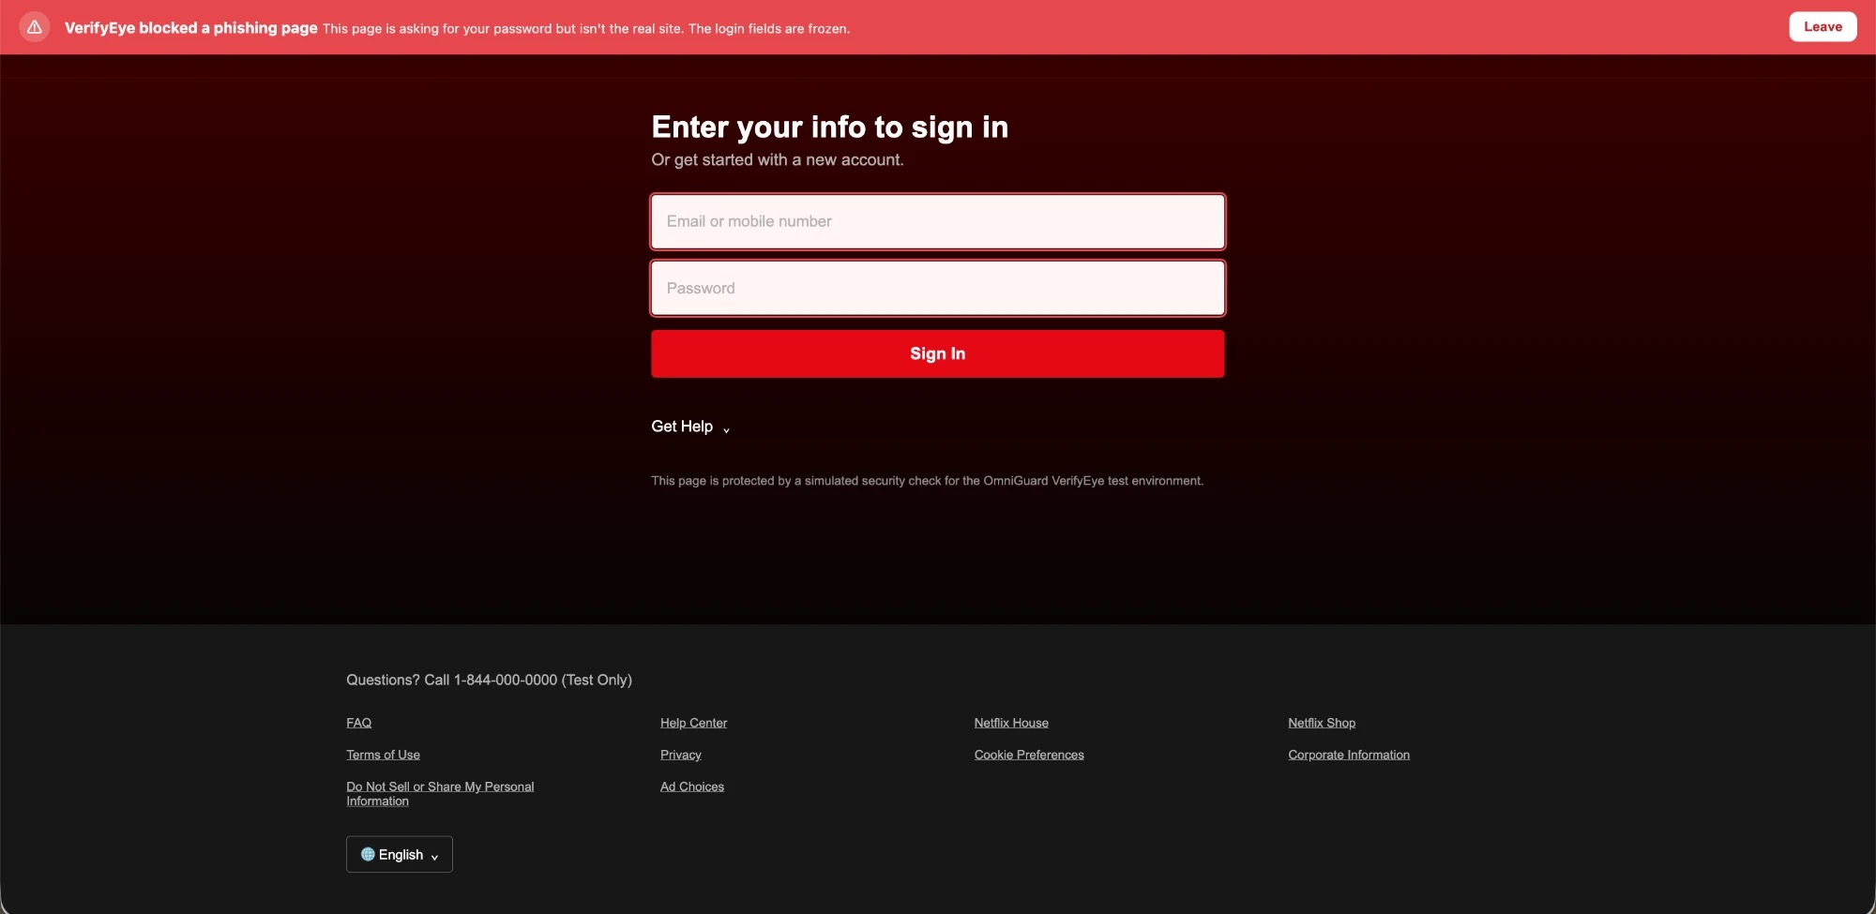
DEFEATING ADVANCED ANTI-ANALYSIS TACTICS
VerifyEye Evasion Defense: OAuth Popups & Dynamic SPAs
Counterfeit OAuth Popup Interception
Neutralizing Secondary Sign-In Window Traps
● The Attack Vector: Phishing sites show 'Continue with Google' opening a secondary popup on a fake domain.
● Zero-Keystroke Trap: VerifyEye catches the popup the millisecond it opens and locks inputs before user types.
Single-Page App (SPA) Mutation Tracking
Defeating Delayed JavaScript Injection Tactics
● The Evasion Trick: Phishing pages load blank and inject login forms 2–3 seconds later to fool static web scanners.
● Sub-Millisecond Neutralization: MutationObserver tracks DOM changes continuously, locking late forms instantly.

Slide 9
FOUNDATIONAL DATA PLATFORM
Central Core API: Unified Schema & Dual Storage
The Unified Alert Contract
Strict Pydantic Schema Across All Sensors
● 1 Shared Schema: VerifyEye, SpectraC2, and test harnesses all publish to POST /alerts seamlessly.
● Server-Stamped Integrity: Backend enforces UTC monotonic timestamps and unique alert IDs.
● Zero Friction: New detection engines connect immediately without backend code modifications.
Durable Telemetry Store (MongoDB)
Complete Raw Evidence & Forensic History
● Full Payload Store: Preserves raw JSON alerts, full DOM snapshots, and flow metadata.
● Immutable Audit Log: Guaranteed compliance-ready forensic trail for incident investigations.
● Fast Document Lookup: Indexed queries on host, alert_id, and severity for instant filtering.
Fast Attack Graph (Neo4j)
Optimized for Microsecond Relationship Traversal
● Decoupled Design: Heavy data lives in Mongo; Neo4j stores strictly nodes (Host, User, Domain, IP).
● Atomic Transactions: Multi-entity ingestion runs in single transactions, preventing orphan nodes.
● Dynamic Entity Merging: MERGE constraints avoid duplicates while linking new threat connections.
Event-Driven Core Fabric
Asynchronous Dispatch & Real-Time Delivery
● Non-Blocking Flow: FastAPI handles HTTP ingest while threadpool writers keep the event loop fast.
● <500ms Push: WebSocket feed (/ws/alerts) pushes live detections directly to analyst screens.
● 10-Second Health Probes: Sidebar monitor continuously verifies Mongo, Neo4j, and Ollama health.

Slide 10
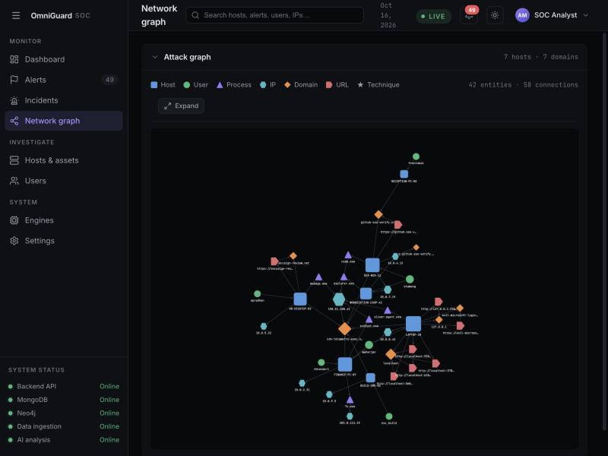
MULTI-ENTITY INCIDENT SYNTHESIS
Attack Graph Correlation: Turning Alerts into Incidents
Multi-Modal Entity Resolution
Connecting Browser Ingress to Encrypted Network Beacons
● Bridging Telemetry Silos: Merges browser alerts (Host, User, URL) with network beacons (Host, C2 IP).
● 2-Hop Blast Radius: Reveals every workstation communicating with the same rogue domain or C2 server.
● Evidence vs. Standing Fact: REPORTED_* edges show alerts; LOGGED_INTO and CONNECTED_TO show network reality.
● Attack Path Tracing: Cypher queries trace lateral pivot chains (e.g., WORKSTATION-CORP-01 ➔ SRV-DB-02).
● 80% Faster MTTD: Eliminates manual queries across separate consoles with instant visual topology.
Interactive Cytoscape Attack Canvas
Real-Time Incident Visualization in Dashboard
● Color-Coded Entities: Distinct visual shapes for Host, User, Domain, IP, URL, and MITRE techniques.
● Click-to-Highlight: Selecting any asset instantly illuminates its entire threat neighborhood.

Slide 11
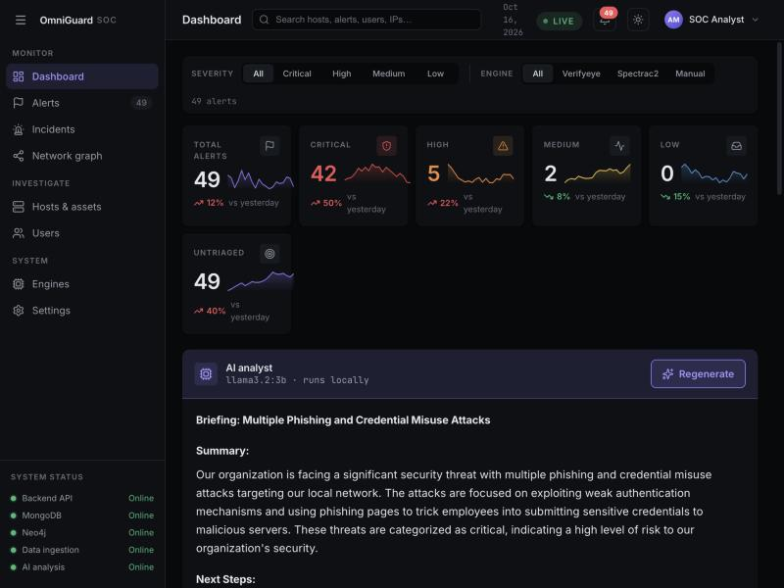
AUTONOMOUS ON-PREMISES AI TRIAGE
Local AI SOC Analyst: Zero-Egress Incident Briefings
Air-Gapped Llama 3.2 Engine
Ollama Localhost Inference with Zero Data Leakage
● 100% On-Premises Privacy: Internal hostnames, usernames, and IP addresses never touch external cloud APIs.
● Regulatory Compliance: Complies with strict HIPAA, GDPR, and defense data sovereignty mandates.
● Context Compression: Condenses the 50 most recent high-severity alerts into an entity-resolved brief.
● Automated MITRE Attribution: Maps observed attacker tactics (T1566 Phishing, T1071 C2, TA0008 Lateral).
● Instant Operator Value: Delivers a concise 3-sentence summary and prioritized action plan in <3 seconds.
Automated Incident Briefing Output
Actionable Guidance for Incident Responders
● 1. Situation Summary: Clear summary of compromised hosts, lures, and active C2 connections.
● 2. Ranked Next Steps: Prioritized host isolation and firewall block commands for rapid triage.

Slide 12
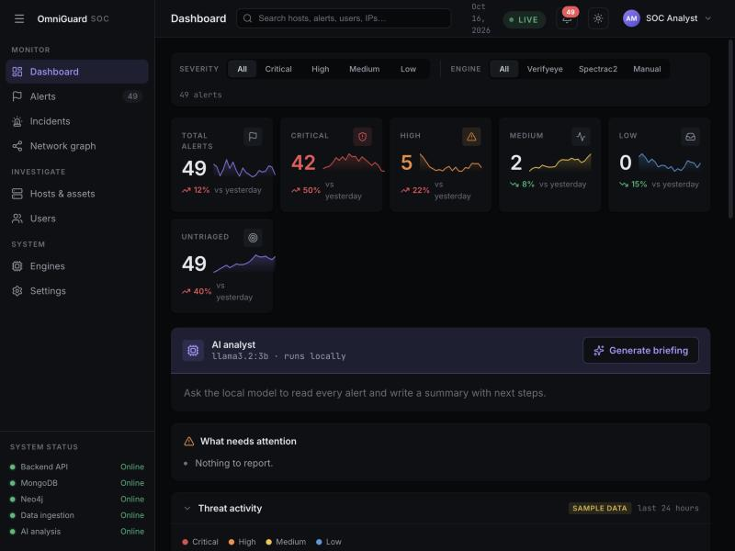
ENTERPRISE OPERATOR WORKSPACE
Unified React SOC Dashboard: Real-Time Event Fabric
Modern SOC Operations Interface
Single Pane of Glass Built in React 18 & WebSockets
● Real-Time WebSocket Feed: Detections appear immediately in the alert table without browser refreshes.
● Interactive Severity Donut: Visual breakdown across Critical, High, Medium, Low, and Untriaged alerts.
● Threat Activity Analytics: Dynamic area charts trace 24-hour threat volume across detection engines.
● Active System Health Polling: Sidebar monitors API, MongoDB, Neo4j, and Ollama every 10 seconds.
● Operator Ergonomics: Sleek, high-contrast dark mode tailored for fast Tier-1 to Tier-3 triage.
Live Operator Telemetry
Multi-Engine Oversight with Live Health Verification
● Top Impacted Assets: Workstations ranked dynamically by threat risk scores.
● MITRE Technique Matrix: Live bars tracking top observed adversary techniques.

Slide 13
END-TO-END VALIDATION & INCIDENT RESPONSE
Validation: 4-Stage Intrusion Replay & Host Containment
Stage 1: Ingress
Initial Access (T1566)
● Adversary Lure: User directed to fake login portal via BadUSB or email lure.
● VerifyEye Defense: Detects brand spoofing, freezes form inputs, and logs Critical alert.
● Result: Zero passwords stolen; host & user flagged.
Stage 2: Egress
Encrypted C2 (T1071)
● Active Implant: Reverse shell beacons to external listener with 25% timing jitter.
● SpectraC2 Defense: FFT analysis isolates 10.0s harmonic peak through the noise floor.
● Result: Critical alert logged with 94% confidence.
Stage 3: Correlation
Attack Graph Fusion
● Entity Fusion: Neo4j merges browser alert & C2 beacon around WORKSTATION-CORP-01.
● Blast Radius: Shows shared user and external infrastructure across endpoints.
● Result: Entire incident linked in 1 graph view.
Stage 4: Containment
1-Click Host Isolation
● Operator Action: Analyst clicks 'Isolate Host' directly on the alert details panel.
● EDR Enforcement: API invokes quarantine, immediately cutting off C2 connection.
● Result: Intrusion contained in seconds; host saved.
PROVEN IMPACT: Automated Test Harness (run_live_demo.py) validates MTTD < 500ms and cuts MTTR from hours to seconds.

Slide 14
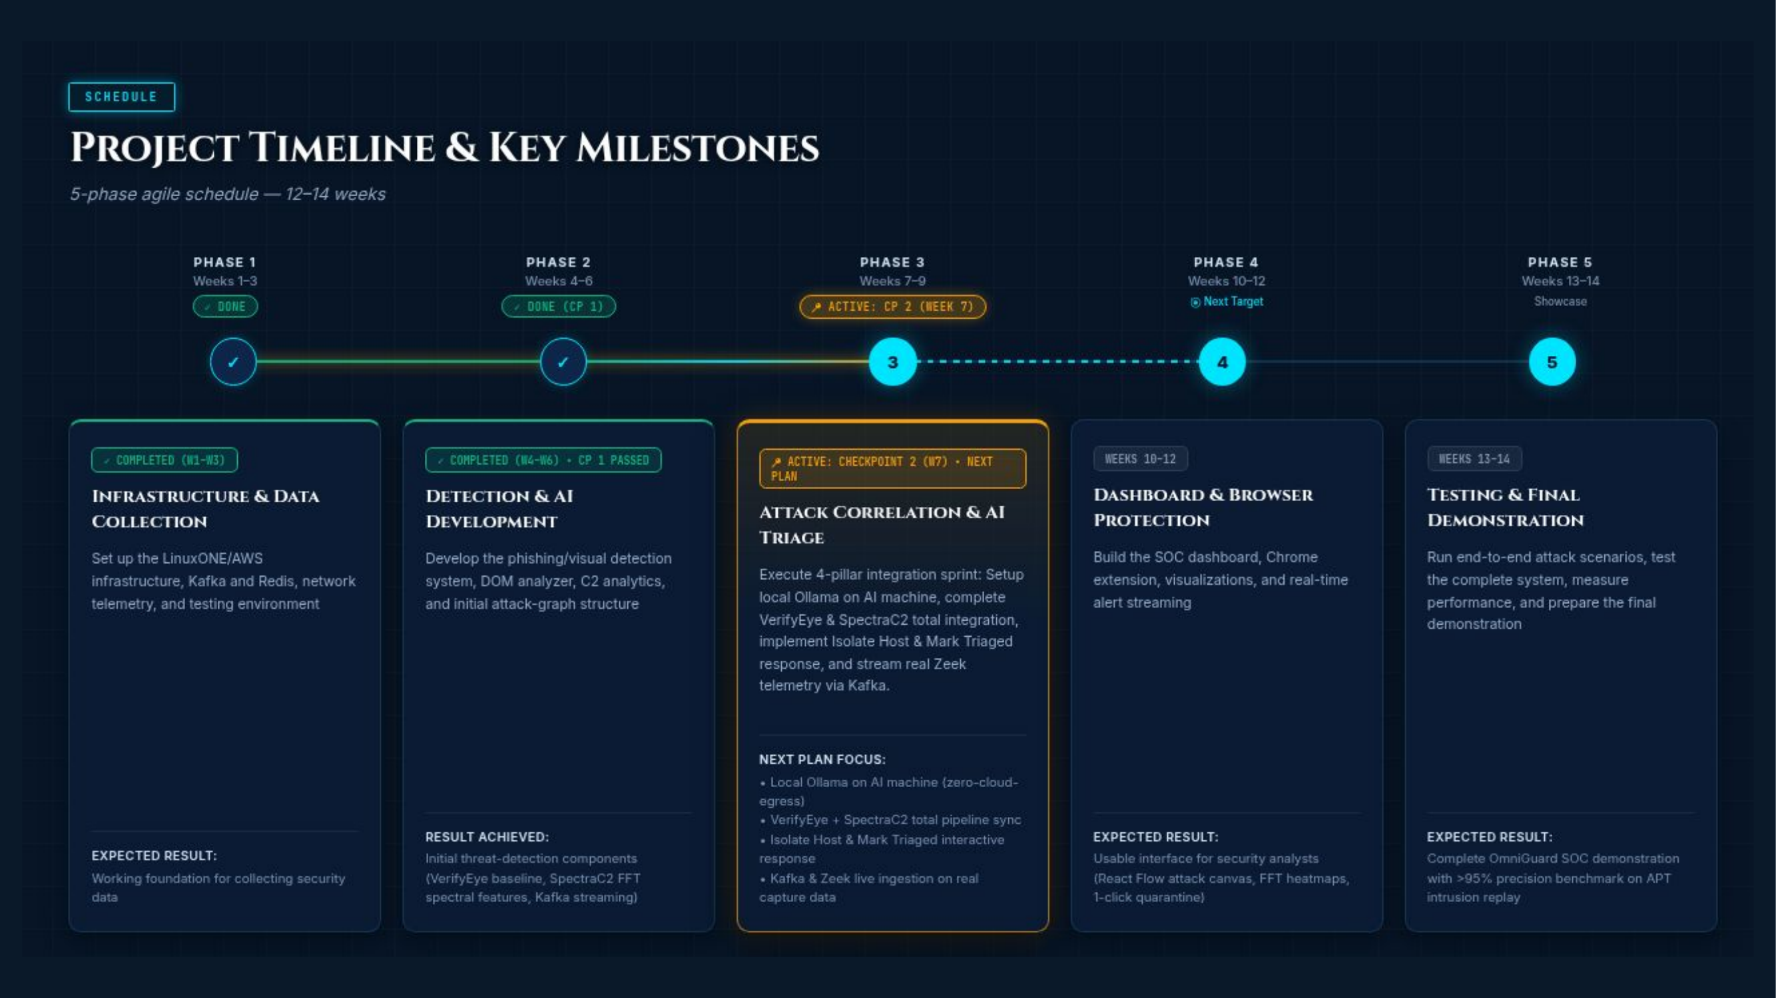

Slide 15
SECOND-HALF DEVELOPMENT ROADMAP
Next Steps: High-Impact Capabilities for Final Showcase
Visual Logo AI Classifier
YOLOv8 & Perceptual Hashing (pHash)
● Computer Vision Defense: Deploy quantized YOLOv8 object detection to identify logos even when HTML text is obfuscated.
● Sub-300ms Browser Inference: Optimize ONNX model weights for lightweight execution without browser slowdown.
● 50+ Enterprise Brands: Expand catalog to protect top enterprise SaaS portals, banking, and cloud consoles.
Conversational SOC Copilot
Natural Language Graph Reasoning
● Plain-English Q&A: Enable analysts to query the attack graph in English ('Which hosts talked to 198.51.100.42?').
● Automatic Cypher Translation: Local LLM converts natural questions into Cypher queries and highlights subgraphs.
● Automated Playbooks: Generates contextual firewall rules and remediation scripts with 1-click execution.
LinuxONE Scale Benchmarking
Enterprise Validation on IBM s390x
● High-Throughput Replay: Stream multi-gigabyte DARPA TC and enterprise PCAPs through Kafka pipeline.
● >95% Verified Precision: Validate beacon detection across 200+ randomized jitter trials.
● December 2026 Showcase: Deliver complete live intrusion defense demonstration for senior capstone defense.

Slide 16
