Slide 1


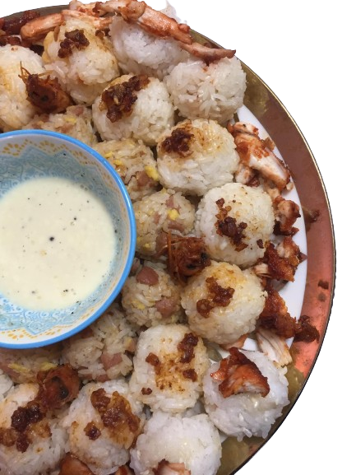
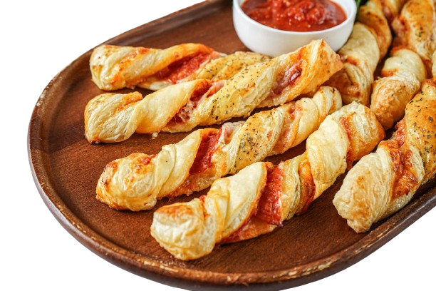
HOME
ABOUT US
DELIVERY
CAREERS
BEST SELLERS
ONIGINOY
SPECIAL
FAMILY PACK
RICEBALLS
A family deal sure to fill the cravings of the house without needing to break the bank. Complete with tons of our signature ONIGINOY rice balls and our special sauce that will make that whole family wanting for more
Slide 5
28 BALLS PER SERVING 150SRP!!
Kunyare nalang pizza twist to…di ko talaga alam kung ano itsura nun pero ito lumabas sa google eh….tas insert Narin ng mga details or something

Slide 2
HOME
ABOUT US
DELIVERY
CAREERS
ABOUT US
COMPANY PROFILE
OnigiNoy, a rice ball businesscreated by 22 students during their Entrepreneurship course,specializesin unique viand-infused rice balls. Ourinspiration comesfrom the Japanese 'Onigiri,'whichwe've adapted to 'OnigiNoy,' meaning 'produced by Pinoy'—a nod to our Filipino roots. The originalconcept,conceived by one of ourstudents,transformsthis traditional productinto a rice ballfilledwith Filipino viand, using rice as our primary ingredient.
Our Goalsisto cultivate cultural appreciation through our Filipinoinspired products, delivering unforgettable flavorsthatcapture the essence oflocalside dishes. We strive to be the preferred choice forthose seeking an affordable, on-the-go rice mealwith a taste of perfection.
Our packaging is both reusable and food-safe for delivery. With a totalcapital of1610 pesoscontributed by our 22 student members,we operate from Kay Talişe St.,Dr. A. Santos Ave., SanDionisio, Parañaque City,wherewe produce, package,store, and sell our products.
Beyond being a delicious meal, ourrice balls offer a unique blend ofrice and variousside dishes, appealing to a diverse customer base, including students and individuals of all ages. We provide an irresistible taste at affordable prices. To expand ourreach,OnigiNoy employs a strategic approach, leveraging social media promotion and pre-order availability to establish a distinctive presence in the food industry. We invite you to experience the joy of Filipino cuisine through our innovative rice balls. Contact us viaMessenger, and letOnigiNoy serve you the best of Filipino flavors.

Slide 3
HOME
ABOUT US
DELIVERY
CAREERS
ABOUT US
COMPANY PROFILE
OnigiNoy, a rice ball businesscreated by 22 students during their Entrepreneurship course,specializesin unique viand-infused rice balls. Ourinspiration comesfrom the Japanese 'Onigiri,'whichwe've adapted to 'OnigiNoy,' meaning 'produced by Pinoy'—a nod to our Filipino roots. The originalconcept,conceived by one of ourstudents,transformsthis traditional productinto a rice ballfilledwith Filipino viand, using rice as our primary ingredient.
Our Goalsisto cultivate cultural appreciation through our Filipinoinspired products, delivering unforgettable flavorsthatcapture the essence oflocalside dishes. We strive to be the preferred choice forthose seeking an affordable, on-the-go rice mealwith a taste of perfection.
Our packaging is both reusable and food-safe for delivery. With a totalcapital of1610 pesoscontributed by our 22 student members,we operate from Kay Talişe St.,Dr. A. Santos Ave., SanDionisio, Parañaque City,wherewe produce, package,store, and sell our products.
Beyond being a delicious meal, ourrice balls offer a unique blend ofrice and variousside dishes, appealing to a diverse customer base, including students and individuals of all ages. We provide an irresistible taste at affordable prices. To expand ourreach,OnigiNoy employs a strategic approach, leveraging social media promotion and pre-order availability to establish a distinctive presence in the food industry. We invite you to experience the joy of Filipino cuisine through our innovative rice balls. Contact us viaMessenger, and letOnigiNoy serve you the best of Filipino flavors.
OBJECTIVES
• Focus on quality,creativity, and customersatisfaction to carve a unique niche in the industrywithOnigiNoy
• Increase sales ofOnigiNoy by leveraging its unique flavorto attractthe target customer base.
• Expand marketreach through social media promotion and accept pre-orders.
•Offer a delicious, healthy meal at an affordable price.
• Become a premier Rice Ball business known foritsinnovation and exceptional flavors
VISION
Our ultimate vision isto establishOnigiNoy asthe premierrice ballOnigiNoy envisions becoming the foremostrice ball business,synonymouswith culinary perfection and convenience in the industry. We are dedicated to delivering unrivaled taste experiences,setting the standard for excellence in taste,texture, and customer service. By offering finger-sized rice ballsfilledwith mouthwatering Filipino-inspired flavors,we aim to infuse creativity into Filipino cuisine and build a remarkable reputation as an innovative and distinctfood brand in the industry
MISSION
OnigiNoy is dedicated to bringing the vibrantflavors of Filipino cuisine to life through oursignature rice balls. We continually innovate ourrecipesto perfectthe texture and flavor of each viand-infused rice ball, ensuring a unique and exceptional Filipino food experience forstudents and staffseeking convenient meal options. Ourcommitment extendsto fostering cultural appreciation through the artistry of Filipino-Cuisine Rice Balls,where tradition meetsflavor. We maintain rigorous quality controlstandardsto ensure customersafety and provide healthy food options. Our mission isto be the preferred choice forthose seeking exceptionalfood experiences. We achieve this by expanding our menu offerings and consistently delivering exceptional quality and taste craftedwith love and servedwith a smile.

Slide 4
HOME
ABOUT US
DELIVERY
CAREERS
ABOUT US
COMPANY PROFILE
OnigiNoy, a rice ball businesscreated by 22 students during their Entrepreneurship course,specializesin unique viand-infused rice balls. Ourinspiration comesfrom the Japanese 'Onigiri,'whichwe've adapted to 'OnigiNoy,' meaning 'produced by Pinoy'—a nod to our Filipino roots. The originalconcept,conceived by one of ourstudents,transformsthis traditional productinto a rice ballfilledwith Filipino viand, using rice as our primary ingredient.
Our Goalsisto cultivate cultural appreciation through our Filipinoinspired products, delivering unforgettable flavorsthatcapture the essence oflocalside dishes. We strive to be the preferred choice forthose seeking an affordable, on-the-go rice mealwith a taste of perfection.
Our packaging is both reusable and food-safe for delivery. With a totalcapital of1610 pesoscontributed by our 22 student members,we operate from Kay Talişe St.,Dr. A. Santos Ave., SanDionisio, Parañaque City,wherewe produce, package,store, and sell our products.
Beyond being a delicious meal, ourrice balls offer a unique blend ofrice and variousside dishes, appealing to a diverse customer base, including students and individuals of all ages. We provide an irresistible taste at affordable prices. To expand ourreach,OnigiNoy employs a strategic approach, leveraging social media promotion and pre-order availability to establish a distinctive presence in the food industry. We invite you to experience the joy of Filipino cuisine through our innovative rice balls. Contact us viaMessenger, and letOnigiNoy serve you the best of Filipino flavors.
OBJECTIVES
• Focus on quality,creativity, and customersatisfaction to carve a unique niche in the industrywithOnigiNoy
• Increase sales ofOnigiNoy by leveraging its unique flavorto attractthe target customer base.
• Expand marketreach through social media promotion and accept pre-orders.
•Offer a delicious, healthy meal at an affordable price.
• Become a premier Rice Ball business known foritsinnovation and exceptional flavors
VISION
Our ultimate vision isto establishOnigiNoy asthe premierrice ballOnigiNoy envisions becoming the foremostrice ball business,synonymouswith culinary perfection and convenience in the industry. We are dedicated to delivering unrivaled taste experiences,setting the standard for excellence in taste,texture, and customer service. By offering finger-sized rice ballsfilledwith mouthwatering Filipino-inspired flavors,we aim to infuse creativity into Filipino cuisine and build a remarkable reputation as an innovative and distinctfood brand in the industry
MISSION
OnigiNoy is dedicated to bringing the vibrantflavors of Filipino cuisine to life through oursignature rice balls. We continually innovate ourrecipesto perfectthe texture and flavor of each viand-infused rice ball, ensuring a unique and exceptional Filipino food experience forstudents and staffseeking convenient meal options. Ourcommitment extendsto fostering cultural appreciation through the artistry of Filipino-Cuisine Rice Balls,where tradition meetsflavor. We maintain rigorous quality controlstandardsto ensure customersafety and provide healthy food options. Our mission isto be the preferred choice forthose seeking exceptionalfood experiences. We achieve this by expanding our menu offerings and consistently delivering exceptional quality and taste craftedwith love and servedwith a smile.
CHARACTERISTICs
OnigiNoy recognizesthe diverse needs ofitsclientswithin the educational and professional landscape. We understand the diverse needs ofthosewho fill our dayswith energy and purpose,from bright-eyed high school and senior high schoolstudentsseeking affordable,convenientsnacks between classesto dedicated faculty and staffwho require quick, nutritiouslunches. For everyone, OnigiNoy offers a delicious escape,saving precious minutes and boosting productivity.
OnigiNoy brings a fiesta of Filipino flavorsto yourfingertipsin bite-sized rice ballsthat are pure deliciousness. Imagine silky-smooth rice like a fluffy cloud hugging yourtaste buds,then picture it explodingwith savory fillingslike tender adobo flakes,creamy buttered shrimp,chicken buffalo ortunawith a twist. OnigiNoy extendsitswarmth beyond the schoolwalls, embracing busy professionals and studentsworking nearbywith a convenient,flavorful option. We fueltheir daywith health-consciouschoicesthat keep them energized and focused. Even families discoverthe comfort ofOnigiNoy,filling theirchildren's lunchboxeswith portable and deliciousfood.
This diverse tapestry ofcustomersreflects ourcore value, inclusivity. We believe everyone deservesto experience the joy of authentic Filipino cuisine in a convenient, deliciousway. And to bridge the gap,we offer online ordering for effortless accessto ourflavorful delights. We develop targeted marketing campaigns,create newflavorsthatsatisfy specific preferences, and constantly strive to reach newaudiences. This dedication fuels oursuccess, leading to sales growth, market diversification, and unwavering customersatisfaction.
OnigiNoy is more than justrice balls; it's a community united by flavor and convenience. Every bite celebratesthe vibrant energy ofthosewho fill our days, reminding usthat delicious momentscan be savored,whereverlife takes us

Slide 5
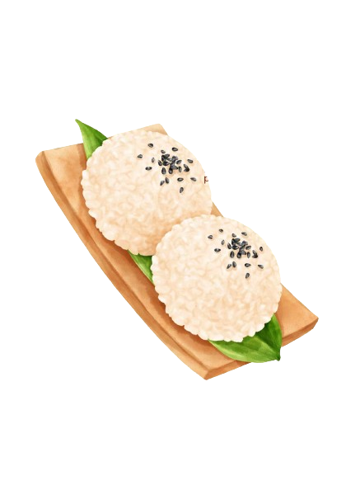
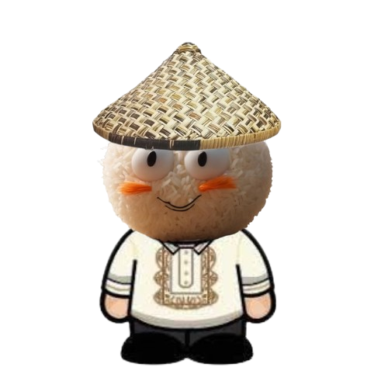
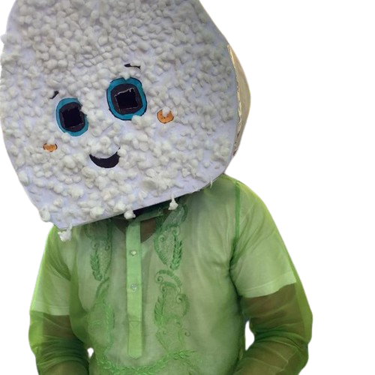

HOME
ABOUT US
DELIVERY
CAREERS
ONIGINOY
SPECIAL
FAMILY PACK
RICEBALLS
PREMIUM ONIGINOY BALLS
ONIGINOY MAN
TUGAP,ANDREI
PIZZATWIST???
DELUX BENG BENG PEW PEW

Slide 6
HOME
ABOUT US
DELIVERY
CAREERS
Indulge in a culinary delight with our mouthwatering platter of rice balls filled with savory adobo and accompanied by a delectable sauce. Bursting with flavor and nostalgia, these rice balls offer a tantalizing fusion of Filipino comfort food and innovative culinary craftsmanship. Crafted from premium ingredients, each rice ball is meticulously handcrafted with care, ensuring a perfect balance of textures and tastes in every bite. Our signature adobo filling, made from tender marinated meat infused with rich spices and tangy vinegar, delivers an explosion of savory goodness that will leave your taste buds craving for more. Paired with a luscious sauce crafted from a secret blend of ingredients, these rice balls are a culinary masterpiece that promises to elevate your dining experience to new heights.
Why settle for ordinary when you can indulge in extraordinary? Our rice balls with adobo filling are more than just a meal—they're a culinary experience that transports you to the bustling streets of Manila, where the aroma of sizzling adobo fills the air. Perfect for sharing with friends and family or savoring as a solo treat, these rice balls are sure to be the star of any gathering or occasion. Whether you're craving a satisfying snack or searching for a unique addition to your dining table, our platter of rice balls with adobo filling offers an irresistible combination of flavors, textures, and nostalgia that will leave you craving for more. Taste the magic of Filipino cuisine with every bite and embark on a culinary journey like no other.
ONIGINOY
SPECIAL
FAMILY PACK
RICEBALLS
P150
28 BALLS
PREMIUM ONIGINOY BALLS
ONIGINOY MAN
TUGAP,ANDREI
PIZZATWIST???
DELUX BENG BENG PEW PEW
PLACE ORDER .

Slide 7
HOME
ABOUT US
DELIVERY
CAREERS
Experience culinary excellence with our premium fist-sized rice balls filled with tantalizing tuna mayo and adorned with delicate sesame seeds. Elevating the art of rice balls to new heights, each luxurious creation is a symphony of flavors and textures, meticulously crafted to delight the senses. Made from the finest ingredients, our rice balls are handcrafted with precision and care, ensuring a perfect harmony of taste and presentation. The creamy tuna mayo filling, made from succulent tuna mixed with creamy mayonnaise and a hint of seasoning, offers a burst of savory indulgence with every bite. Topped with fragrant sesame seeds, these rice balls exude elegance and sophistication, making them a true culinary masterpiece that is as pleasing to the eyes as it is to the palate.
Savor the exquisite blend of flavors and textures that our premium rice balls with tuna mayo offer. Whether enjoyed as a luxurious snack or a sophisticated appetizer, these fist-sized delights are perfect for any occasion. Impress your guests at your next gathering or treat yourself to a moment of culinary bliss with these indulgent rice balls. With their impeccable taste, premium quality, and elegant presentation, our rice balls are sure to elevate your dining experience to new heights and leave you craving for more. Taste the epitome of culinary excellence with every bite and indulge in a gastronomic adventure that will tantalize your taste buds and leave you longing for another exquisite bite.
PREMIUM ONIGINOY BALLS
P70
2 BALLS
ONIGINOY
SPECIAL
FAMILY PACK
RICEBALLS
ONIGINOY MAN
TUGAP,ANDREI
PIZZATWIST???
DELUX BENG BENG PEW PEW
PLACE ORDER .

Slide 8

ONIGINOY
ENTER LOCATION
ENTER YOUR DELIVERY ADDRESS TO LOCATE THE STORE NEAREST YOU
PREMIUM ONIGINOY BALLS
ONIGINOY MAN
SEARCH ADDRESS HERE
TUGAP,ANDREI
PIZZATWIST???
DELUX BENG BENG PEW PEW
CONTINUE .

Slide 9
HOME
ABOUT US
DELIVERY
CAREERS
LOCATION
LEVEL
SPECIALIZATION
FILTER
MANAGER TRAINEE – NCR
NCR
ENTRY LEVEL
APPLY
MANAGER TRAINEE – REGION III
REGION III
ENTRY LEVEL
APPLY

Slide 10
HOME
ABOUT US
DELIVERY
CAREERS
LOCATION
LEVEL
SPECIALIZATION
FILTER
MANAGER TRAINEE – NCR
NCR
ENTRY LEVEL
APPLY
MANAGER TRAINEE – REGION III
REGION III
ENTRY LEVEL
APPLY
MANAGER TRAINEE – MARS
MARS
ENTRY LEVEL
APPLY
MANAGER TRAINEE – REGION IV CALABARZON
REGION IV CALABARZON
ENTRY LEVEL
APPLY

Slide 11

HOME
ABOUT US
DELIVERY
CAREERS
BEST SELLERS
ONIGINOY
SPECIAL
FAMILY PACK
RICEBALLS
A family deal sure to fill the cravings of the house without needing to break the bank. Complete with tons of our signature ONIGINOY rice balls and our special sauce that will make that whole family wanting for more
Slide 5
28 BALLS PER SERVING 150SRP!!
Kunyare nalang pizza twist to…di ko talaga alam kung ano itsura nun pero ito lumabas sa google eh….tas insert Narin ng mga details or something

Slide 12
HOME
ABOUT US
DELIVERY
CAREERS
ABOUT US
COMPANY PROFILE
Pizza twist company was first founded on March 2022 by Crysnel Alexa Ecle who had a passion to create new kids of pizza.On September 2023 Pizza twist company was officially established by fantastic group lead by Ecle in 8155 Dr.Arcadio Santos Ave. neer in Paranaque National HighSchool Main.Every product of pizza twist company being made is with a goal of providing a unique and innovative pizza that will satisfy customers cravings.Pizza twist company offers a wide range of classic flavors and ingredients in a wrapped and ball form,It can be easily consumed by customers without the needs of utensils unlike traditional pizza that offen require plates&utensils and offers repeated flavors. Pizza twist company is proud to offer a customizable experience for its customers.We allow customers to make their pizza creations by choosing their preffered style,sauce and toppings.This level of custumization ensure that customers can create a pizza tailored to their individual tastes and preferences.Our company is known for its quality ingredients and fast friendly service because we use freshest ingredients including high quality sauce, ham,peppironi, cheese and home made tortilla wrap.Our pizza typically ready within 15 minutes. Pizza twist company is still in developing progress. We are currently expanding its operations to new markets in nation wide. As a part of business industry we are committed to provide unique and quality food in affordable cost that customer is looking for. Striving to satisfy the customers by making sure that every bite of our product was worth it. Pizza twist company aim to attract potential buyer and shift it into real customer to increase the business overall customer base. This can be achieved through marketing strategies, promotions and efforts. To ensure the profitability of our company we will focus in mentaining cost efficiency that will serves as a tool for expanding its market. Opening new branches in different areas and creating partnership with other business such as food delivery service to increase distribution that will lead to a known business Pizza twist company emphasizes the use of fresh and locally-sourced ingredients. We value sustainability by incorporating organic and ethical-sourced ingredients when possible.

Slide 13
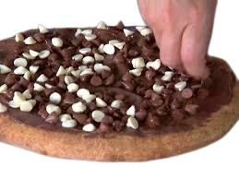
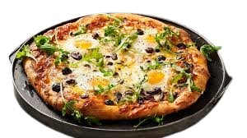


HOME
ABOUT US
DELIVERY
CAREERS
PIZZATWIST???
DEPRESSION
DEFINETLY NOT PIZZA HUT
Slide 16
OBAMA, BARACK
PREMIUM ONIGINOY BALLS
SUPREME BANG BANG

Slide 14
HOME
ABOUT US
DELIVERY
CAREERS
LOCATION
LEVEL
SPECIALIZATION
FILTER
MANAGER TRAINEE – NCR
NCR
ENTRY LEVEL
APPLY
MANAGER TRAINEE – REGION III
REGION III
ENTRY LEVEL
APPLY

Slide 15
HOME
ABOUT US
DELIVERY
CAREERS
LOCATION
LEVEL
SPECIALIZATION
FILTER
MANAGER TRAINEE – NCR
NCR
ENTRY LEVEL
APPLY
MANAGER TRAINEE – REGION III
REGION III
ENTRY LEVEL
APPLY
MANAGER TRAINEE – MARS
MARS
ENTRY LEVEL
APPLY
MANAGER TRAINEE – REGION IV CALABARZON
REGION IV CALABARZON
ENTRY LEVEL
APPLY

Slide 16
HOME
ABOUT US
DELIVERY
CAREERS
Experience culinary excellence with our premium fist-sized rice balls filled with tantalizing tuna mayo and adorned with delicate sesame seeds. Elevating the art of rice balls to new heights, each luxurious creation is a symphony of flavors and textures, meticulously crafted to delight the senses. Made from the finest ingredients, our rice balls are handcrafted with precision and care, ensuring a perfect harmony of taste and presentation. The creamy tuna mayo filling, made from succulent tuna mixed with creamy mayonnaise and a hint of seasoning, offers a burst of savory indulgence with every bite. Topped with fragrant sesame seeds, these rice balls exude elegance and sophistication, making them a true culinary masterpiece that is as pleasing to the eyes as it is to the palate.
Savor the exquisite blend of flavors and textures that our premium rice balls with tuna mayo offer. Whether enjoyed as a luxurious snack or a sophisticated appetizer, these fist-sized delights are perfect for any occasion. Impress your guests at your next gathering or treat yourself to a moment of culinary bliss with these indulgent rice balls. With their impeccable taste, premium quality, and elegant presentation, our rice balls are sure to elevate your dining experience to new heights and leave you craving for more. Taste the epitome of culinary excellence with every bite and indulge in a gastronomic adventure that will tantalize your taste buds and leave you longing for another exquisite bite.
WHAT I ASSUME PIZZA TWIST IS
P0.25
0 PIECES
ONIGINOY
SPECIAL
FAMILY PACK
RICEBALLS
ONIGINOY MAN
TUGAP,ANDREI
PIZZATWIST???
DELUX BENG BENG PEW PEW
PLACE ORDER .

Slide 17
PIZZA TWIST
ENTER LOCATION
ENTER YOUR DELIVERY ADDRESS TO LOCATE THE STORE NEAREST YOU
PREMIUM ONIGINOY BALLS
ONIGINOY MAN
SEARCH ADDRESS HERE
TUGAP,ANDREI
PIZZATWIST???
DELUX BENG BENG PEW PEW
CONTINUE .

