Slide 1


Storytelling Case Study: Airbnb, NYC
By : MYNUDDIn S
RAJDEEP SAHA
&
PULKIT TUNDWAL

Slide 2
Objective:
Airbnb is an online platform using which people can rent their unused accommodations.
During the covid time, Airbnb incurred a huge loss in revenue.
People have now started travelling again and Airbnb is aiming to bring up the business again and e ready to provide services to customers.

Slide 3

Background
Past few months, Airbnb has seen a major Drawback in decline in revenue.
After the restrictions have started and people have started to travel more, Airbnb wants to make sure that it is fully prepared for this change.
So, analysis has been done on data and consisting of various Airbnb listings in New York.

Slide 4
Data Preparation
Removing Null Values and Verifying the unique values and drop the missing values
Dropped insignificant columns.
Identifying the outliers

Slide 5
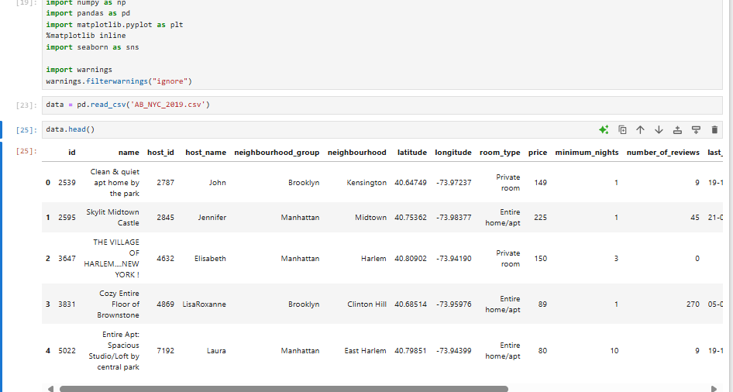
CLEANING and ANALYSING USING JUPYER NOTEBOOK

Slide 6
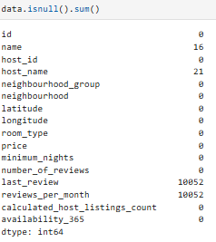
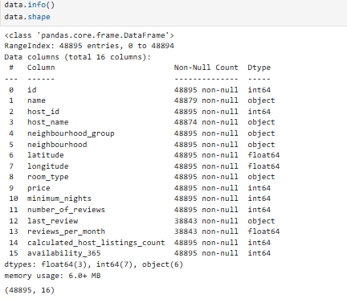
Total data has 48895 columns with 16 rows with null values on – name, host_id, last_review, reviews_per_month

Slide 7
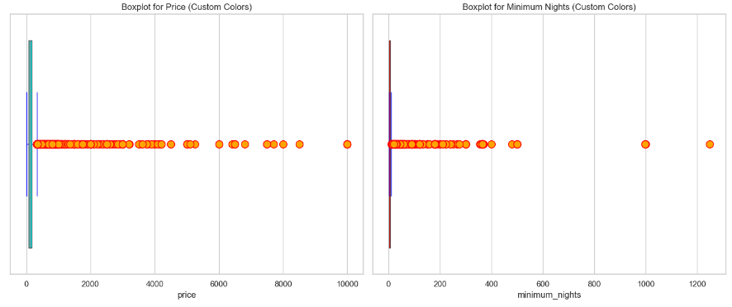
FIDING OUTLIERS on PRICE and MINIMUM NIGHTS
Summary of outliers: Price: There are 388 outliers, with extreme values like $3000, $2999, and $2000.Minimum Nights: There are 327 outliers, with some listings requiring a minimum of 90 to 365 nights. These high values deviate significantly from typical listings.

Slide 8
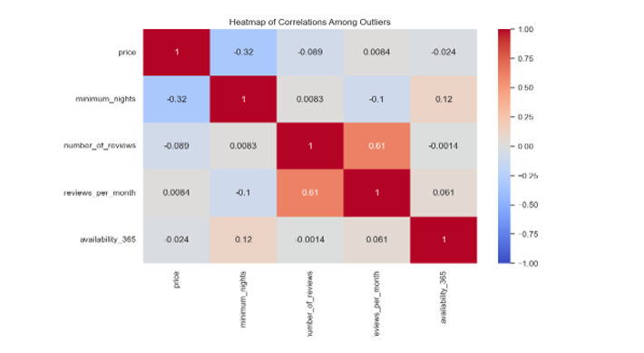
Correlation Coefficients:

Slide 9
Observations Correlation and Coefficients:
Price vs. Availability: There might be a negative correlation between price and availability_365. High prices could be causing low bookings, reflected by high availability.
Price vs. Number of Reviews: You may observe a negative or weak positive correlation. Higher-priced listings might receive fewer reviews, as fewer bookings occur, while reasonably priced listings tend to attract more reviews.
Minimum Nights vs. Availability: A positive correlation might exist if listings with high minimum_nights requirements are underbooked, leading to higher availability.
Reviews per Month vs. Number of Reviews: These two metrics are typically positively correlated because properties with more total reviews are likely to receive more frequent new reviews.

Slide 10
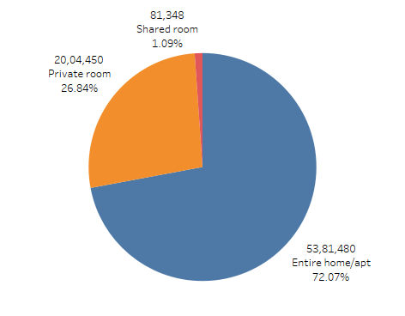
Room type with PRICE
There are three types of rooms - Entire home/Apartment, Private room & shared room.
Overall, REVENUE appear to prefer private rooms (72.07%)
The AIR BNB Can concentrate on better discounts on private rooms and sharing category

Slide 11
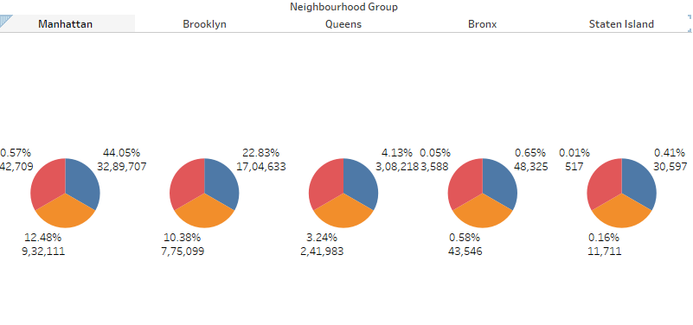
ROOM TYPE WITH NEIGHBOURHOOD
MANHATTAN and BROOKLYN are on higher occupancy
Bronx and staten island are in low frequency
Queens are in middle

Slide 12
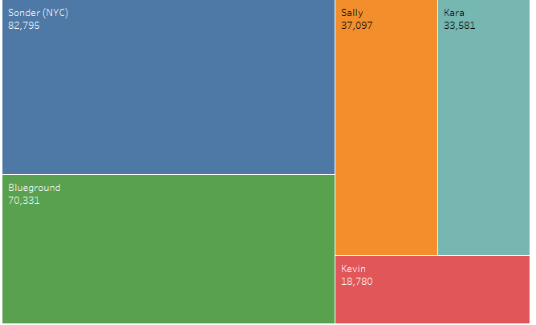
Top 05 Host
Host Sonder (id 219517861), has been booked most number of times as 327 with price of 82795.
Host GREEN ground is the second popular host.

Slide 13
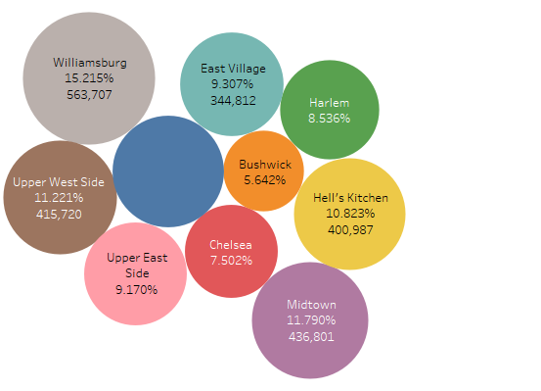
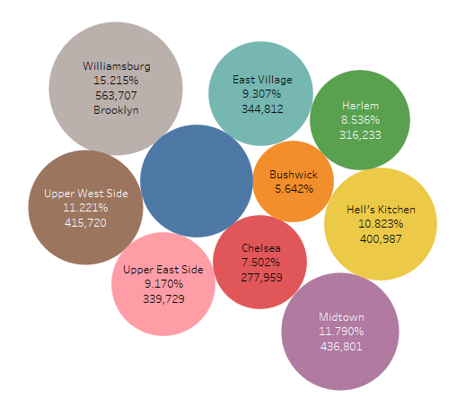
TOP 10 Price with NEIGHBOURHOOD
Mr. Wiiliamburgs has to paid among the all in Brooklyn
Follwed by midtown manhattan
Bronx appears to be an affordable neighbourhood as the average price is almost half than Manhattan’s average price.

Slide 14
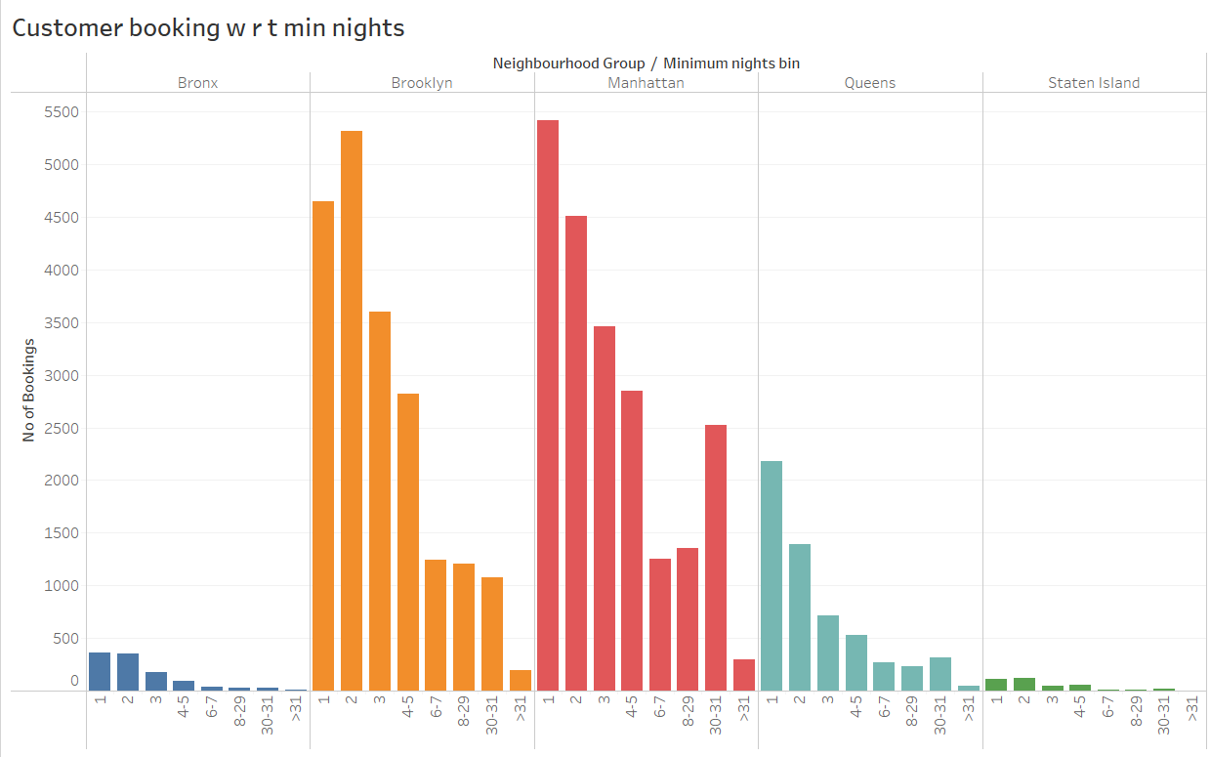
Customer Booking with respect to minimum nights
The listings with Minimum nights 1-5 have the most number of bookings. We can see a prominent spike in 30 days, this would be because customers would rent out on a monthly basis.
After 30 days, we can also see small spikes, this can also be explained by the monthly rent taking trend.
Manhattan &Queens have higher number of 30 day bookings compared to the others. The reason could be either tourists booking long stays or mid-level employees who opt for budget bookings due company visits

Slide 15
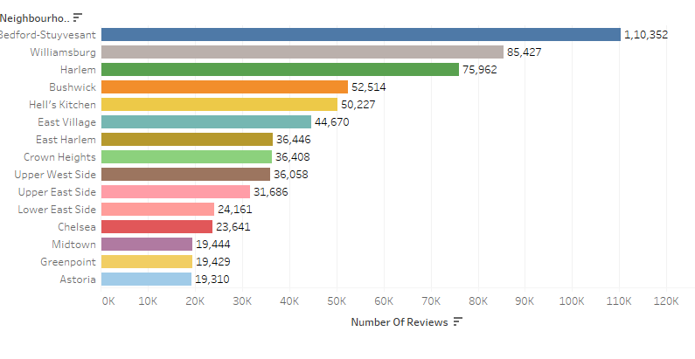
Popular Neighborhoods BY NUMBER OF REVIEWS
We see that Bedford-Stuyvesant is the highest popular with 1,10,352 no of reviews in total followed by Williamsburg.
Harlem got the highest no of reviews followed by Hell’s kitchen.
The higher number of customer reviews imply higher satisfaction in these localities.

Slide 16
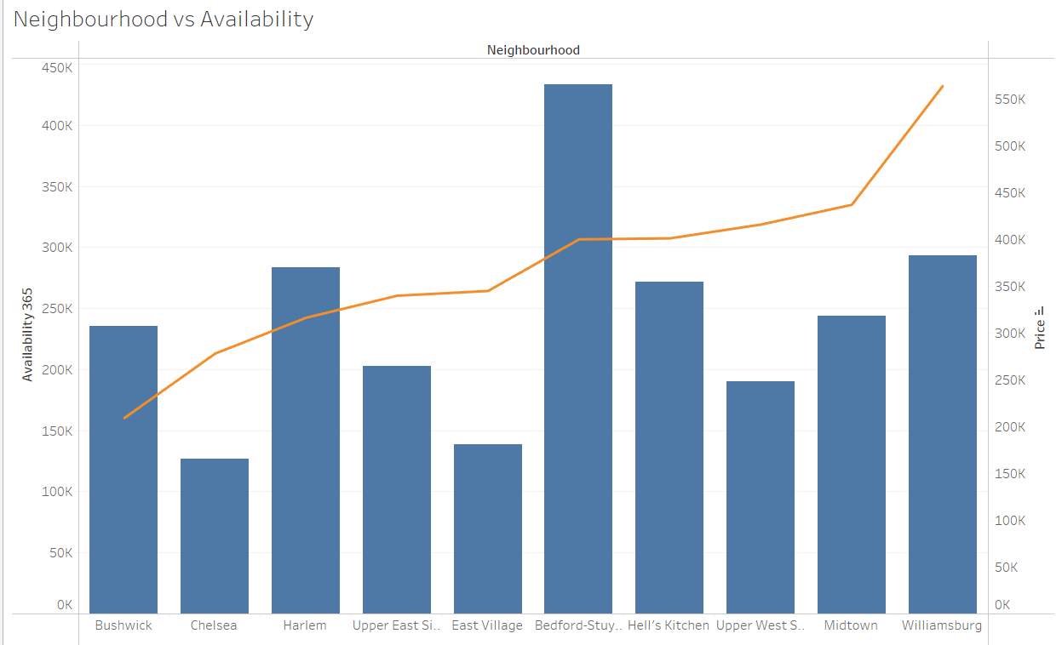
Neighbourhood WITH Availability
Plot a dual axis with line on price along with availability on other side
Chelsea’s availability is down but it is expensive.
William’s price is high and has average availability.

Slide 17
Observations Correlation and Coefficients:
Price vs. Availability: There might be a negative correlation between price and availability_365. High prices could be causing low bookings, reflected by high availability.
Price vs. Number of Reviews: You may observe a negative or weak positive correlation. Higher-priced listings might receive fewer reviews, as fewer bookings occur, while reasonably priced listings tend to attract more reviews.
Minimum Nights vs. Availability: A positive correlation might exist if listings with high minimum_nights requirements are underbooked, leading to higher availability.
Reviews per Month vs. Number of Reviews: These two metrics are typically positively correlated because properties with more total reviews are likely to receive more frequent new reviews.

Slide 18
1. Pricing Outliers and Variability:
The price data exhibits significant outliers. Prices for some listings are extremely high (ranging up to $3000), compared to the majority of listings which are under $500. The presence of high outliers skews the overall distribution of prices.
Recommendation: Further investigation into these high-price listings is needed to understand whether they represent luxury properties or if the prices are misaligned with market trends. It may also be worthwhile to filter out these outliers when calculating average prices or making decisions on pricing strategies.
2. Minimum Nights Requirement:
The minimum nights for bookings shows a wide range, with some listings requiring over 90 or even 365 nights. This is highly unusual for short-term rentals, where a typical stay might range from a few days to a couple of weeks.
Recommendation: Listings with excessively high minimum night requirements should be reviewed to ensure they align with the intended business model. If these are long-term rental offerings, it may be worth categorizing them separately to avoid confusing potential customers who are looking for short-term stays.
3. Host Listings and Availability:
There are hosts with multiple listings, and certain properties have 100% availability (365 days a year). High availability might indicate that these listings are either new, overpriced, or have low demand.
Recommendation: An analysis of the performance of these high-availability listings could help in optimizing pricing strategies or improving the marketing of these properties to reduce vacancy rates.
4. Neighborhood and Room Type Trends:
The data spans multiple neighborhoods and room types (private room, entire home/apartment, etc.). Certain neighborhoods (e.g., Manhattan, Brooklyn) are likely to command higher prices, but further exploration of which areas have higher occupancy and demand would be useful for targeted investment or marketing.
Recommendation: Understanding neighborhood-specific trends could help Airbnb hosts or the platform itself in tailoring marketing efforts. Price adjustments could be recommended based on demand for particular neighborhoods or room type

Slide 19
THANK YOU

