Slide 1
Analysis of DKASC, Alice Springs SunPower, 5.8 kW, mono-Si , Fixed, 2009, 215W (Australia)
Manufacturer | SunPower
Array Rating | 5.805kW
PV Technology | mono-Si
Array Structure | Fixed: Ground Mount
Installed | 2009
Array Rating | 5.805kW
Panel Rating | 215W
Number Of Panels | 27
Panel Type | SunPower SPR-215-WHT-I
Array Area | 33.6 m²
Type Of Tracker | N/A
Inverter Size / Type | 6 kW, SMA SMC 6000A
Installation Completed | Thu, 26 Nov 2009
Array Tilt/Azimuth | Tilt = 20, Azi = 0 (Solar North)

Slide 2
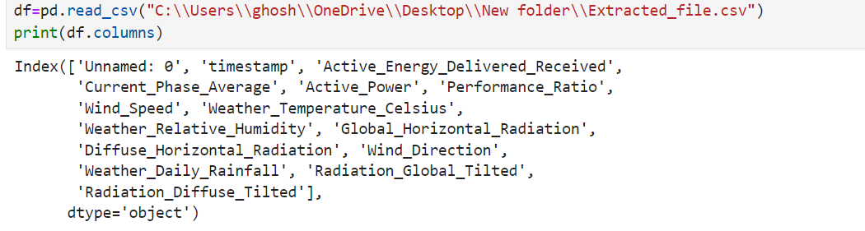
The given solar system has been taken into account and data from May,2013 to December 2014 is analysed. Data is extracted from the website of DKA Solar Centre.

Slide 3
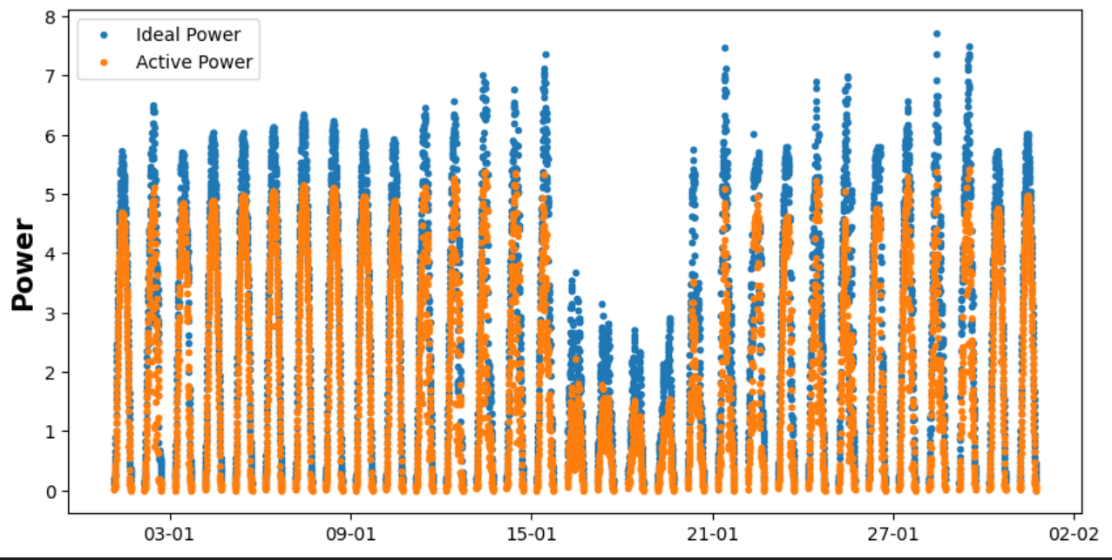
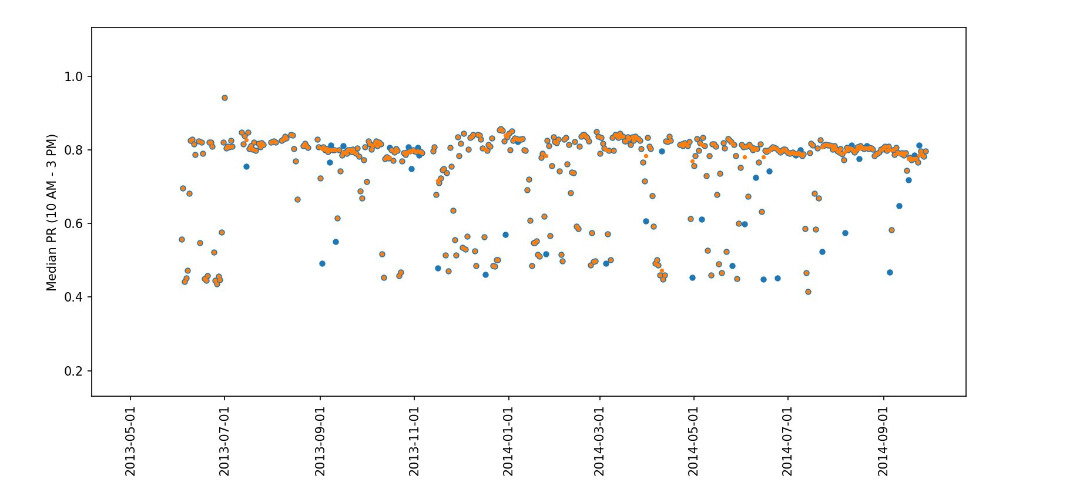
Without the implementation of Erbs model:

Slide 4

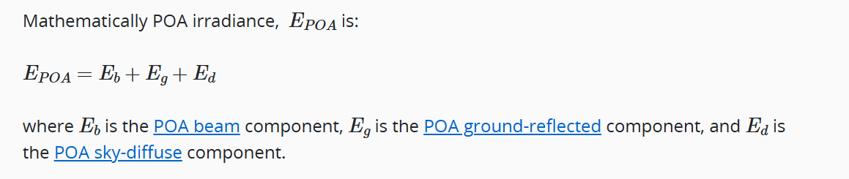
Implementation of Erbs model:
GHI- > Global Horizontal Irradiance DHI->Diffused Horizontal Irradiance
DNI->Direct Normal Irradiance
The Erbs Model uses ‘GHI’ and ‘DHI’ to get the ‘POA beam’ and ‘POA diffused’
Adding both of them, we get the total plane of array irradiance.
The ‘TimezoneFinder’ package is used to find the time zone wrt to universal timezone and it to the index column. We get the solar position and hence the zenith of the place.

Slide 5
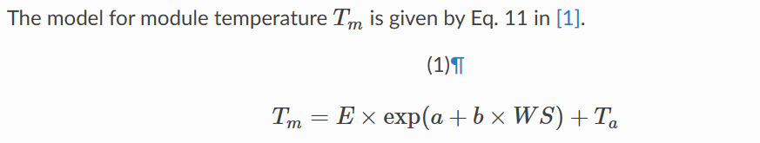
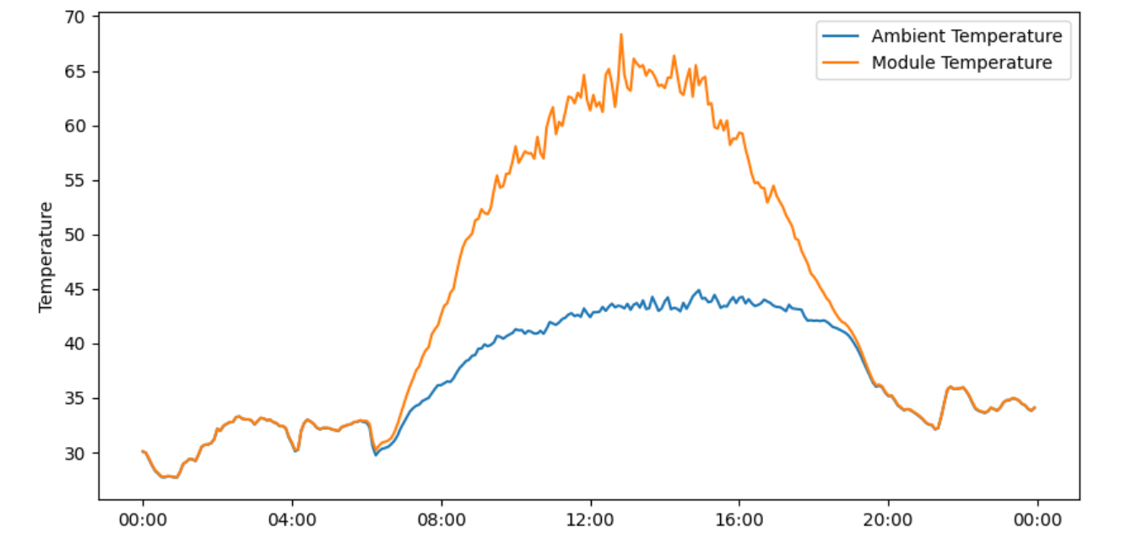
King’s model:
Purpose: to find out the module temperature
E-> POA irradiance WS-> Wind Speed
Ta->Air Temperature in Celsius
a,b-> constants
For open rack , glass-polymer module a=-3.56 b=-0.075
Ambient Temperature and Module Temperature:

Slide 6
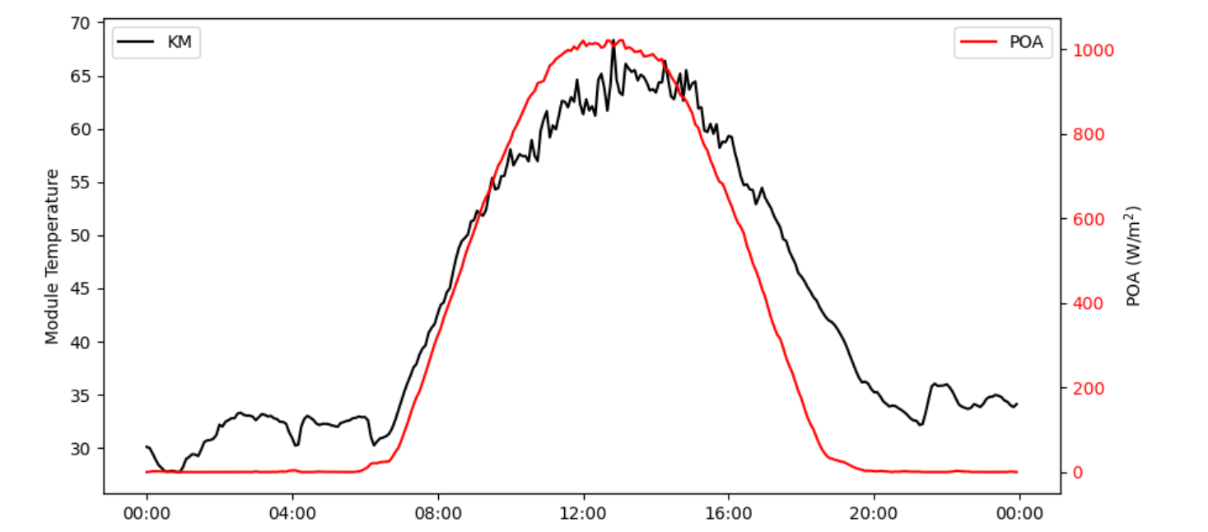
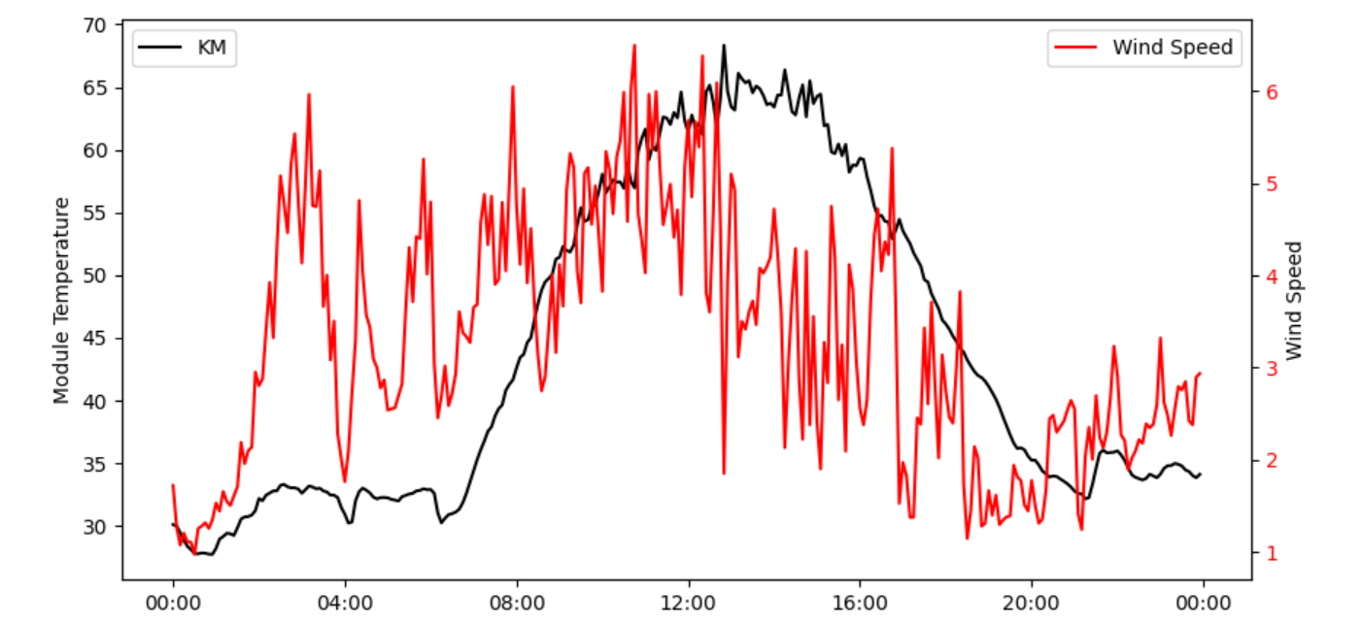
Module Temperature and POA irradiance:
Module Temperature and Wind Speed:

Slide 7
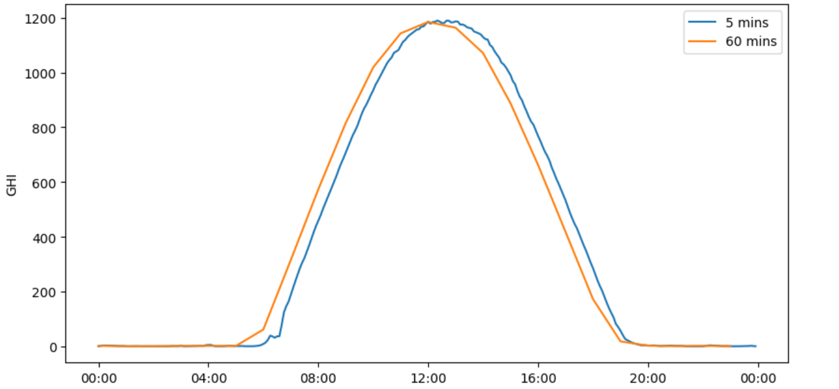
Drawbacks of King’s model:
The King’s model does not take into account the thermal inertia of a body as it varies with POA irradiance. Hence, Prilliman’s model is used to overcome this drawback. However, we have used King’s model in our analysis.
Need for high resolution :

Slide 8
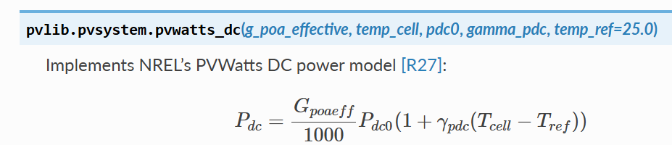
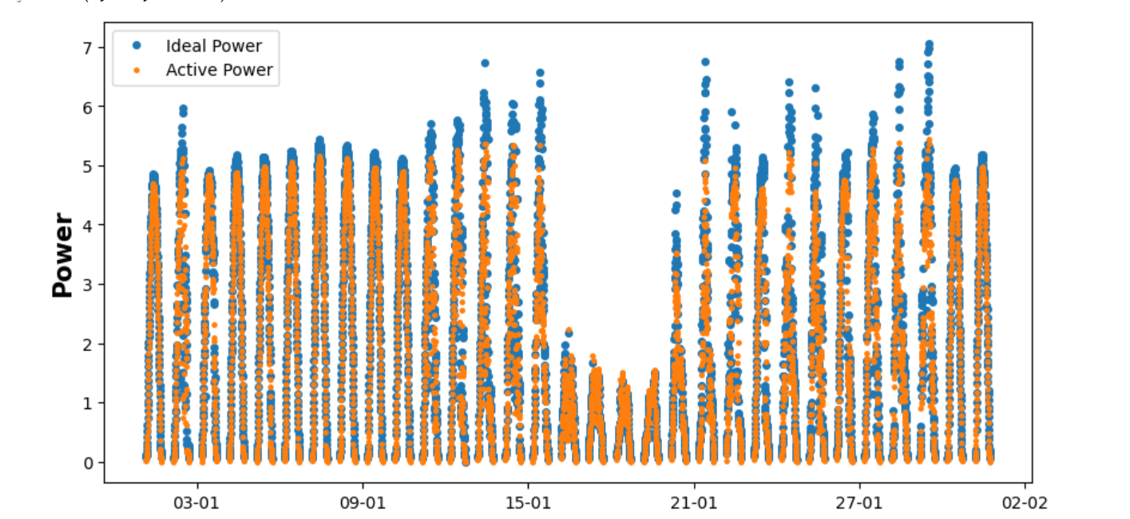
Calculation of Maximum Power:
Pdc=Gpoaeff*Pdc0(1+γpdc(Tcell−Tref))/1000
Pdc0=215 W rated total=5.805kW
Tcell=temperature from King's model
Tref=25
Maximum Power and Active Power:

Slide 9
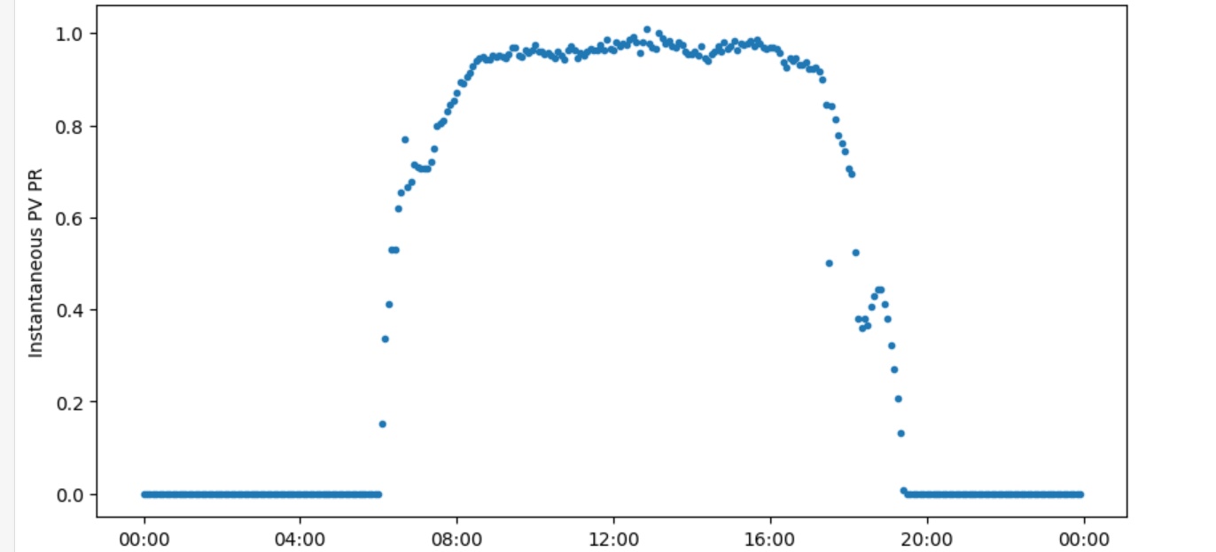
Calculation of Performance Ratio:
Performance Ratio=Active Power/Ideal Power
Instantaneous PVPR
We choose the window of 10 AM to 3 PM for soiling analysis as it provides us with considerably high values

Slide 10
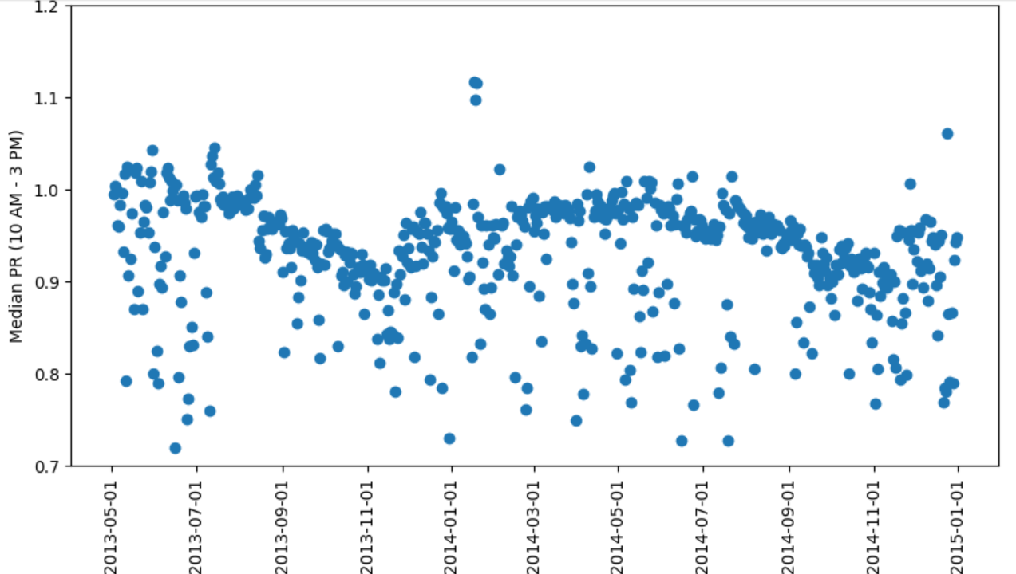
Plotting PR for the whole duration

Slide 11
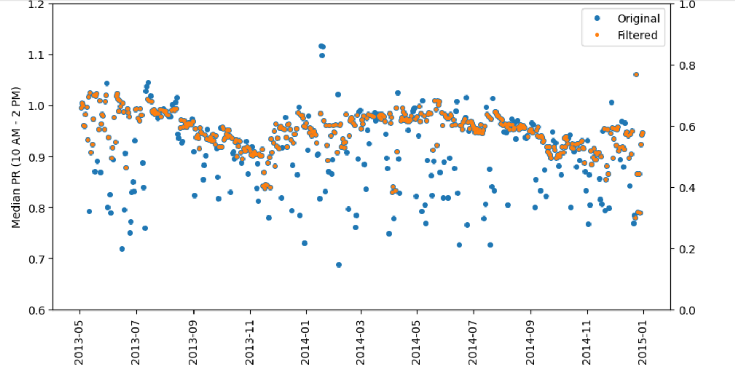
Applying Modified Hampel Filter:
The “1-sigma” designation signifies that the points that deviate from the median of each window by more than one mean absolute deviation are considered outliers.
A scaling factor of 1.4826 is used in the Hampel filter to make it robust against Gaussian distributed residuals.
Instead of using window median to replace the outliers, they are replaced by forward filling the points with the last valid point.

Slide 12
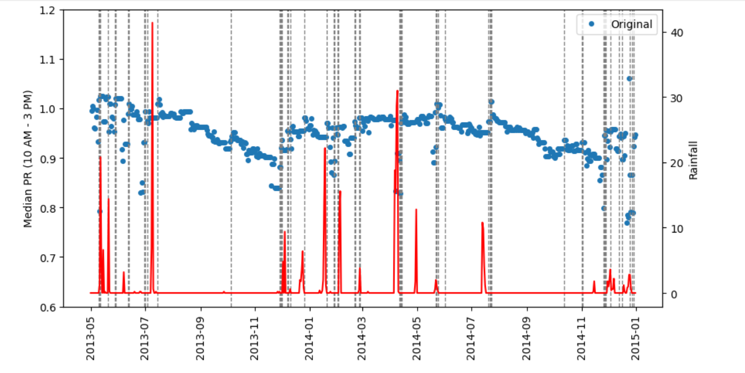
Cleaning Event Detection:
Q3 + α × (Q3 − Q1) is the optimal threshold to detect cleaning events . α is a scaling parameter prone to the dataset’s noise level. In this case, a rolling window of length 6 and α=6 is used for detection of cleaning events.

Slide 13
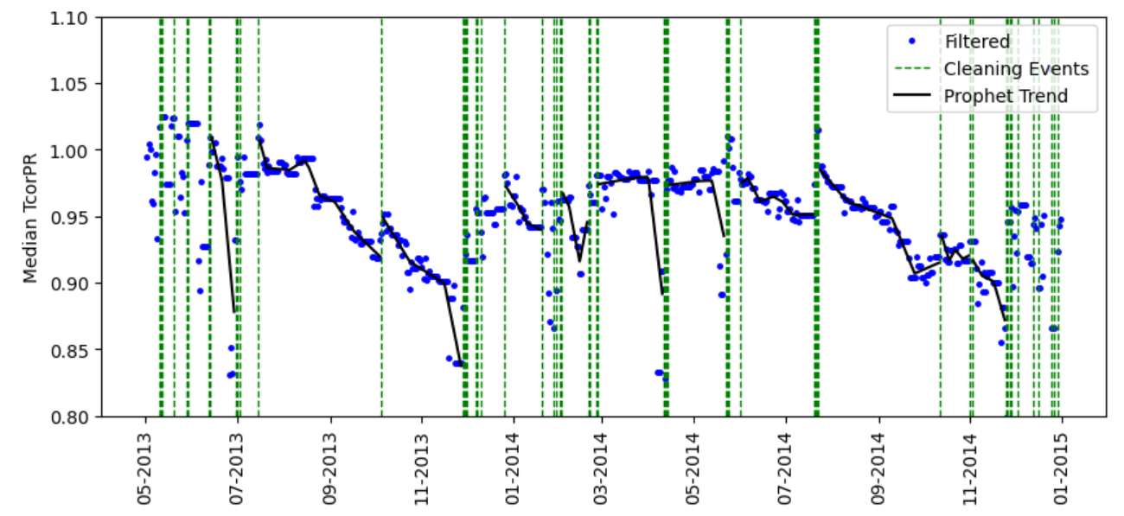
Using Prophet for analysis:
Prophet is used to determine the trends between the cleaning events. Trends are only plotted where valid points exceed 15 so as to avoid detections during noisy data or false detections.

Slide 14
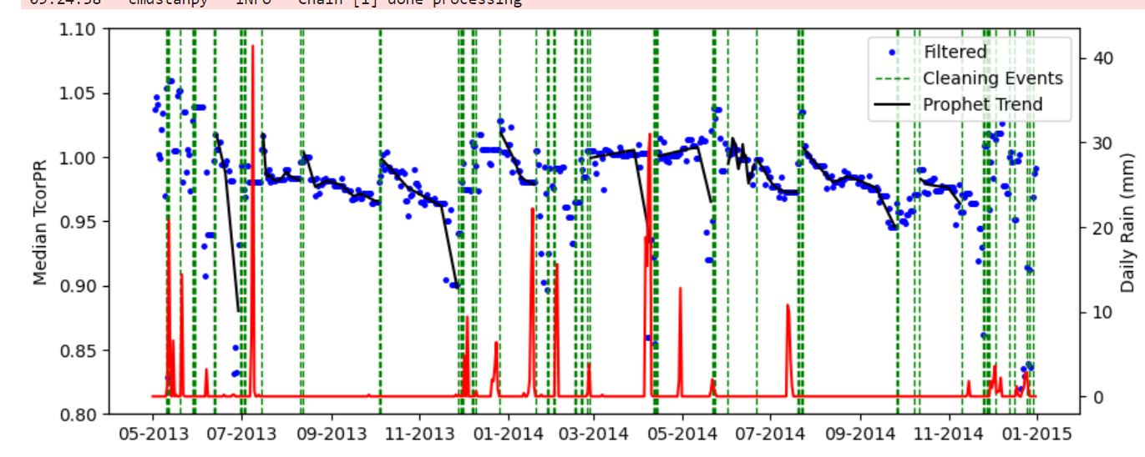
Analysis:
Cleaning is mostly the work of the precipitation in form of rain. Though there is substantial noise, cleaning event is detected almost after every rainfall.
A cleaning event is detected during October of both 2013 and 2014 though there is no record of rain. Such a case is either a false detection or it is more likely to be attributed to wind acting as the medium for cleaning ( due to low humidity)
A seasonal variation has been detected which has to be removed.

Slide 15
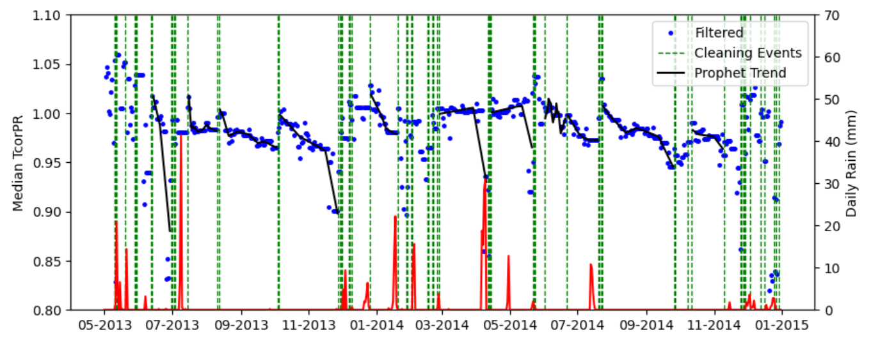
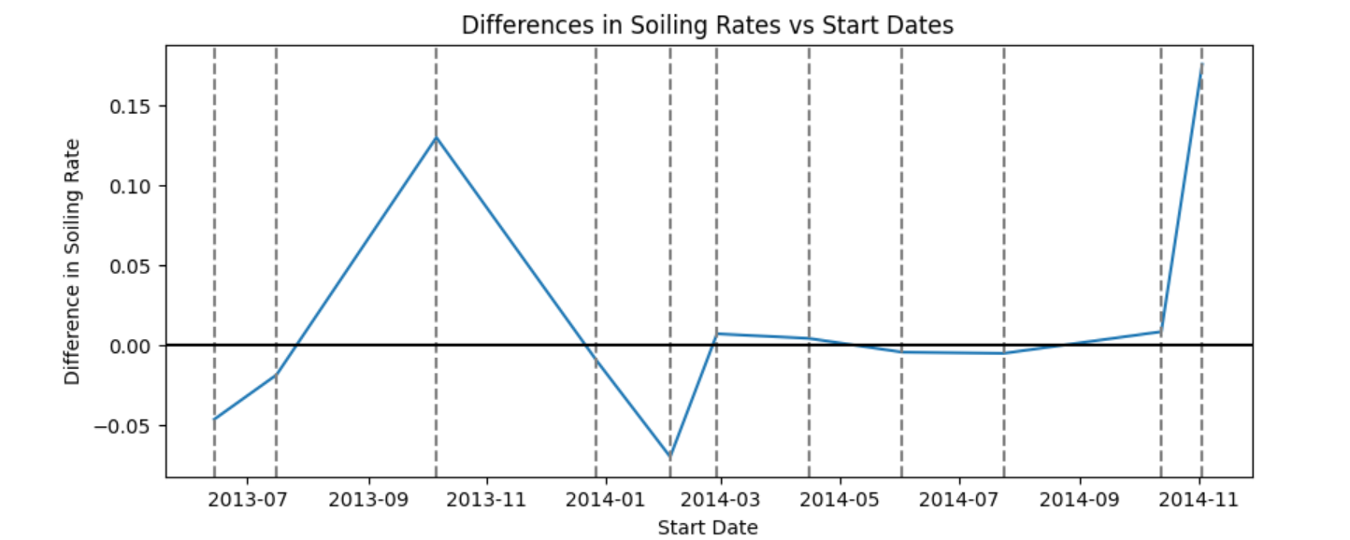
Removal of Seasonal Variation:
Using Fast Fourier Theorem, time series data is converted to frequency, the peaks are removed and with applying inverse Fourier transform, it is again converted back into time series data.

Slide 16
THANK YOU

