Slide 1
Entity Relationship Diagram
“Organize the database structure Before storing the data ”

Slide 2
What is an ER diagram?
An Entity Relationship (ER) Diagram is a type of flowchart that illustrates how “entities” such as people, objects or concepts relate to each other within a system. ER Diagrams are most often used to design or debug relational databases in the fields of software engineering, business information systems, education and research. Also known as ERDs or ER Models, they use a defined set of symbols such as rectangles, diamonds, ovals and connecting lines to depict the interconnectedness of entities, relationships and their attributes. They mirror grammatical structure, with entities as nouns and relationships as verbs.

Slide 3
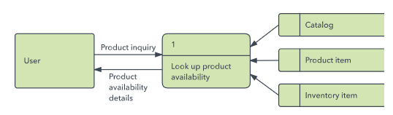
ERD Vs DFD
ER diagrams also are often used in conjunction with data flow diagrams (DFDs), which map out the flow of information for processes or systems. A data flow diagram shows how data is processed within a system based on inputs and outputs. Visual symbols are used to represent the flow of information, data sources and destinations, and where data is stored.

Slide 4
Logical Vs Physical (Data model)
Logical data model is created at the requirements gathering, system analysis and top level design. It is a communication and specification tool for business analysts and business. Physical data model is created when you translate top level design into physical tables in the database. This model is slightly different due to the fact that you have to worry about many details. This model is created by database/software architects, software developers or database administrators.

Slide 5
Uses of entity relationship diagrams
Database design: ER diagrams are used to model and design relational databases, in terms of logic and business rules (in a logical data model) and in terms of the specific technology to be implemented (in a physical data model.) Database troubleshooting: ER diagrams are used to analyze existing databases to find and resolve problems in logic or deployment. Drawing the diagram should reveal where it’s going wrong. Business information systems: The diagrams are used to design or analyze relational databases used in business processes. Any business process that uses fielded data involving entities, actions and interplay can potentially benefit from a relational database. It can streamline processes, uncover information more easily and improve results. Business process re-engineering (BPR): ER diagrams help in analyzing databases used in business process re-engineering and in modeling a new database setup.

Slide 6
The components and features of an ER diagram
ER Diagrams are composed of entities, relationships and attributes. They also depict cardinality, which defines relationships in terms of numbers.

Slide 7
ERDs depict database’s main components:
Entities Attributes Relationships

Slide 8
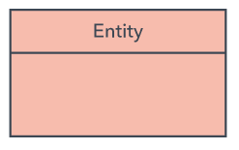

Entity
- Refers to entity set and not to single entity occurrence. - Corresponds to table and not to row in relational environment. - In both Chen and Crow’s Foot models, entity is - represented by rectangle containing entity’s name. - Entity name, a noun, is usually written in capital letters
Chen notations
Crows Foot Model

Slide 9
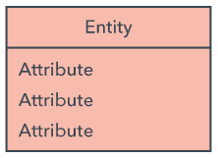

Attributes
- Characteristics of entities - In Chen model, attributes are represented by ovals and are connected to entity rectangle with a line - Each oval contains the name of attribute it represents - In Crow’s Foot model, attributes are written in attribute box below entity rectangle
Chen notations
Crows Foot Model

Slide 10
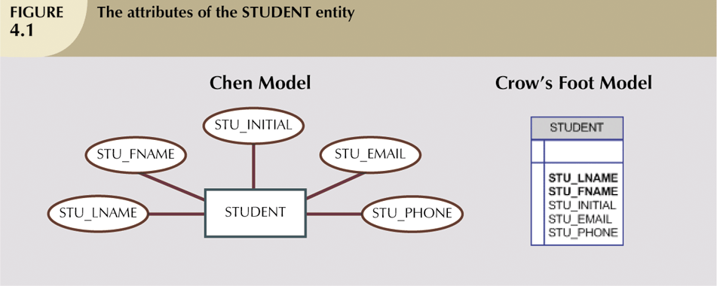
Attributes

Slide 11

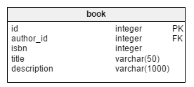
Identifiers (Primary Keys)
Underlined in the ERD Key attributes are also underlined in frequently used table structure shorthand
Chen notations
Crow foots notation

Slide 12
Composite Primary Keys
Primary keys ideally composed of only single attribute Possible to use a composite key Primary key composed of more than one attribute

Slide 13
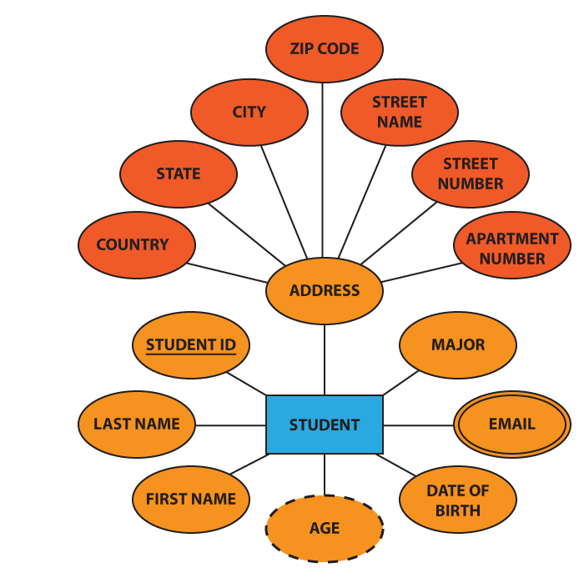
Composite Attributes
Some attributes can be further subdivided into smaller parts. For example, the attribute “address” can be subdivided into street name, street number, apartment number, city, state, zip code, and country. These are called composite attributes and are depicted as follows:

Slide 14
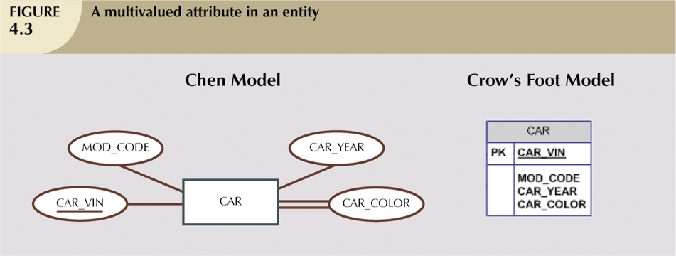

Multivalued Attributes

Slide 15
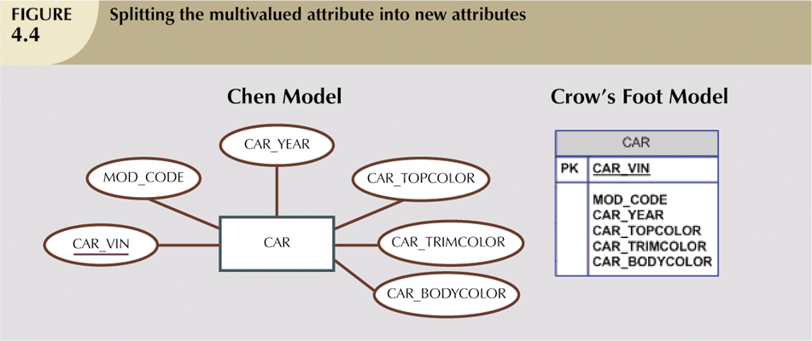
Multivalued Attributes

Slide 16
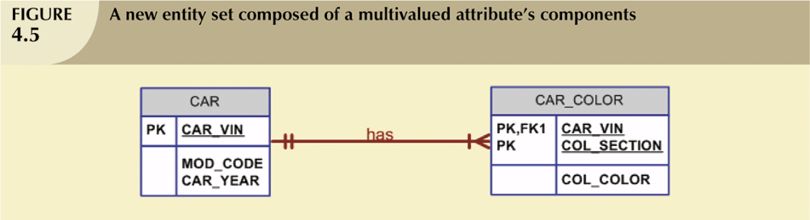
Resolving Multivalued Attribute Problems

Slide 17
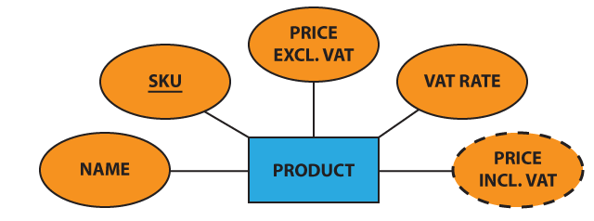

Derived Attributes Attribute whose value may be calculated (derived) from other attributes “Need not be physically stored within database Can be derived by using an algorithm”

Slide 18
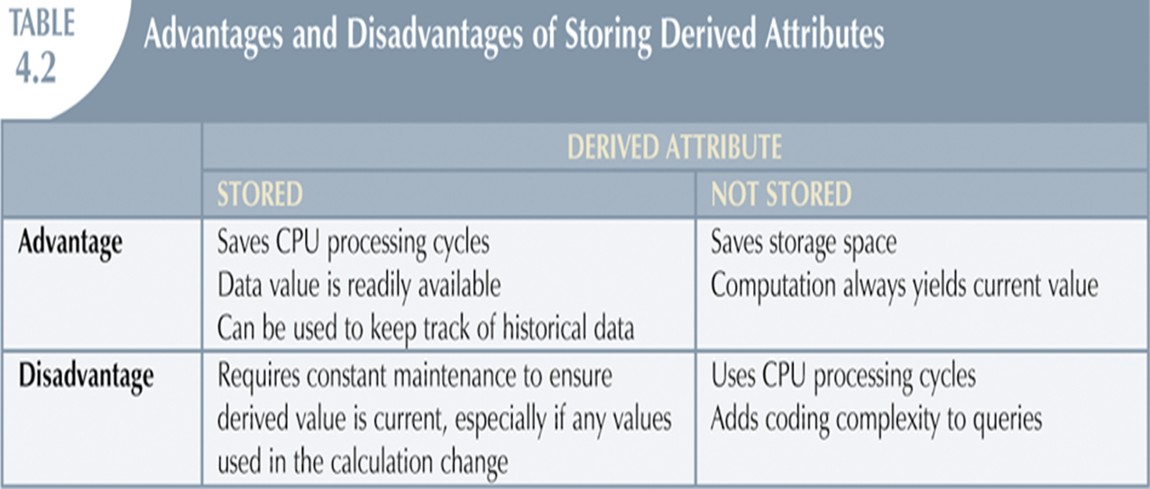
Derived Attributes

Slide 19
Keys Super Key An attribute or a combination of attribute that is used to identify the records uniquely is known as Super Key. A table can have many Super Keys. E.g. of Super Key 1 ID 2 ID, Name 3 ID, Address 4 ID, Department_ID 5 ID, Salary 6 Name, Address 7 Name, Address, Department_ID ………… So on as any combination which can identify the records uniquely will be a Super Key.

Slide 20
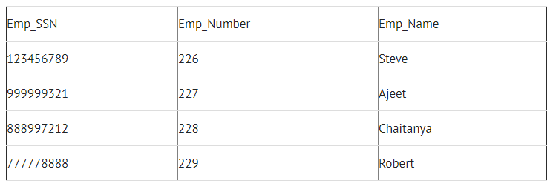
Keys Super Key
{Emp_SSN}
{Emp_Number}
{Emp_SSN, Emp_Number}
{Emp_SSN, Emp_Name}
{Emp_SSN, Emp_Number, Emp_Name}
{Emp_Number, Emp_Name}

Slide 21
Keys Candidate Key It can be defined as minimal Super Key or irreducible Super Key. In other words an attribute or a combination of attribute that identifies the record uniquely but none of its proper subsets can identify the records uniquely OR A super key with no redundant attribute is known as candidate key. Candidate keys are selected from the set of super keys, the only thing we take care while selecting candidate key is: It should not have any redundant attributes. That’s the reason they are also termed as minimal super key.

Slide 22
Keys E.g. of Candidate Key 1 Code 2 Name, Address For above table we have only two Candidate Keys (i.e. Irreducible Super Key) use to identify the records from the table uniquely. Code Key can identify the record uniquely and similarly combination of Name and Address can identify the record uniquely, but neither Name nor Address can be used to identify the records uniquely as it might be possible that we have two employees with similar name or two employees from the same house.

Slide 23
Keys Candidate Key
{Emp_SSN}
{Emp_Number}

Slide 24
Keys Primary Key A Candidate Key that is used by the database designer for unique identification of each row in a table is known as Primary Key. A Primary Key can consist of one or more attributes of a table. E.g. of Primary Key Database designer can use one of the Candidate Key as a Primary Key. In this case we have “Code” and “Name, Address” as Candidate Key, we will consider “Code” Key as a Primary Key as the other key is the combination of more than one attribute.

Slide 25
Keys Primary Key
{Emp_SSN} or {Emp_Number}

Slide 26
Keys Composite Key If we use multiple attributes to create a Primary Key then that Primary Key is called Composite Key (also called a Compound Key or Concatenated Key). E.g. of Composite Key, if we have used “Name, Address” as a Primary Key then it will be our Composite Key. Alternate Key – Alternate Key can be any of the Candidate Keys except for the Primary Key. E.g. of Alternate Key is “Name, Address” as it is the only other Candidate Key which is not a Primary Key. Secondary Key – The attributes that are not even the Super Key but can be still used for identification of records (not unique) are known as Secondary Key. E.g. of Secondary Key can be Name, Address, Salary, Department_ID etc. as they can identify the records but they might not be unique.

Slide 27
Relationships Association between entities Participants are entities that participate in a relationship Relationships between entities always operate in both directions Relationship can be classified as 1:M Relationship classification is difficult to establish if know only one side of the relationship.

Slide 28
Connectivity and Cardinality Connectivity Used to describe the relationship classification Cardinality Expresses minimum and maximum number of entity occurrences associated with one occurrence of related entity Established by very concise statements known as business rules

Slide 29
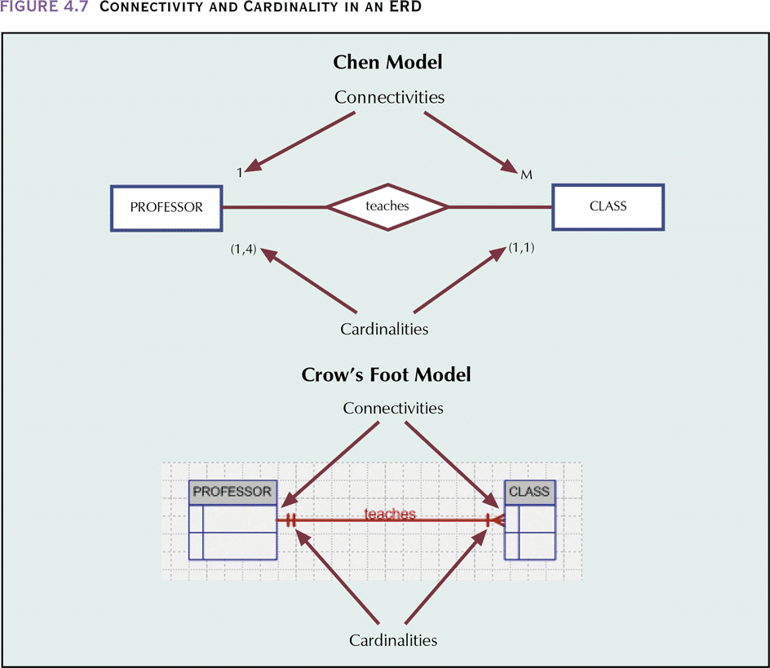
Connectivity and Cardinality

Slide 30
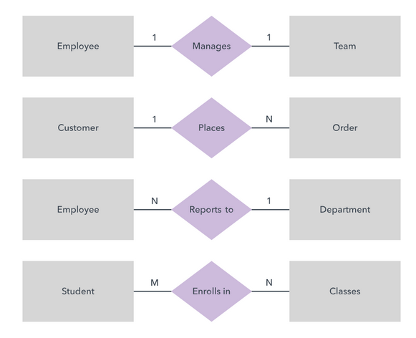
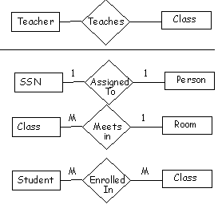
Connectivity and Cardinality Example

Slide 31

Relationship Strength(Classification) Identifying Relationships Exists when PK of related entity contains PK component of parent entity. Identifying relationships exist when the primary key of the parent entity is included in the primary key of the child entity. non-identifying relationships Exists if PK of related entity does not contain PK component of parent entity. Non-identifying relationship exists when the primary key of the parent entity is included in the child entity but not as part of the child entity’s primary key

Slide 32
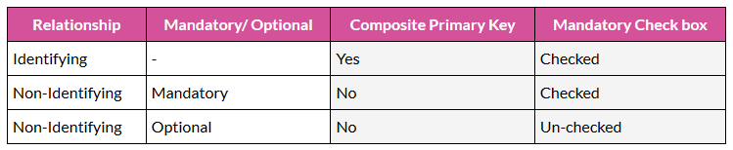
Relationship Strength(Classification)

Slide 33
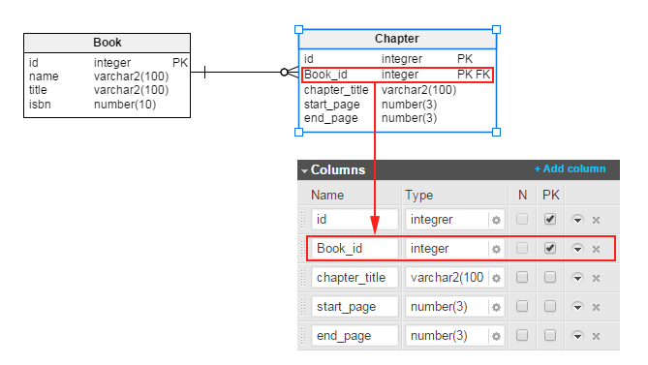
Relationship Strength(Classification) Strong (Identifying) Relationships

Slide 34
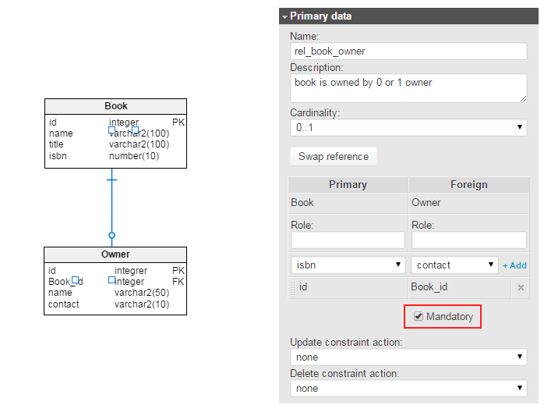
Relationship Strength(Classification) Weak (non-identifying ‘Mandatory’) relationships A “mandatory” non-identifying relationship exists when the value in the child table cannot be null.

Slide 35
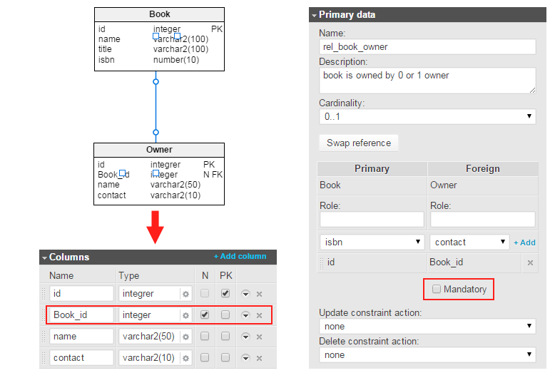
Relationship Strength(Classification) Weak (non-identifying ‘Optional’) relationships An “optional” non-identifying relationship exists when the value in the child table can be null

Slide 36
Weak Entities Weak entity meets two conditions -Existence-dependent Cannot exist without entity with which it has a relationship. -Has primary key that is partially or totally derived from parent entity in relationship.

Slide 37
Relationship Degree Indicates number of entities or participants associated with a relationship Unary relationship Association is maintained within single entity Binary relationship Two entities are associated Ternary relationship Three entities are associated

Slide 38
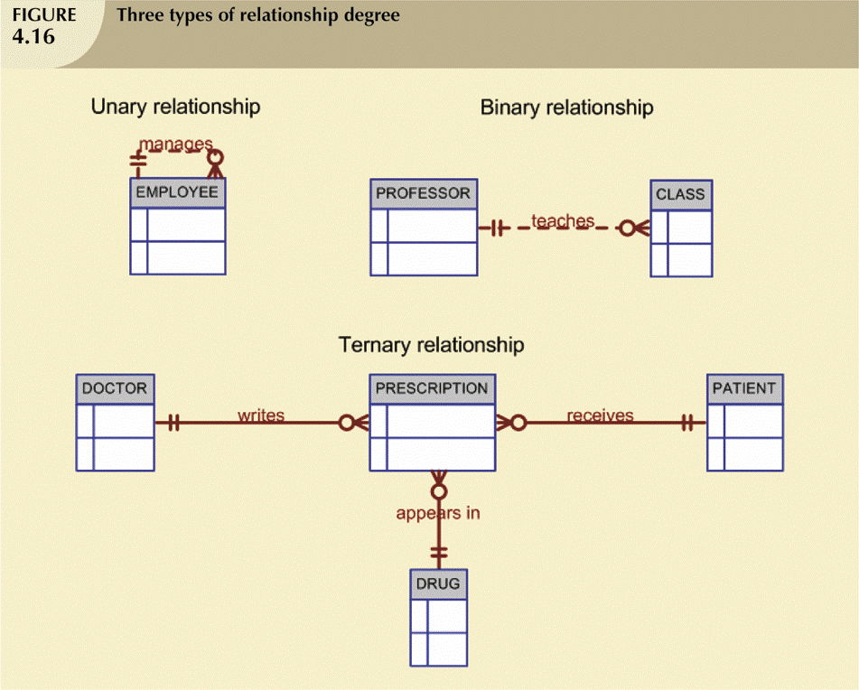
Relationship Degree

Slide 39
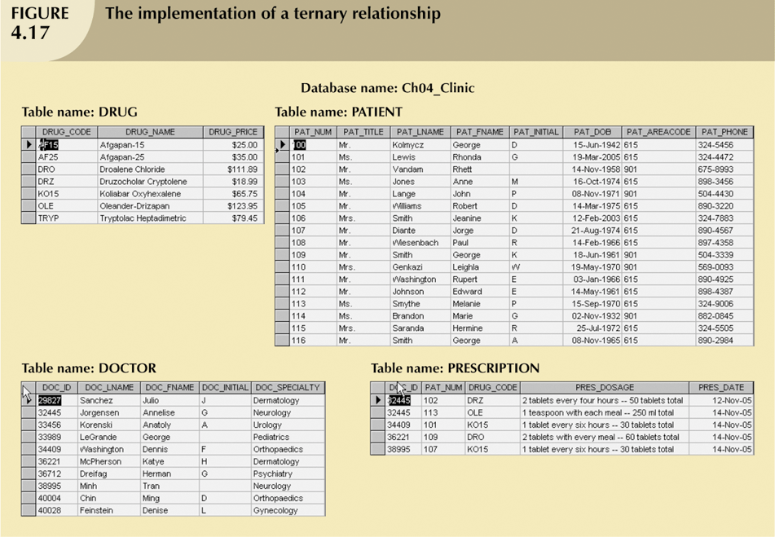
Relationship Degree

Slide 40
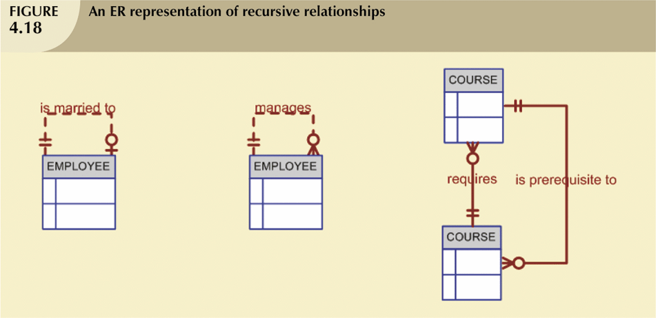
Recursive Relationships
-Relationship can exist between occurrences of the same entity set.
-Naturally found within unary relationship

Slide 41
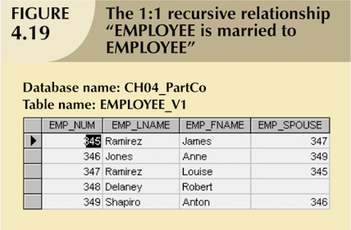
Recursive Relationships

Slide 42
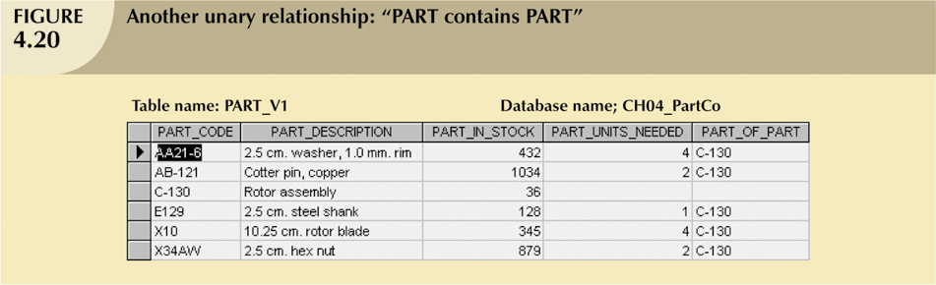
Recursive Relationships

Slide 43
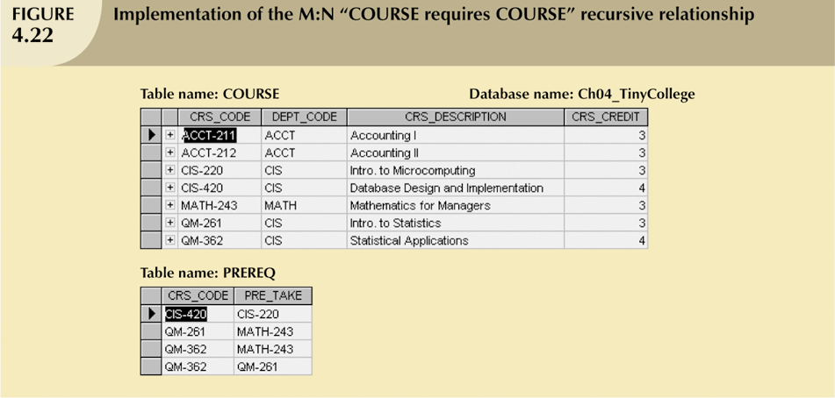
Recursive Relationships

Slide 44
Composite Entities Also known as bridge entities. Composed of primary keys of each of the entities to be connected May also contain additional attributes that play no role in connective process.

Slide 45
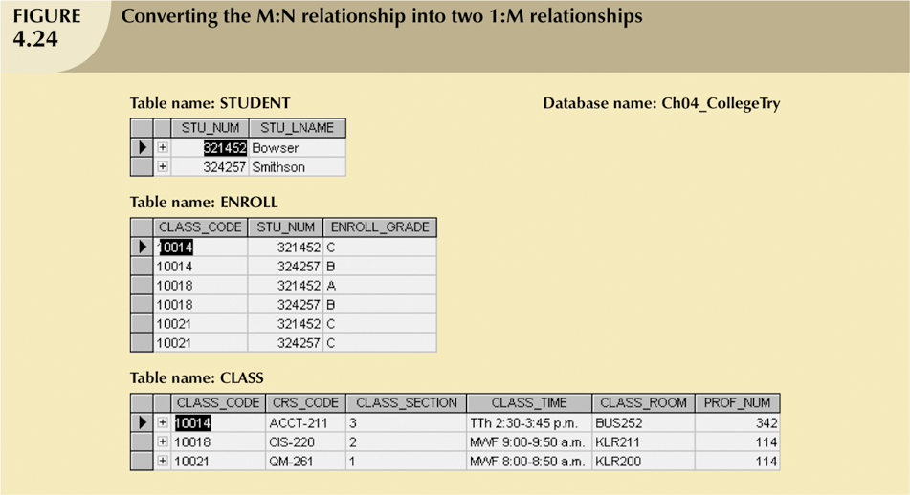
Composite Entities

Slide 46
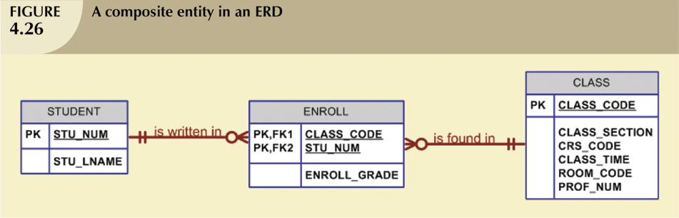
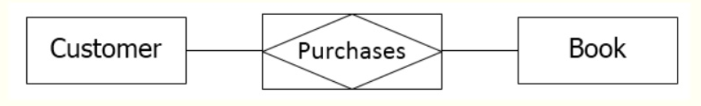
Composite Entities

