Slide 1
Normalization
1

Slide 2
Normalization
 The biggest problem needed to be solved in database is data redundancy.
 Why data redundancy is the problem? Because it causes:



Insert Anomaly Update Anomaly Delete Anomaly
Teacher |  | Subject | Teacher Degree | Tel
Sok | San | Database | Master's | 012666777
Van | Sokhen | Database | Bachelor's | 017678678
Sok | San | E-Commerce | Master's | 012666777
2

Slide 3
Normalization (Cont.)
 Normalization is the process of removing redundant data from your tables to improve storage efficiency, data integrity, and scalability.
 Normalization generally involves splitting existing tables into multiple ones, which must be re-joined or linked each time a query is issued.
 Why normalization?

The relation derived from the user view or data store will most likely be unnormalized.
The problem usually happens when an existing system uses unstructured file, e.g. in MS Excel.

3

Slide 4
Steps of Normalization
 First Normal Form (1NF)
 Second Normal Form (2NF)
 Third Normal Form (3NF)
 Boyce-Codd Normal Form (BCNF)
 Fourth Normal Form (4NF)
 Fifth Normal Form (5NF)
In practice, 1NF, 2NF, and 3NF are enough for database.
4

Slide 5
First Normal Form (1NF)
The official qualifications for 1NF are:
Each attribute name must be unique.
Each attribute value must be single.
Each row must be unique.
There is no repeating groups.
 Additional:

Choose a primary key.
 Reminder:
A primary key is unique, not null, unchanged. A primary key can be either an attribute or combined attributes.
5

Slide 6
First Normal Form (1NF) (Cont.)
 Example of a table not in 1NF :
Group | Topic | Student | Score
Group A Group B | Intro MongoDB Intro MySQL | Sok San | 18 | marks
 |  | Sao Ry | 17 | marks
 |  | Chan Tina | 19 | marks
 |  | Tith Sophea | 16 | marks
It violates the 1NF because:
 Attribute values are not single.
 Repeating groups exists.
6

Slide 7
First Normal Form (1NF) (Cont.)
 After eliminating:
Group | Topic | Family Name | Given Name | Score
A | Intro MongoDB | Sok | San | 18
A | Intro MongoDB | Sao | Ry | 17
B | Intro MySQL | Chan | Tina | 19
B | Intro MySQL | Tith | Sophea | 16
 Now it is in 1NF.
However, it might still violate 2NF and so on.
7

Slide 8
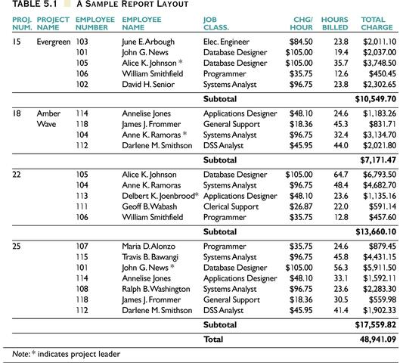
Example
8

Slide 9
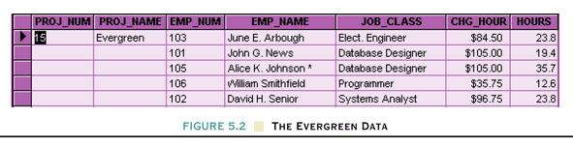
Example (Repeating groups)
9

Slide 10
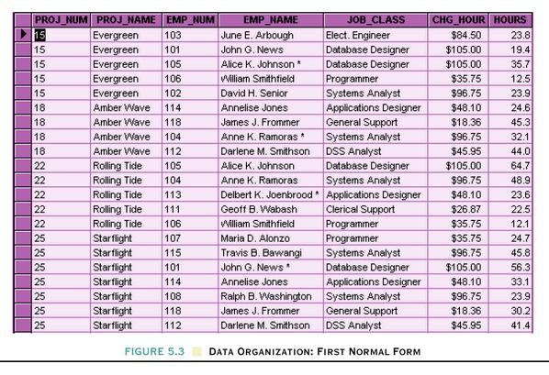
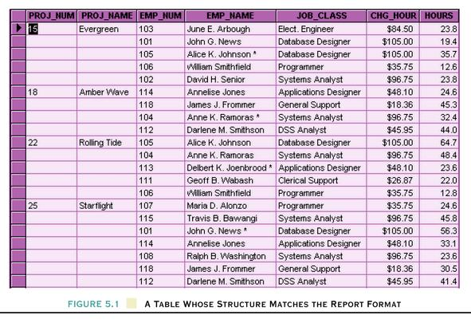
Example Data Organization: First Normal Form
After
Before
10

Slide 11
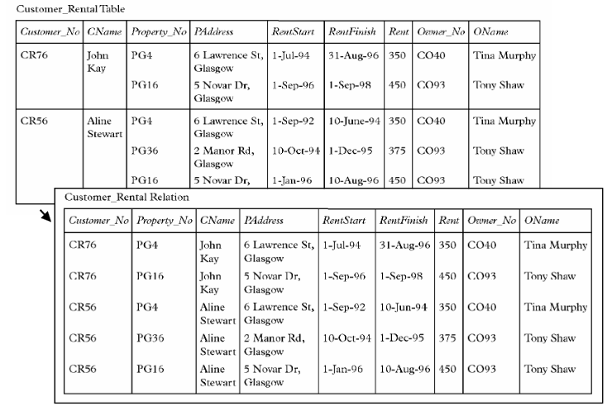
Example

Slide 12
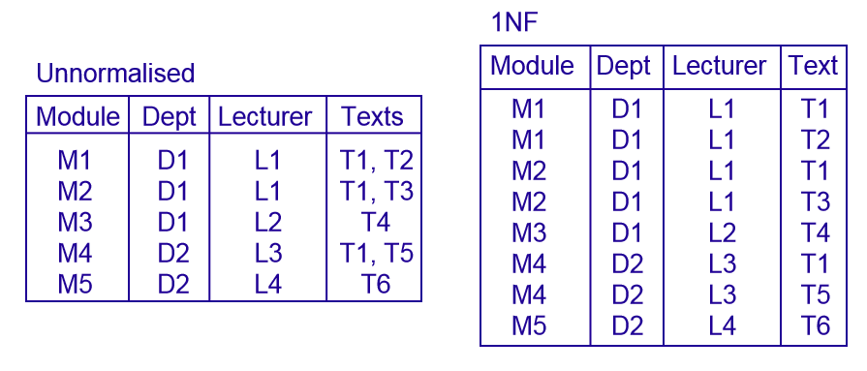
Example

Slide 13
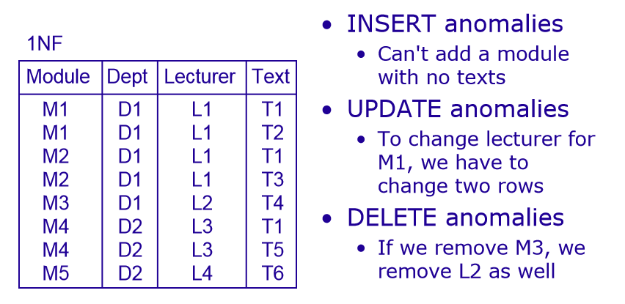
Problem in 1NF

Slide 14
Functional Dependencies
We say an attribute, B, has a functional dependency on another attribute, A, if for any two records, which have
the same value for A, then the values for B in these two records must be the same. We illustrate this as:
A -> B (read as: A determines B or B depends on A)
employee name | project | email address
Sok San | POS Mart Sys | soksan@yahoo.com
Sao Ry | Univ Mgt Sys | sao@yahoo.com
Sok San | Web Redesign | soksan@yahoo.com
Chan Sokna | POS Mart Sys | chan@gmail.com
Sao Ry | DB Design | sao@yahoo.com
employee name -> email address

Slide 15
Functional Dependencies (cont.)
EmpNum | EmpEmail | EmpFname | EmpLname
123 | jdoe@abc.com | John | Doe
456 | psmith@abc.com | Peter | Smith
555 | alee1@abc.com | Alan | Lee
633 | pdoe@abc.com | Peter | Doe
787 | alee2@abc.com | Alan | Lee
If EmpNum is the PK then the FDs:
EmpNum -> EmpEmail, EmpFname, EmpLname
must exist.
15

Slide 16
Functional Dependencies (cont.)
EmpNum -> EmpEmail, EmpFname, EmpLname
3 different ways you might see FDs depicted
EmpEmail EmpFname
EmpLname
EmpNum
EmpNum
EmpEmail
EmpFname
EmpLname

Slide 17
Determinant
Functional Dependency
EmpNum -> EmpEmail
Attribute on the left hand side is known as the
determinant
EmpNum is a determinant of EmpEmail

Slide 18
Second Normal Form (2NF)
The official qualifications for 2NF are:
A table is already in 1NF.
All nonkey attributes are fully dependent on the primary key.
All partial dependencies are removed to place in another table.

Slide 19
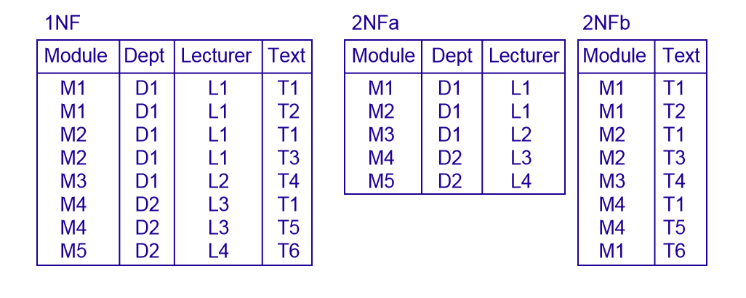
1NF to 2NF –Example

Slide 20
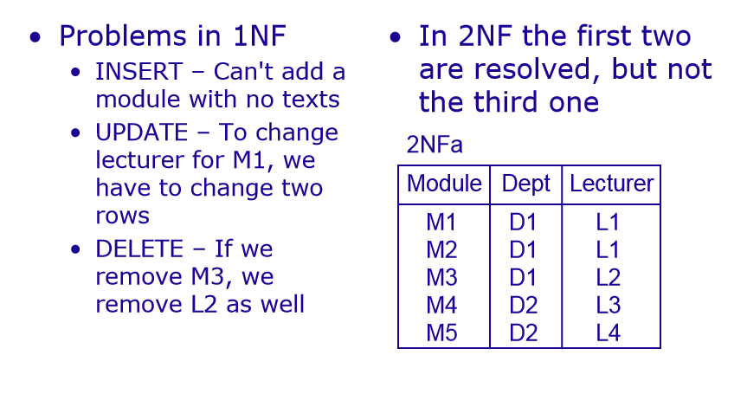
Problems Resolved in 2NF

Slide 21
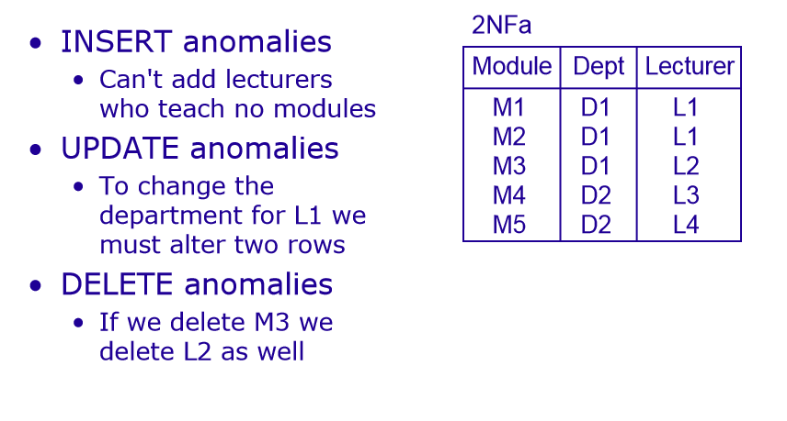
Problems Remaining in 2NF

Slide 22


Example of a table not in 2NF:
CourseID | SemesterID | Num Student | Course Name
IT101 | 201301 | 25 | Database
IT101 | 201302 | 25 | Database
IT102 | 201301 | 30 | Web Prog
IT102 | 201302 | 35 | Web Prog
IT103 | 201401 | 20 | Networking
Primary Key
The Course Name depends on only CourseID, a part of the primary key not the whole primary {CourseID, SemesterID}.It’s called partial dependency.
Solution:
Remove CourseID and Course Name together to create a new table.

Slide 23
CourseID
CourseID | Course Name
IT101 | Database
IT101 | Database
IT102 | Web Prog
IT102 | Web Prog
IT103 | Networking
SemesterID
Num Student
IT101
201301
25
IT101
201302
25
IT102
201301
30
IT102
201302
35
IT103
201401
20
Done? Oh no, it is still not in 1NF yet.
Remove the repeating groups too.
Finally, connect the relationship.
CourseID
Course Name
IT101
Database
IT102
Web Prog
IT103
Networking

Slide 24
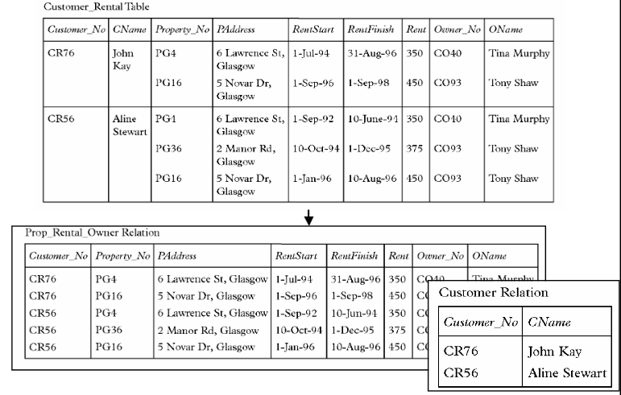
Example

Slide 25
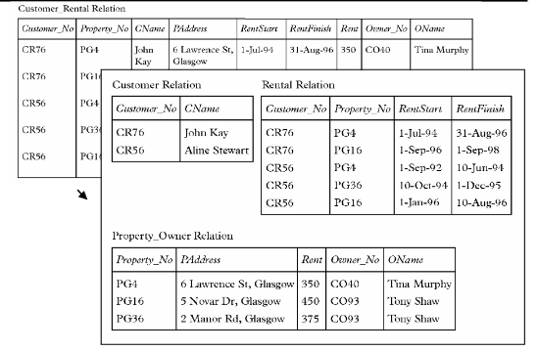
Example

Slide 26
Third Normal Form (3NF)
The official qualifications for 3NF are:
A table is already in 2NF.
Nonprimary key attributes do not depend on other nonprimary key attributes
(i.e. no transitive dependencies)
All transitive dependencies are removed to place in another table.

Slide 27
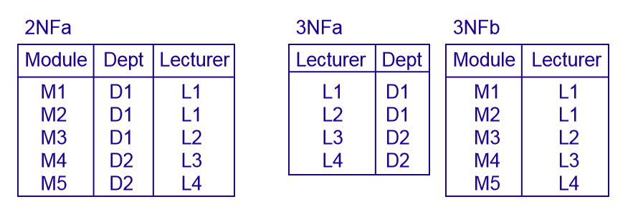
2NF to 3NF –Example

Slide 28
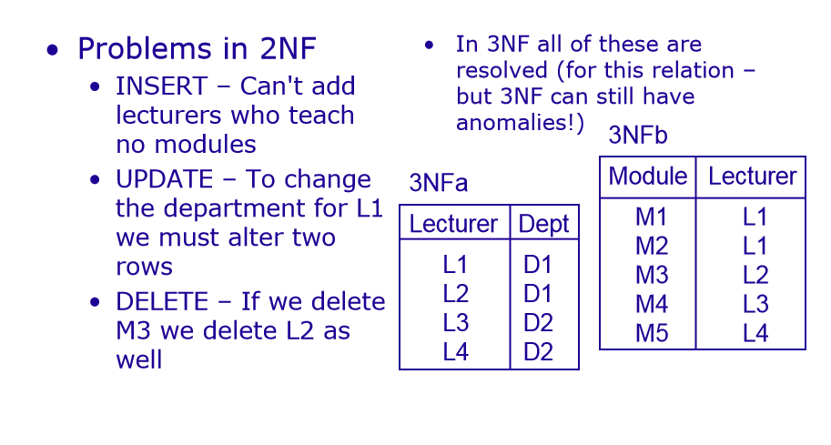
Problems Resolved in 3NF

Slide 29


Example of a Table not in 3NF:
StudyID | Course Name | Teacher Name | Teacher Tel
1 | Database | Sok Piseth | 012 123 456
2 | Database | Sao Kanha | 0977 322 111
3 | Web Prog | Chan Veasna | 012 412 333
4 | Web Prog | Chan Veasna | 012 412 333
5 | Networking | Pou Sambath | 077 545 221
Primary Key
The Teacher Tel is a nonkey attribute, and the Teacher Name is also a nonkey atttribute. But Teacher Tel depends on Teacher Name.
It is called transitive dependency.
Solution:
Remove Teacher Name and Teacher Tel together to create a new table.

Slide 30
Done?
Oh no, it is still not in 1NF yet. Remove Repeating row.
Teacher Name | Teacher Tel
Sok Piseth | 012 123 456
Sao Kanha | 0977 322 111
Chan Veasna | 012 412 333
Chan Veasna | 012 412 333
Pou Sambath | 077 545 221
StudyID Course Name T.ID
Database T1
Database T2
Web Prog T3
Web Prog T3
Networking T4
Teacher Name | Teacher Tel
Sok Piseth | 012 123 456
Sao Kanha | 0977 322 111
Chan Veasna | 012 412 333
Pou Sambath | 077 545 221
Note about primary key:
-In theory, you can choose
Teacher Name to be a primary key.
-But in practice, you should add Teacher ID as the primary key.
17
ID | Teacher Name | Teacher Tel
T1 | Sok Piseth | 012 123 456
T2 | Sao Kanha | 0977 322 111
T3 | Chan Veasna | 012 412 333
T4 | Pou Sambath | 077 545 221

Slide 31
Boyce Codd Normal Form (BCNF) – 3.5NF
The official qualifications for BCNF are:
A table is already in 3NF.
All determinants must be superkeys.
All determinants that are not superkeys are removed to place in another table.

Slide 32
Boyce Codd Normal Form (BCNF) (Cont.)
 Example of a table not in BCNF:
Student | Course | Teacher
Sok | DB | John
Sao | DB | William
Chan | E-Commerce | Todd
Sok | E-Commerce | Todd
Chan | DB | William
 Key: {Student, Course}
 Functional Dependency:
 {Student, Course}→ Teacher

Teacher → Course
 Problem: Teacher is not a superkey but determines Course.

Slide 33
Solution: Decouple a table contains Teacher and Course
from from original table (Student,
Course). Finally, connect the new and old table to third table contains Course.
Student
Course
Sok
DB
Sao
DB
Chan
E-Commerce
Sok
E-Commerce
Chan
DB
Course
DB
E-Commerce
Course
Teacher
DB
John
DB
William
E-Commerce
Todd

Slide 34
Forth Normal Form (4NF)
The official qualifications for 4NF are:
A table is already in BCNF.
A table contains no multi-valued dependencies.
 Multi-valued dependency: MVDs occur when two or more independent multi valued facts about the same attribute occur within the same table.
A -> -> B (B multi-valued depends on A)

Slide 35
Forth Normal Form (4NF) (Cont.)
 Example of a table not in 4NF:
Student | Major | Hobby
Sok | IT | Football
Sok | IT | Volleyball
Sao | IT | Football
Sao | Med | Football
Chan | IT | NULL
Puth | NULL | Football
Tith | NULL | NULL
 Key: {Student, Major, Hobby}
 MVD: Student -> -> Major, Hobby

Slide 36
Solution: Decouple to each table contains MVD. Finally,
connect each to a third table contains Student.
Student | Major
Sok | IT
Sao | IT
Sao | Med
Chan | IT
Puth | NULL
Tith | NULL
Student
Sok
Sao
Chan
Puth
Tith
 | Student | Hobby
 | Sok | Football
 | Sok | Volleyball
 | Sao | Football
 | Chan | NULL
 | Puth | Football
 | Tith | NULL

Slide 37
Fifth Normal Form (5NF)
The official qualifications for 5NF are:
A table is already in 4NF.
The attributes of multi-valued dependencies are related.

Slide 38
Fifth Normal Form (5NF) (Cont.)
 Example of a table not in 5NF:
Seller | Company | Product
Sok | MIAF Trading | Zenya
Sao | Coca-Cola Corp | Coke
Sao | Coca-Cola Corp | Fanta
Sao | Coca-Cola Corp | Sprite
Chan | Angkor Brewery | Angkor Beer
Chan | Cambodia Brewery | Cambodia Beer
 Key: {Seller, Company, Product}
 MVD: Seller -> -> Company, Product
 Product is related to Company.

Slide 39
Seller
Company
Company
Seller
1
^{M} Sok
MIAF Trading
1 MIAF Trading
Sok
Sao
Coca-Cola Corp
Coca-Cola Corp
Sao
Chan
Angkor Brewery
Angkor Brewery
Chan
Chan
Cambodia Brewery
Cambodia Brewery
1
1
M
M
Company
Product
Seller
Product
1
MIAF Trading
Zenya
Sok Zenya
M
Coca-Cola Corp
Coke
Sao Coke
Product
Coca-Cola Corp
Fanta
Sao Fanta
Zenya
Coca-Cola Corp
Sprite
Sao Sprite
Coke
Angkor Brewery
Angkor Beer
Chan
Angkor Beer
Fanta
Cambodia Brewery
Cambodia Beer
Chan
Cambodia Beer
Sprite
Angkor Beer
M
1
Cambodia Beer

