Slide 1
ARTIFICIAL INTELLIGENCE
The quest to forge gods

Slide 2
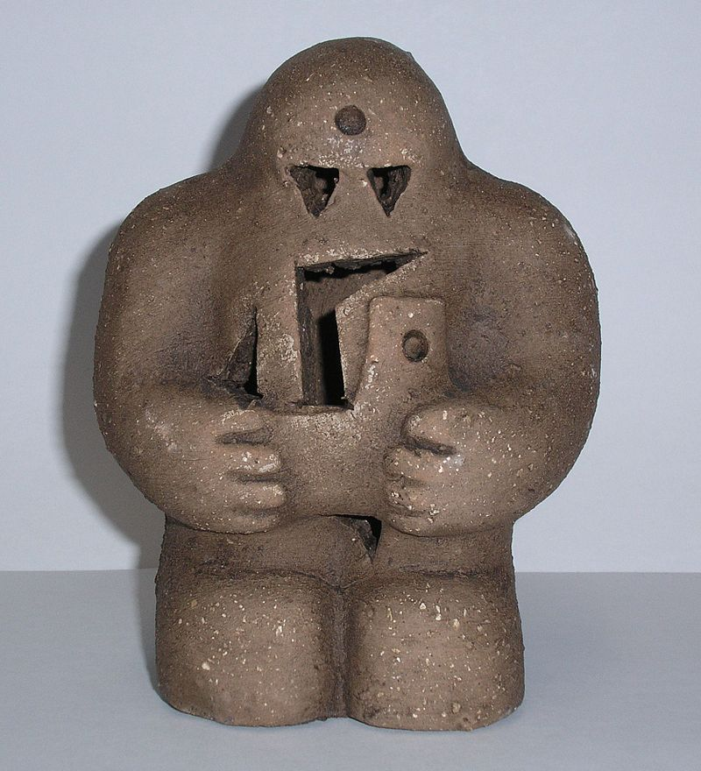
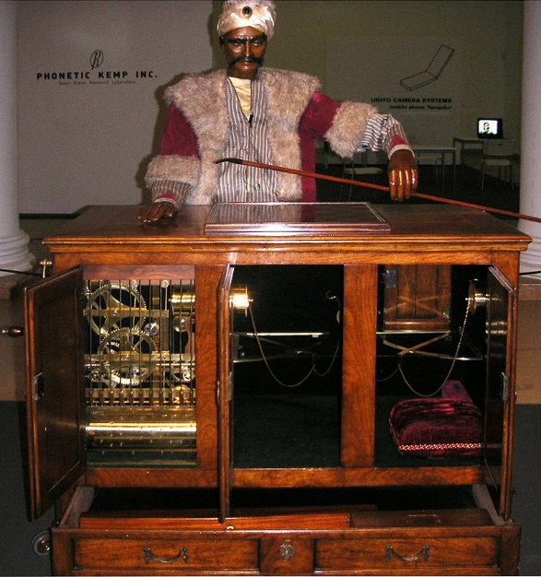
The secret origins of Artificial Intelligence
Long before electronic computers made Artificial Intelligence into a significant field of academic study; humans have dreamed about, experimented and conned each other with the idea of creating artificial life.
Ancient Greek myths of Hephaestus’ automatons were followed by The Golem of Judaism and the 18th Century fake-chess machine - the ‘Mechanical Turk’ (both pictured)
For almost as long philosophers, theologians and authors have been warning of the hubris of believing that humans could ever accomplish the goal of creating AI, and of the dangers of doing so. Stories such as Frankenstein, The Terminator and The Matrix are all examples of this genre.
For its entire history the idea of AI has been a compelling, utopian dream for some and a foolish, or nightmarish idea for others.

Slide 3
Computers: making the dream seem possible
The birth of AI as a field of research began in 1956 at Dartmouth College in the US. It was there that researchers from various fields gathered for the first time under the idea that "every aspect of learning or any other feature of intelligence can be so precisely described that a machine can be made to simulate it“.
The widespread availability of digital computers on university campuses and new research in human neurology, computation, networks and game playing algorithms all led the researchers at the first AI conference to believe that an electronic version of a human brain could be built.
They even had a computer program called Logic Theorist that was able to create logical proofs of the theorems in Issac Newton’s Principia Mathematica. One of the proofs created by the program was more elegant than the human researchers were able to produce. Logic Theorist is often described as the first AI program.

Slide 4
“Strong” AI vs “Weak” AI
These terms are sometimes used to distinguish between two approaches to, or beliefs about AI.
Strong AI – Is the pursuit of an ‘artificial general intelligence’, in other words an AI program that can think and understand as well, or better, than a human and solve as wide a variety of problems as we can.
Weak AI – Is the pursuit of intelligent behaviours by machines, usually to solve specific problems or classes of problems.
Weak AI researchers sometimes regard Strong AI proponents as wide-eyed dreamers. The vast majority of current AI development takes a weak AI approach.

Slide 5
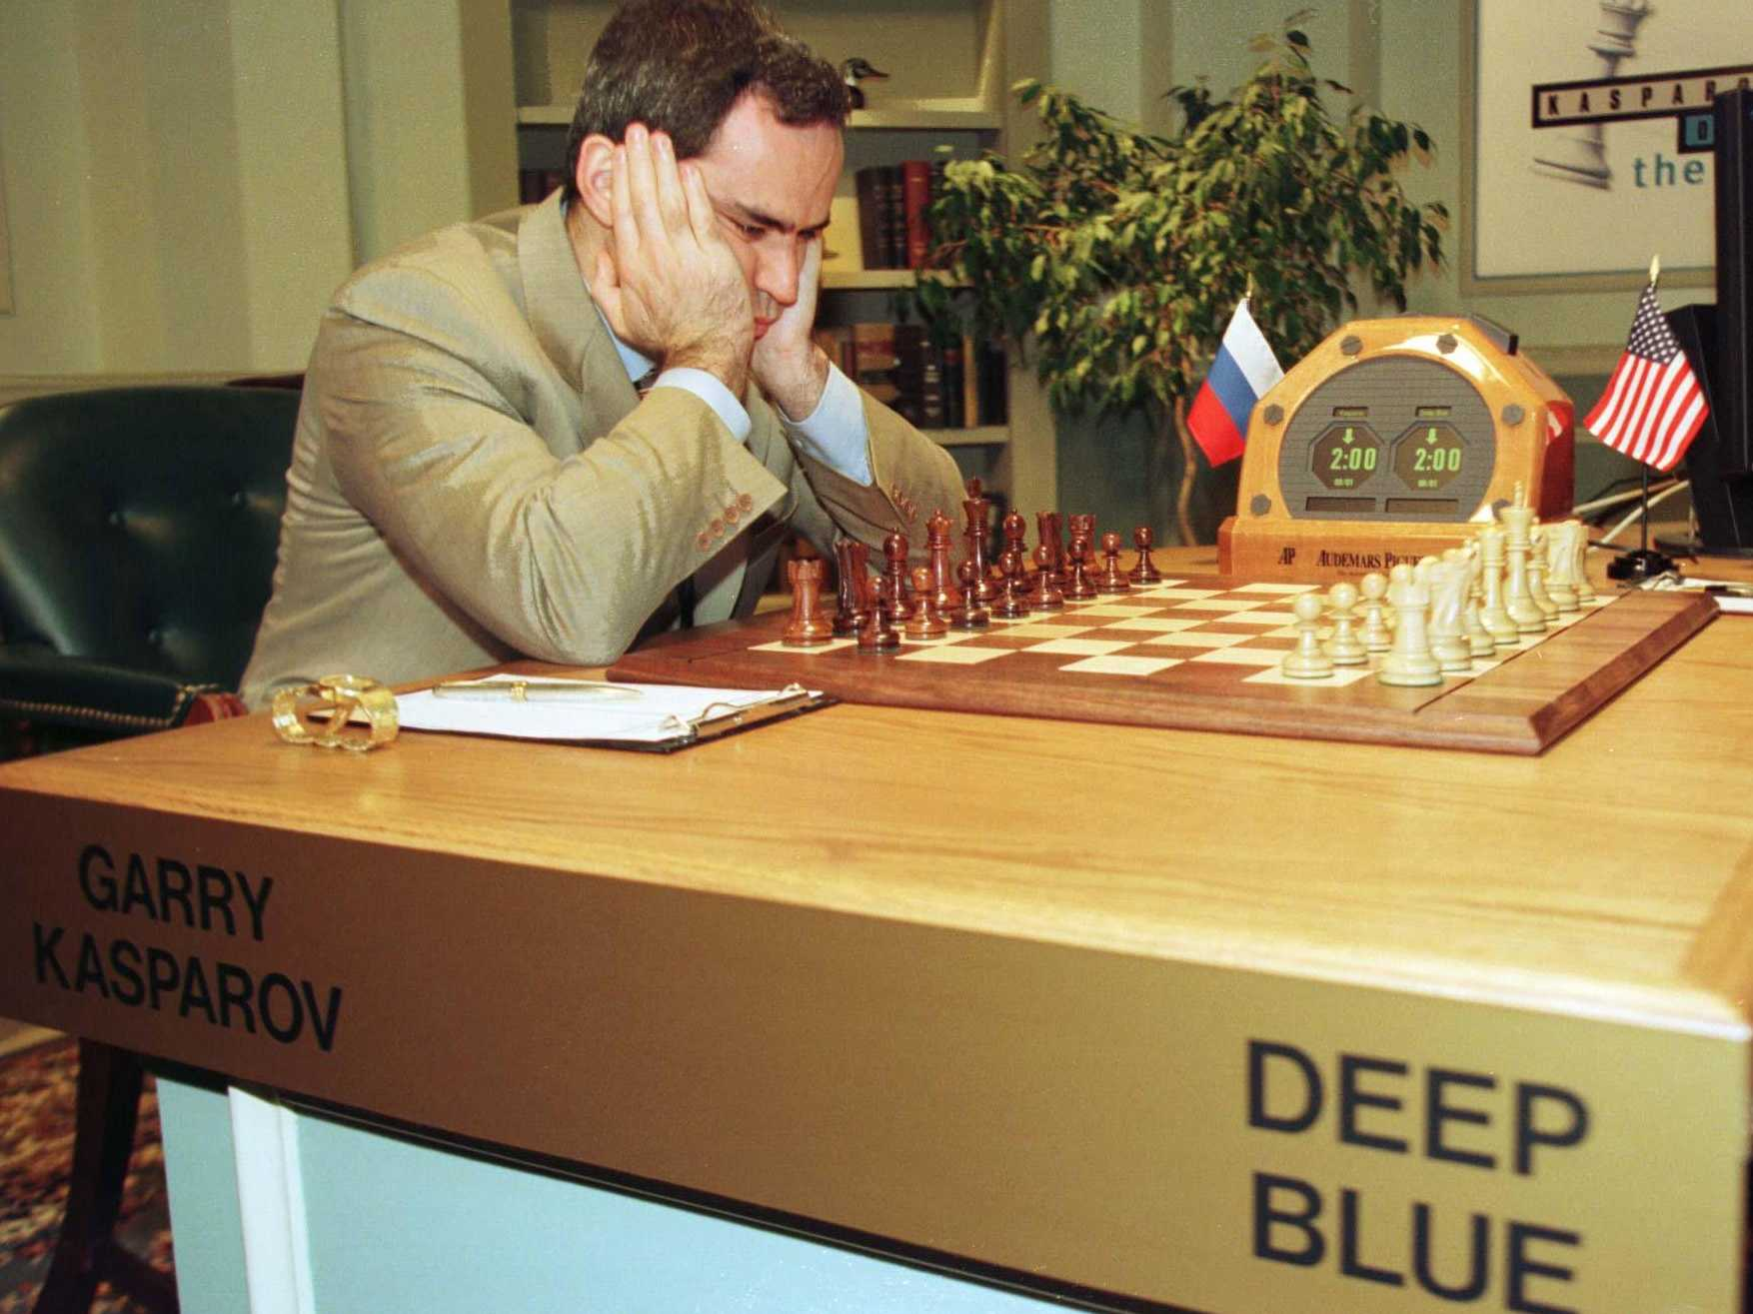
Searching for intelligence
One of the most common approaches to add intelligent seeming behaviour to machines is to use their speed to rapidly search through large numbers of possible choices and evaluate each one against a defined value function.
It was this ‘brute force’ method of creating intelligent behaviour that helped IBM’s Deep Blue defeat World Chess Champion Garry Kasparov in 1997.
Deep Blue could use its rapid searching capability to look at all the possibilities of each move up to 6 or 7 moves ahead in the time available.
A function that quickly evaluates potential steps (or moves) in a search is called a heuristic function

Slide 6
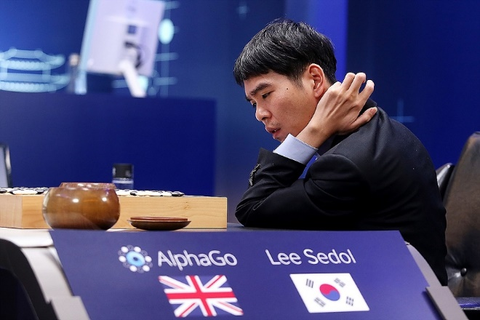
Machine Learning
Some problems are harder to solve with a search based ‘brute force’ approach. For example, for a long time nobody was able to create an AI for the popular Chinese boardgame Go that could beat world champion level players.
That changed in 2016 when Google’s ‘AlphaGo’ AI was able to defeat many World Champion Go players using a new approach combining search and the use of machine learning techniques to ‘train’ it’s decision making.
The basic idea of machine learning is to use large amounts of data and ‘experience’ to train a network representing game states and potential behaviours (or moves). In the case of the Go AI; winning a match is valued highly by the AI and moves that eventually lead to victory will be valued more highly than moves that lead to a loss. The AI will ‘remember’ it’s victories and defeats by making small adjustments in this network of values. By playing millions and millions of matches, eventually the value network is able to mimic, and exceed the behaviour of an expert Go Player without the original programmers knowing exactly why it is making each move.
Machine learning techniques have also recently been producing improvements in image recognition, translation, speech recognition and many other areas.

Slide 7
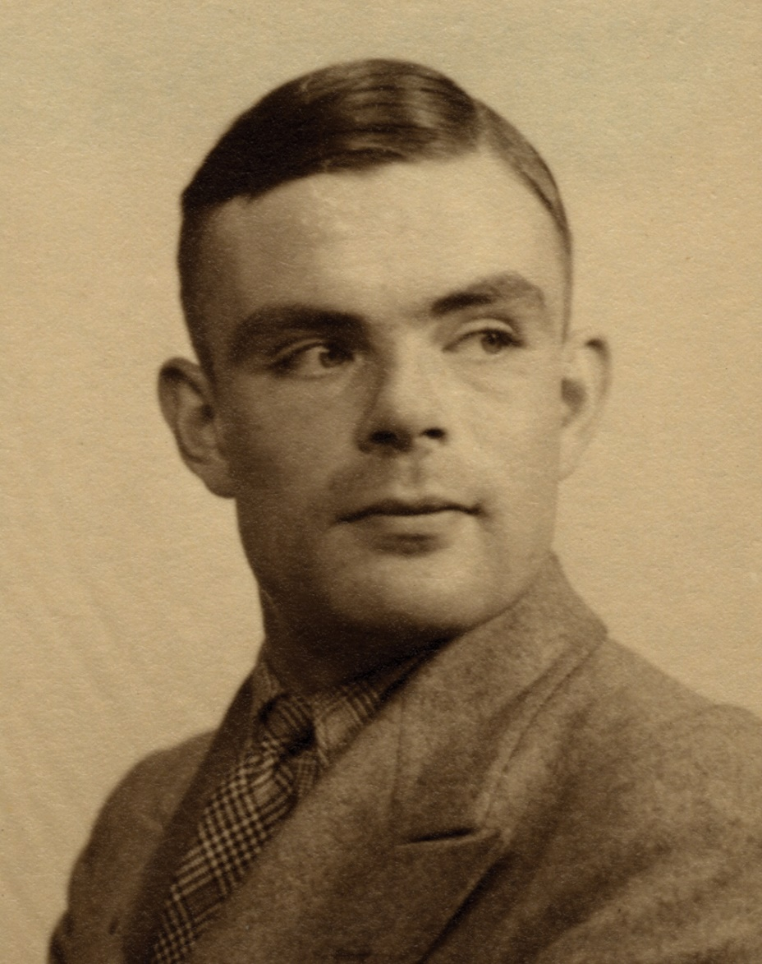
Testing for Strong AI
The Turing Test, described by British Computer Scientist Alan Turing, is a proposed test for an AI that might be able to think. The idea is that a human should talk to an AI for a time, while not being able to see it, and if they cannot tell whether they are talking to a human or not then the AI would pass.
Several variations of this kind of test have been proposed since such as the ‘Total Turing Test’ that would also test an AI’s ability to perceive things in videos or images and it’s ability to manipulate physical objects ‘i.e. stack some blocks into a shape’.

Slide 8
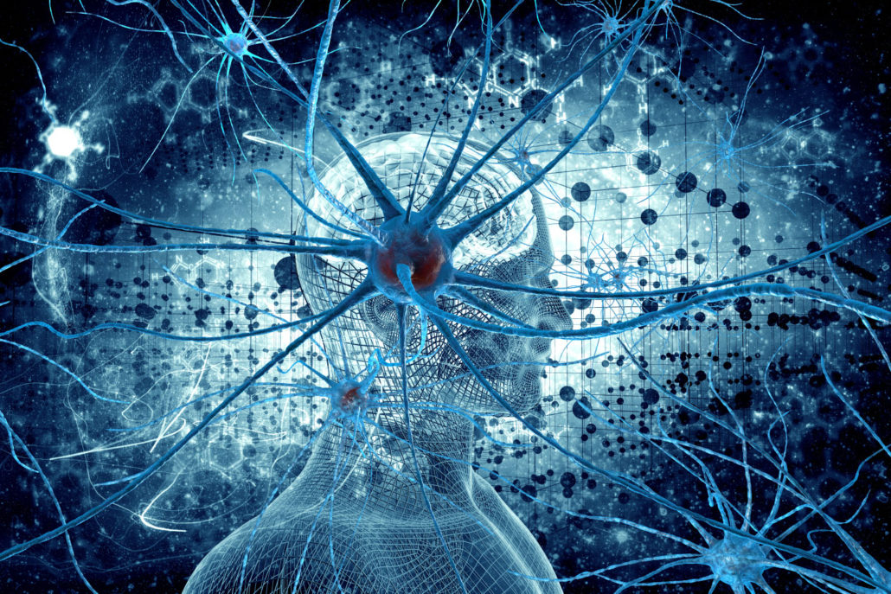
Super intelligence
It is theorised that, if it is possible to create an artificial general intelligence as smart as a human then it should very quickly become much smarter than us.
This is because an artificial intelligence, with full knowledge of its own code, would be able to modify itself to improve its own intelligence - theoretically infinitely. It should also be able to go through this process of improvement very fast.
This idea that the first strong AI will quickly grow to be dramatically more intelligent than humans is sometimes called the technological singularity.

Slide 9
The End.

